Slide 1
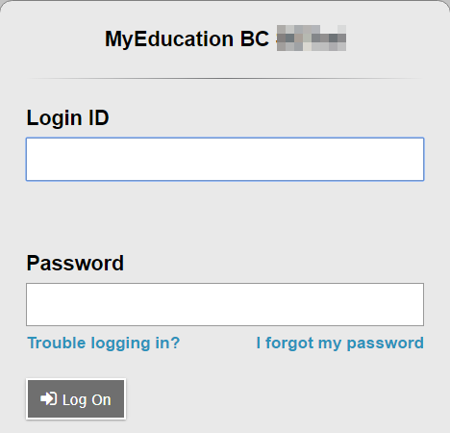
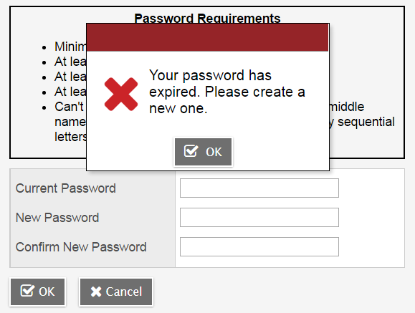
Student Portal User Instructions
MyEducationBC
The MyEducationBC (MyEdBC) application is a secure portal used in most school districts in the Province of BC. Security is guided by the rules and regulations of the School Act and Freedom of Information and Protection of Privacy Act (FOIPPA). If you have any questions or concerns please contact your school principal.
Logging In
A Login ID and a temporary Password will be provided by your School.
The MyEdBC website is: https://www.myeducation.gov.bc.ca/aspen/logon.do
Enter your Login ID and temporary Password
Click Log On
3. You will be prompted to change your password. ‘Current Password’ is the temporary Password you were provided. Enter a ‘New Password’ and ‘Confirm New Password’. Password requirements are displayed behind the red warning message.

Slide 2
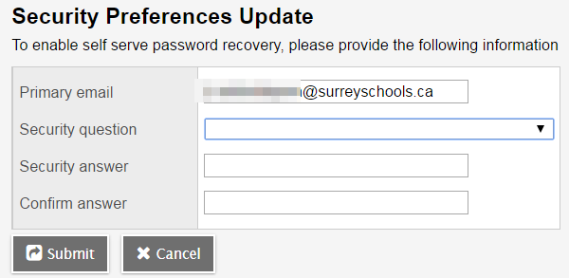
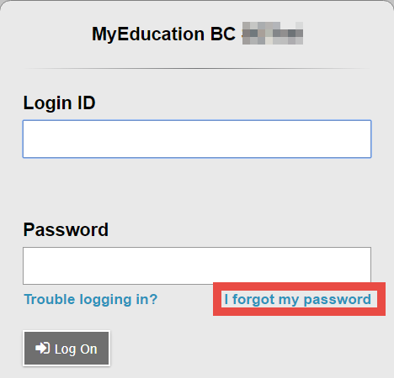
Student Portal User Instructions
4. You will be prompted to enter your Security Preferences. Enter an email address in case you forget your password, and choose a security question and answer that you will remember.
2.1 Preferences
After you have logged in, you can make changes to your preferences by selecting the drop down arrow beside your name and ‘Set Preferences’ in the top right of the screen.
2.2 Password Recovery
If you forget your MyEdBC Portal Password, you can click the ‘I forgot my password’ link on the login screen and an email will be sent to you with a new temporary password.

Slide 3
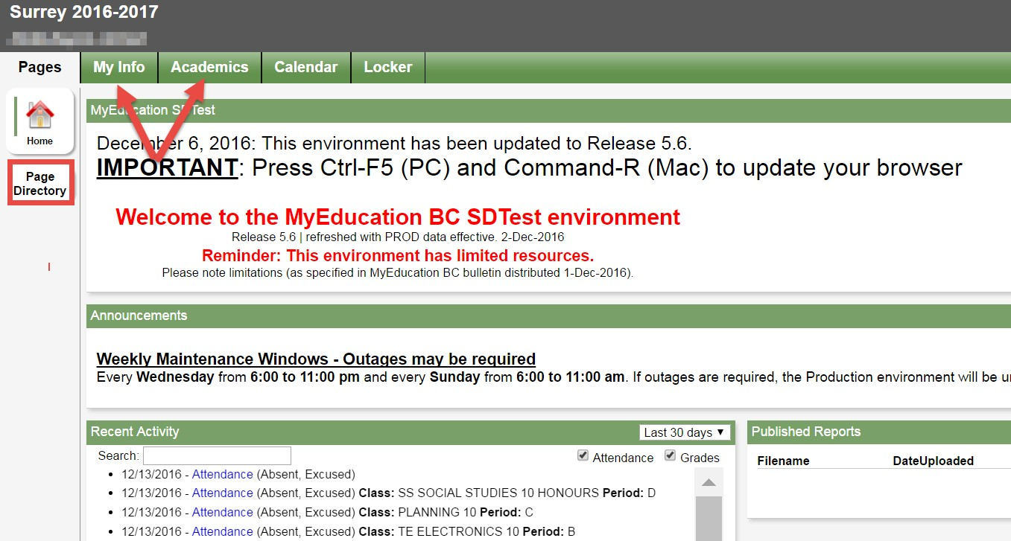
Student Portal User Instructions
3 Navigation
Top Tabs: There are five Top Tabs on the main page. The Top Tab you are currently viewing will be highlighted.
Side Tabs: The tabs along the side will change depending on the current Top Tab
3.1 Pages Top Tab
You will land on the Pages top tab every time you log in. There will be notices about upcoming system outages and other information from the system administrator.
The main landing Page includes a Recent Activity widget with info about recently posted attendance and some mark information.
Click on Page Directory to see other web pages that you have access to. Click Add to add the Page to your view. The added Page will now be available in the Pages list on the left.

Slide 4
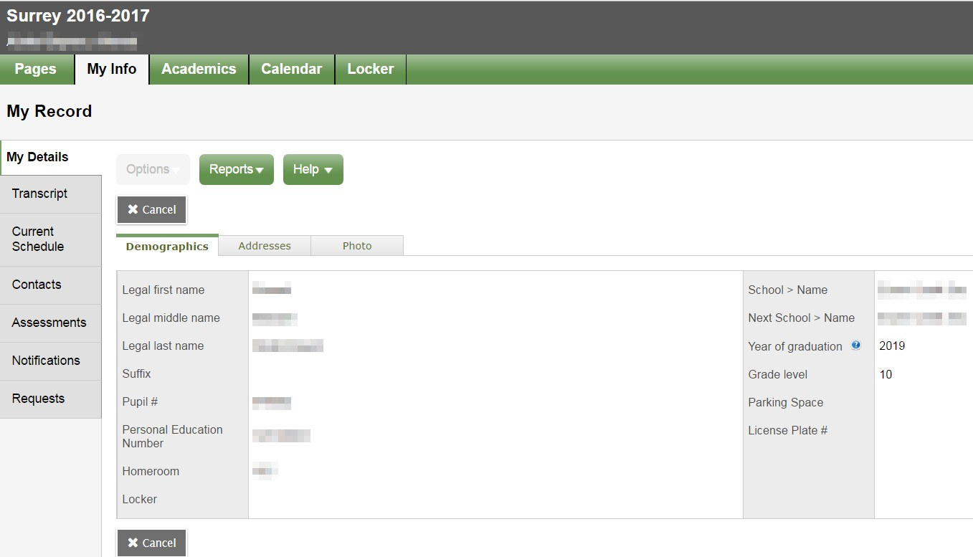
Student Portal User Instructions
3.2 My Info Top Tab
This tab contains your demographic details. Each Side Tab contains specific information.
My Details side tab shows basic information including demographics, physical and mailing addresses, and your most recent photo.
Transcript side tab includes class marks from current and previous years. IMPORTANT: Change the Dictionary Menu to All in order to view all records.
Set the Filter to All Records or Current Year depending on what you’d like to see.
Current Schedule side tab shows your current courses. There are two ways to view your schedule: List View and Matrix View. You can toggle between the two views using the <<List view and Matrix view >> options at the top left of the screen.
Contacts side tab shows your parent/guardian(s) and emergency contacts. Please check this and inform the school of any changes.
Assessments side tab currently contains provincial assessments like FSA or Provincial Exams.
Notifications side tab is not currently in use. It may be used as we move forward in the project.
Requests side tab contains course Requests for the next school year and a Graduation Progress summary.

Slide 5
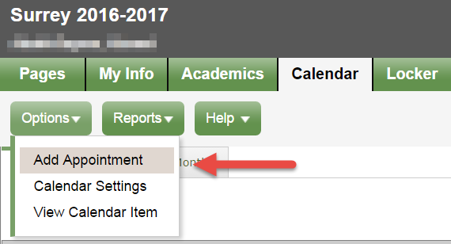
Student Portal User Instructions
3.3 Academics Top Tab
The Academics Top Tab will allow you to select a course (using the checkbox beside the course) then click on the available Side Tabs to see details about the course you selected.
Assignments side tab may provide assignment and assessment information.
Attendance side tab provides attendance for the selected class.
Once you have selected a course and clicked on a Side Tab you can use the navigation buttons to switch between courses that are in the list. Navigation Buttons make it easy to move back and forth through records.
Please note: marks provided here may not be a full picture of a student’s level and they may not relate to their report card mark.
3.4 Calendar Top Tab
You are able to view the calendar by Day, Week, or Month.
This calendar may contain School Calendar information, as well as teachers may include information about when assignments were assigned and due
You are able to enter your own Appointments in this calendar by using the Options menu and selecting Add Appointment.

Slide 6
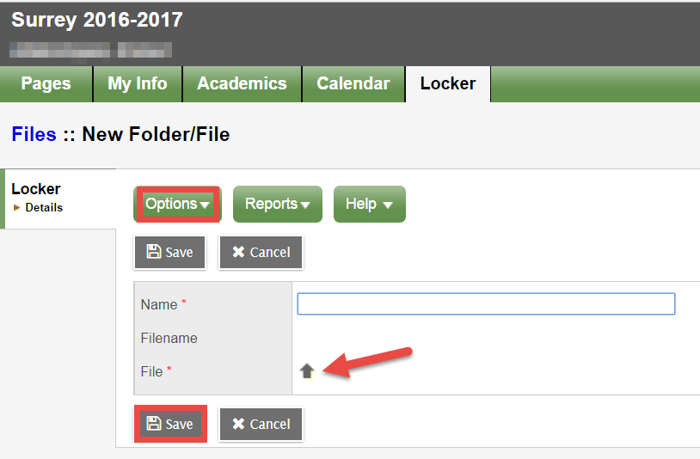
Student Portal User Instructions
3.5 Locker Top Tab
This tab can be used to upload and store documents. From the Options menu, select Add. Fill in the Name field and click on the File Arrow to upload a document.
Select Choose File to find the document you wish to upload, Import and Save.

