Slide 1
Course Selection Preparing for what comes next
Johnston Heights
2024

Slide 2
COUNSELLING SERVICES jh.counsellorappointments.com
COUNSELLORS
Ms. Tifenbach (A – Deol) tifenbach_t@surreyschools.ca
Ms. Gill (Supporting A – Deol and Lam – Q) gill_harpreet@surreyschools.ca
Mr. Sharma (Der – L) sharma_m@surreyschools.ca
Ms. Flack (Lam – Q) flack_r@surreyschools.ca
Ms. Domingo (R – Z) (domingo_e@surreyschools.ca)
Mr. Kaukas (Supporting course selection)
Academic Counselling – course selection, course changes, career planning, graduation requirements, and post-secondary information
Personal Counselling – confidential discussion of personal concerns

Slide 3
Issues to Consider

Slide 4
GRADUATION REQUIREMENTS
English 10, 11, 12
Literacy Assessment exams requirements
Math 10 & 11: Pre-Calculus/ Foundations/ Workplace
Numeracy assessment exam requirement
Science 10 & 11
Most courses are worth 4 credits each
At least 20 courses = 80 credits minimum required for graduation
Socials 10
1 Senior Social Studies course
PE10
Fine Arts or Applied Skills (10, 11 or 12)
Career Life Education 10
Career Life Connections 12
Capstone Project
3 additional courses at the Grade 12 level
Indigenous course requirement

Slide 5
EARN GRADUATION CREDITS ELSEWHERE
Previous school
LANGUAGE CHALLENGE
EXTERNAL CREDENTIALS
DISTRICT PROGRAMS
TRANSCRIPT
EXAMS
Done outside of school
& APPRENTICESHIPS

Slide 6
Typical Schedule
GRADE 10 | GRADE 11 | GRADE 12
English 10 | English 11 | English 12
A Math 10 | A Math 11 | CLC 12
Science 10 | A Science 11 | Course 12
Socials 10 | Socials 12 | Course 12
PE 10 | Language 11 (*if university bound)/Elective | Elective
CLE 10 | Elective | Elective
Language 10 | Elective | Elective
Elective | Elective | Elective/Study block
** You may take up to 3 HL IB DP courses to be an IB DP Candidate. Consult with Ms. Wilcox.
***You must take 1 Indigenous content course at Grade 10, 11 or 12***

Slide 7
X – BLOCK CLASSES – GRADE 11 & 12
**NEW**
If you are planning to take an X block class (out of the regular timetable, before school or after school), please be prepared to identify a course to DROP for a study during your regular schedule.
Write it in the NOTES section so your counsellor can see it.
You will NOT be able to drop this course throughout the year so consider this option VERY CAREFULLY.

Slide 8
Typical Schedule – IB DP
GRADE 10 | GRADE 11 | GRADE 12
English 10 | English 11 SL / HL | English 12 SL / HL
A Math 10 | A Math 11 SL / HL | A Math 12 SL / HL
Science 10 | A Science 11 SL / HL | A Science 12 SL / HL
Socials 10 | Socials 11 SL / HL | Socials 12 SL / HL
PE 10 | Language 11 and 12 SL | Elective 12 SL / HL
CLE 10 | Elective SL / HL | TOK, EE, CAS, CLC 12
Language 10 | TOK, EE, CAS, CLC 12
Elective
* IB DP applications due BY 8 AM on Wednesday, January 24th, 2024. See Ms. Wilcox.
**You must take 1 Indigenous content course at Grade 10, 11 or 12**

Slide 9
POST – SECONDARY OPTIONS
Work / Travel
Adult Basic Education
Skill Upgrading
Vocational & Career Programs
Trades & Technical Institutes
Apprenticeships
Private Institutions
Colleges
Universities

Slide 10
POST-SECONDARY CREDENTIALS Study commitments vary from a few hours of learning to several years
CERTIFICATES, TICKETS
Several hours – 2 years
DIPLOMAS
1 - 2 years
ASSOCIATE DEGREE
2 years
BACHELOR'S DEGREE
4 years
PROFESSIONAL ACCREDITATION
MASTER'S DEGREE
Minimum 2 years
Ph. D. (DOCTORATE DEGREE)
Minimum 2 years
Doctor(s) of …
Minimum of 2+ years

Slide 11
LOWER MAINLAND POST-SECONDARY INSTITUTIONS (PSIs)
Capilano University Cap U)
BC Institute of Technology (BCIT)
Douglas College (DC)
Kwantlen Polytechnic University (KPU)
Langara College
Simon Fraser University (SFU)
Trinity Western University (TWU)
University of British Columbia (UBC)
University of the Fraser Valley (UFV)
Vancouver Community College (VCC)
North Vancouver
Burnaby/Richmond
New Westminster/Coquitlam
Langley/Surrey/Richmond
Vancouver
Burnaby/Surrey
Langley
Vancouver
Abbotsford/Chilliwack
Vancouver

Slide 12
PROGRAMS & ADMISSION LINKS FOR POST-SECONDARY INSTITUTIONS (PSIs) IN BC
INSTITUTION | LOCATIONS | PROGRAMS/ADMISSIONS LINK TO INFO
BCIT (British Columbia Institute of Technology) | Burnaby/ Vancouver/ North Vancouver/ Richmond/ Delta | www.bcit.ca/admission/how-to-apply/high-school-applicants/
Camosun College | Victoria | camosun.ca/programs-courses/find-program
Capilano University (CapU) | North Vancouver/Sechelt | capilanou.ca/admissions/apply-to-capu/admission-requirements/?utm_source=admission-requirements&utm_medium=web&utm_campaign=Redirect
Coast Mountain College | Terrace | www.coastmountaincollege.ca/programs/programs
College of New Caledonia | Prince George/ Burns Lake/ Fort St. James/ Mackenzie/ Quesnel/ Vanderhoof | cnc.bc.ca/programs-courses
College of the Rockies (COTR) | Cranbrook | cotr.bc.ca/programs/
Corpus Christi and St. Mark’s College | Vancouver | corpuschristi.ca/admissions/
Douglas College | New Westminster/ Coquitlam | www.douglascollege.ca/programs
Emily Carr University of Art and Design (ECUAD) | Vancouver | www.ecuad.ca/admissions/application-info/undergraduate-applications/application-requirements
Fairleigh Dickson University | Vancouver | www.fdu.edu/campuses/vancouver-campus/admissions/undergraduate-admissions/
Kwantlen Polytechnic University (KPU) | Surrey/ Richmond/ Langley/ Cloverdale | www.kpu.ca/admission/requirements
Langara College | Vancouver | langara.ca/programs-and-courses/index.html
Nicola Valley Institute of Technology (NVIT) | Merritt/Burnaby | nvit.ca/programs/default.htm
North Island College | Courtenay/ Campbell River/ Port Alberni/ Port Hardy/ Ucluelet | www.nic.bc.ca/programs/
Northern Lights College | Atlin/ Chetwynd/ Dawson Creek/ Dease Lake/ Fort Nelson/ Fort St. John/ Tumbler Ridge | calendar.nlc.bc.ca/content.php?catoid=5&navoid=133
Okanagan College | Kelowna/ Vernon/ Penticton/ Salmon Arm | www.okanagan.bc.ca/program-search
Royal Military College of Canada (RMCC) | Kingston (ON)/ Saint-Jean (PQ) | www.rmc-cmr.ca/en/registrars-office/admissions
Royal Roads University | Victoria | https://www.royalroads.ca/programs?program_area_title=&program_name=&field_program_delivery_value=All&field_program_group_id_value_1=1
Selkirk College | Castlegar | selkirk.ca/programs
Simon Fraser University (SFU) | Burnaby/ Surrey/ Vancouver | www.sfu.ca/students/admission/admission-requirements/canadian-highschool/bc-yukon.html
Thompson Rivers University (TRU) | Kamloops/ Williams Lake | www.tru.ca/programs.html
Trinity Western University (TWU) | Langley | www.twu.ca/admissions-aid/admission-requirements/canadian-high-school-students
University of British Columbia (UBC) | Vancouver/ Kelowna | you.ubc.ca/programs/#mode=by-program&viewMode=list
University of Northern British Columbia (UNBC) | Prince George | www.unbc.ca/programs
University of the Fraser Valley (UFV) | Abbotsford/ Chilliwack/ Mission | ufv.ca/programs/
University of Victoria (UVic) | Victoria | www.uvic.ca/undergraduate/programs/undergraduate-programs/
Vancouver Community College (VCC) | Vancouver | www.vcc.ca/programscourses/
Vancouver Island University (VIU) | Nanaimo/ Duncan/ Powell River/ Parksville | https://www.viu.ca/admissions/admission-requirements#English12

Slide 13
POST-SECONDARY INSTITUTION ENTRANCE& ADMISSION REQUIREMENTS
English 11 and 12 are the most important courses you will take.
Your Math course is the next most important course.
Other specific courses (Grade 11 and/or Grade 12 courses) which may be determined by the program or faculty in which you apply.
You must do your research because the admission requirements vary so greatly.
IT IS THE STUDENT’S RESPONSIBILITY TO ENSURE THEY MEET THE REQUIREMENTS FOR THEIR PROGRAM(S)!!!

Slide 14
GRADE 12 ("approved") COURSES which may be used by PSIs for admission
LANGUAGE ARTS: English Studies, English First Peoples, French 12, Spanish 12 and other Modern/Foreign Languages
SENIOR SOCIAL SCIENCES: Economic Theory, Genocide Studies, Human Geography, 20th Century World History, Law Studies, Social Justice, Comparative Cultures, Contemporary Indigenous Studies, IB Global Politics, IB Psychology
SCIENCES: Anatomy & Physiology, Chemistry, Physics
MATHS: Foundations, Pre-Calculus, Calculus

Slide 15
BUSINESS/COMMERCE PROGRAMS
The following is a generalization (as every post-secondary institution's requirements are different) of admission requirements:
PRE-CALCULUS 11 (or FOUNDATIONS MATH 12)
LANGUAGE 11 COURSE (dependent on the PSI)
ENGLISH 12
PRE-CALCULUS 12 (*recommended)
*Calculus 12 recommended
*A minimum of two (or more) approved courses (accepted in the use of calculation of admission average)
IT IS THE STUDENT’S RESPONSIBILITY TO ENSURE THEY MEET THE REQUIREMENTS FOR THEIR PROGRAM(S)!!!

Slide 16
SCIENCE PROGRAMS
The following is a generalization (as every post-secondary institution's requirements are different) of admission requirements:
PHYSICS 11
CHEMISTRY 11
A MINIMUM %AGE IN PRE-CALCULUS 11 may also be required
LANGUAGE 11 (dependent on the PSI)
ENGLISH 12
PRE-CALCULUS 12
At least ONE Science 12 (dependent on the PSI)
*Calculus 12 recommended
*A minimum of two (or more) approved courses (accepted in the use of calculation of admission average)
IT IS THE STUDENT’S RESPONSIBILITY TO ENSURE THEY MEET THE REQUIREMENTS FOR THEIR PROGRAM(S)!!!

Slide 17
ARTS/HUMANITIES/SOCIAL SCIENCES PROGRAMS
The following is a generalization (as every post-secondary institution's requirements are different) of admission requirements:
ENGLISH 12 (a minimum %age may be required)
Some universities require a minimum %age in a particular Math 11 courses (CHECK!!!)
A minimum of three (or more) approved courses (accepted in the use of calculation of admission average)
** Faculty of Arts students may be required to take the equivalent of a Grade 12 Language course during their university career.
IT IS THE STUDENT’S RESPONSIBILITY TO ENSURE THEY MEET THE REQUIREMENTS FOR THEIR PROGRAM(S)!!!

Slide 18
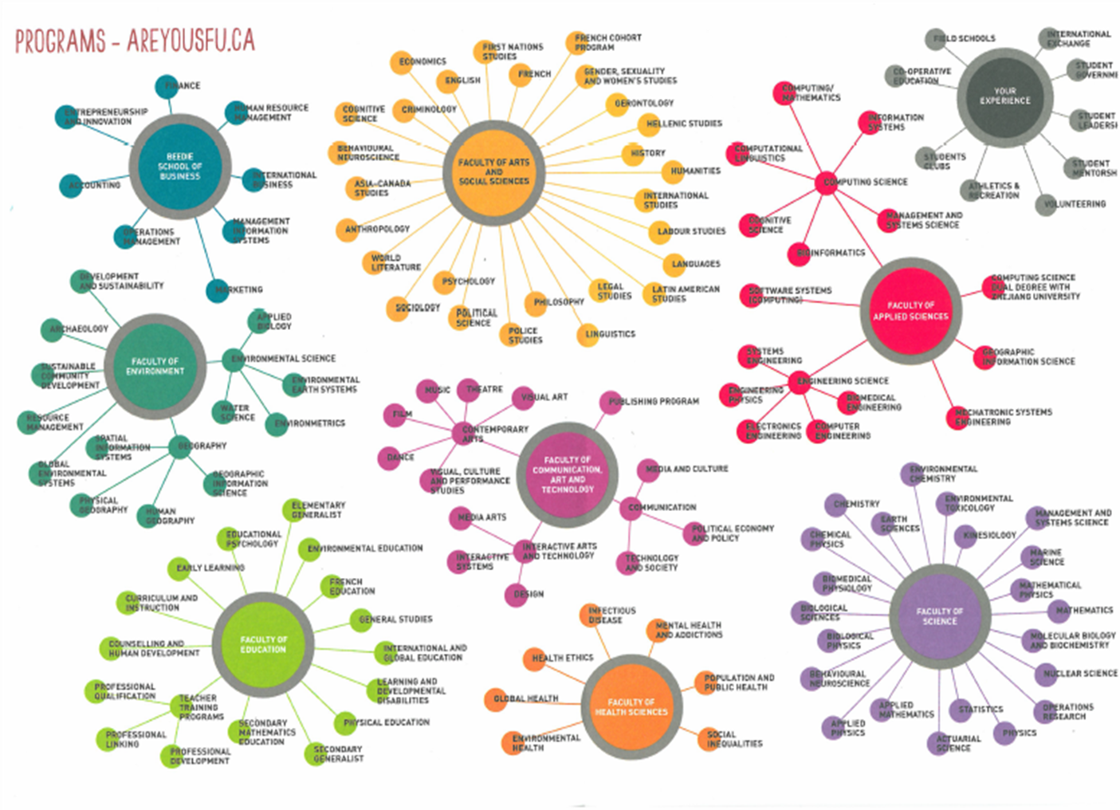
timeline
NOV 20XX
disseminate standardized metrics
SEP 20XX
synergize scalable e-commerce
JAN 20XX
coordinate e-business applications
MAR 20XX
foster holistically superior methodologies
MAY 20XX
deploy strategic networks with compelling e-business needs

Slide 19
WORKPLACE TRENDS
Employers want transferable skills & long-term adaptability.
Plan to be a life-long learner.
Critical thinking, problem solving, analytical and communication skills, as well as a framework for understanding technology.
Develop the mindset that you will never be done learning new skills and looking for new jobs/career opportunities.
Employers want employees who demonstrate good work habits, who show up to work AND on time.

Slide 20
COURSE SELECTION
APPLIED SKILLS & DESIGN TECHNOLOGIES (ADST)
Business Education
Computer Education/Information Technology
Design Technology Education
Cook Training
Home Economics
ACADEMICS
English
Math
Modern Languages
Science
Social Studies
CAREER EDUCATION
Career Life Connections (CLC)
Work Experience
PHYSICAL EDUCATION
Active Living
Fitness and Conditioning
LIBRARY SCIENCE
FINE ARTS
Performing Arts (Dance/Drama)
Music (Band/Choir)
Visual & Studio Arts
LEADERSHIP / PEER TUTORING
DISTRICT PROGRAMS
Visit the Career Education Department for further information

Slide 21
NEW COURSES
Intro Punjabi 11
Earth Science 11
Metal Work 11/12
Automotive Technology 11/12
Personal Health 11/12 – for individuals identifying as female only
APPLICATIONS REQUIRED FOR SPECIFIC COURSES:
(Speak with your counsellor)
PERLs (PE Leadership)
Peer Tutoring
Peer Counselling
Library Science

Slide 22
KEYS TO COURSE SELECTION
Choose your courses by:
Graduation requirements
Post-Secondary requirements
Career aspirations
Evaluate strengths, weaknesses and past performance to make informed decisions about future study
Consider areas of interest, affinity, and strength
Life experiences

Slide 23
COURSE SELECTION PROCESS
You will have access to MyED to enter your courses online in January 2024 until February 20th, 2024.
Students will receive AND return their course selection sheets from their CLE10 or Math 11 teacher.
Please take a photo of your completed course selection sheet and hand your sheet back to either your CLE10 or Math 11 teacher. Your counsellor can still make changes to your requests after MyED is closed to students.
We encourage students to book a course selection consultation appointment with their counsellor. (This may be a virtual appointment.) Please identify some post-secondary plans/goals for your counsellor.
Do your best to make thoughtful choices before entering course requests.

Slide 24
IB DP COURSE SELECTION
GRADE 10 INTO 11
Complete course selection for IB DP with your application package.
Complete your course selection for your regular program online and hand in your course selection sheet to your CLE10 teacher.
GRADE 11 INTO 12
Carry on with your current courses, excluding French or Spanish because you will be writing your exams in the Spring (of your Grade 11 year).
Connect with your counsellor and IB Coordinator (Ms. Wilcox) if you are not meeting IB DP requirements.

Slide 25
THINGS TO CONSIDER
Academic classes require pre-requisite skills which are usually
associated with good marks and work habits.
For example: to be successful in Pre-Calculus 11, you should earn a “B” (minimum 3/4) in Foundations of Math and Pre-Calculus 10.
To be successful in Chemistry 11 and Physics 11, you should earn a “B” (minimum 3/4) in Foundations of Math and Pre-Calculus 10 AND a “B” (minimum 3/4) in Science 10.
To be successful in Pre-Calculus 12, you should earn a “B” C(minimum 73%) in Pre-Calculus 11.
Physics 12 => “B” in Pre-Calculus 11 AND “B” in Physics 11
Chemistry 12 => “B” in Pre-Calculus 11 AND “B” in Chemistry 11

Slide 26
THINGS TO CONSIDER
The school work WILL become more difficult!
Teacher and instructor expectations evolve. Course demands evolve. Your study strategies and work habits must also evolve.
The IB Learner Profile and Approaches to Learning skills are especially important.
Communication and Collaboration Skills
Research, Critical and Creative Thinking Skills
Time Management and Organization Skills
Self-Management – taking care of yourself

Slide 27
FINANCING POST-SECONDARY
RESP
Family savings plan plus government top-up.
Scholarships
A grant, payment, or monetary award based on some merit or achievement.
STUDENT LOANS
Based on financial need and must be repaid.
BURSARIES
A monetary award based on financial need and merit.
PART-TIME EMPLOYMENT
Many students work part time while attending post-secondary.

Slide 28
USEFUL WEBSITES
MyED login
BC Ministry of Education Graduation Requirements
Education Planner BC
My BluePrint
Work BC Career Exploration
BuildForce Canada
Bounce Back BC
Foundry BC
Mental Health - Let's Talk About It
Johnston Heights Course Selection Booklets

Slide 29
Questions???

