Slide 1
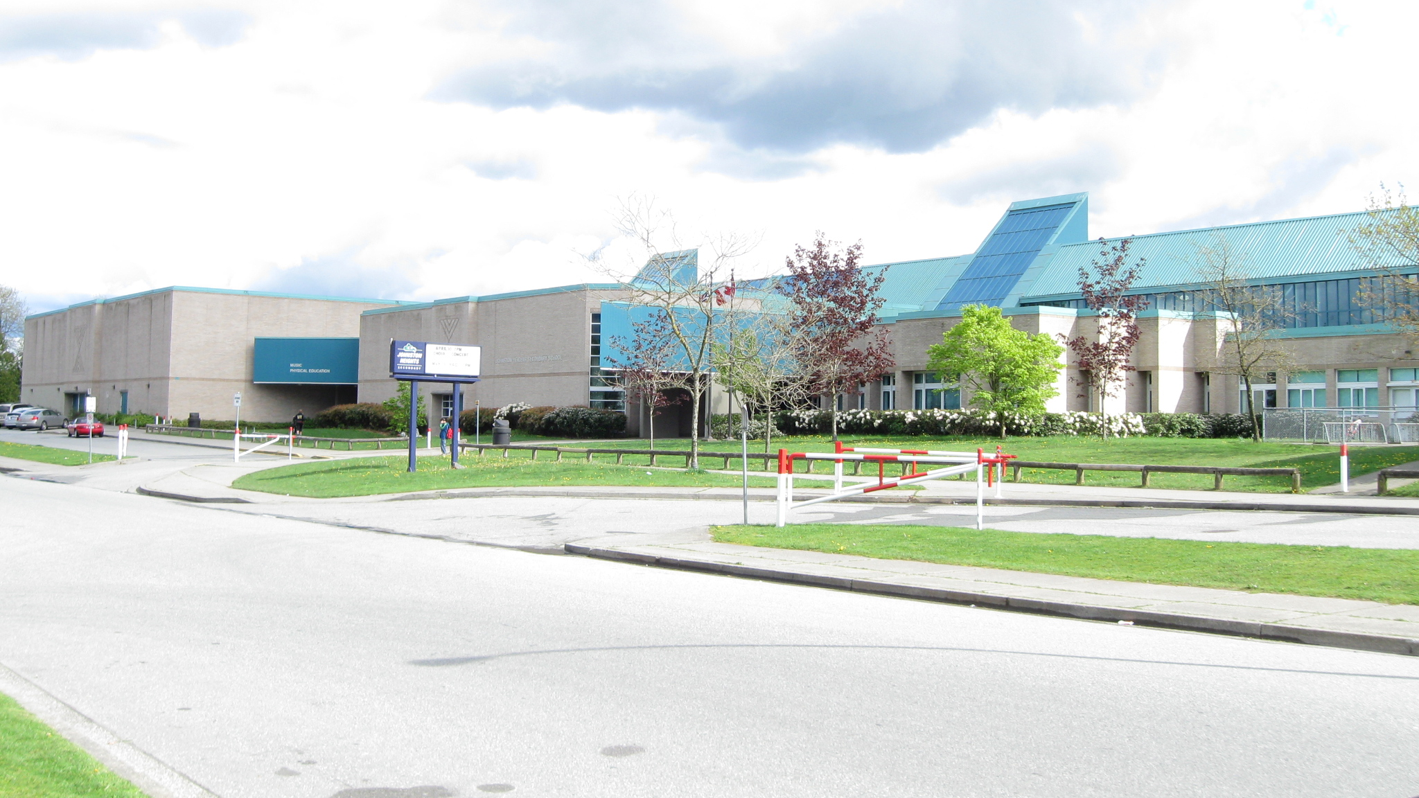
IB World School A caring community of excellence
Grade 7 Course Planning

Slide 3
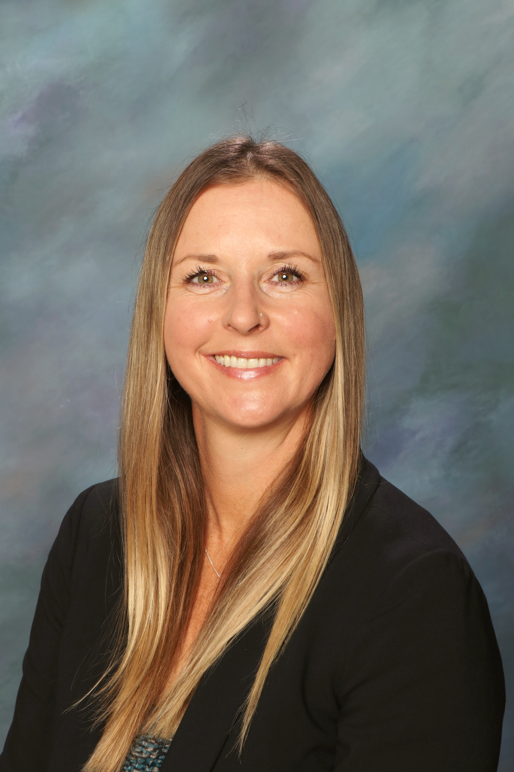
Ms. MacDonald (LAM-Z) Ms. Beyer Ms. Moennick (A-LAN)
Principal
Leadership Team

Slide 4
Our Shared Goal: to create a caring environment that supports our students to become global citizens.
Grade 11/12: IB DP Program
Grade 10: IB MYP Personal Project
Choice
Grade 8: The IB MYP journey begins!
Choice
Grade 11/12: BC Program
MYP Coordinator – Ms. Alana Douglas​
​
Notes:
Alana

Slide 5
Key Components of MYP
Growth based
We inquire, investigate, reflect
Service as Action
We learn when we combine and apply knowledge between subjects
Grade 10 Personal Project

Slide 6
IB Attributes for lifelong learning
Inquirers
Knowledgeable
Thinkers
Communicators
Principled
Open-minded
Caring
Risk-takers
Balanced
Reflective

Slide 7
Approaches to Learning
Research
Critical and creative thinking
Helping students learn how to learn by developing skills for
Communication
Collaboration
Self-management

Slide 8
Bell Schedule
REGULAR: MON / WED / THU / FRI
TUESDAY LATE START​
Warning Bell 8:25am​
First Block 8:30 - 9:50am​
Second Block 9:55 - 11:15am​
Lunch Break 11:15 - 11:55pm​
Third Block 12:00 - 1:20pm​
Fourth Block 1:25 - 2:45pm
Warning Bell 9:10am​
First Block 9:15 - 10:25am​
Second Block 10:30 - 11:40am​
Lunch Break 11:40 - 12:15pm​
Third Block 12:20 - 1:30pm​
Fourth Block 1:35 - 2:45pm

Slide 9
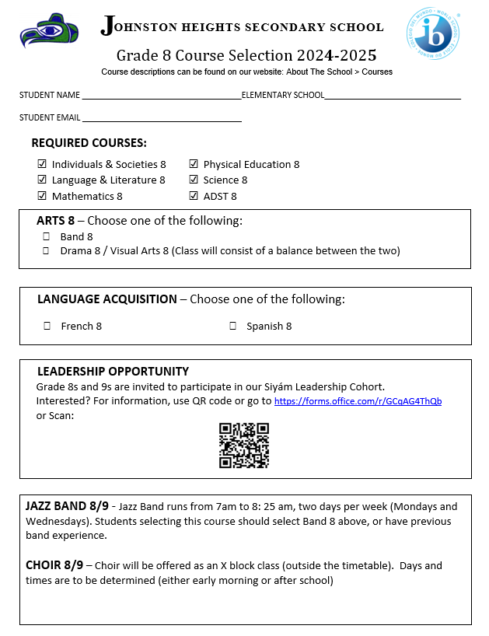
GRADE 8 COURSE SELECTION

Slide 10
CHOOSE YOUR COURSES
Every student will take:
Language and Literature (English)
Science
Math
Individuals and Societies (Social Studies)
Physical Health Education
Applied Design, Skills and Technology

Slide 11
CHOOSE YOUR COURSES
Choose the following:
FINE ARTS-
Band or
Fine Arts rotation- Drama, Visual Arts and Music
2. LANGUAGE ACQUISITION-
Spanish or French

Slide 12
Additional Opportunities
LEADERSHIP 8
JAZZ BAND 8
CHOIR 8

Slide 13
Extracurricular Activities at JH
CLUBS
SPORTS
Tutorial Club
Grade 8 Girls Group
Grade 8 Boys Group
YO Bro/YO Girl
FITNESS
Crochet at Three (CAT)
French Club
JH Animal Society
Good Guys
JH Car Club
JH Fitness Club
KPOP Club
JH Media Crew
Language Learning Club
Model UN Club
MSA of JH
Poetry Club
Run Club
Senior Film Club
SOGI
Wellness Initiative
FALL
Volleyball
Boys Soccer
Cross Country
WINTER
Basketball
SPRING
Flag Football
Girls Soccer
Ultimate
Badminton
Track & Field

Slide 14
IB World School A caring community of excellence
Thank you for coming! Enjoy your school tour

