Slide 1
Ecole Panorama Ridge Course Selection February 2024
GRADE 10

Slide 2
Graduation Requirements
1 English 10 (4 options all with composition + a specific focus)
1 Math 10 (3 options)
Social Studies 10
Science 10
Physical Health and Education10
Career Life Education 10
1 Applied Skill or Fine Art (in grade 10, 11 or 12)
Language (If planning to attend University)
OR 1 other Elective
Numeracy 10 assessment
Literacy 10 Assessment
Minimum 8 courses
GRADE 10

Slide 3
Graduation Requirements
1 English 11 (6 options – including First People’s English 11)
1 Socials 12 (Taken in grade 11 or grade 12)
1 Math (5 options)
1 Science (7 Options)
Language 11 (4 Options - If planning for University)
4 Electives (could be more sciences, socials or fine arts etc.)
Numeracy assessment (if not already done)
No study blocks
Options: see Course Selection Sheet Minimum 8 courses
GRADE 11

Slide 4
Graduation Requirements
English 12 OR English First Peoples 12
Contemporary Indigenous Studies 12 (If you are not taking English First Peoples 12 and did not take English First Peoples 11)
Career Life Connections 12 (which includes the Capstone Project)
A minimum of 2 additional grade 12 courses
Electives to complete required number of credits
Literacy 12 Assessment
Minimum required credits for grades 10-12 is 80
Each course completed counts as 4 credits
GRADE 12

Slide 5
French Immersion Students
Required Courses:
Grade 10: Sciences 10, Sciences Humaines 10, Francais Langue 10, Education Physique 10, a Math 10, an English 10, CLE 10
Grade 11: Histoire du Monde 12, Communication Orale 11, a Math 11, an English 11, a Science 11
Grade 12: Francais Langue 12, English Studies 12, CLC 12, Literacy 12 Assessment, Évaluation de Littératie – Immersion 12
* You will also need to take an Indigenous English OR Social Studies course in grade 11 or 12. *

Slide 6
Languages
Please note: this is NOT a graduation requirement
A language 11 is a requirement for DIRECT university entrance (and in some cases a grade 12 language is recommended)
Punjabi 10 Spanish 9 and Spanish 10 French 10 Intro Japanese 11 OR Intro Spanish 11
Punjabi 11 Spanish 11 French 11
Punjabi 12 Spanish 12 French 12

Slide 7
Language Challenge Exam
An exam done in January at the Delta School District (Registration is at end of October/early November)
Must have documentation of prior learning
Can be used as a grade 12 course for graduation and as an entrance course for some universities (NOT for UBC)
Satisfies the language requirement for all universities
Languages available to Challenge:
French 11/12 Mandarin 11/12
German 11/12 Punjabi 11/12
Japanese 11/12 Spanish 11/12
Korean 11/12

Slide 8
Math Pathways
Math 9 Math 9
Workplace Math 10 Foundations and Pre-Cal 10
Workplace Math 11 Foundations 11 Pre-Cal 11
Foundations 12 Pre-Cal 12
Calculus

Slide 9
Courses that Require Applications
Leadership Courses (grades 11-12) – applications in Counselling
All Coop Programs (grade 11) – Ms. Dudley or Mr. Crosby or Ms. Mangat
All Career Prep Programs (grades 11 &12) – Ms. Martin and Ms. Ramsay
Peer Tutoring (grades 11 & 12) – Mr. Lee
Library Science (grades 11 & 12) – Ms. Rudan
Yearbook (grades 11 & 12) – Ms. Mayer
Theatre Company (audition grades 11 &12) – Ms. Coupar
Dance Choreography (10-12) – Ms. Bryson
Choose your courses as if you are not getting into these classes and we will change your schedule once you are accepted!

Slide 10
Summer School
Full credit courses available (Grades 10-12)
Registration begins in April
Information at Surrey Summer Learning online www.surreysummer.ca
If you enroll in a summer school course, please connect with your counsellor to ensure that your course selection is accurate for the Fall. There will be an opportunity to fill out an Online Course Change Request before the year begins, but it is always best to keep your counsellor informed!

Slide 11
Alternate Learning
Online Courses (SAIL): Must be completed by the end of January of grade 12 to be used for university entrance in September of the same year.
Night School: Can be completed in semester 1 or 2 of grade 12 and be used for university entrance.

Slide 12
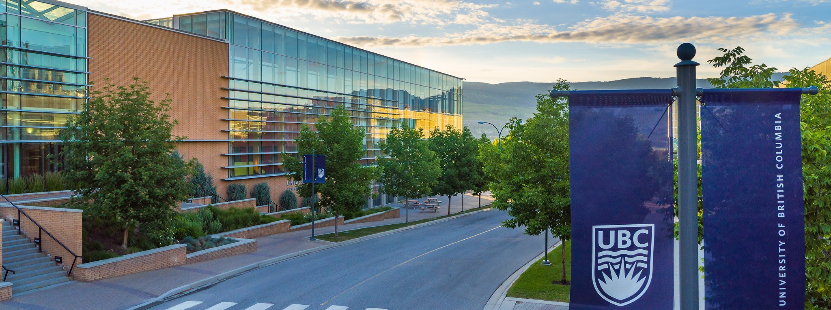
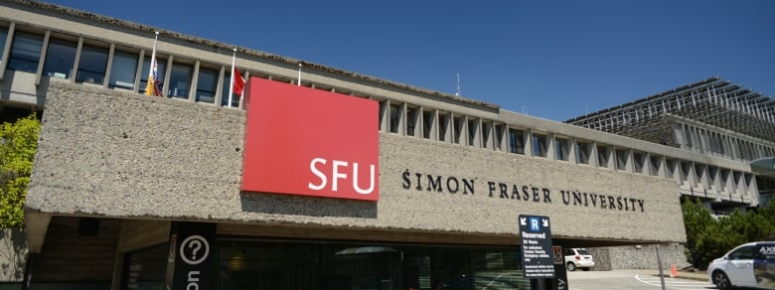
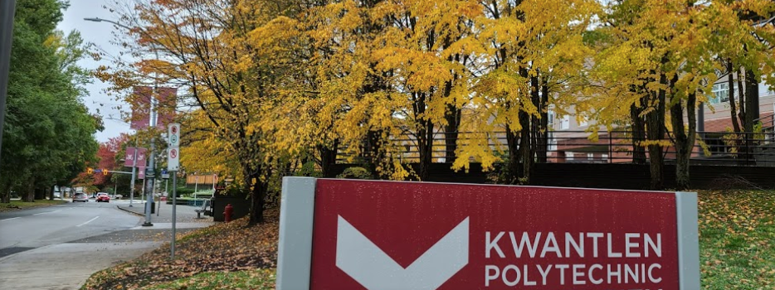
Applying to University
DIRECT ROUTE
Apply DIRECTLY to UNIVERSITY from high school. VERY COMPETITIVE (80% average or higher)
You apply to a FACULTY (Arts, Business, Science, Engineering, Nursing etc.)
INDIRECT ROUTE
Apply to COLLEGE and then TRANSFER to university after 1-2 years (70% in English is the only requirement)

Slide 13
University Degree General Guide
5 (SFU) or 6 (UBC) grade 12 courses
Arts : English 11, Language 11, Science 11, Math 11 (Pre-Calculus or Foundations)
English 12, (Language 12 recommended for UBC), Math or Science 12 (SFU)
Science: English 11, Language 11, Physics and Chemistry 11, Pre-Calculus 11
English 12, Pre-Calculus 12, and two of Biology 12, Chemistry 12, or Physics 12
Business: English 11, Language 11, Pre-Calculus 11, Science 11
English 12, Pre-Calculus 12 plus other academic Grade 12 courses (Calculus recommended)
Applied Science / Engineering English 11, Language 11, Pre-calculus 11, Physics 11,
Chemistry 11, English 12, Pre-Calculus 12, Physics 12, Chemistry 12, Calculus 12 (required by some and recommended for others)
Nursing: Requirements vary – please check individual institutions

Slide 14
Contacting Your Counsellor
If you would like to discuss any of this information in further detail, contact your counsellor on TEAMS to make an APPOINTMENT.
Ms. Peters A – Dham
Ms. Wisniewski Dhan – Khas
Ms. Mumford Khat – Rom
Ms. Kurrein Ron - Z

