Slide 1
Ecole Panorama Ridge Secondary Course Selection February 2024
Parent Information Evening

Slide 2
Graduation Basics
Grade 10
English 10 (4 options)
Math 10 (3 options)
Socials 10, Science 10, P.E. 10
Career Life Education 10
1 Applied Skill / Fine Art (10, 11 OR 12)
Literacy Assessment
Numeracy Assessment
Grade 11
English 11 (6 options)
1 Math 11 (3 options)
1 Socials (Socials 11 or 12)
1 Science 11
4 other courses

Slide 3
Grade 10 Considerations
English Options
Creative Writing, Focused Literary Studies, New Media, Spoken Language (all include Composition)
Math Options
Foundations and PreCalculus 10, Workplace Math 10
Language or no Language?
French 10
Punjabi 10 (or Punjabi 11 with writing/reading experience)
Intro Spanish 11
Intro Japanese 11
Language Challenge Exam (written in Delta)
GRADE 10

Slide 4
Math Pathways
Math 9 Math 9
Workplace Math 10 Foundations and Pre-Cal 10
Workplace Math 11 Foundations 11 Pre-Cal 11
Foundations 12 Pre-Cal 12
Calculus

Slide 5
Languages
Please note: this is NOT a graduation requirement
A language 11 is a requirement for DIRECT university entrance (and in some cases a grade 12 language is recommended)
Punjabi 10 Spanish 9 and Spanish 10 French 10 Intro Japanese 11 OR Intro Spanish 11
Punjabi 11 Spanish 11 French 11
Punjabi 12 Spanish 12 French 12

Slide 6
Language Challenge Exam
An exam written in January at the Delta School District (Registration is at end of October/early November)
Must have documentation of prior learning
Can be used as a grade 12 course for graduation and as an entrance course for some universities (NOT for UBC)
Satisfies the language requirement for all universities
Languages available to Challenge:
French 11/12 Mandarin 11/12
German 11/12 Punjabi 11/12
Japanese 11/12 Spanish 11/12
Korean 11/12

Slide 7
Grade 11 Considerations
English Options
Creative Writing, Focused Literary Studies, New Media, Spoken Language, Composition, First People’s English 11
Math Options
Workplace Math 11, Foundations 11 or PreCalculus 11
Language Options
French 11, Punjabi 11, Spanish 11, Intro Japanese 11
Language Challenge Exam
Decide on a Science, Arts or Business focus
Start searching post-secondary requirements
www.educationplannerbc.ca
Continue to explore interests!
GRADE 11

Slide 8
Co-op Programs
COMMUNITY LEADERSHIP CO-OP 11
Includes English Composition 11, P.E. and Health Outdoor Education 11, Career Life Connections 12, Work Experience 12A, Work Experience 12B
Semester 1, 20 credits
Teachers = Mr. Crosby and Ms. Dudley
Applications are in the Career / Counselling Offices.
Submit to P.E. Office.
SCIENCE CO-OP 11
Includes Chemistry 11, Physics 11, Career Life Connections 12, Work Experience 12A and Work Experience 12B
Semester 2, 20 credits
Teacher = Ms. Mangat
Applications are in the Career / Counselling Offices. Submit to B212.

Slide 9
Grade 12 Considerations
Grade 12
English 12 or English First People’s 12
Career Life Connections 12 (includes the Capstone Project)
2 other grade 12 courses
Post-secondary requirements
Applying for Post-Secondary – begins in October with deadlines in December (for early admission and entrance scholarships) and January
Provincial Assessments
Literacy Assessment 10 (if not completed in grade 10 or 11)
Numeracy Assessment 10 (if not completed in grade 10 or 11)
Literacy Assessment 12

Slide 10
Indigenous Graduation Requirement
All students must complete an Indigenous Studies course either in grade 10, 11 or 12
Students can choose one of the following options:
First People’s 12
(this counts as your English 12 requirement)
Contemporary Indigenous Studies 12
(this counts as your Social Studies 11/12 requirement)
First People’s 11 will be offered in 2024/25
GRADE 12

Slide 11
Study Blocks
Grade 12 students may choose 1 Study Block during online course selection.
Check your credits. You need 80 credits to graduate.
You may APPLY for a 2ND STUDY BLOCK by filling out an application (available in May in the Counselling Office)
Be aware that universities look for a rigorous program (some with a minimum of 6 grade 12 acceptable courses)

Slide 12
French Immersion Students
Required Courses:
Grade 10: Sciences 10, Sciences Humaines 10, Francais Langue 10, Education Physique 10, a Math 10, an English 10, CLE 10
Grade 11: Histoire du Monde 12, Communication Orale 11, a Math 11, an English 11, a Science 11
Grade 12: Francais Langue 12, English Studies 12, CLC 12, Literacy 12 Assessment, Évaluation de Littératie – Immersion 12
* You will also need to take an Indigenous English OR Social Studies course in grade 11 or 12. *

Slide 13
Courses that Require Applications
Leadership Courses (grade 11/12) – applications in Counselling
All Coop Programs (grade 11) – Ms. Dudley or Mr. Crosby or Ms. Mangat
All Career Prep Programs (grades 11 &12) – Ms. Martin and Ms. Ramsay
Peer Tutoring (grades 11 & 12) – Mr. Lee
Library Science (grades 11 & 12) – Ms. Rudan
Yearbook (grades 11 & 12) – Ms. Mayer
Theatre Company (audition grades 11 &12) – Ms. Coupar
Dance Choreography (10-12) – Ms. Bryson
Choose your courses as if you are not getting into these classes and we will change your schedule once you are accepted!

Slide 14
Planning for Post-Secondary
www.educationplannerbc.ca
SEARCH
Type in PROGRAM / CAREER (e.g. Nursing, Architect, Plumbing, Veterinarian)
Choose INSTITUTION of Choice (e.g. BCIT, SFU, KPU)
Click on ADMISSIONS INFO (tab at the top)

Slide 15
University Degree General Guide
5 (SFU) or 6 (UBC) grade 12 courses
Arts : English 11, Language 11, Science 11, Math 11 (Pre-Calculus or Foundations)
English 12, (Language 12 recommended for UBC), Math or Science 12 (SFU)
Science: English 11, Language 11, Physics and Chemistry 11, Pre-Calculus 11
English 12, Pre-Calculus 12, and two of Biology 12, Chemistry 12, or Physics 12
Business: English 11, Language 11, Pre-Calculus 11, Science 11
English 12, Pre-Calculus 12 plus other academic Grade 12 courses (Calculus recommended)
Applied Science / Engineering: English 11, Language 11, Pre-calculus 11, Physics 11,
Chemistry 11, English 12, Pre-Calculus 12, Physics 12, Chemistry 12, Calculus 12 (recommended by most institutions)
Nursing: Requirements vary – please check individual institutions

Slide 16
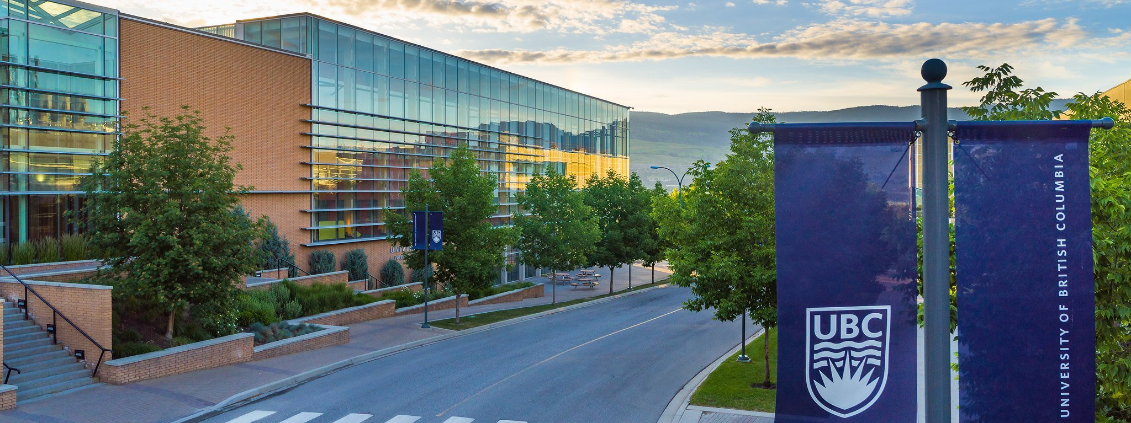
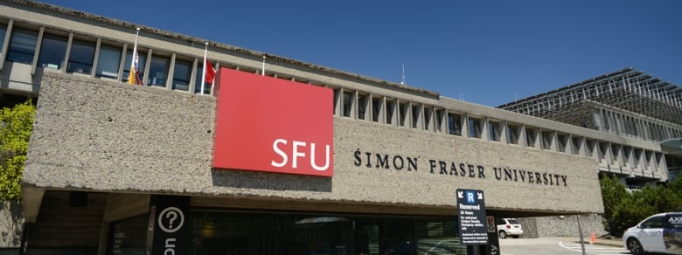
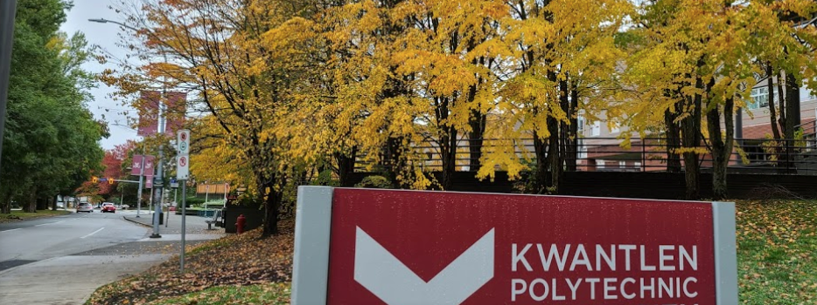
Applying to University
DIRECT ROUTE
Apply DIRECTLY to UNIVERSITY from high school. VERY COMPETITIVE (80% average or higher)
You apply to a FACULTY (Arts, Business, Science, Engineering, etc.)
INDIRECT ROUTE
Apply to COLLEGE and then TRANSFER to university after 1-2 years (70% in English is the only requirement)

Slide 17
Summer School
Full credit courses available (Grades 10-12)
Registration begins online in April
Information at Surrey Summer Learning online www.surreysummer.ca
If you enroll in a summer school course, please connect with your counsellor to ensure that your course selection is accurate for the Fall. There will be an opportunity to fill out an Online Course Change Request before the year begins, but it is always best to keep your counsellor informed!

Slide 18
Alternate Learning
Online Courses (SAIL): Must be completed by the end of January of grade 12 to be used for university entrance in September of the same year.
Night School: Can be completed in semester 1 or 2 of grade 12 and be used for university entrance.

Slide 19
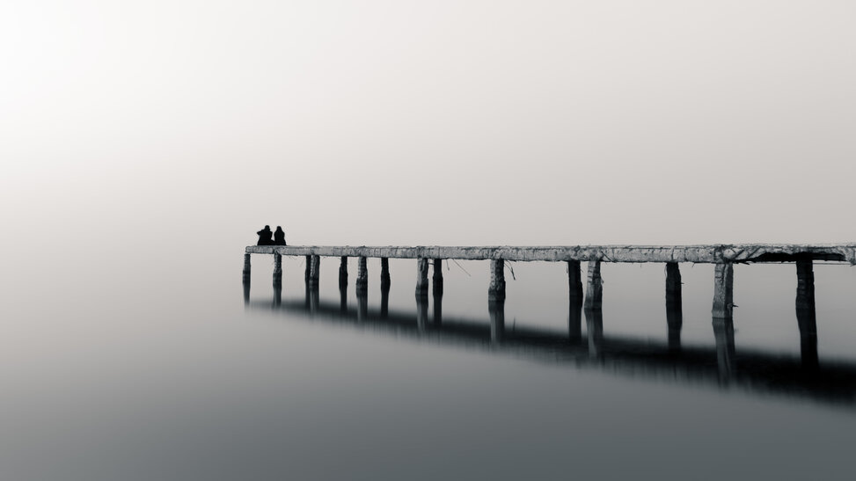
Remember…
This is an exciting time full of possibilities – find opportunities for your child to go to open houses, and research with them!! They do a lot of research in CLE 10 and CLC 12 so sit with them and offer to do it with them.
It can also be an overwhelming time full of doubt and questions and fear – our role as parents is to support and guide, not to decide for our kids.
Many students do not know exactly what they want to study and that is absolutely ok – many programs are designed so that students find their passion in the first few years.
It is also absolutely ok for students to take a gap year to work in the world and figure out whether Post-Secondary studies are for them.
Some students will not wish to continue studies and will be excited to begin their work journey and that is also absolutely ok.

Slide 20
Contacting Your Counsellor
If you would like to discuss any of this information in further detail, contact your counsellor on TEAMS to make an APPOINTMENT.
Ms. Peters A – Dham
Ms. Wisniewski Dhan – Khan
Ms. Mumford Khao – Rom
Ms. Kurrein Ron - Z

