Slide 1
École Panorama Ridge Secondary
Physical
Health
Education
Course Outline & Policies
Active Living 11/12

Slide 2
The Big Ideas Active Living 11/12

Slide 3
Evaluation:
60% Participation and Safety
20% Health and Well-Being
20%Leadership

Slide 4
Participation and Safety (60%):
Demonstrate safety, fair play, and leadership in physical activities
Explain how the use of proper techniques prevents injury
Develop and demonstrate skills needed to plan, organize, and safely participate in recreational events and other preferred physical activities
Apply methods of monitoring and adjusting exertion levels in physical activity
Assessment examples (vary teacher to teacher):
-Daily participation mark /10, Unit participation mark, self assessment, journals, Fitness testing, 2-3 lap school run /10

Slide 5
Health and Well-Being (20%):
Explain how developing competencies in physical activities can increase confidence and encourage lifelong participation in those activities
Explain the importance of maintaining personal health
Identify and explain motivational factors influencing participation in recreational activities
Describe the impact of various types of physical activities on health and mental well-being
Assessment examples (vary teacher to teacher):
-Guest speaker, journals, nutrition log, reflection, portfolio

Slide 6
Leadership (20%):
Demonstrate competencies and problem-solving strategies required for physical activity and recreation leadership
Develop and demonstrate skills needed to plan, organize, and safely participate in recreational events and other preferred physical activities.
Assessment examples (vary teacher to teacher):
-Leadership hours (volunteer), peer teaching, journals, organizing class games

Slide 7
Health Topic Disclaimer
Health topics can be of sensitive nature (suicide prevention, drug awareness, sexual assault, bullying, etc)
Your teacher, the youth care worker and counsellors are available to talk and offer guidance to you.

Slide 8
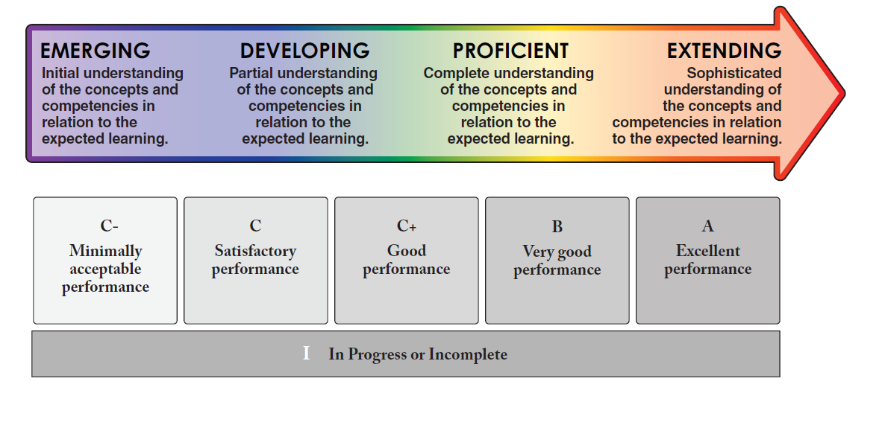
PROFICIENCY SCALE
4 POINT SCALE/ NUMERICAL EQUIVALENT | EMERGING 1-5 | DEVELOPING 6 | PROFICIENT 7-8 | EXTENDING 9-10
LETTER GRADE | C- | C, C+ |  | A

Slide 9
Daily Evaluation Criteria: EXTENDING
A= 86%-100%
In PE strip, on time, AWESOME attitude and participation, on task, STRONG consistent effort, respects peers and teacher, offers to help with equipment and demonstrates LEADERSHIP.
“I can do it on my own consistently and/or with depth”

Slide 10
PROFICIENT B = 73%-85%
In PE strip, on time, GOOD attitude and participation, on task, STRONG consistent effort, respects peers and teacher, offers to help with equipment.
“I can do it on my own”

Slide 11
DEVELOPING C/C+= 60%-72%
In PE strip, on time, GOOD attitude and participation, on task, good consistent effort and respects peers and teachers.
“I can do it, but may need support at times”

Slide 12
EMERGING I/C- = 0%-59%
Is late for class, not in full gym strip, negative attitude towards activities and fellow athletes, displays disruptive and disrespectful behaviour or puts out minimal effort.
Is absent or truant.
“I am beginning and need support”

Slide 13
Attendance
Please proceed straight to your learning space when coming to PE. Maintain your physical distance from other students (2 meters). Attendance will be taken approximately 5 minutes after the bell, so be on time and sitting in your attendance rows or you may lose marks for that day.
PLEASE NOTE: At the end of class, you should be in your area (not in the hallway) until your teacher dismisses you.

Slide 14
Unexcused Absences (Truancy):
Students missing class without a valid reason (i.e. school sponsored activity, medical excuse: both with a signed note) will require to make up the class based on a plan created by their teacher. Failure to follow through on the plan can result in a decreased mark.

Slide 15
Verified Absences:
Parents need to call the office to verify your absence.

Slide 16
Gym Strip
Your teacher will review their plan regarding PE Strip. The expectation is that you are in PE strip for PHE class. The change rooms are available to you if you wish to use them.
To help maintain cleanliness, students are encouraged to store all their belongings in their school locker (lockers in the change room are also available).
Strategies for personal hygiene upkeep:
-Have an extra T-shirt in your bag in case you require to change after getting sweaty.
-Apply deodorant before and after class (Avoid any spray antiperspirants & deodorants in PHE due to student allergies and sensitivities).
-Wear jogging pants, shorts, runners to school if you have PHE.
Parents will be notified if students continue having difficulty understanding the above expectation.

Slide 17
Thumbs Up ☺
Running shoes – tied up
Socks
Sweat pants, shorts, tights, Dri-Fit, etc.
T-shirts that cover shoulders, stomach and trunks
Hair tied back
Minimal jewellery – small necklaces, ear studs
Clean gym clothes
Closed water bottles (plastic only)

Slide 18
Facilities & Equipment:
Equipment rooms are out of bounds to all students unless under the direct supervision of a PE teacher.
It is imperative that all PE equipment (balls, racquets, nets, etc.) be treated with care.

Slide 19
Lock It Up!
The PE department is NOT responsible for lost or stolen items.
Please ensure all your belongings are locked up (including your phone ☺)

Slide 20
Medical Info Update
Please update your medical information with the office so that we have your Care Card Number, emergency contact, etc. on file.
Please let your PE teacher know (privately) of allergies or medical concerns.

Slide 21
Have a successful semester!

