Slide 1
École Panorama Ridge Secondary
Physical
Health
Education
Course Outline & Policies
Grade 8-10

Slide 2
The Big Ideas PHE Gr. 8 & 9:

Slide 3
The Big Ideas PHE Gr. 10:

Slide 4
Evaluation:
60% Physical Literacy
20% Active Living
20% Health (Social and Community Health, Mental well-being)

Slide 5
Physical Literacy (60%) and Active Living (20%):
Fundamental movement skills in a variety of physical activities and environments
Movement concepts and strategies in different physical activities
Monitoring and adjusting exertion levels in physical activity
Safety, fair play, and leadership in physical activities
Identify and describe preferred types of physical activity
Participate daily in physical activity designed to enhance and maintain health components of fitness
Assessment examples (vary teacher to teacher):
-Daily participation mark /10, Unit participation mark, self assessment, journals, Fitness testing, 2-3 lap school run /10

Slide 6
Health (20%): Social Health, Community Health, Mental Health
Promoting healthy eating choices in different settings
Assess factors that influence healthy choices and identify factors that influence health messages from a variety of sources.
Identify and apply strategies to pursue personal healthy-living goals
Reflect on outcomes of personal healthy-living goals and assess strategies used
Propose strategies for avoiding and/or responding to potentially unsafe, abusive, or exploitive situations
Propose strategies for responding to discrimination, stereotyping, and bullying
Propose strategies for developing and maintaining healthy relationships
Create strategies for promoting the health and well-being of the school and community
Describe and assess strategies for promoting mental well-being, for self and others
Describe and assess strategies for managing problems related to mental well-being and substance use, for others
Create and assess strategies for managing physical, emotional, and social changes during puberty and adolescence
Explore and describe the impact of transition and change on identities
Assessment examples (vary teacher to teacher):
-Guest speaker, journals, nutrition log, reflection

Slide 7
Health Topic Disclaimer
Health topics can be of sensitive nature (suicide prevention, drug awareness, sexual assault, bullying, etc)
Your teacher, the youth care worker and counsellors are available to talk and offer guidance to you.

Slide 8
Health Resources
https://www.surreyschools.ca/page/12345/students-families
https://vimeo.com/600350874

Slide 10
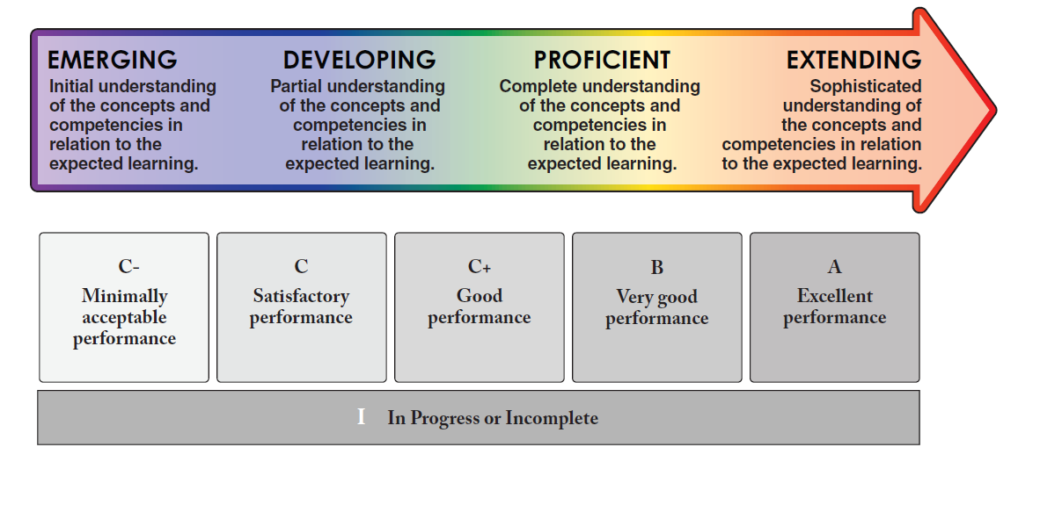
PROFICIENCY SCALE

Slide 11
Daily Evaluation Criteria: EXTENDING
A= 86%-100
In PE strip, on time, AWESOME attitude and participation, on task, STRONG consistent effort, respects peers and teacher, offers to help with equipment and demonstrates LEADERSHIP. Doesn't use their cell phone in class
“I can do it on my own consistently and/or with depth”

Slide 12
PROFICIENT B= 73%-85%
In PE strip, on time, GOOD attitude and participation, on task, STRONG consistent effort, respects peers and teacher, offers to help with equipment.
“I can do it on my own”

Slide 13
DEVELOPING C/C+= 60%-72%
In PE strip, on time, GOOD attitude and participation, on task, good consistent effort and respects peers and teachers.
“I can do it, but may need support at times”

Slide 14
EMERGING I/C- = 0% -59%
Is late for class, not in full gym strip, attitude towards activities and fellow athletes needs improvement, displays disruptive and disrespectful behaviour or puts out minimal effort.
Use of cell phone
Is absent or truant.
“I am beginning and need support”

Slide 15
Attendance
Please proceed straight to your learning space when coming to PE. Attendance will be taken approximately 5 minutes after the bell, so be on time and sitting in your attendance rows.
PLEASE NOTE: At the end of class, you should be in your area (not in the hallway) until your teacher dismisses you.

Slide 16
Unexcused Absences (Truancy):
Students missing class without a valid reason (i.e. school sponsored activity, medical excuse: both with a signed note) will require to make up the class based on a plan created by their teacher. Failure to follow through on the plan can result in a decreased mark.

Slide 17
Verified Absences:
Parents need to call the office to verify your absence.

Slide 18
Gym Strip
Your teacher will review their plan regarding PE Strip. The expectation is that you are in PE strip for PHE class. The change rooms are available to you.
To help maintain cleanliness, students are encouraged to store all their belongings in their school locker (lockers in the change room are also available).
Strategies for personal hygiene upkeep:
-Have an extra T-shirt in your bag in case you require to change after getting sweaty.
-Apply deodorant before and after class (Avoid any spray antiperspirants & deodorants in PHE due to student allergies and sensitivities).
-Wear jogging pants, shorts, runners to school if you have PHE.
Parents will be notified if students continue having difficulty understanding the above expectation.

Slide 19
Thumbs Up ☺
Running shoes – tied up
Socks
Sweat pants, shorts, tights, Dri-Fit, etc.
T-shirts that cover shoulders, stomach and trunks
Hair tied back
Minimal jewellery – small necklaces, ear studs
Clean gym clothes
Closed water bottles (plastic only)
No Gum in the gym

Slide 20
Facilities & Equipment:
Equipment rooms are out of bounds to all students unless under the direct supervision of a PE teacher.
It is imperative that all PE equipment (balls, racquets, nets, etc.) be treated with care.

Slide 21
Lock It Up!
The PE department is NOT responsible for lost or stolen items.
Please ensure all your belongings are locked up (including your phone ☺)

Slide 24
PHE 8-10
First Aid & CPR
PHYSICAL ACTIVITY helps us:
improve test scores
reduces stress
improve mood
reduces anxiety/depression
improves self-esteem
reduces heart disease
improves life expectancy
decreases medication needs
manages healthy weight
improves sleep
decreases risky behaviors
decreases illness
increases strength
increases endurance
increases flexibility
increases energy
promotes optimal growth
Healthy Eating
Sex Ed
Mental Health
Drug Education
Physical Literacy

Slide 26
Medical Info Update
Please update your medical information with the office so that we have your Care Card Number, emergency contact, etc. on file.
Please let your PE teacher know (privately) of allergies or medical concerns.

Slide 27
Have a successful semester!

