Slide 1


Course Selection Parent Information Virtual Session

Slide 2

Land Acknowledgement
“We would like to acknowledge the shared, unceded traditional territory of the Katzie, Semiahmoo, Kwantlen and other Coast Salish Peoples on which we work, play and learn.”

Slide 3
Questions about Course Selection?
Ask your child ☺
Consult the Course Selection Catalogue Book
Email Counsellor Mr. Lendvoy: Lendvoy_j@surreyschools.ca
Connect for an appointment with your child’s alpha counsellor
Notes:
Any questions or concerns about your child’s course selection can be asked on our virtual live Q&A session next Thursday January 14th from 6pm to 630pm. This Question and Answer session can be accessed on Zoom from a link provided on the School Website portal. Parents are invited to ask any questions through the chat feature or audio speaking future and we will have a counsellor and other school staff ready to answer between the scheduled hours.

Slide 4

Questions about Scheduling
A to D
Mr. Jeremy Lendvoy
lendvoy_j@surreyschools.ca
E to K
Ms. Jenny Hundal
hundal_jenny@surreyschools.ca
L to Q
Ms. Melissa Sira
sira_m@surreyschools.ca
R to Z
Mrs. Sandra Kelly
kelly_s@surreyschools.ca
Careers/ Post Secondary
Ms. Leesha Nikkanen
nikkanen_l@surreyschools.ca

Slide 5
Introductions
Vice Principals:
A-Gh Mr. Sukh Rai
Gi-N Mr. Anthony Sabarre
O-Z Ms. Geralie Oba-Underwood
Principal:
Mr. Bal Ranu

Slide 6
What Has My Child Received?
1. Course Selection Presentation Assembly
*Ask your child to show you the presentation on their Microsoft Teams Account*
2. Course Selection Form
*This form has instructions on how to register for courses stapled to it*

Slide 7
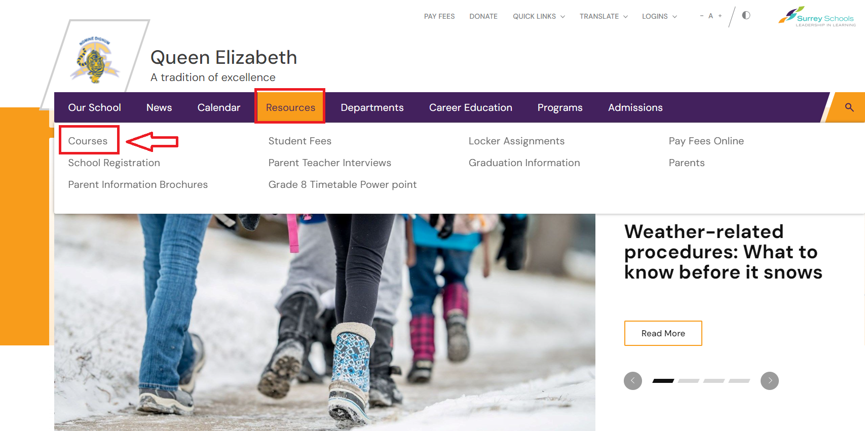

Where Can Parents Find the Course Handbook Catalogue?
Option 1:
On the school Website as a downloadable PDF under Resources > Courses
Option 2: On your child’s Grade Microsoft Teams Channel, along with a copy of your course selection sheet, in case you have lost it

Slide 8
The Grade 9 Program
English 9
Mathematics 9
Physical Health Education 9
Science 9
Social Studies 9
One Fine Art Education 9 elective
One Applied Skills and Technology 9 elective
One additional elective
(Encouraged French 9 or Spanish 9, unless planning to take Punjabi 10)
Notes:
Grade 8’s heading into grade 9 have an exciting year ahead of them with five mandatory academic courses: English, Math, PE, Science and Social Studies. Your child will also have three elective choices. It is suggested one elective is a Fine Arts course, another is an Applied Skills and Tech course and finally it is recommended to take a Modern Language Elective. If your child took French 8 and was successful passing the course they may select French 9, if they would like to try something different, Spanish 9 is also a new option.

Slide 9
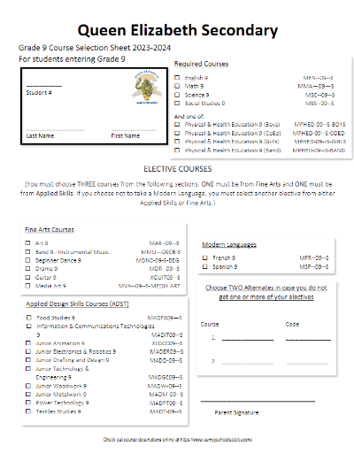
GRADE 9 Courses Example

Slide 10
What If I my Child is Emerging or Can’t Complete a Gr 8 Class
You may be:
Recommended by your teacher to attend remedial summer school in July
Recommended to retake the class next year(replacing one of your Gr 9 electives)
Having a teacher/counsellor/lst teacher create a support plan in order to advance you to the Grade 9 level of the course

Slide 11

2023/24 B C GRADUATION PLAN
(Gr. 10-12)
80 Credits all together: between grade 10 to 12
12 Required courses (48 Credits)
7 Elective courses (28 Credits) (one elective choice must come from the areas of Art or Life Skills)
Provincial Assessments: Literacy 10/12, Numeracy 10
*Indigenous-focused Grad requirement course
Grand Total Credits: 80

Slide 12

WHY GRADE 10 Is a Big Year?
Beginning of the Dogwood Diploma
Credits count
6 Mandatory Graduation Courses
Gr 10 Provincial Assessments:
Literacy & Numeracy
(Graduation Requirements)

Slide 13
Typical Grade 10 Schedule
Other
Elective A
Elective B
(Modern Language highly recommended) Punjabi, French or Spanish
Graduation Requirements
English 10
Socials 10
Math 10 *
Science 10
P. E. 10
Career Life Education 10

Slide 14

Mathematics 10
All students will be auto-registered
for their Math Class Next Year
Placement in either Workplace Math or
Foundations of Math & Pre-Calculus will be determined on:
  Performance in Math 9
  Student/Teacher Conversations & Recommendations
*NOTE* Students taking Workplace Math 10 route have opportunities to advance to Foundations of Math or Pre-Calculus pathways by challenging F&P Math 10 in summer school or the following year.

Slide 15


Indigenous-Focused Graduation Requirement
As part of the Province of British Columbia’s commitments to truth, reconciliation, and anti-racism, the Ministry of Education and Child Care (the Ministry) is implementing an Indigenous-focused graduation requirement for all students starting in the 2023/24 school year.

Slide 16
Indigenous-Focused Graduation Requirement
As part of the Province of British Columbia’s commitments to truth, reconciliation, and anti-racism, the Ministry of Education and Child Care is implementing an Indigenous-focused graduation requirement for all students starting in the 2023/24 school year.
**Indigenous-focused Grad requirement course
(done automatically through English First Peoples 12)

Slide 17
Typical Senior Schedule- Sciences Focused
GRADE 11
English 11
Socials 12
Pre-Calculus 11
Physics 11
Chemistry 11
Language 11
Elective 11
Elective 11
GRADE 12
English 12
Career Life Connections 12
Science 12 x 1
Science 12 x 2
Pre-Calculus / Calculus 12 *
Peer Tutoring 12
Elective 11/12
Socials 12

Slide 18
Typical Senior Schedule- Arts/Humanities Focused
GRADE 11
English 11
Socials 12
Foundations of Math 11
One Science 11
(Life Science, Specialized Sciences 12, or Earth Science 11)
Career Life Connections 12
Language 11
Elective 11
Elective 11
GRADE 12
English 12
Socials12 x 1
Socials 12 x 2
Language 12
Peer Tutoring
Math 12 Foundations (Optional)
Socials 12 Elective (Ex. Psychology)
Elective 11/12

Slide 19
Typical Senior Schedule- Business Focused
GRADE 11
English 11
Socials 12
Foundations of Math 11
One Science 11
(Life Science, Specialized Sciences 12, or Earth Science 11)
Career Life Connections 12
Language 11
Elective 11
Elective 11
GRADE 12
English 12
Socials12 x 1
Socials 12 x 2
Language 12
Peer Tutoring
Math 12 Foundations (Optional)
Socials 12 Elective (Ex. Psychology)
Elective 11/12

Slide 20
Typical Senior Schedule- Trades Focused
GRADE 11
English 11
Career Life Connections
12
Workplace 11 Math
One Science 11
(Life Science, Specialized Sciences 12, or Earth Science 11)
Trades 11 Elective
Trades 11 Elective
Or Auto or Robotics Coop
GRADE 12
English 12
Socials12
Trades 11 Elective
Trades 11 Elective
Or
Trades Based Coop
Or
Trades District Partnership Programs

Slide 21
Choosing Electives in Grades 10-12
Students should research and choose carefully.
They should:
    speak to their counsellors
    consider their interests and career goals
    speak to teachers who teach those courses
    consult with parents
    check out the Course Description Handbook online at http://www.surreyschools.ca/schools/queene Or on their Microsoft Teams Channel
Notes:
Electives are an important part of senior years as students begin to control their academic direction towards post-secondary education. Ultimately, it is important for students and families become knowledgeable about the elective options by learning more about their descriptions through the Course Handbook which is accessible to families on the Queen Elizabeth website. Universities are looking for students who have challenged themselves with a wide variety of courses and also have taken electives that align with their future post secondary pathway and career goals.

Slide 22

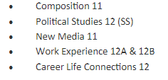
Co-Op Programs @ QE
Gr 11
Themed, pre-packaged cohorts that include extra credits and a variety of courses. You will stay with the same teacher and each coop includes a valuable 100hrs of work experience portion that looks great for Scholarships, post-secondary and college entrance applications
Targeting students with clear post-secondary or career visions and strong attendance
Ex. Mr. Hardman's Humanities Coop
What are Coops?

Slide 23
2024/25 Co-Op Programs @ QE
Half Day (2 Periods)
12 Credits
FULL DAY (1 Semester)
24 Credits
Science (Chem Focus)
(Mr. Romswinkel)
Entrepreneurship Business
(Ms. Sachdeva)
Robotics Engineering
(Mr. Wright)
Humanities/Law Co-Op
(Mr. Hardman)
Auto Mechanics Co-Op
(Mr. Friesen)

Slide 24

Career Life Connections (CLC)
Stand alone ‘enrolled’ course taken in grade 11 or 12
Post-secondary applications, post-secondary visits, grant/scholarship applications
CLC 12 is offered in all of QE’s Co-ops (gr. 11)
Notes:
Career Life Connections is a relatively new grad requirement that has been formally implemented in the last three years. This course culminates with a CAPSTONE project that is a creative expression of your child’s passion, goals and future direction. Students can take and receive credit for this course by one of two ways. A student in Grade 11 or 12 who enrolls in a COOP will have this CLC 12 course embedded into the COOP. If your child doesn’t take a COOP, they will take CLC 12 as a stand alone course in either their Grade 11 or 12 timetable. Most students attempt to complete this course in Grade 11 as they will be better prepared for their post secondary applications, for scholarships and for career choices.

Slide 25
DISTRICT PARTNERSHIP PROGRAMS
AUTOMOTIVE SERVICE TECHNICIAN | AUTOMOTIVE COLLISION | AUTOMOTIVE PREP/PAINT | HEAVY DUTY MECHANIC | TRADES SAMPLER
CARPENTRY | ELECTRICAL | WELDING | METAL FABRICATION | PAINTER
CULINARY ARTS | BAKING AND PASTRY ARTS | HAIRSTYLIST | MILLWRIGHT | DRAFTING CADD
PIPING (PLUMBING) | AVIATION GROUND SCHOOL | EDUCATION ASSISTANT (EA) | CHILD AND YOUTH CARE | TAH-TUL-UT INDIGENOUS EDUCATION PATHWAY
HEAD START IN ART (EMILY CARR) | INTRO TO HEALTH SCIENCE | HORTICULTURE | CANADIAN CRIMINAL JUSTICE | ROOFING

Slide 26
WHAT IF I HAVEN’T COMPLETED A REQUIRED GRADE 11/12 GRADUATION COURSE?
You may:
Register for summer Learning 2024 (End April)
B. Retake Grade 11 class first semester of next year in place of elective
C. Investigate whether the course is offered at QE Night School (2024 fall)
D. Complete course on SAIL Online ** Not Recommended**

Slide 27
QE Course Selection Timeline
Today: You and your child should familiarize yourselves with the courses using the Course Selection Handbook
Grade 8-9: Login to MYEDBC portal between Feb 16-29th to select courses
Grade 10-11’s: Selecting courses in the cpu labs with their counsellors Feb 20-29th
*All Course Selection Paper forms submitted to Assembly Teachers*

Slide 28
FINAL REMINDERS & LINKS
QUESTIONS: Any additional questions have your child Microsoft teams message their alpha counsellor or email Counselling Dept Leader Mr Lendvoy: Lendvoy_j@surreyschools.ca
COURSE SELECTION CATALOGUE: Find more detailed information about the courses offered through our course catalogue available for download and reading on our school website or as an attachment on Teams
3. Coops , District Programs AND Scholarships: QE Career Department

Slide 29
Questions about Scheduling
A to D
Mr. Jeremy Lendvoy
lendvoy_j@surreyschools.ca
E to K
Ms. Jenny Hundal
hundal_jenny@surreyschools.ca
L to Q
Ms. Melissa Sira
sira_m@surreyschools.ca
R to Z
Mrs. Sandra Kelly
kelly_s@surreyschools.ca
Careers/ Post Secondary
Ms. Leesha Nikkanen
nikkanen_l@surreyschools.ca

