Slide 1
Understanding the Semester 1 Gr 8 Timetable

Slide 2
Where Do I Get my Schedule?
Semester 1 Schedules were mailed out to your home address indicated on file in August
You can also login to your MYEDBC Student account to view them
Tues Sept 5: Gr 8's without schedules can also come in a bit early (1130am) and a counsellor can show you your schedule (Take a Picture!) :)

Slide 3
Get Familiar with Your First Semester!

Slide 4
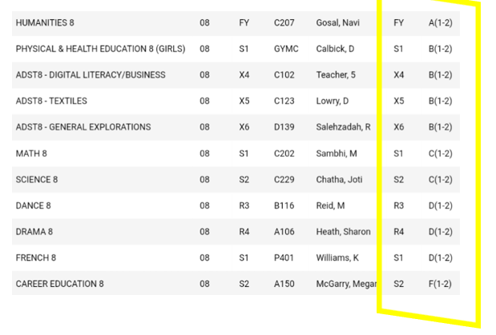
Understanding When You Have a Semester 1 Course?

Slide 5
FY = A Class you have All Year X1,X2,X3 = Sem 1 Elective Class R1, R2 = Sem 1 Elective Class S1= Semester one Class

Slide 6
There Are Four Blocks Per Semester
A *HOMEROOM*
B
C
D

Slide 7
Practice Writing Out Your Semester 1 Schedule So You're Ready
SEMESTER 1
A (Homeroom): ?
B : ?
C: ?
D: ?

Slide 8
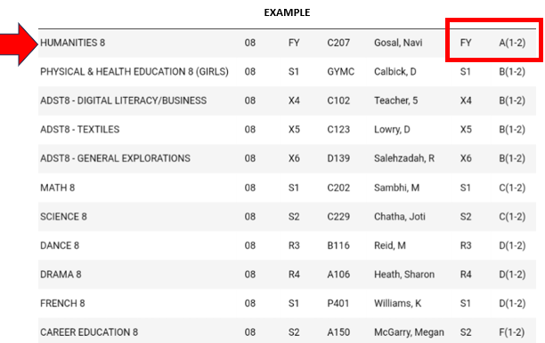
Semester 1 A Block
HINT: Look for the A Block that has either FY, S1, X1 or R1 next to it
Highlight it and write it down on your piece of paper

Slide 9
EXAMPLE SCHEDULE- WRITE IN A
SEMESTER 1
A (Homeroom): HUMANITIES (MS GOSAL ROOM C207)
B : ?
C: ?
D: ?

Slide 10
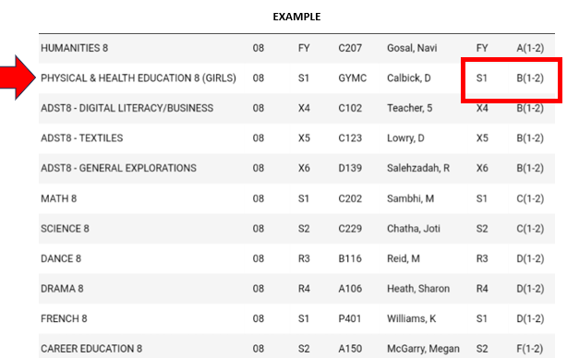
Semester 1 B Block
HINT: Look for the B Block that has either FY, S1, X1 or R1 next to it
Highlight it and write it down on your piece of paper

Slide 11
WRITE IN YOUR B!
SEMESTER 1
A (Homeroom): HUMANITIES (MS GOSAL ROOM C207)
B : GIRLS PE (MS CALBICK GYMNASIUM)
C: ?
D: ?

Slide 12
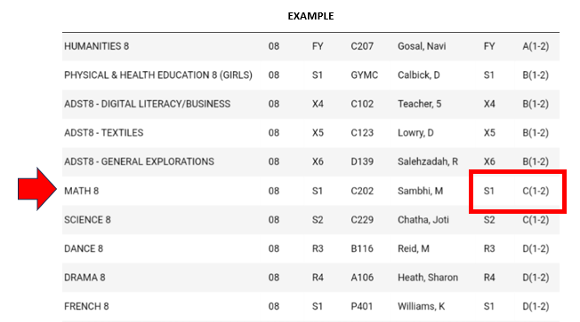
Semester 1 C Block
HINT: Look for the C Block that has either FY, S1, X1 or R1 next to it
Highlight it and write it down on your piece of paper

Slide 13
WRITE IN YOUR Sem 1 C!
SEMESTER 1
A (Homeroom): HUMANITIES (MS GOSAL ROOM C207)
B : GIRLS PE (MS CALBICK GYMNASIUM)
C: MATH 8 (MR SAMBHI C202)
D: ?

Slide 14
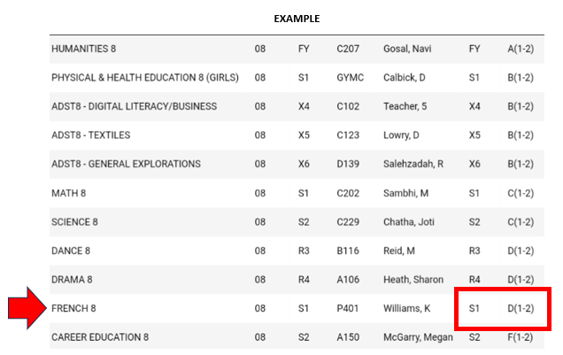
Semester 1 D Block
HINT: Look for the D Block that has either FY, S1, X1 or R1 next to it
Highlight it and write it down on your piece of paper

Slide 15
WRITE IN YOUR Sem 1 D!
SEMESTER 1
A (Homeroom): HUMANITIES (MS GOSAL ROOM C207)
B : GIRLS PE (MS CALBICK GYMNASIUM)
C: MATH 8 (MR SAMBHI C202)
D: FRENCH 8 (M. WILLIAMS Portable(P) 404)

Slide 16
Bring This Paper to Your First Day
SEMESTER 1- FAKE SCHEDULE
A (Homeroom): HUMANITIES (MS GOSAL ROOM C207)
B : GIRLS PE (MS CALBICK GYMNASIUM)
C: MATH 8 (MR SAMBHI C202)
D: FRENCH 8 (M. WILLIAMS Portable(P) 404)
*****Might Be Smart to Take a photo of your Full Schedule and have on phone too for Day 1 :)

Slide 17
See You Soon!
Tuesday September 5- 12pm
Main Gym
Bring 1 Binder, Paper and Pen

