Slide 1
Welcome!
Reporting Changes Information Session: Grades 8 and 9

Slide 2
We would like to acknowledge that the lands on which we work, play and learn, are on the shared traditional territory of the Katzie, Kwantlen, Semiahmoo and other Coast Salish Peoples.

Slide 3
What is a Reporting Policy?
Outlines the requirements for communicating student learning
Determines what report cards look like and how student learning is communicated

Slide 4
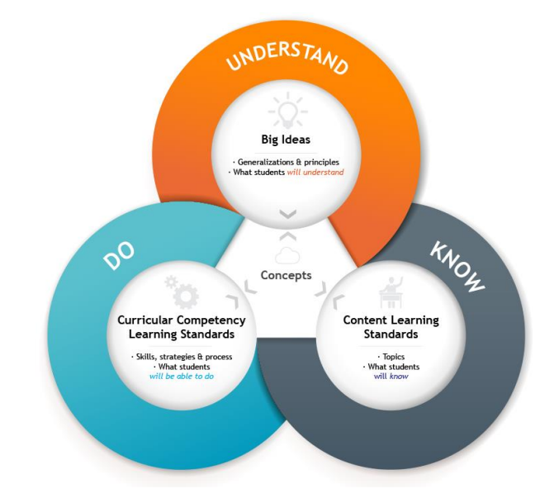
Why the change?
The BC curriculum changed in 2016 to become more competency (skill) based
Focuses on all three components of the curriculum model – know, do, understand
How we communicated student learning, did not change.

Slide 5
Learning over Letter Grades
The change in reporting allows for a more accurate picture of where students are at in their learning journey
Where students are excelling (Strengths)
Areas for improvement (Next Steps)
- Personalized feedback for continued growth (Descriptive Feedback)

Slide 6
Proficiency Scale
Emerging | Developing | Proficient | Extending
Emerging means your child is beginning to understand something in the area they are learning. They are still learning and may need more support to move ahead. Emerging does not mean your child is unsuccessful in this area. | Developing means your child understands some things in an area of learning but still has others to work on. Like emerging, it doesn’t mean your child is unsuccessful in this area. | Proficient is the goal for your child. It’s also the goal for all students. When your child is proficient, it means they fully understand the required learning. But it doesn’t mean their learning stops. | Extending is when students show a deeper understanding. It’s when your child is able to apply their learning in new and different ways. Extending is not the goal for all students in every area of learning.

Slide 7
Learning Goal: I can drive a motor vehicle in a safe, responsible, and skilled way.

Slide 8
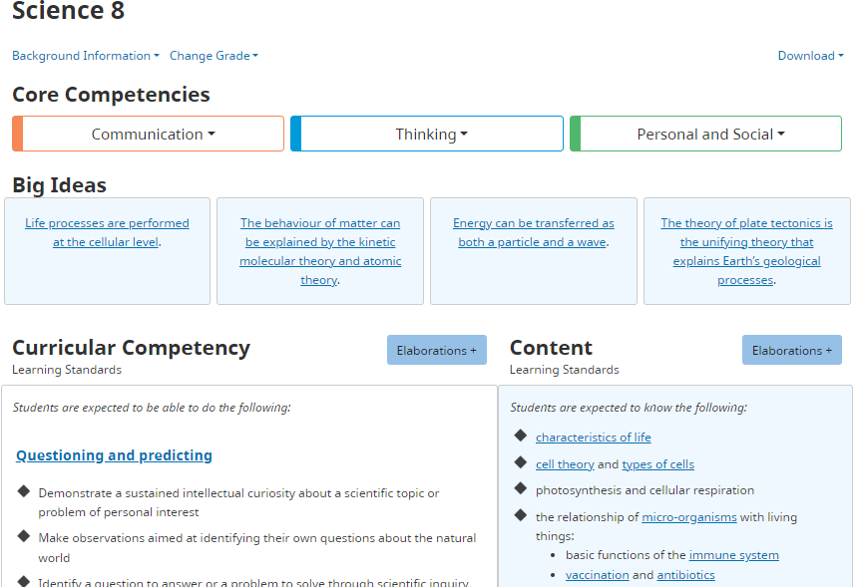
Science 8 Example

Slide 9
Learning Standards – Proficiency Scale
Emerging | Developing | Proficient | Extending
I can list the characteristics of living things of a familiar example. | I can describe the characteristics of living things that I observe in situations I am familiar with. | I can transfer and apply my learning of the characteristics of life to justify whether something is alive. | I can research to improve my investigation, create something new, or solve a novel problem that demonstrates sophisticated understanding.

Slide 10
Math 8: Example
Emerging | Developing | Proficient | Extending
I can solve problems with proper fractions. $\frac{3}{4}−\frac{1}{4}$ $\frac{3}{4}×\frac{1}{4}$ | I can represent and solve problems involving mixed number and improper fractions using a method of my choosing. $1\frac{3}{4}+\frac{1}{2}$ $$2\frac{1}{2}÷\frac{1}{4}$$ | Is it possible to add a set of brackets to the left side of the equation to make it true? Justify your answer $$1\frac{1}{2}+2\frac{1}{2} ÷\frac{3}{4}−\frac{1}{8}=5\frac{1}{5}$$ | Use all of the digits from 1 to 8 in place of a to h in the expression $\frac{a}{b}+\frac{c}{d}−\frac{e}{f}−\frac{g}{h}$ to make… -The greatest result -A result between ½ and ¾ -Discuss your problem-solving strategy using relevant vocabulary

Slide 11
Self Assessment of Core Competencies and Goal Setting
All students at Semiahmoo Secondary (Grades 8-12) will complete a Self Assessment of the Core Competencies at 3 points during the school year (October, January, May)
Instructions with how to access these student self-assessments will be included on report cards.

Slide 12
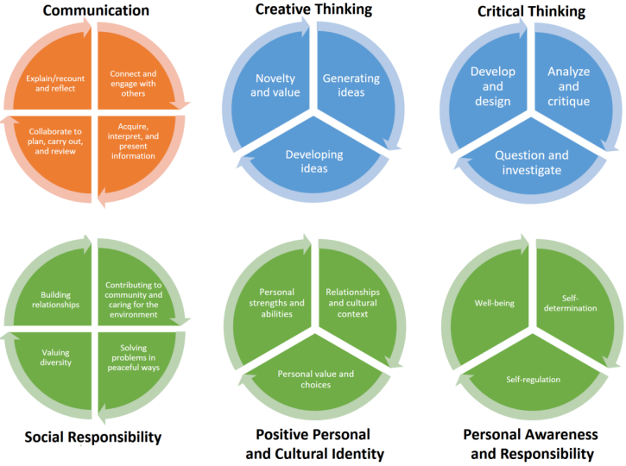
Core Competencies

Slide 13
How will you know how your child is doing?
In grades 8 and 9:
Proficiency Scale with reference to key learning standards up to that point in learning.
Descriptive Feedback- Areas of strength, areas for improvement, ways to support improvement, student engagement

Slide 14
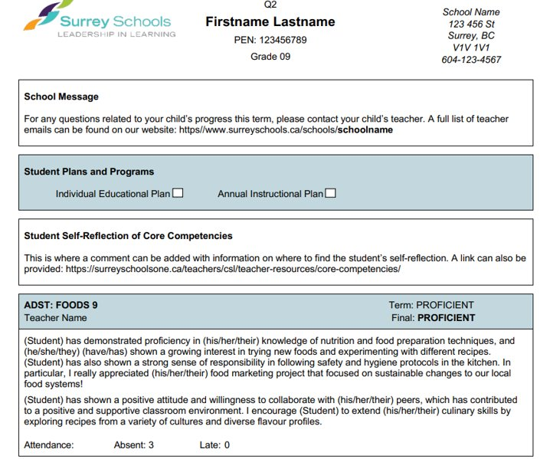
New Report Card Example Grade 8 & 9

Slide 15
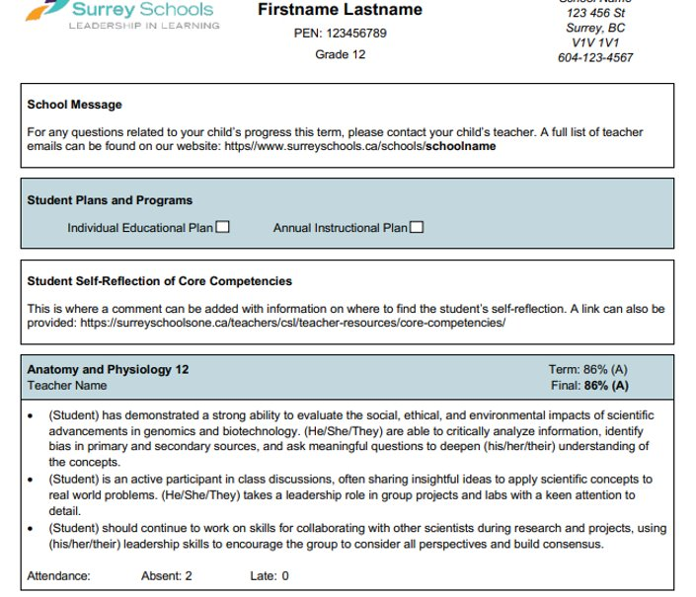
New Report Card Example Grade 10-12

Slide 16
Questions?

