Slide 1
Planning For Your Future
Notes:
Here to discuss options for what you might considering looking into for after high school
To begin our presentation, I will start off by just discussing what you need to meet the graduation requirements.

Slide 2
What We Will Discuss Today
High school graduation requirements
Admission requirements (direct from high school to post-secondary)
Common post-secondary requirements for various fields
Mini presentation from Careers Centre
Application process and tips
Gap year or work
Things to consider
Upcoming post secondary events
Counsellor website, Instagram and contacts

Slide 3
BC GRAD REQUIREMENTS (Dogwood)
 | Grade 10 | Grade 11 | Grade 12 | 8
 | 1. English 10 * | 1. English 11 * | 1. English 12 *
 | 2. Social Studies 10 | 2. Social Studies 12 * | 2. Elective 12
 | 3. Science 10 | 3. Science 11 or 12 | 3. Elective 12
 | 4. Math 10 | 4. Math 11 or 12 | 4. Elective 12
 | 5. Career Life Education 10 | 5. Elective 10, 11 or 12 | 5.Career Life Connections 12
 | 6. Physical and Health Education 10 | 6. Elective 10, 11 or 12 | 6. Elective 11 or 12
 | 7. Fine Art/Applied Skill 10, 11 or 12 | 7. Elective 10, 11 or 12 | 7. Elective 11 or 12
 | 8. Elective 10, 11 or 12 | 8. Elective 10, 11 or 12 | 8. Elective 11 or 12
 |  | Credits required for Graduation: 80 | * = can include Indigenous focused courses
 | *Grade 10 Numeracy Assessment must be written prior to the end of June *Grade 10 & 12 Literacy Assessment must be written prior to end of June
Notes:
To begin, just to review with you all the bc grad requirements.

Slide 4
REQUIRED PROVINCIAL ASSESSMENTS
Required for graduation.
Scored on a proficiency scale not
a percentage or letter grade.
All scores are acceptable to meet the graduation requirement.
UBC requires "Proficient" Level 3
on the evaluation scale.
Contact Mr. Thibault for missed exams
Grade 10
Literacy +
Numeracy
Grade 12
Literacy
students
10
Notes:
In grade 10 and grade 12, there are required provincial assessments. If you completed a course during summer, and didn’t do the assessment please see mr. T

Slide 5
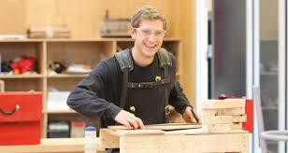
College or University
to obtain a diploma, certificate, degree
or up-grade courses
Trades & Technical Training
Work
Travel (e.g. Gap Year)
OPTIONS AFTER HIGH SCHOOL
Notes:
During our presentation today, we are going to go over the following options that you can consider for after high school.

Slide 6
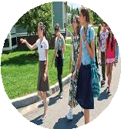
Start Early
HELP WITH YOUR DECISION MAKING…
There are many different opportunities available to you
m
Research programs and options
MyBluePrint, Education Planner BC, Counselling Website
Campus Tours & Information Sessions
Virtual or in-person
Check admission requirements
General + Specific
Check admission deadlines
Have a tentative Plan “A”
… and a Plan “B” and “C” and “Have a ttive Plan “A”
… and a Plan “B” and “C” and
Talk to your:
Family
Teachers
Counsellor
Careers teachers
Post-secondary representatives
Have a tentative Plan “A”​
… and a Plan “B” and “C” and “D”
13
Notes:
It’s not easy to make a decision on your own and its also ok if you are still unsure on what you want to do after high school. But there are things you can consider to help make a decision.
If your plan is to attend post-secondary – then you want to start early and look at diff opportunities

Slide 7
ADMISSION REQUIREMENTS
Always check with each
post-secondary institutions
for up-dated information for
general and specific requirements

Slide 8
Common Post-Secondary Requirements
BRITISH COLUMBIA
OUT OF PROVINCE
Public Post-Secondary Institutions in BC | English/ EFP 12 MINIMUM Mark Requirement | # of grade 12 Approved Academics Required In Addition to English
Capilano | Required: 60% | 2
Douglas | Required: 60% | -
KPU | Required: 67% | -
SFU | Required: 70% + | 4
UBC | Required: 70% + | 5
UFV | Required: 67% | 2
UVIC | Required: 67% | 3
Public Post-Secondary Institutions​ | English/ EFP 12 Mark Requirement​ | # of grade 12 ​ Approved Academics Required In Addition to English​
Alberta | Varies | 4
Ontario | Varies | 4-5
Notes:
Institutions often have a specific number of Grade 12 courses reviewed for admission – e.g. 3-6 Grade 12 courses (depending on th institution), one of which is always your English Language Arts 12 mark
Many universities outside BC use 5 or 6 approved Grade 12 courses
Applicants need to check the institution’s website to see if there is an “Approved Academic Course List”

Slide 9
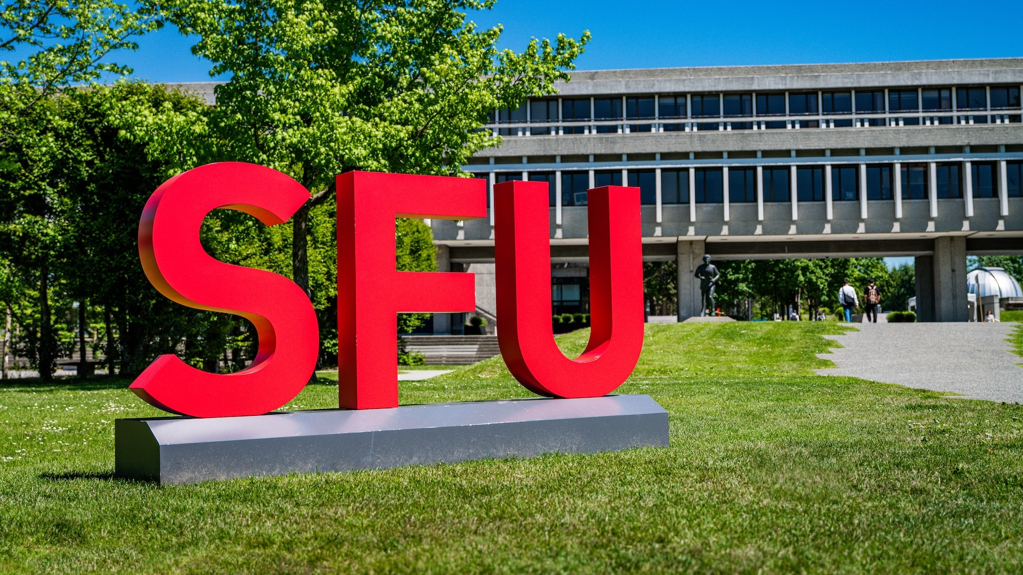
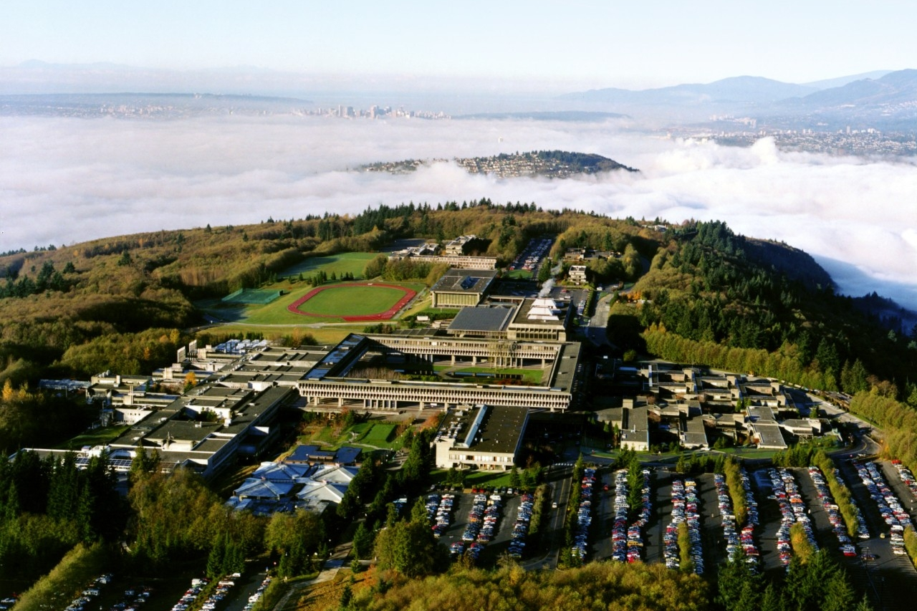
Example of Admission Averages (SFU)
Arts and Social Sciences: 80%
Business: 83%
Communication Arts and Technology: 80%
Engineering: 86%
Environment: 80%
Health Sciences: 88%
Science: 85%

Slide 10
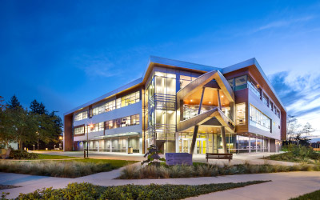
Example of Admission Averages (UFV)
Applied and Technical Studies (Trades): 67%
Arts: 73%
Engineering Transfer Program: 73%
Health Sciences: 67%
Professional Studies (Business): 73%
Sciences: 73%

Slide 11
Second Language Requirements
UBC
Second language 11 needed for admissions (Intro/ Beginner courses not accepted)
Language 12 or university second language course (For BA programs only)
SFU
Second language 11 needed for admissions (Intro/ Beginner courses accepted)
KPU and UFV
Second language 11 not needed for general admission
HOWEVER, BA programs require a second language 11 OR a university second language

Slide 12
BCIT
Can study a wide array of programs which all have individual requirements
Faculties: Applied and Natural Sciences, Business, Computers and IT, Technology, Aviation, Engineering, Health Sciences and Trades (Arts/ Humanities programs not offered)
Check the BCIT website for program specific requirements and deadlines/ start dates
See your counsellor and career center for assistance

Slide 13
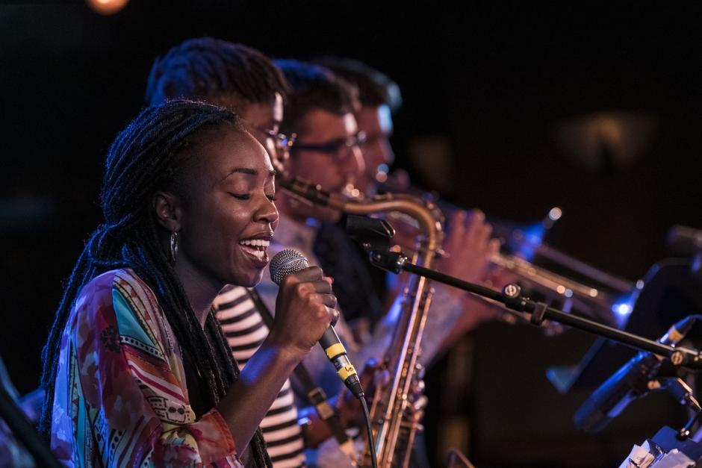
Fine Arts and Music
Art:
Capilano University
Emily Carr University
KPU
Langara College
SFU
TRU
UBC
UFV
UVIC
Requirement: Portfolio needs to be completed by Gr. 12. Check individual schools for specific requirements.
See Ms. Farrant for more specific details, recommendations and help with portfolios.
Music:
Camosun College
Capilano University
Douglas College
KPU
Thomson River University
UBC
UVIC
Vancouver Community College (VCC)
Check individual schools for specific requirements.
See Ms. Kennedy for more information/ recommendations on programs locally and nationally.

Slide 14
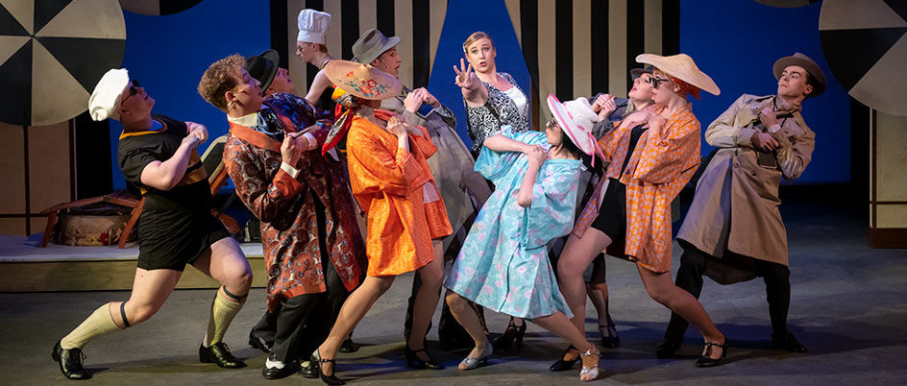
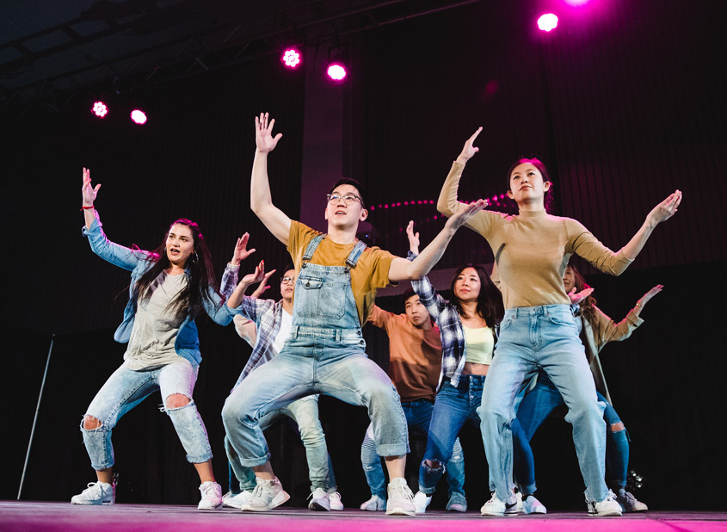
Performing Arts
Dance:
SFU
Vancouver Community College
There are many additional private institutions that students may wish to explore in Dance.
Check individual schools for specific requirements.
See Ms. Law for more information about more dance opportunities and schools locally, across Canada, and internationally after high school.
Theatre:
Capilano University
Douglas College
Langara College
SFU
TRU
UBC
UFV
UVIC
Check individual schools for specific requirements.
See Mr. Smith for more information on the audition process and recommendations on programs after high school.

Slide 15
Athletics
Starting in Grade 11, coaches will come out to scout players in various sports for post-secondary/scholarship opportunities.
Check individual schools for specific requirements.
See your PE teacher and coach for more information
on athletic opportunities after high school.

Slide 16
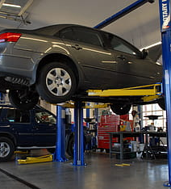
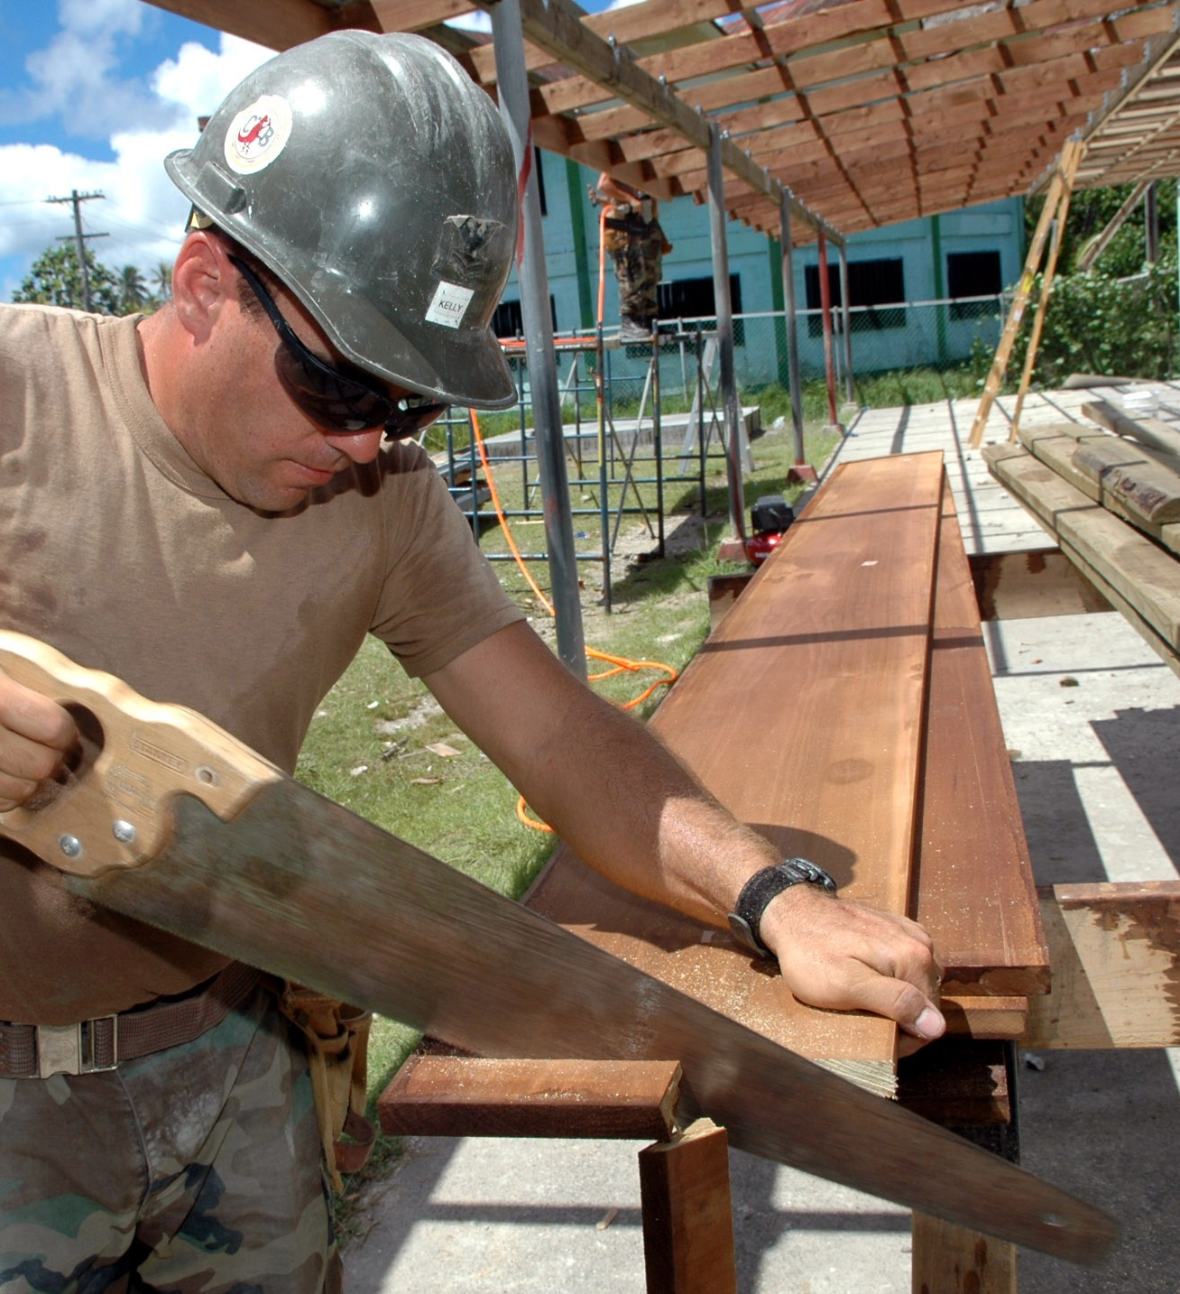
Post-Secondary & Career Options in the Trades
This Photo by Unknown author is licensed under CC BY-NC.

Slide 17
Why a Trades Pathway
Earning income while learning on the job
Grants and Bursaries available while taking technical training
Pay raises as you move through the different levels of an apprenticeship
In demand jobs across all trades areas

Slide 18
Average Wage for a full Red Seal Certified Tradesperson
Carpenter - $25 to $36 per hour average
Electrician - $ 27.50 to $43 per hour average
Heavy Equipment Operator - $28.40 to $39 per hour average
Plumber - $26 to $36 per hour average
Construction Manager (Apprenticeship, Trades experience, construction manager courses, business manager experience - $36.25 to $57.70
Work BC. Labour Market Outlook 2019 Edition – Industry Profile

Slide 19
Trades Pathways
Direct Apprentice
Start a Job with a company in a trade area and that company becomes your apprenticeship sponsor
WBT hours begin to accumulate once a probation period finishes (usually 2-3 months – some companies will backdate WBT hours)
Attend school for 6-8 weeks for Level 1 Technical Training after you have gained on the job training
Foundation Program
- Take a 4-6 month program at KPU,, VCC or BCIT, UFV or a private trades college to get your level 1 trades technical training.
- Get a job in the trade area after completing a level 1 Foundation to start accumulating on the job WBT Hours (Work Based Training)

Slide 20
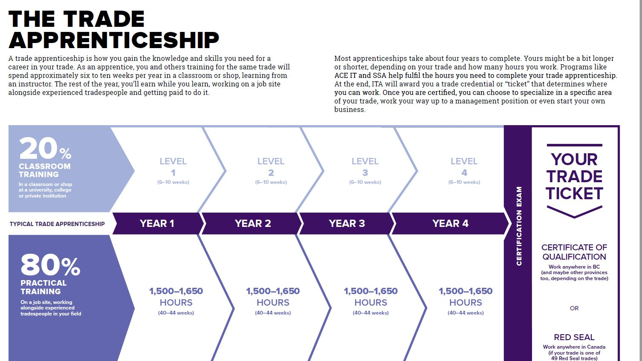
Train in Trades/ACEIT
Work in Trades/SSA

Slide 21
I want to work in a Trade area, but have no idea which one!
BCIT offers a Trades Discovery program that is 16 weeks in length
During those weeks you get to try out 15 different trade areas
Have a 2-week work experience and get great hands-on experience to help guide you towards a trades focus
Activities you may get to try:
Installing hot water tanks,
Framing a small house,
Welding,
Wiring three-way switches,
Working on mechanical systems in automobiles, aircraft, and heavy equipment.

Slide 22
Skilled Trades BC www.skilledtradesbc.ca
Government Agency that leads and coordinates British Columbia’s skilled trades system.
Skilled TradesBC works with employers, apprentices, industry, labour, training providers and government to issue credentials, supports apprenticeships, fund programs, set program standards and increase opportunities in the trades.
Industry Training Authority manages over 100 trades programs in BC, 49 of which are Red Seal
Manage your Apprenticeship in with the Apprentice Direct Access portal to see your technical training hours and levels and track your WBT (Work Based Training) hours (on the job work)

Slide 23
Your TICKET --- Your Ticket is your credential — BC Certificate of Qualification (CofQ) or a National Red Seal. Your Ticket is what you can earn at the end of your training

Slide 24
Where do I do my Technical Training
Public Training Institutions
16 BC Training Institutes across all areas of BC
BCIT
KPU
VCC
TRU
UFV
Private and Union Training Programs
Over 30 Private / Union Training
www.tradestrainingbc.ca

Slide 25
School District Partnership Programs
Carpentry
Piping
Electrical
Automotive Service Tech
Auto Collision and Body Repair
Millwright
Welding
Metal Fabrication
Exploration in Aviation
Culinary Arts (professional cook)
Baking and Pastry Arts
Early Childhood Education
Drafting/CADD
Inclusive Education Support Worker (EA)
Horticulture
Hairstylist
Painter (commercial/residential)
Construction Craft Worker

Slide 26
Programs CURRENTLY Accepting Gr 12 students -- must be in English 12 1st semester
ECE
Early Childhood Education
Partnership with Douglas College
Hybrid (online/In-class/Practicum Placement)
Culinary Arts
Professional Cook Level 1
Taught at Tamanawis Secondary by a Professional Chef
Work Experience Placement in the industry – higher end restaturants or some 'big chain" restaurants

Slide 27
Grade 11 Program Applications
Apply through the career center (January – March)
Ms. Rogerson manages Partnership Program Applications
Tuition is paid for by the school district
$$$ Scholarship Opportunities for students who do a Partnership program

Slide 28
Grade 12 Scholarship Meeting
October 3rd
Lunch in B110
Overview of Scholarship Process
How to get nominated for Nomination awards
Overview of District Authority, Partners36 and Internal Scholarships
REFERENCE LETTERS – how and when to ask for reference letters

Slide 29
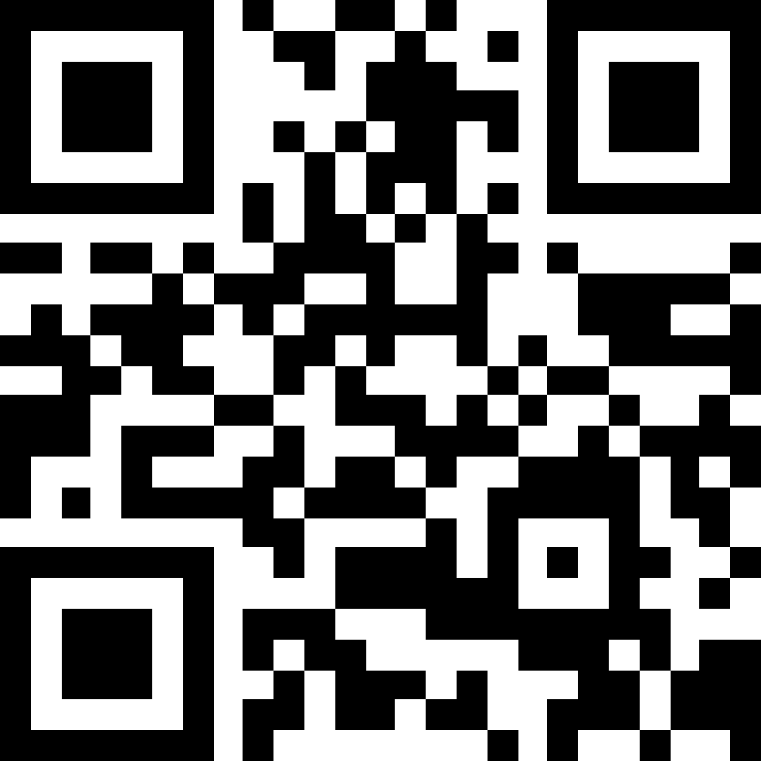
Follow
Scholarship TEAM
SHSS Scholarship Info Grads 2024
TEAM CODE 9macuab

Slide 30
CLC Community Engagement Requirement
The semester you are doing CLC 12 you need to show minimum of 30 hours of COMMUNITY ENGAGEMENT
service learning
volunteerism
employment
fieldwork
projects
entrepreneurship
passion projects

Slide 31
REPEATING COURSES
All BC institutions will take the highest course mark for any academic Grade 11 or 12 course – no penalty is applied.
Summer School and Night School are great options for upgrading your marks.
We do not advise summer school as a first attempt at a core academic course.
Notes:
Transcript – does the repeated classes show up on transcript?

Slide 32
Application Process
All applications are completed online (use personal email)
Apply through Education Planner
http://www.educationplannerbc.ca/
It has direct links to many colleges/universities
NOT: BCIT (access site directly)
Create a BCEID account (Dec. 5th- Block D)
Credit card is required for registration fees

Slide 33
EDUCATIONPLANNERBC.CA
Search programs and check pre-requisites
Research careers
Apply to most institutions (apply to at least 2)

Slide 34
Application Tips
Check application deadlines as each institution varies
Start researching now (in grade 11)
Start applying now (in grade 12)
All application portals will be open by October 3rd
Recommended to finish applications by end of Winter Break (grade 12s only)
Consider applying to more than one institution (with varying entrance requirements)

Slide 35
Reporting Marks
Student Transcript Service (STS):
Grade 12 students will complete this process in class
(Dec. 5th- Block D)
No need to send in individual transcripts
SFU asks for self-reporting of grades
Be honest!
April report card is critical!

Slide 36
Out of Province Applications
For all Alberta post-secondary institutions, apply through Apply Alberta: https://applyalberta.ca
For all Ontario post-secondary institutions, apply through Ontario Universities’ Application Centre (OUAC): https://www.ouac.on.ca
For applications to any other provinces, please apply directly to the institution

Slide 37
Gap Year or Work
Gap Year
Benefits of gap year include gaining skills and experience while giving you time to reflect on what you would like to do in the future.
Check out https://www.cangap.ca
Work
Save money
Gain valuable work experience
Find new interests
Develop contacts in a field you may be interested in

Slide 38
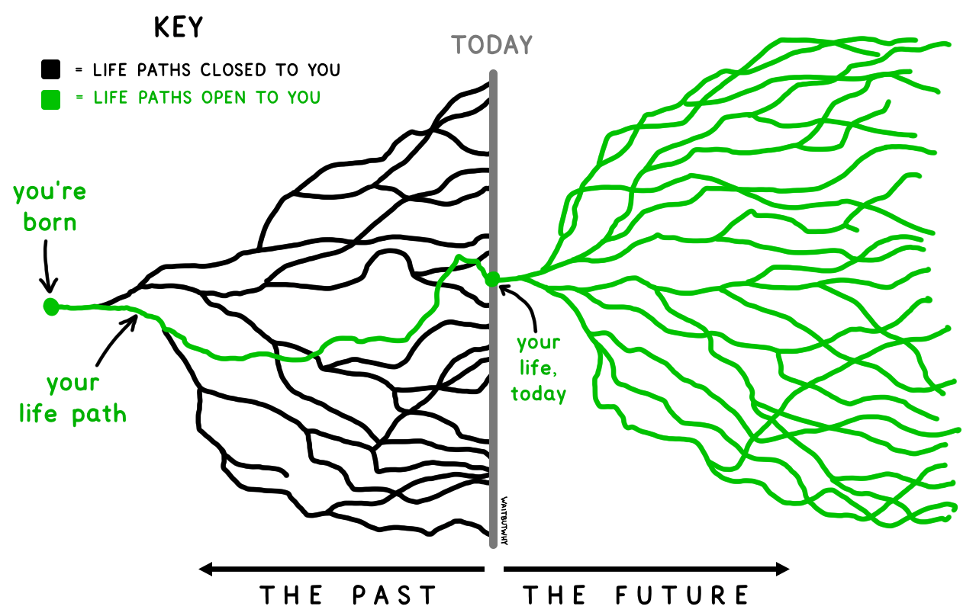
Steps to Plan Your Future
Know yourself
Explore possibilities
Choose a direction
Make it happen
Learning Clicks
Know Yourself

Slide 39
Things to Consider
Set realistic goals
Review strengths and weaknesses (look at previous marks)
Direct admission into desired institution or transferring between post-secondary schools
Consider length of program
Certificate, Diploma, Degree
Consider desired class size (KPU, Douglas and UFV- max. 35 students per class)
Consider transportation
Consider cost of tuition
Changing your mind
Career
Program
School
Undecided about future plans

Slide 40
Post-Secondary BC Evening at Sullivan
Monday, October 16th: 6:00 – 8:30 pm
Open to all Sullivan grade 10-12 students and their parents/ guardians
Many BC post-secondary institutions will be here
No pre-registration required
Listen to presentations and visit information booths
An opportunity to have all your questions answered!

Slide 41
Upcoming Post Secondary Events
CUE – Canadian Universities Event | Thursday, Oct. 5th 6:30 – 9pm | Sheraton Guildford Hotel | Register at cuebc.org
BCIT Big Info | Wednesday, Oct. 11th 4 – 7pm | Burnaby Campus | Register at bcit.ca
Explore CapU- Capilano Open House Event | Saturday, Nov. 25th 11am – 2pm | North Vancouver | Register at CapilanoU.ca/explore
KPU Open House | Saturday, Oct. 14th 12 – 2pm | Surrey Campus | Register at kpu.ca
UBC – Okanagan In-Person Info Session | Thursday, Oct. 26th 6:30 – 7:30pm | Princess Margaret Secondary 12870 – 72nd Avenue
University of Calgary | Friday, Dec. 1st Lunch | Multipurpose Room | Register in counselling starting Nov. 20th
UFV Open House | Saturday, Oct. 21st 10am – 2pm | Abbotsford Campus | Register at ufv.ca/openhouse
Explore UVic | Saturday, Nov. 25th 10am – 5:15pm | Victoria Campus | Register at uvic.ca/explore
Experience VCC | Wednesday, Nov. 15th 3 – 6pm | Broadway Campus | Register at vcc.ca

Slide 42
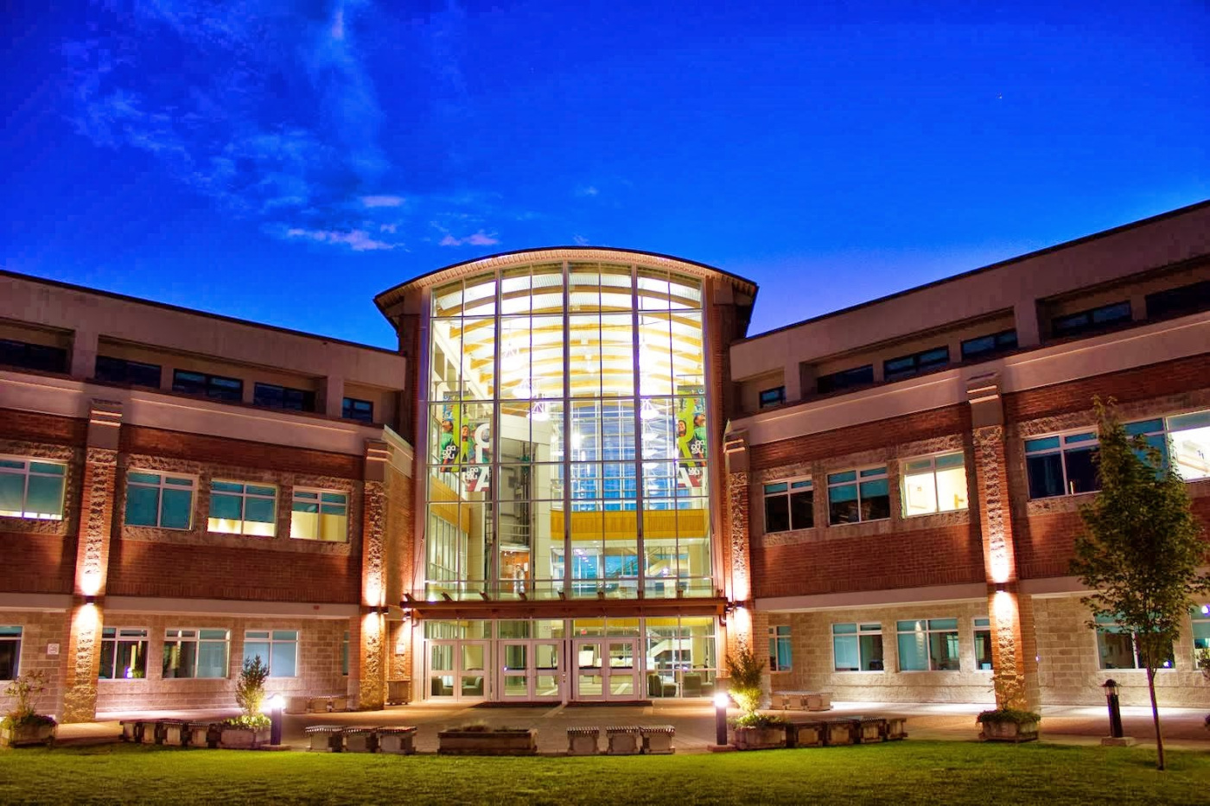
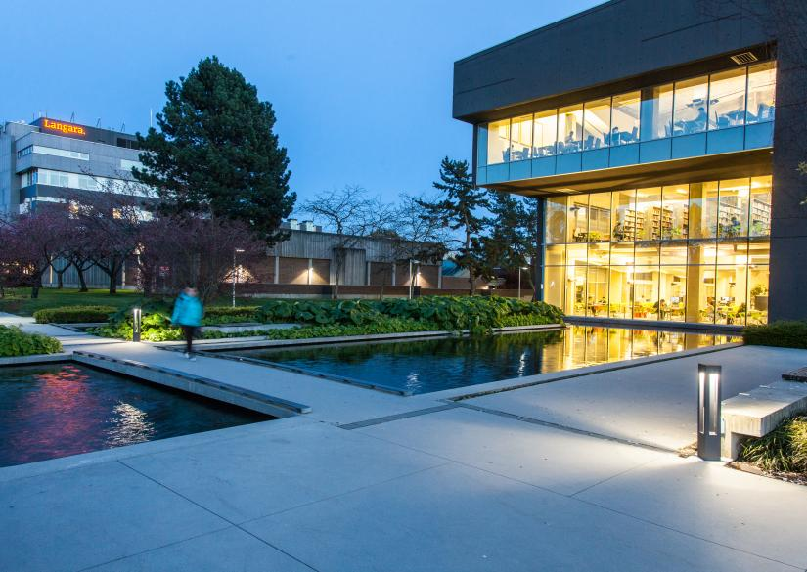
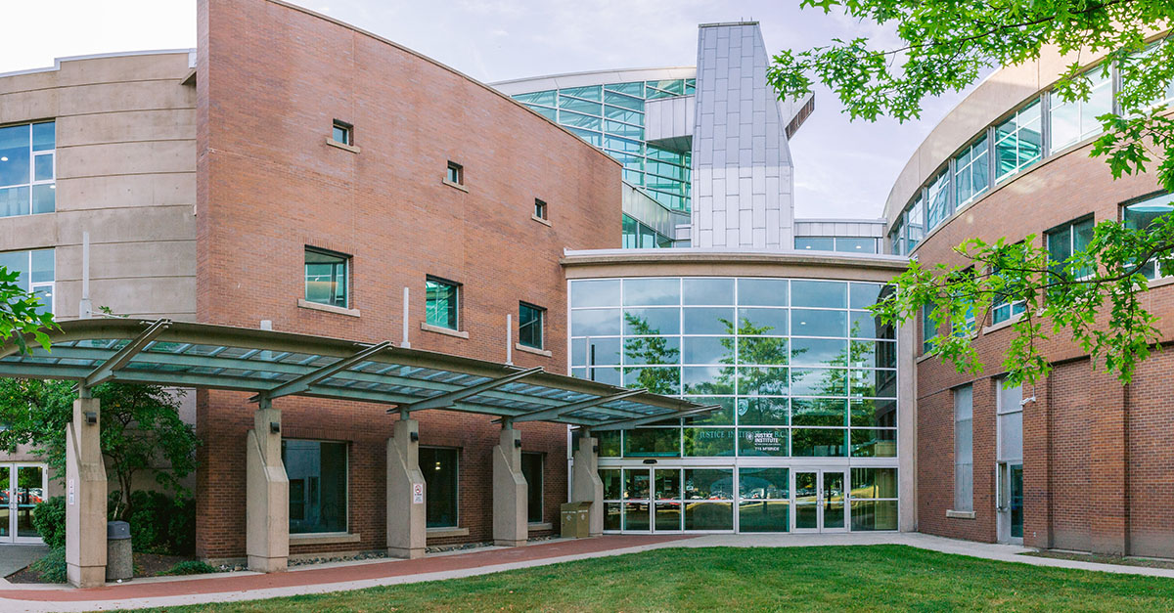
Upcoming Post-Secondary Events
Douglas, Langara and JIBC have individual information sessions by program.
Check with each post-secondary institution websites for dates and registrations.

Slide 43
Sullivan Heights Counselling Website

Slide 44
INSTAGRAM
Follow @sullicounselling

Slide 45
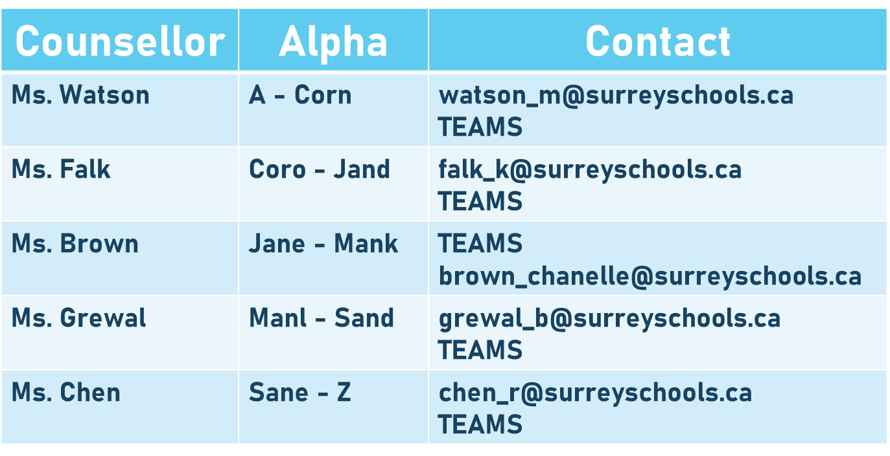
Counselling Alpha

