Slide 1
COURSE SELECTION
For the 2023 – 2024 School Year
Notes:
The purpose of this presentation is that you can leave today with a clear idea of what courses you need for next year.

Slide 2
Making the right choice
Reading course descriptions – Check the school website.
Courses (surreyschools.ca)
Planning with parents
Planning with counsellors
Talking to the teachers
Checking post-secondary websites directly:
www.educationplannerbc.ca or www.postsecondarybc.ca
Attending virtual information sessions at Post-Secondary Institutions
Notes:
don’t choose courses based on what your friends are choosing.
Picking

Slide 3
GRADUATION PLANNING
Grade 10 | Grade 11 | Grade 12 | ADST (Applied Skill or Fine Arts) Requirement * First Peoples Requirement 80 credits needed for graduation
English 10 * | English 11 * | English 12 *
Math 10 | Math 11 | CLC
Science 10 | Science 11 | ELECTIVE
Social Studies 10 | Social Studies * | ELECTIVE
Physical Education 10 | Career Life Education | ELECTIVE
Language or ELECTIVE | Language or ELECTIVE | ELECTIVE
ELECTIVE | ELECTIVE | ELECTIVE
ELECTIVE | ELECTIVE | ELECTIVE
32 Credits | 32 Credits | 32 Credits
Notes:
Provide students with “graduation planning record sheet” – they should fill out their basic information (PEN not required). Have them fill out the courses they have taken and beside each class write the mark they received.
GO TO PAGE TO SHOW ADST COURSES

Slide 4
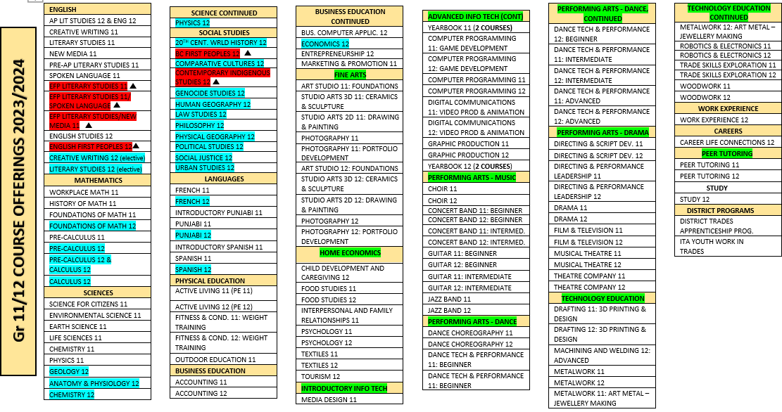
FINE ARTS/ ADST: At least one required from grade 10-12 at least one First Peoeples course required grade 12 academic courses for post-secondary

Slide 5
Pathway for Math
Foundation & Pre-calculus 10
Pre-Calculus 11
Pre-Calculus 12
Calculus 12
Foundations of Math 11
Foundations of Math 12
Workplace Math 10
Workplace Math 11
Any Math 10
OR
OR
History of Math 11
Notes:
Questions?

Slide 6
Post-secondary Faculties
Science | Nursing | Engineering
English 12 Pre-Calculus 11 and 12 Physics 11 Chemistry 11 Life Sciences 11 (strongly recommended) Social Studies 12 2 additional Science 12’s Anatomy and Physiology 12 Chemistry 12 Physics 12 Recommended: Calculus 12 and all three Sciences | English 12 Chemistry 11 and 12 Math 11 or 12 (varies by Post-secondary institutions) Anatomy & Physiology 12 * Physics and Calculus: Not required * See nursing grid | English 12 Pre-Calculus 11 and 12 Calculus 12 Physics 11 and 12 Chemistry 11 and 12 Social Studies 12
*** Check post-secondary school websites for program specific requirements
Notes:
Go over elective courses with the students – that they ca use towards particular programs.

Slide 7
Post-secondary Faculties
Business | Arts (Social Science/ Humanities)
English 12 Math 11 (Pre-Cal 12 at some Institutions) 3 to 4 additional grade 12 academics KPU: Accepts Foundations 11 or Workplace Math 11 * SFU or UBC: Pre-Calculus 12 + 3 to 4 additional grade 12 academic courses | English 12 Math or Science 12 (SFU: Geology 12 or Physical Geography 12 can meet this requirement) 3 to 4 additional grade 12 academics *SFU: accepts FOM 11 or Pre-Calc. 11 *UBC: accepts Pre-Calc. 11 or FOM 12
*** Check post-secondary school websites for program specific requirements

Slide 8
Second Language
UBC: ​
Second Language 11 for admissions​ (Beginner or Intro language is not accepted)
Second Language 12 or First year Second Language course (For BA program only)​
SFU​:
Second Language 11 for admission (Beginners or Intro level accepted)​
KPU and UFV​:
No Second Language needed for general admission​
HOWEVER, BA programs require Language 11 OR First Year University Language ​

Slide 9
Language challenge Exam
French 11/ 12
Spanish 11/ 12
Punjabi 11/ 12
Mandarin 11/ 12
Korean 11/ 12
Japanese 11/ 12
Register with your counsellor in October – Exam is written mid-January
Notes:
PORTAL opens FRIDAY

