Slide 1
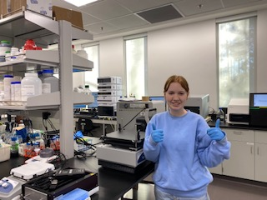
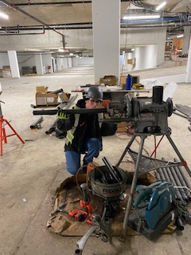
Career Programs at Grandview Heights! 1) Bio-chem Co-op 2) Humanities Adventure Co-op Applications and Reference Forms DUE FEB 15th to Career Centre 3) Career Prep (CLC/Work Experience) Takes 2 blocks of a semester – no application required

Slide 2
DISTRICT PARTNERSHIP PROGRAMS & COURSES
Earn Dual Credit – high school & post-secondary
Students obtain entry level training
Surrey Schools pays the tuition
Become employed/apprenticed
Open for Grade 10 & 11 students to apply
Applications available in the Career Centre at each secondary school
Surrey Schools offers District Partnership Programs & Courses in collaboration with local post-secondary & training providers.

