Slide 1

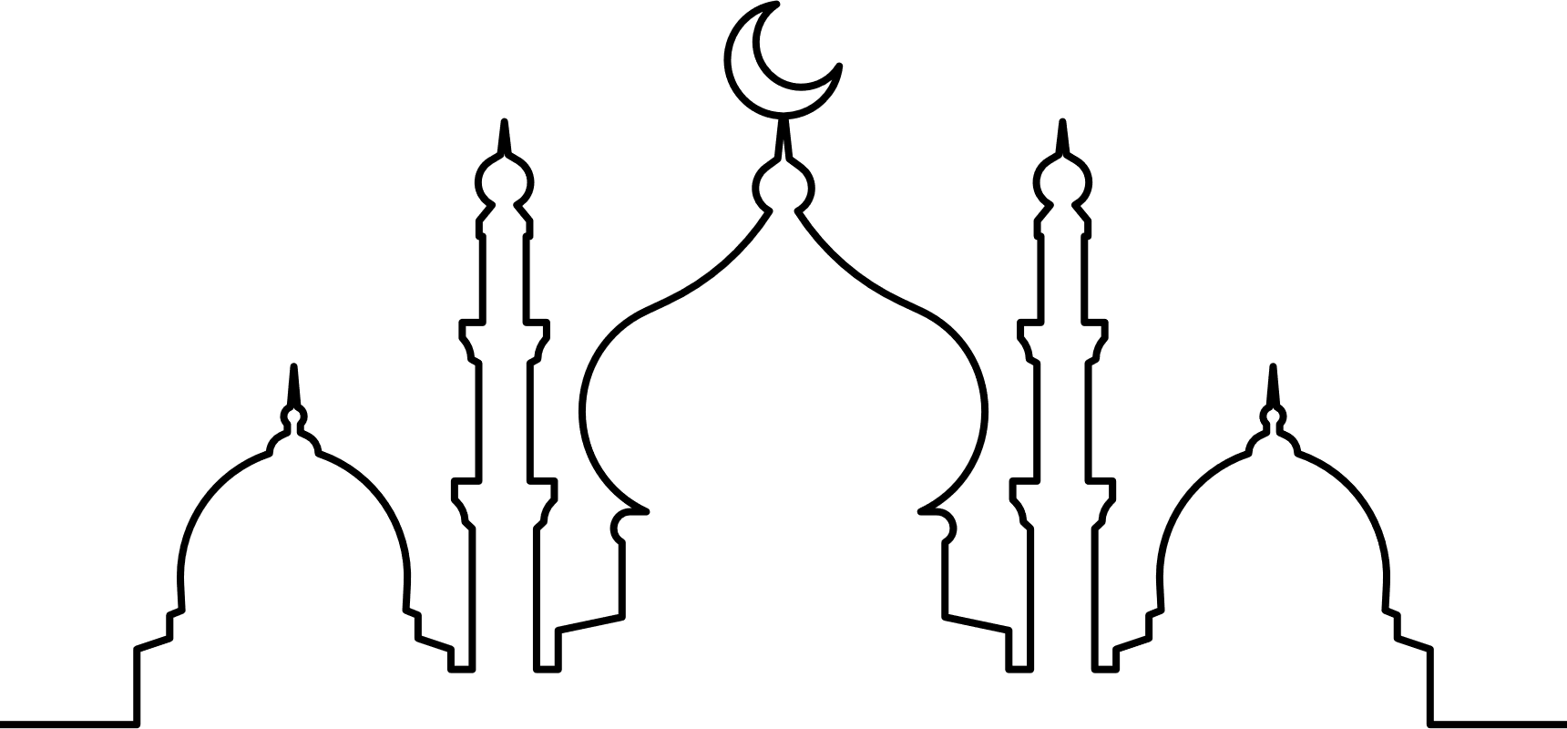
Ramadan
Understanding Ramadan & How to Support The School Community
Presented By Zahraa Dean

Slide 2
Land Acknowledgement
I would like to acknowledge that our district is on the shared, unceded, traditional territory of the Katzie, the Semiahmoo, the Kwantlen and other Coast Salish Peoples, and I honour their stewardship of this land. As Ramadan is observed, I also appreciate the freedom to practice my faith on this land, which I do with gratitude and respect for its original inhabitants

Slide 3

What is Ramadan?
Ramadan is the 9th month of the Islamic calendar, during which fasting is observed from sunrise to sunset by Muslims worldwide

Slide 4
Keywords
  Ramadan (raa-muh-daan): 9th Islamic Month of fasting
  Suhoor (su-hoor): The meal eaten before sunrise followed by Fajr prayer
  Iftaar (if-thaar): The meal eaten at sunet when breaking your fast followed by Maghrib prayer
  Salah (sa-laah): Prayer (5 x a day: Fajr, Duhur, Asr, Maghrib, Isha)
  Tarawih (tha-raa-weeh): A prayer that takes place after Isha prayer at the masjid which involves
reading long portions of the Quran
  Laylat-al-Qadr (lay-lath-ul-kad-ar): Translates to ‘The Night of Power’ which is the holiest night of Ramadan, as the first verses of the Quran were revealed to Prophet Muhammed (Peace Be Upon Him) on this night. The exact date of laylat-al-qadr is unspecified but it is believed to occur on the 27th night or one of the odd-numbered nights during the final ten days of the month.

Slide 5
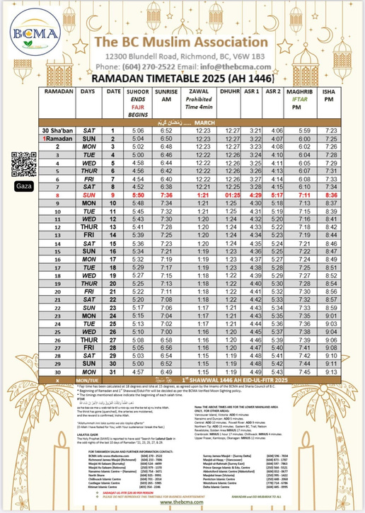
Ramadan Timetable 2025
Timings may vary slightly depending on different interpretations and local moon sightings

Slide 6
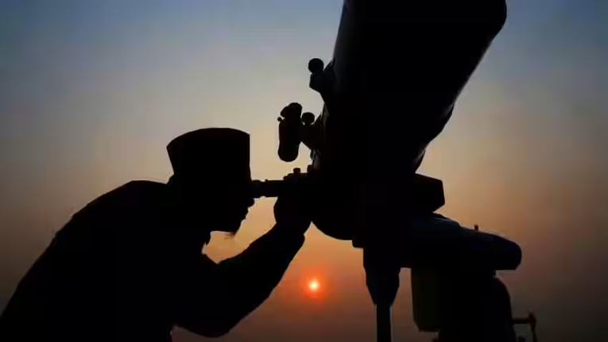
When is Ramadan?
The beginning and end of Ramadan are determined by the sighting of the crescent moon. In 2025, Ramadan is expected to commence around Saturday, March 1, but the exact date may vary based on moon sightings

Slide 7
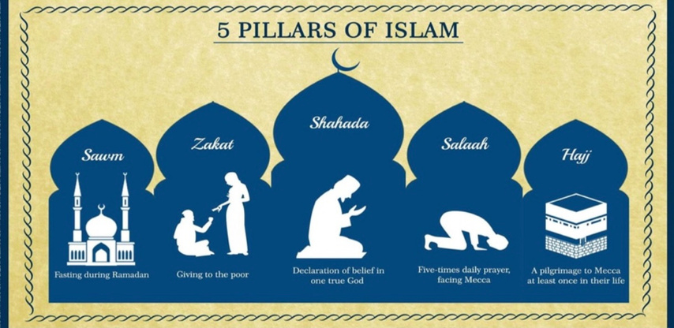
Why do muslims fast?
Fasting is one of the five obligatory pillars in Islam. Pillars of Islam are fundamental practices in Islam considered to be obligatory acts of worship for all Muslims

Slide 8

What is the significance of Ramadan?
It is the month in which the first verses of the Quran, Muslim’s holy book, was revealed to Prophet Muhammad (Peace Be Upon Him)

Slide 9
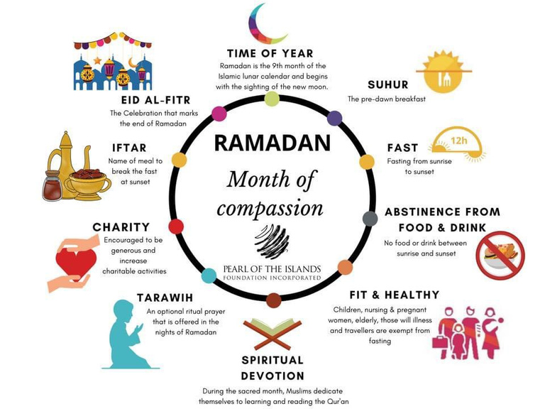
Ramadan at a Glance

Slide 10
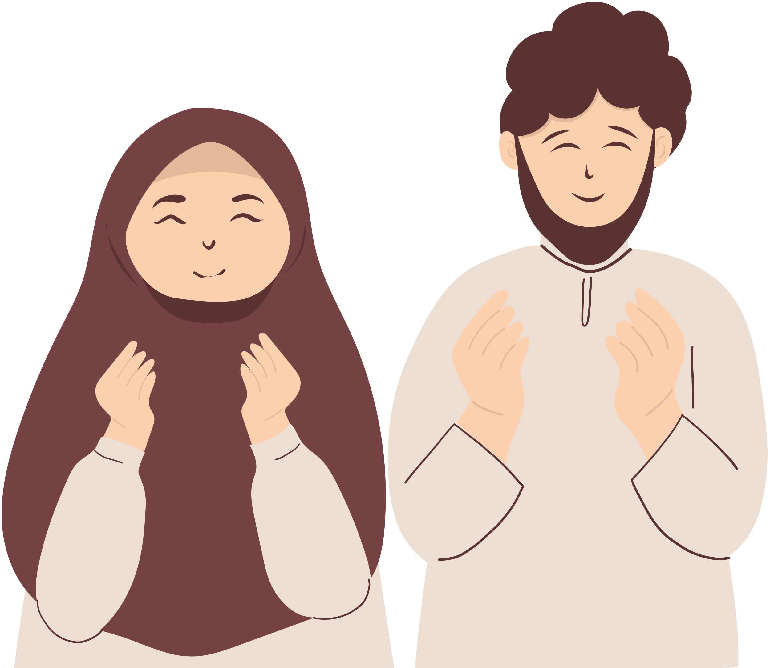
Islamic Dress Code During Ramadan
  During Ramadan, many people choose to dress more modestly, which may include wearing longer or looser clothing.
  Women may wear a hijab, niqab, burka, or abaya, while men may wear a topi (hat) or thobe
  Commenting on someone’s attire can be uncomfortable. For example, saying, “You look better without a hijab” is not a compliment, it can feel invalidating and disrespectful.
  It is important to note that not everyone will wear Islamic attire, and that is okay. Everyone’s journey is personal and solely between them and God.

Slide 11

Salah
  During Ramadan, many students and staff are steadfast in observing their Salah (prayers). Please allow them to leave promptly for prayer when needed.
  When allocating a space for prayer, it should be clean, quiet, and free from disruptions. People should avoid walking in front of those praying as it is considered disrespectful in Islam.
  The Dhuhr prayer (the second of the five daily prayers) takes place during school hours. Please refer to the Ramadan timetable in the previous slides for the exact time.

Slide 12
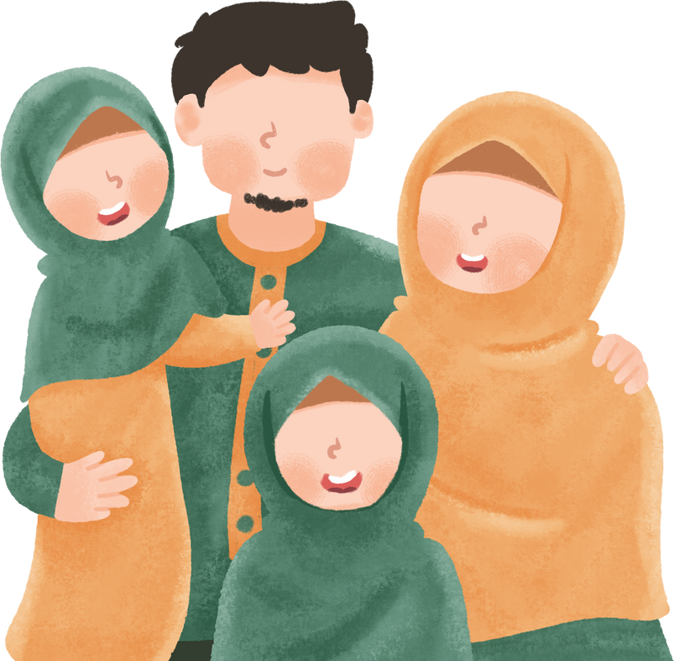
Exemptions from Fasting
  During Ramadan, some practicing individuals may eat or drink during the day because they are exempt from fasting.
  Please avoid asking, “Why are you not fasting?” as it can be personal and may cause discomfort.
  Fasting exemptions apply to:
    Menstruating individuals
    Pregnant and nursing women
    Elderly individuals
    Travelers
    Children
    Those with medical conditions

Slide 13
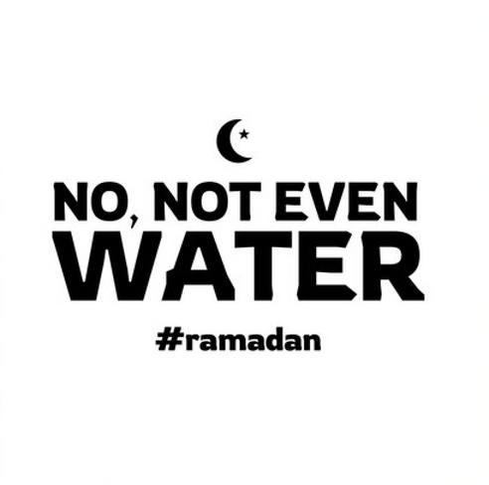
What NOT to Say to Someone Fasting 🚫
Examples of insensitive comments and why they might be uncomfortable:
    “Not even water?”
    “I could never do that!”
    “You must be starving!”
    “You don’t look Muslim, why are you fasting?”

Slide 14

How can you be supportive?
Understanding
  One of the most important ways to create a safe and inclusive environment for Muslim students during Ramadan is by educating yourself about the month.
  Many teachers and classmates may not fully understand why Muslims fast.
  It’s essential to build your own understanding rather than relying on Muslim students to explain Ramadan to the class.

Slide 15
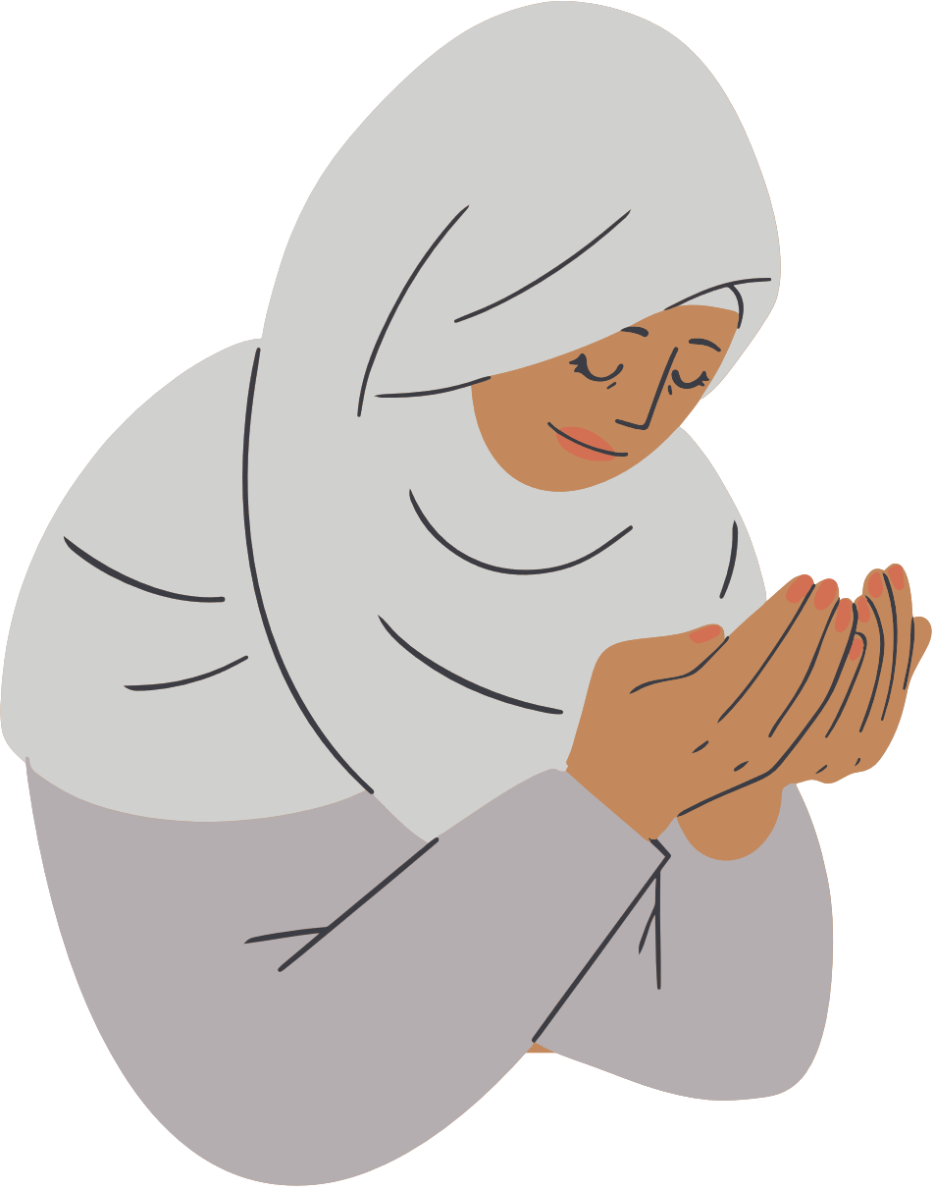
How can you be supportive?
Space
  Lunchtime can be particularly challenging for fasting students, as hunger may intensify when surrounded by others eating.
  Lunch monitors/supervisors: Be mindful that fasting students do not eat or drink during lunch. Avoid penalizing them or asking, “Why are you not eating?”
  Providing an alternative space for fasting students can be beneficial. This space can serve as a quiet area for resting, praying, or engaging in other activities to pass the time.
  Participation is optional, but having this space available ensures students have a supportive environment.

Slide 16


How can you be supportive?
Accommodations
  Practicing one's religion while having the necessary conditions to succeed academically is a fundamental right.
  Teachers can offer accommodations to support fasting students, such as:
    Physical Education (PE): Allowing students to walk instead of engaging in strenuous activities.
    Foods Class: Providing an alternative task instead of requiring participation in a food lab.
  Accommodations should be optional, allowing students to choose what best suits their needs.

Slide 17

How can you be supportive?
Empathy
  True empathy involves understanding and acknowledging the experiences of others.
  When planning school activities and events, consider their impact on practicing students.
    Will anyone feel left out?
    What steps can you take to make activities more inclusive?
    How can you better support your school community?
  Small adjustments and awareness can make a meaningful difference in fostering inclusivity and respect.

Slide 18
“If students have the right accomodations and support from teachers and their peers, it can turn a challenging month into the most rewarding.”
-Rasul Alrubail
(Alrubail, 2019)

Slide 19
Ramadan
M U B A R A K

Slide 20
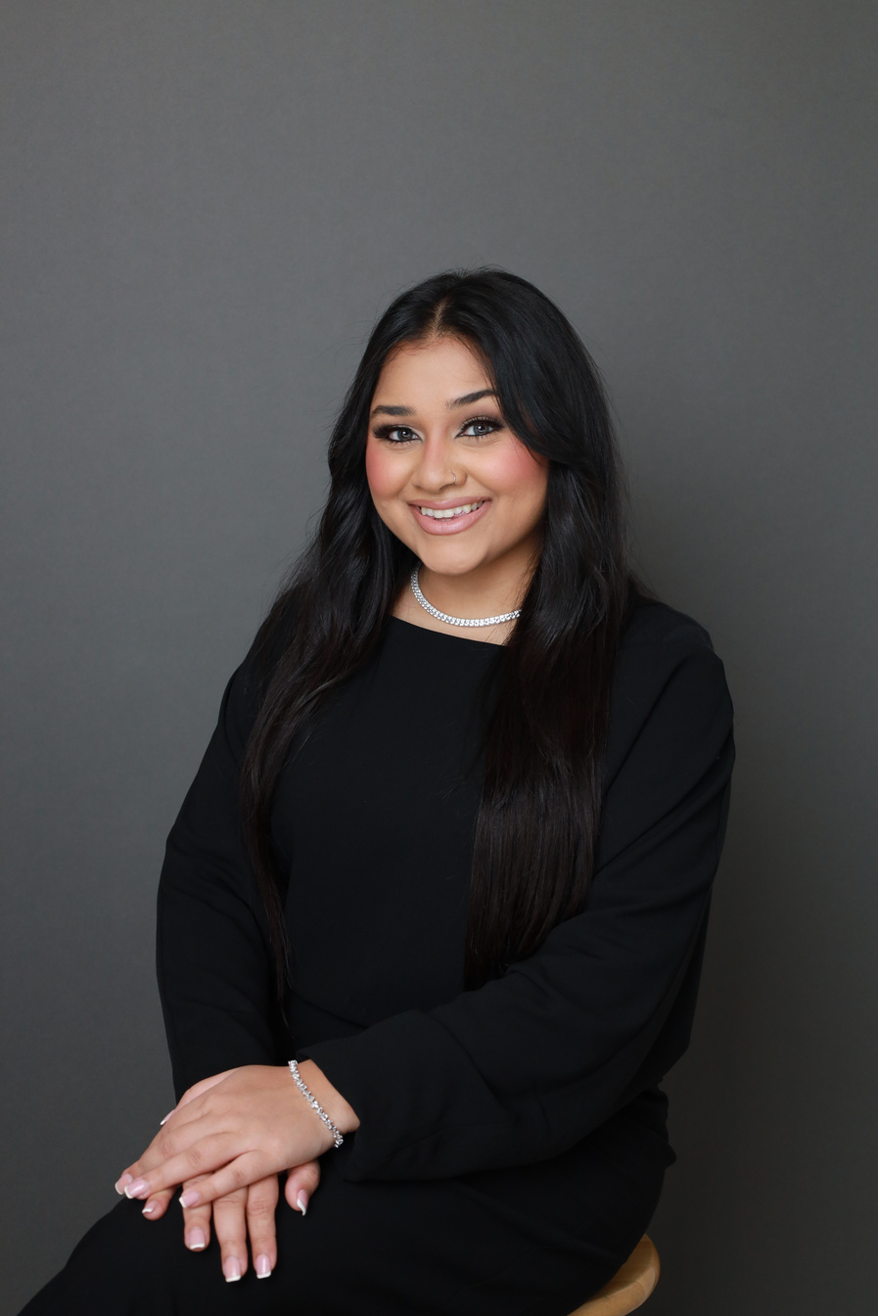
Bridging Education & Inclusivity
📸 My name is Zahraa Dean, and I’m currently a student teacher in the PDP program at Simon Fraser University while on education leave from my role as an Inclusive Education Support Worker (IESW) with Surrey Schools.
🌙 As a practicing Muslim, I am passionate about fostering inclusivity and ensuring that all students feel supported in their learning environments.
🙏 I hope this resource has provided valuable insight into Ramadan and how we can collectively create a more welcoming and understanding school community for those observing it.
dean_zahraa@surreyschools.ca | zdean@surreyschools.ca

