Slide 1

Welcome to Kindergarten
Big Steps for Little Learners
We can’t wait to welcome you in September

Slide 2


Welcome to Latimer Road
We can't wait to meet you!

Slide 3
Our Team
Ms. McCracken – Kindergarten Teacher
Ms. Kavanagh – Kindergarten Teacher
Ms. Losse – Kindergarten Teacher
Ms. Cox and Ms. Oliver – Kindergarten/Grade One Teachers
Ms. McKenzie – Learner Support Teacher
Ms. Fett – Learner Support Teacher
Ms. Vaillancourt – Indigenous Support Worker
Ms. Avetisan – Integration Support Teacher
Ms. Donaldson – Integration Support Teacher
Ms. Sahota – Integration Support Teacher
Ms. Starr – Teacher Librarian

Slide 4
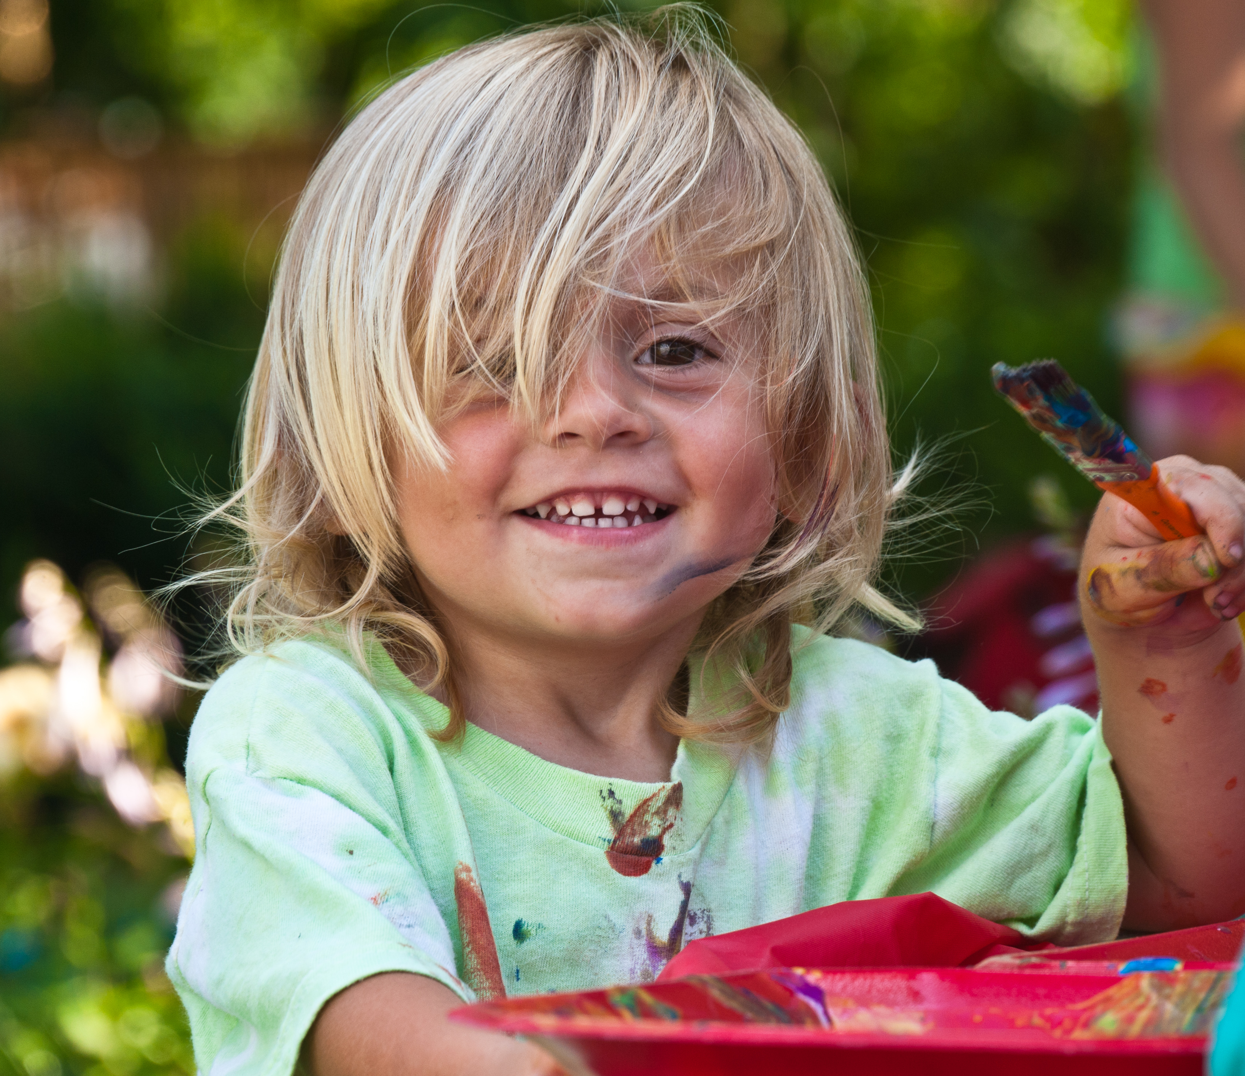
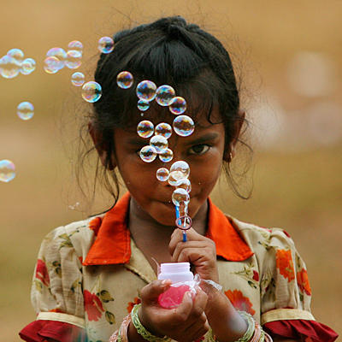
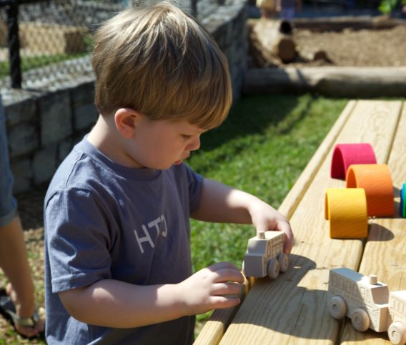
The Importance of PLAY!
Play is an essential element that runs through each aspect of development
Notes:
Playmaking brings children a greater awareness and understanding of the world in which they live (Burke, 2019). It is integral to well-being and learning and is social in nature.
When you enter a kindergarten class you will notice, see, hear and feel many things:
* You will notice books, play centers, creative materials, and science exploration tools.
* You will see your child participating in many forms of play which involve creating, exploring, dramatizing, observing, building and more.
You will hear them socializing with others as they exchanging ideas, solve problems and communicate.
You will hear them asking questions and express delight as they create something new.
* And you will feel a mix of emotions as your child embarks on this new journey.
The new Early Learning Framework is from 0-8 and play is embedded in all early learning and beyond. Older children tinker, create, explore.
Play can reduce stress, increase calmness, maintain social and emotional equilibrium, build coping skills and resilience, produce subjective feelings of well-being. Children's play promotes optimal language development, thinking skills, creativity, and physical, social and emotional skills in early and middle childhood (Early Learning Framework).

Slide 5


Foundations of Learning: Supporting the Whole Child
Social and Emotional
Language and Communication
Cognitive
Physical
Notes:
Children learn in mind, body and spirit (ELF).
* Learning involves supporting the whole child – social/emotional, cognitive, language/communication, physical. It is focused on building relationships, on connectedness and fostering a sense of community.

Slide 6

Communication and Oral Language
Speaking
Listening
Sharing
Communicating
Socializing
Negotiating
Notes:
Oral language development is an important part of emergent literacy. Children learn how language has a purpose and is used in different contexts. They learn how to share their ideas, communicate, and how to socialize with others. They begin to understand how sounds and letters are linked and they begin to make sense of how reading and writing fit in with their social world.
Things you can do to support oral language:
Encourage them to talk, talk, talk
Encourage your child to share their thoughts and feelings (builds confidence)
Actively listen to your child's message
Model good listening and ways to communicate
Model how they might talk about what they are learning
Use positive language
Extend conversations by asking questions
Offer access to games and activities that give may opportunities to chat, listen and discuss
In Indigenous cultures, knowledge was traditionally shared orally and sharing stories orally is still important today.

Slide 7
SPEECH MILESTONES
Average age children learn to pronounce English consonants correctly
(Based on 15 English speech acquisition studies compiled by McLeod and Crowe, 2018)
6 YEARS
th (voiceless)
5 YEARS
r, zh, th (voiced)
4 YEARS
2-3 YEARS
Eg. thank you, thumb, bathroom, teeth
Eg. this, feather, breathe
l, j, ch, sh, s, v, z
p, b, m, d, n, h, t, k, g, w, ng, f, y

Slide 8
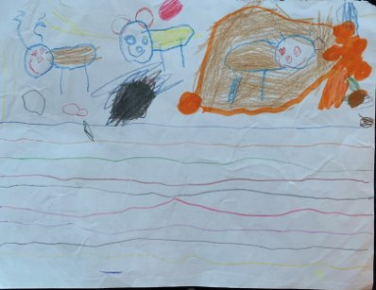
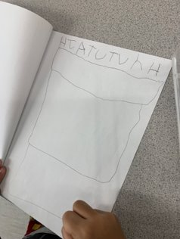

Emergent Writing
Drawing
Scribbling
Forms that resemble letters
Random Letters
One letter to represent a word
Familiar words
Notes:
Never underestimate the power of a good scribble. Each child works through the developmental stages of writing at their own pace. It is important to encourage where they are at. Encouraging your child to begin with drawing their ideas, stories and thoughts is important. You can also begin to talk about letters and sounds and if they are drawing a cat, you can model sounding it out and encourage them to write down any sound they hear. If they hear a "c", that should be celebrated. If they only here a "t" that also should be celebrated.
What is important is to celebrate and encourage all attempts and provide opportunities to practice. We are trying to build confidence and encourage risk taking in these early stages. Modeling writing is another way to share how writing is part of our every day world – grocery lists, letters, notes, etc. are all natural ways to model writing.
Things you can do to support emergent writing:
* Provide tools for literacy - Provide paper, crayons, pencils, markers, paints, booklets
* Provide opportunities to write – play restaurant with a note pad, write pretend mail, make letters with rice or macaroni, etc.
* Create stories together by drawing, using puppets, story boards, retelling familiar stories, dress up (dramatic play), make books together – they draw picture – you write text
* Encourage them to see, copy or write their name whenever possible – e.g. On their bedroom door, signing cards

Slide 9

Emergent
Reading
Exploring books
Looking at pictures
Retelling stories in their own words
Recognizing rhyme
Recognizing alphabet letters and sounds
Recognizing environmental print
Connecting, visualizing, questioning
This Photo by Unknown author is licensed under CC BY-ND.
Notes:
As children begin to explore books, they start by simply turning the pages and looking at the pictures. They then may begin to retell stories in their own words and wordless books are a wonderful way to encourage them to look at the illustrations for clues as to what the story is about. They may then start to recognize familiar letters or words, or they may memorize familiar books. As you read or explore books, encourage your child to make connections to what they already know or their own experiences, have them make pictures in their minds (visualize) and ask questions as you go along to deepen understanding.
Ways to support emergent reading:
* Surround them with books: wordless, fiction/non-fiction, poetry, chants, humorous books, adventure books- read daily, visit the library,
* Point out familiar words in your environment (STOP signs, billboards, logos) - ask what letter does it begin with, what sounds do you hear
* Play I spy games – I spy..... something in the room that begins with R, something at the park that begins with _, something at the beach that begins with ___.
* Notice letters in the environment that match letters in their name

Slide 10
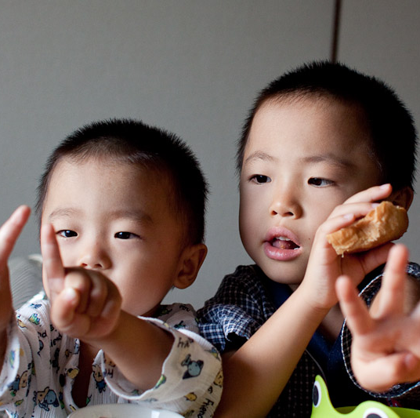
Emergent Numeracy
Part of everyday life
Problem solving
Logical thinking
Exploring number relationships
Notes:
Numeracy is the ability to reason with and understand math concepts that are relevant to our daily lives. Math offers an enormous repository of games and other play-based opportunities for learning and skill building. Estimation, patterning, observation, and number recognition are part of children's everyday lives. (Burke, 2019)
Research has revealed that "...children have surprisingly powerful everyday (informal) arithmetic knowledge" (Baroody & Dowker, 2003)
Things you can do to support Numeracy Development:
Numeracy Books – patterning, counting, nursery rhymes (1, 2 buckle my shoe), patterns
Board games require counting with dice and one to one correspondence. Hide and Seek – requires counting
Daily activities: Getting dressed – count everything they will put on, count fingers and toes. Meal time – Count the plates, ask how many forks will we need if there are 4 of us? Eating smarties – make a pattern, count stairs as you go up them, count cars as you pass by
Cook together – discuss counting, measuring and nutrition - bigger and smaller
Nature walks- notice patterns in forests, streams, in the community – Count trees, count cars, etc., sort leaves/rocks/etc. based on attributes, discuss smaller/bigger, same/different, go over, under, through

Slide 11
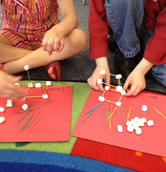
Critical and Creative Thinking
Generating new or novel ideas and concepts
Making judgements
Exploring materials
Gathering, assessing and analyzing information
Risk taking
Persevering
This Photo by Unknown author is licensed under CC BY-SA.
Notes:
Having your child participate in critical and creative thinking is integral to preparing them for 21st Century skills. Children will face jobs and challenges later in life that are not even imagined yet. Being involved in critical and creative thinking develops perseverance, curiosity, and innovation. They have to solve problems and collaborate to try to figure out what to do when they don't know what to do. This may involve the notion of try and try again – experiencing failure and persevering. This is where thinking outside of the box comes into play and where our future inventors and creators evolve from.
Example: Building a boat that floats on water – using boxes, tape, sticks, paper, plastic, etc. - Question – how many marbles can it hold, how will the water impact the materials, could you make a mast? Challenge: Who can make a boat that can hold the most marbles? - Perseverance
Things you can do to support Critical and Creative Thinking:
Provide open ended materials (loose parts) for creating (sticks, rocks, shells, cardboard tubes, popsicle sticks, buttons, pipe cleaners, boxes) - Not Just a Box
Plant a garden – use rakes, shovels, seeds – connecting with the environment – how much water, how much sun, how deep
Build and create – structures, forts, a boat that floats – a race track – test it
Make music using pots, pans, buckets, bells, spoons
Create a dance to your favourite music – perform it

Slide 12

Physical Development
Fine and Gross Motor Skills
Movement
Coordination
Outdoor Play
Notes:
It is important for children to participate in physical play as it develops fine and gross motor skills, helps them to develop an awareness of body space and enhances coordination.
There has been a reduction in play and this may be a contributing factor in rising levels of childhood obesity, as well as increasing incidences of anxiety, stress, and depression in young children (Hewes, 2014). When children are outside and enjoying the natural environment, this is another "classroom" for them to extend their learning and to build connections and appreciation of the land on which we live. Indigenous teachings and beliefs hold that the health of a human being is tied to the health of the land they inhabit so having our children play outside, respecting their environment and appreciating all that we can learn from our "outdoor classrooms" supports our well being.
Ways to support physical development:
* Fine Motor Skills: Using playdough, threading beads onto pipe cleaners, making a pasta necklace, using scissors, handling crayons
* Give them plenty of opportunity to play both inside and outside – at least one hour per day
* Engage in the world around you – the forest, the park, the playground. In the snow, the rain, in puddles
* Screen time should be limited to less than 1 hour per day from 2-4 and 2 hours for 5 and older. If you are using screen time, choose age appropriate apps/programs. Turn off all screens during family mealtimes and other family activities
*Little ones need lots of sleep, usually 10-12 hours a night. Start turning back the clock before school starts.

Slide 13

You've Got Mail
Sign up
Please sign up for the Surrey Schools App
Check
Check the Latimer Road Website for all important information
Receive
In June you will receive a package for your child's first weeks of kindergarten
Gradual Entry Calendar
Grouping Information for your child
School Supply list
Bell Schedule

Slide 14
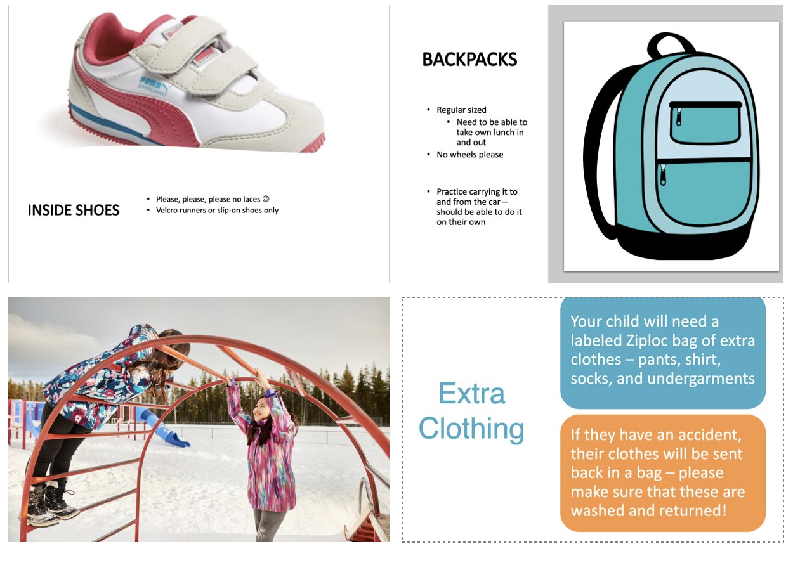

Slide 15

School Supplies
The teachers will be bulk ordering the kindergarten supplies this year. It saves money and ensures only supplies needed are purchased. In September you will receive a link to our Cash Online system to pay for your child's supplies.

Slide 16
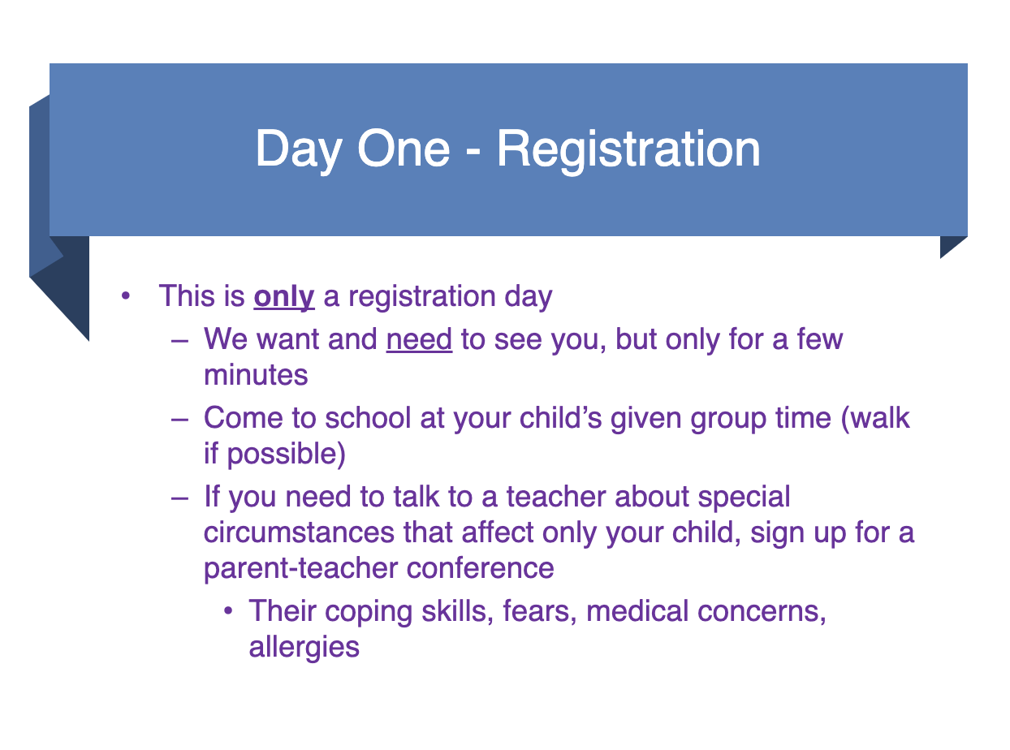

Slide 17

Classroom Assignments
We will work to have classes set in a timely manner
Students will attend full time on September 18, 2023 (8:30 – 2:30)

Slide 18
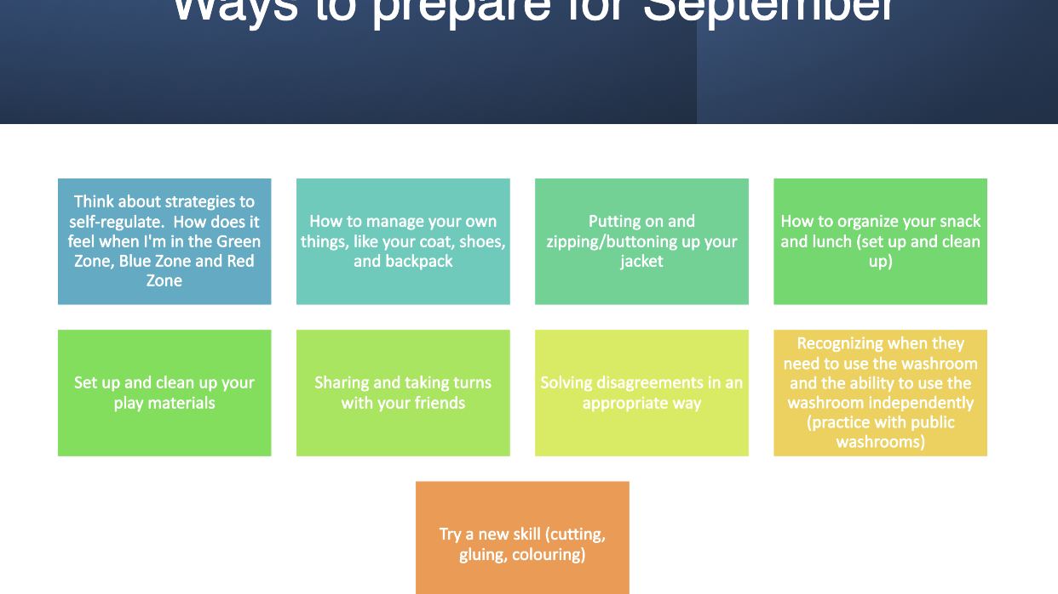

Slide 19
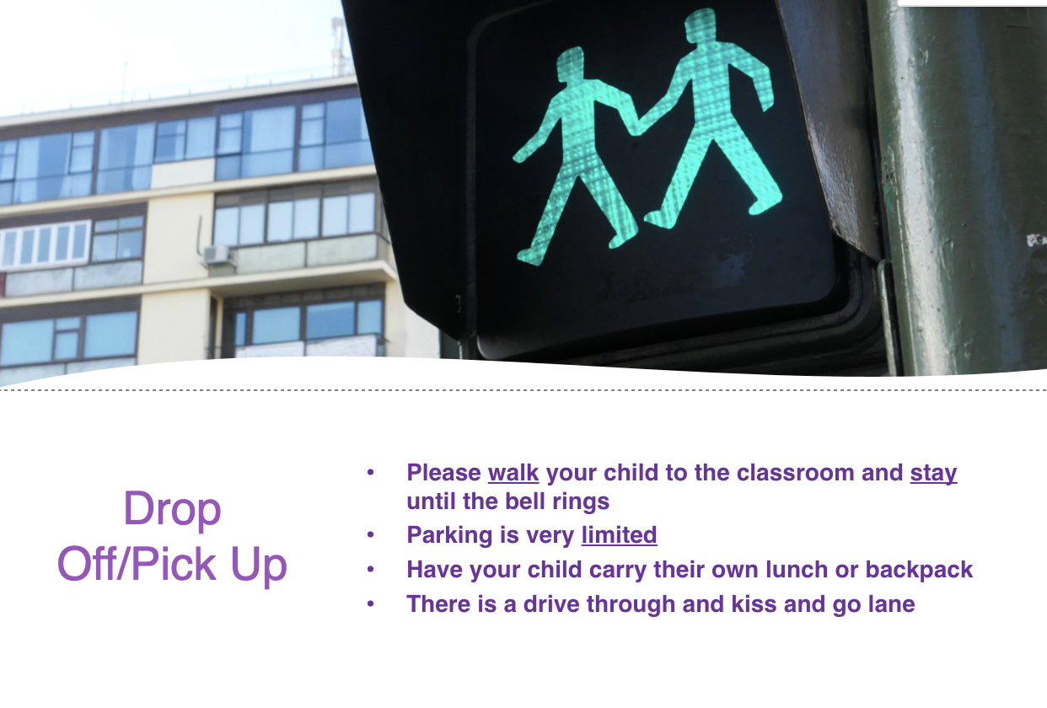

Slide 20

What you will experience when you walk through the door......
Gradual Entry Process
Relationship Building
Welcoming Conversations
Notes:
There will be a gradual entry process where each day your child attends for longer periods of time . This can take different formats but the purpose is to have your child gradually adjust to their new environment in small group sessions. Teachers will introduce children to classroom routines and procedures so they will feel comfortable and more at ease.
The teacher(s) will want to get to know you and your child – building relationships through welcoming conversations –
Your child will form a bond with teachers, other children, the school community
The school is preparing for your child's arrival and you are integral to that process - you are their first and most important teacher
We are a team, and we are eagerly preparing for your little learners arrival

Slide 21

Access More Services Through Our Community Partners
Options Community Services - First Steps - CCRR - Family Resource Programs
Fraser Region Aboriginal Friendship Centre
Metis Nation BC
Early Years HUB
Surrey Libraries
Notes:
Options - Provide early learning programs, resources and support for children and families. * Daycare, childcare, parenting support, counselling, family navigators.
First Steps - Provide resources, support, services and early years programs for refugee families.* Translation services, nutrition and health info, mental health counselling, settlement support.
Child Care Resource and Referral -Provide childcare information, services and support as well as early learning programs.* childcare benefits, parent education sessions, parent-child drop in, lending library, car seat clinics.
FRAFCA –- Provides resources, support, services and cultural connections for Indigenous families. *Family Nights, Elders, cultural activities, preschool, parenting programs.
Metis Nation BC - Provide resources, support, services and literacy programs for Metis children and families.* Family connections, well-being program, funding opportunities, imagination library.
Early Years Hub - Provide early learning programs, resources, supports, and early assessments of your child’s development. Family Navigators.
Surrey Libraries - Provide books, activities, story time sessions, and much more for families and children of all ages.

Slide 22
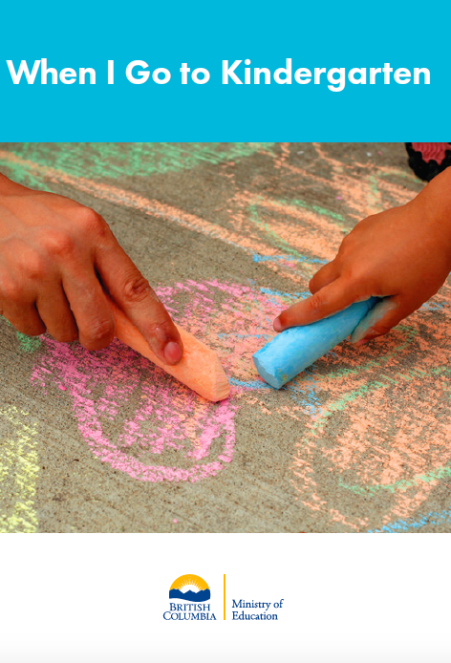
Additional Information for Families
When I Go to Kindergarten
Early Learning Framework – A Guide for Families
Let’s Play – Activities for Families
Appetite to Play
First Peoples Principles of Learning
Surreyschoolsone.ca - For ideas to support learning at home
Notes:
There are numerous resources you can access to support your child's transition into kindergarten.

Slide 23


Slide 24
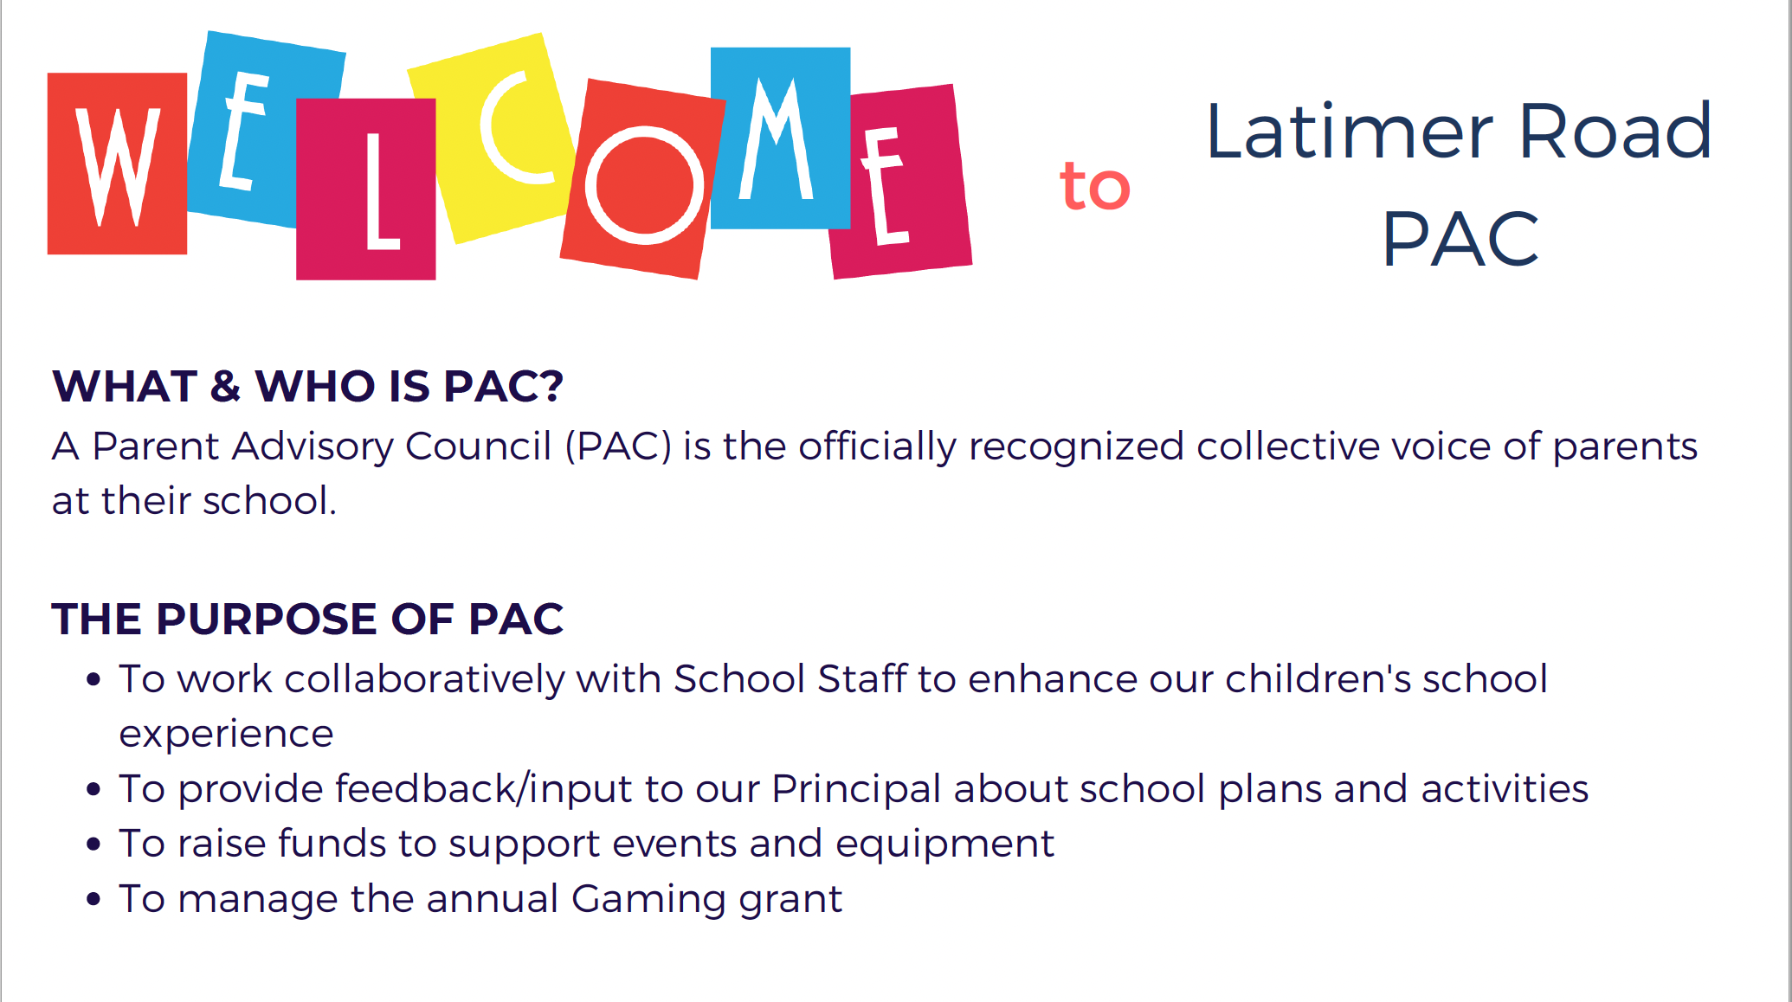

Slide 25
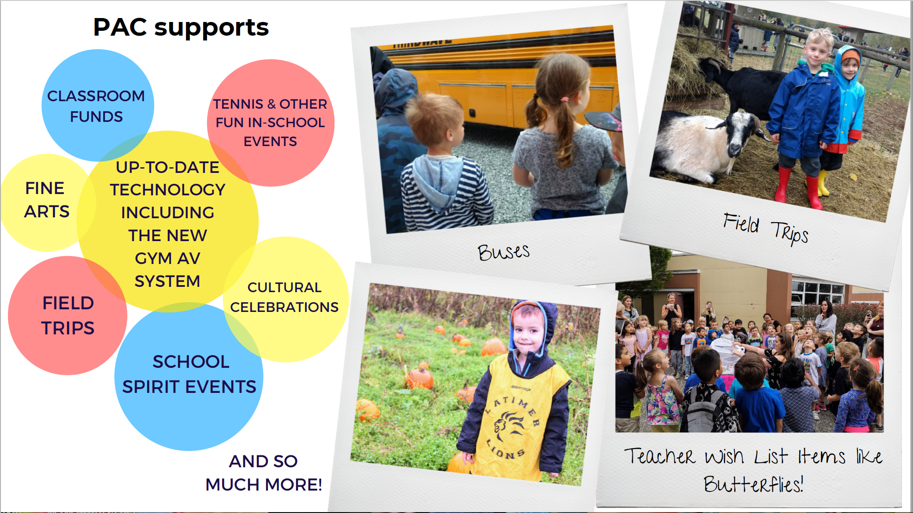

Slide 26
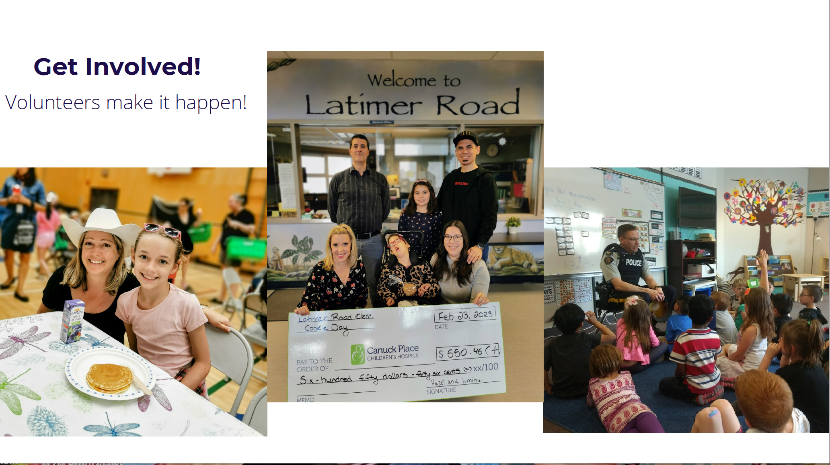

Slide 27
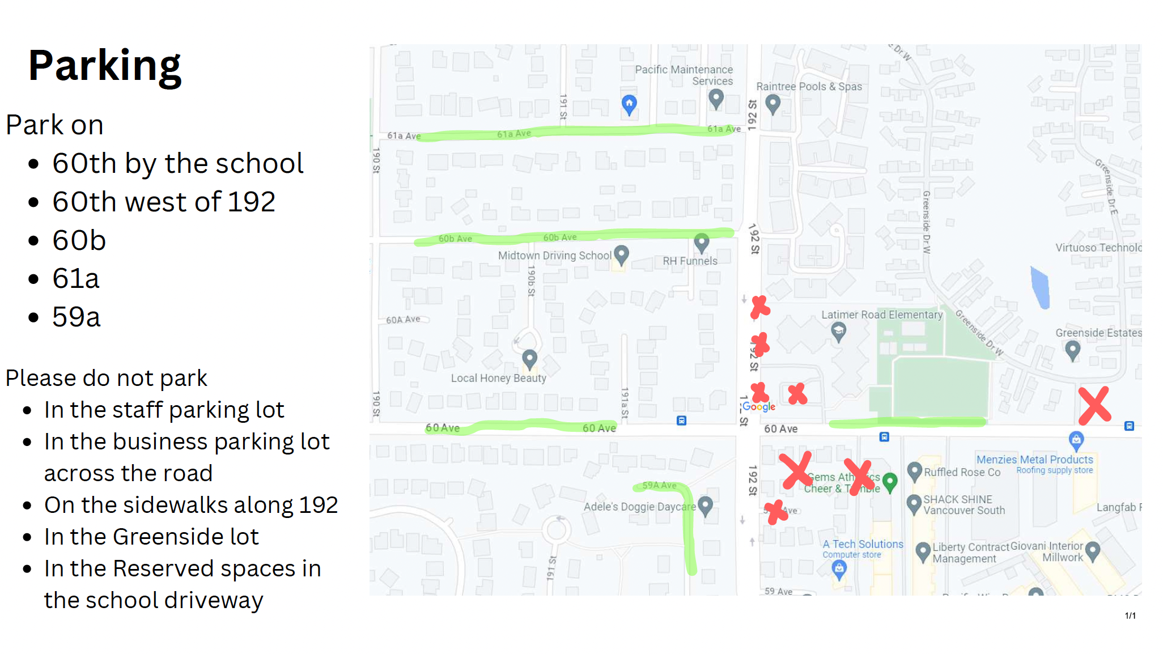

Slide 28
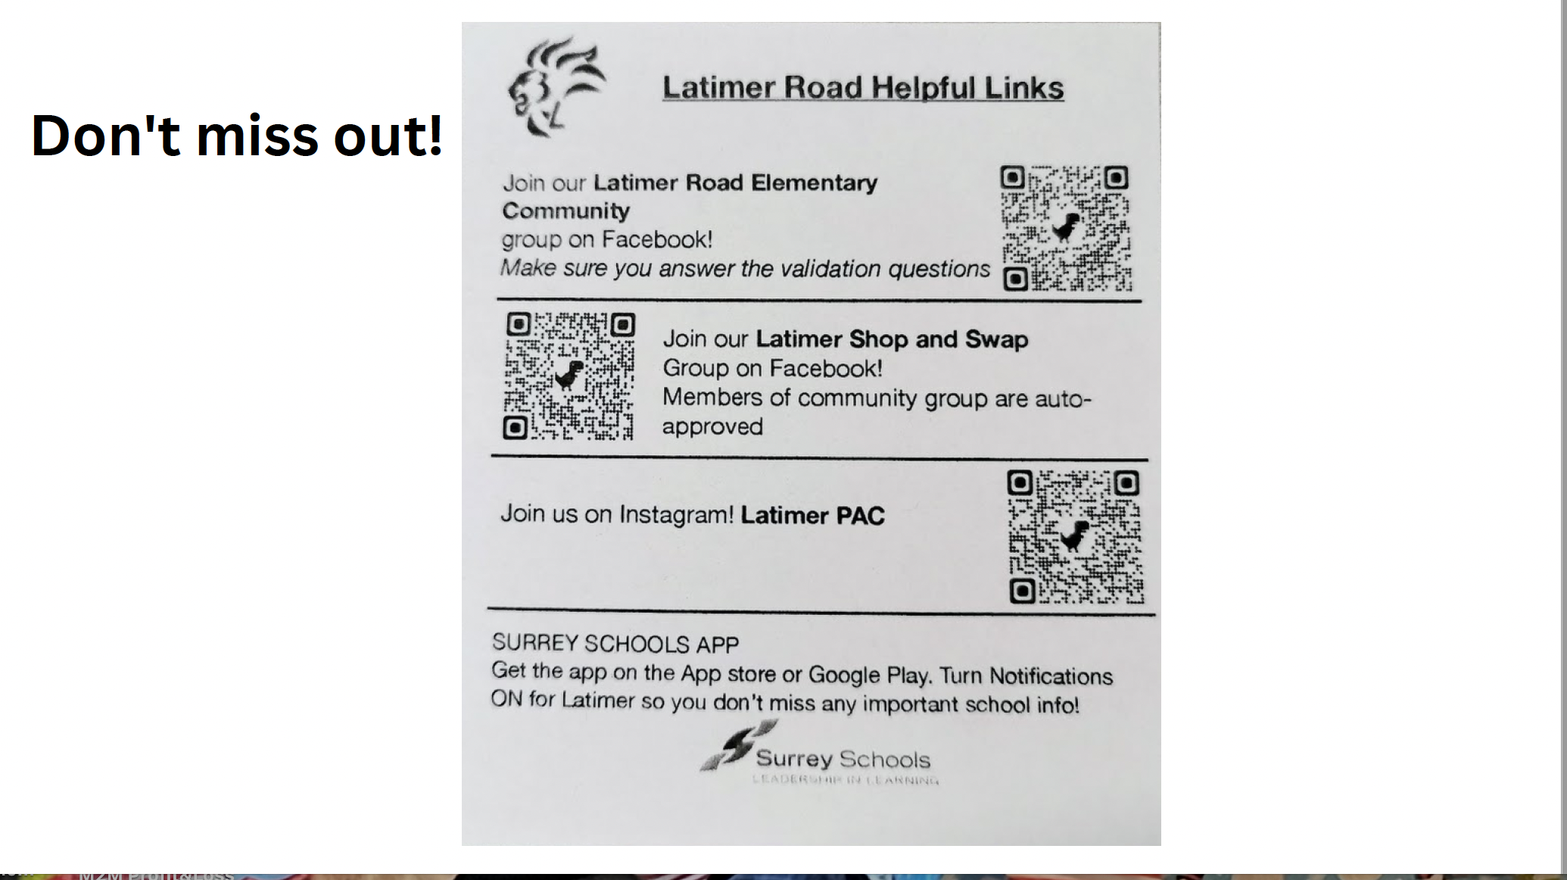

Slide 29
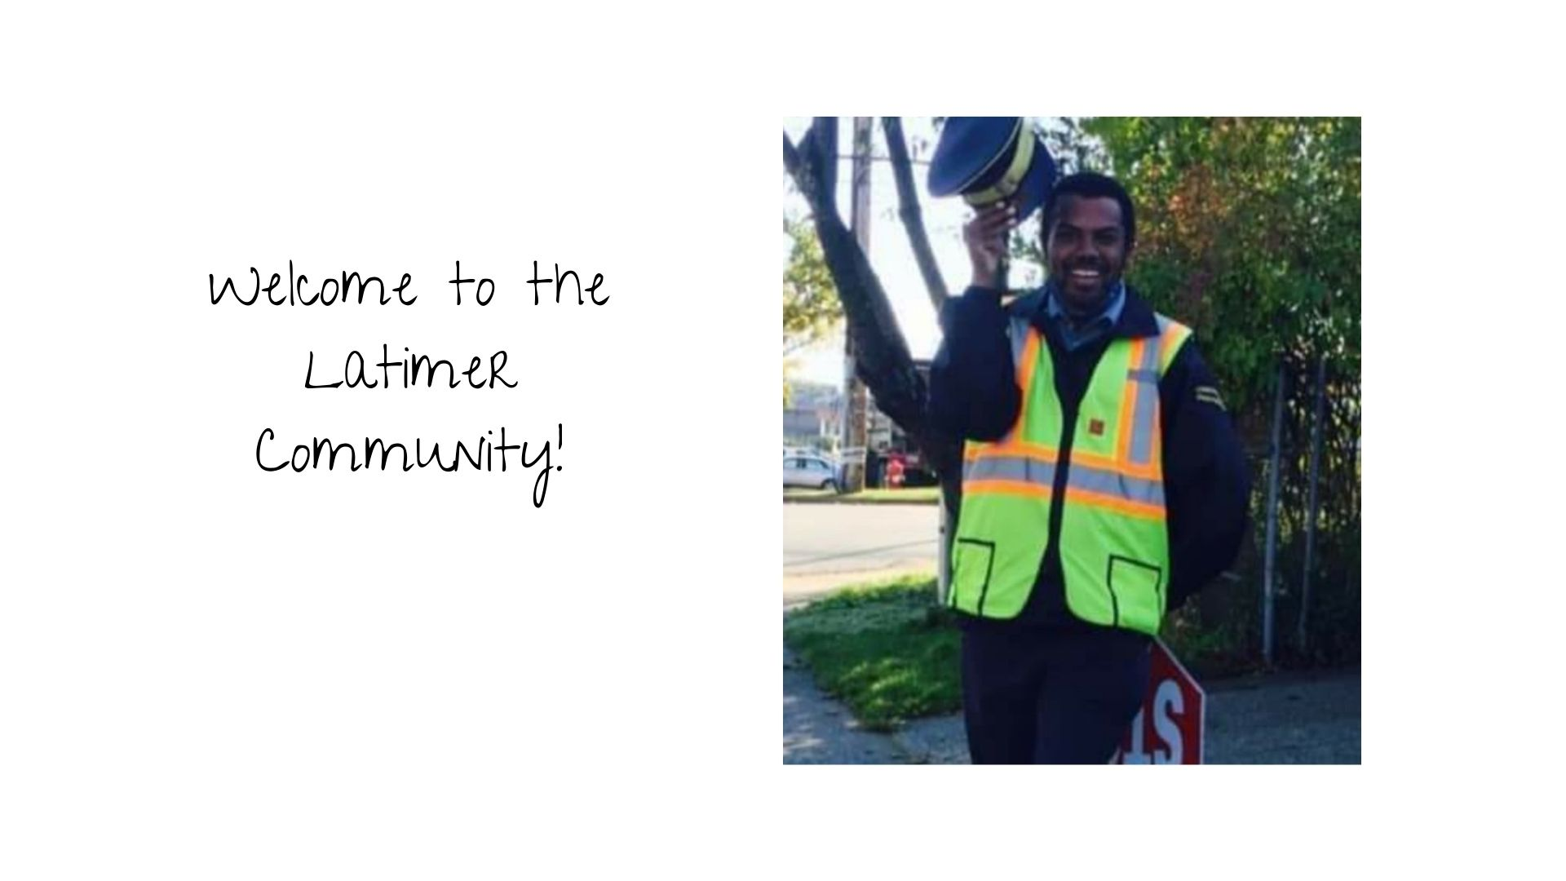

Slide 30

We look forward to seeing you in September!

