Slide 1
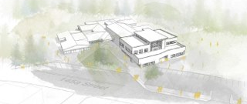
Community Meeting
November 20th 2023

Slide 2
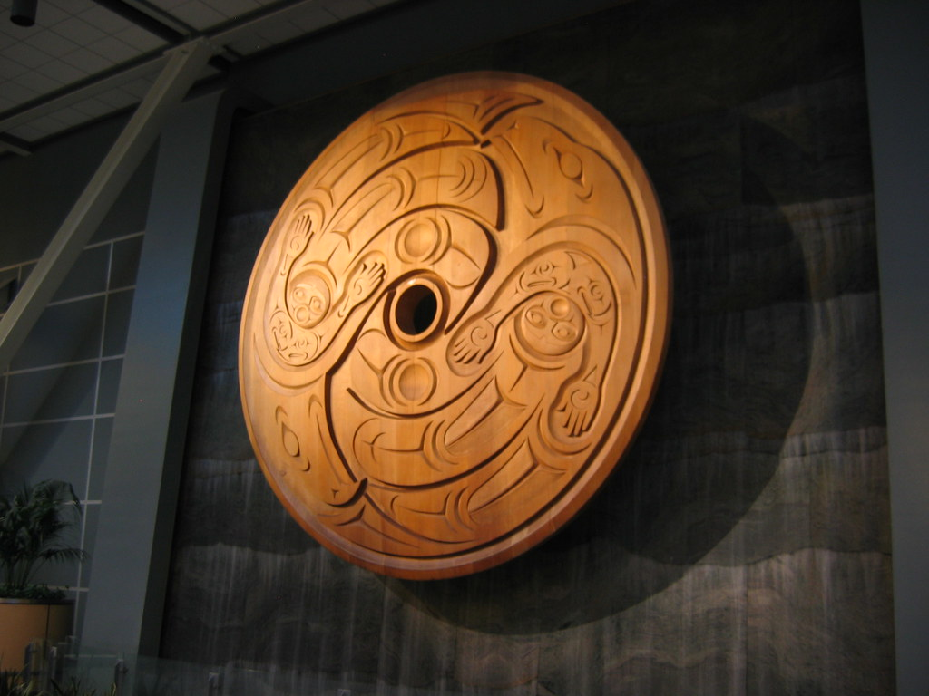
Ey' Swayel

Slide 3
Karen Fadum Principal
Katie Clark Vice Principal
Neder Dhillon Assistant Superintendent
Capital Projects Office
Sheetal Basra Capital Project Manager
Trevor Wong Associate Director, Construction

Slide 4
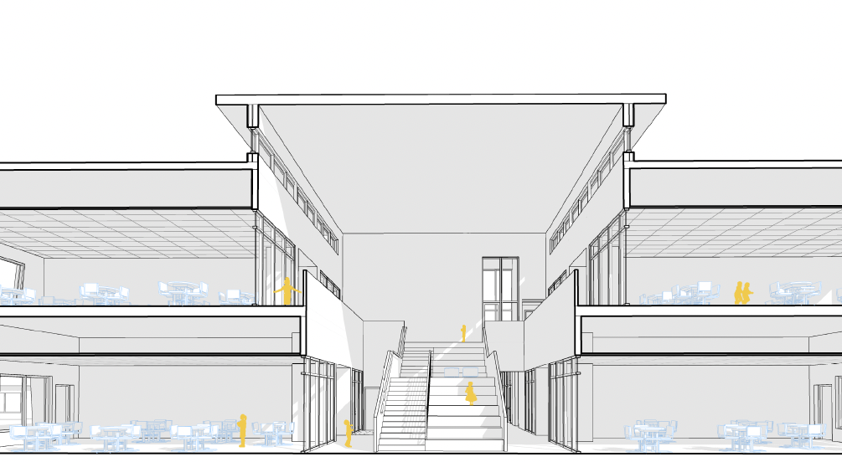
Semiahmoo Trail Elementary Addition
Space for 250 more students
10 New Classrooms
Opening Fall 2024/Winter 2025

Slide 5
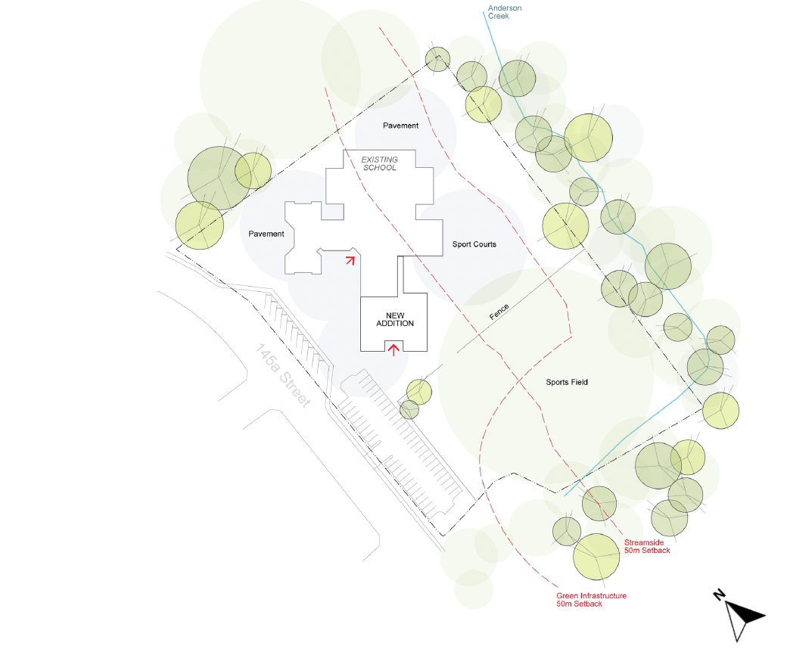
Environmental Restrictions

Slide 6
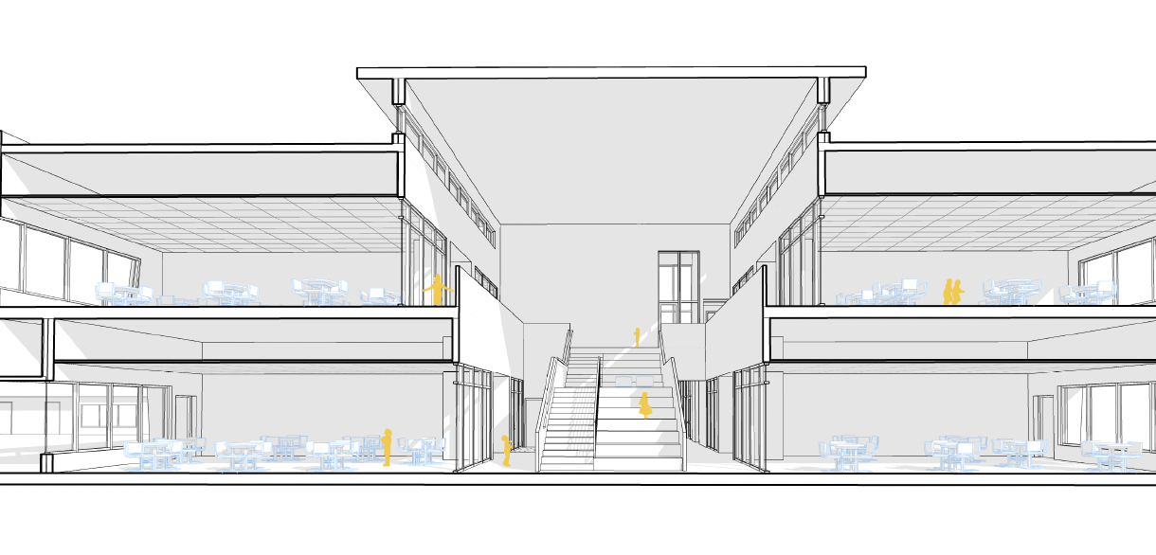
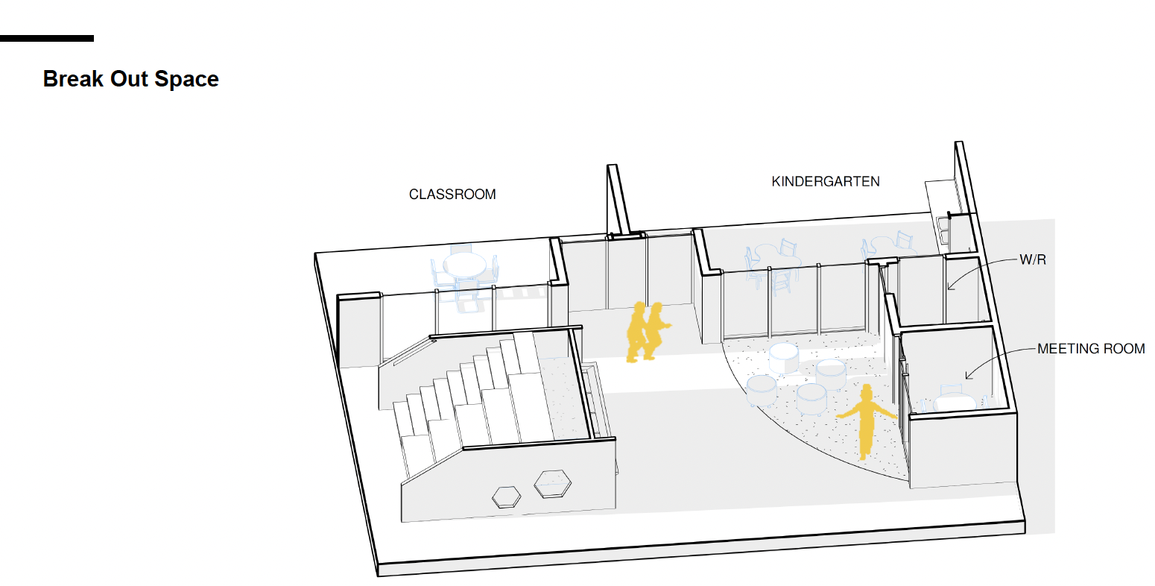
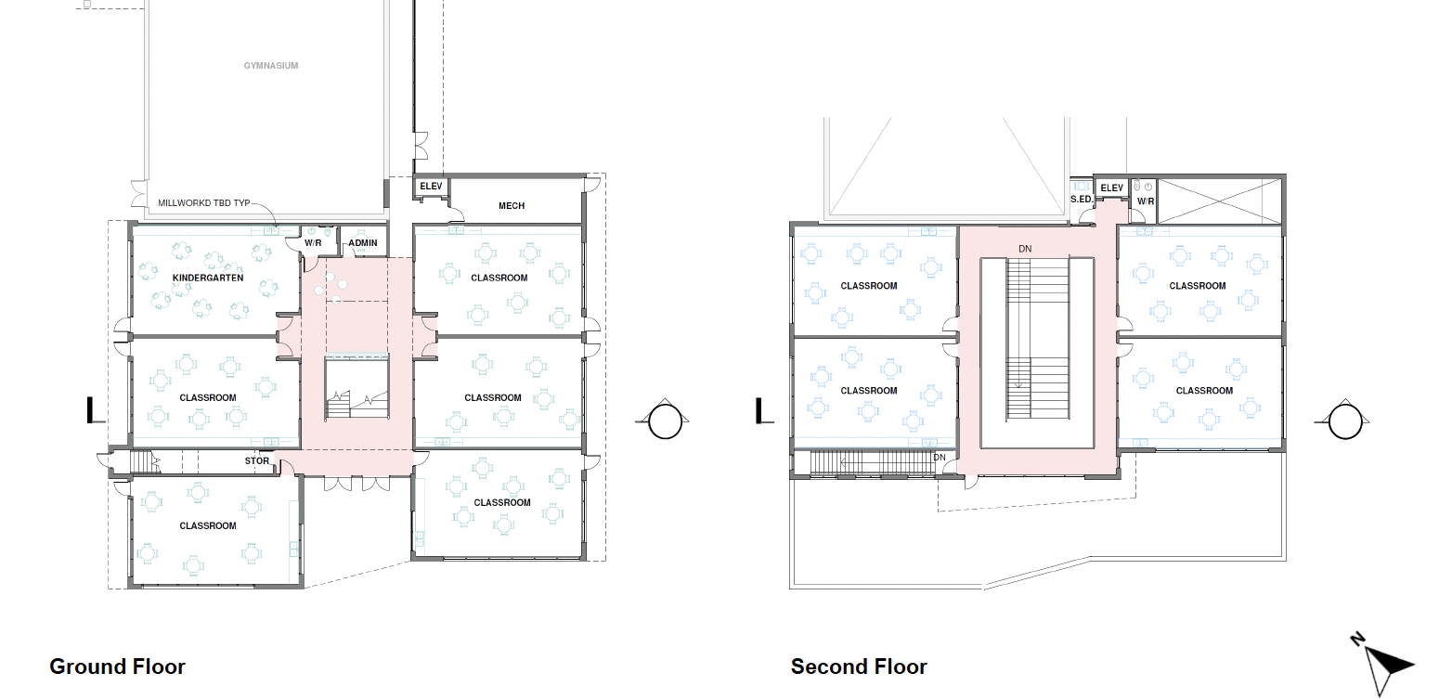
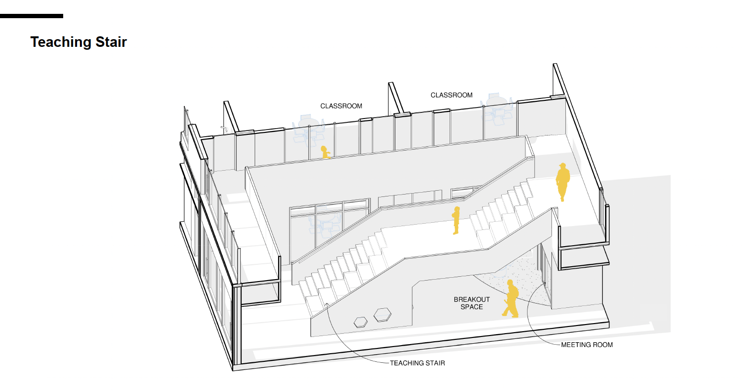

Slide 7
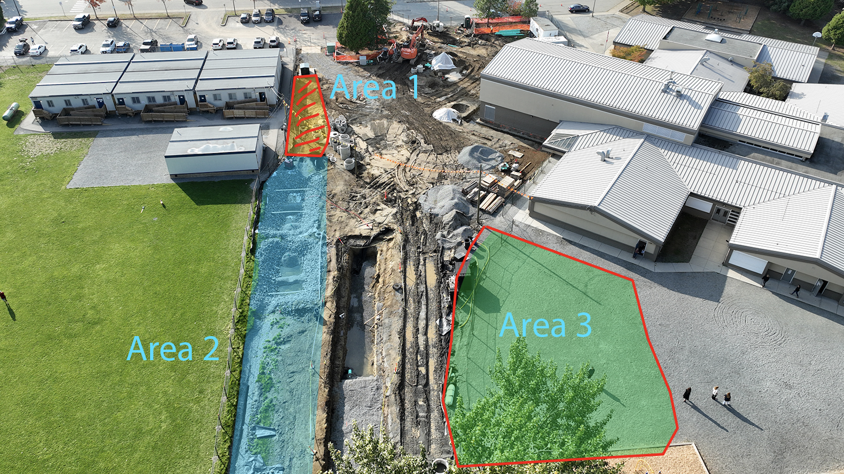

Slide 8
Current Concerns (Feedback from Community)
 | Heavy machinery and proximity to children. Children crossing paths with construction vehicles Close proximity of portable #1&7 to construction site now through future phases. Site safety supervision from construction group limited Criminal Records Checks Kids in portables are not being supervised when they have to walk to the main building No additional supervision from school/district. We now have a Supervisory Aide monitoring area 9am-2pm until there is a path away from the road. The work seems to be only done when kids are in school Keeping community informed

