Slide 1
Core Competency Self- Assessment #2
February 2024

Slide 2
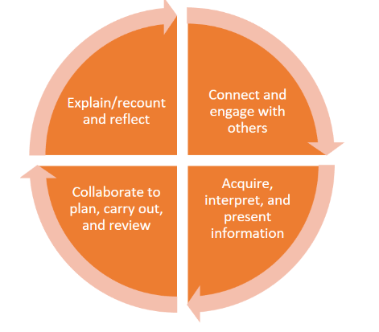
Core Competency Focus: Communication

Slide 3
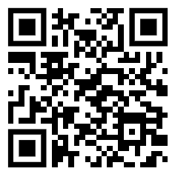
How to Find and Complete the Self-Assessment
Go to: https://ca.spacesedu.com/?lang=en – Make sure you are on the Canadian Site (Canada flag in top corner)
Login using surrey schools username and password, a pop up will appear for you to type in your password.
If you are using Safari you will need to disable the pop-up blocker by going to
General Settings >>> Safari >>> Selecting the toggle to “Off” to allow pop ups
You will need to close all of your tabs and go to Spaces again

Slide 4
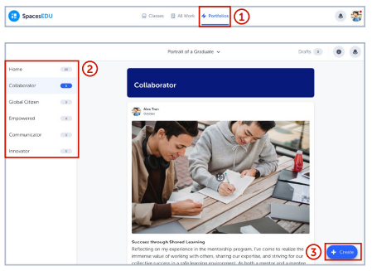
How do I access my portfolio?
Click the Home button in the top right corner
From your Dashboard, click Portfolios in the top navigation
Click into your Portfolio “Core Competencies Self-Assessment”. Click on the Communication (February) folder.
Review the instructions and links that will support you in creating your first artifact
When you're ready, click Get Started in the top right

Slide 5
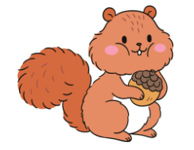
In a nutshell:
1. Find an example of growth or success in communication.
2. Explain why you chose the example. Why are you proud of it?
3. Identify a goal and how you will get better in the way you communicate or collaborate.
Upload your work to Spaces!

Slide 6
To Help You Get Started: I Can Statements and Reflection Examples
Two documents containing examples to help you get ideas and see what your self-assessment COULD look like are available on Spaces.
Refer to the list of “I can” statements provided for some examples of ways you may have experienced the communication core competency. Think about how you may have demonstrated and grown in your classes, as parts of clubs/teams, or during school events, etc.
You can also refer to the reflection examples provided if you are unsure as to how the final product will look. Remember, you can showcase your learning and growth in many different ways!

Slide 7
1. Find an example of growth or success.
The example or artifact should demonstrate success or improvement in your ability to communicate this year.
How will you know?
Classroom discussions
Talking to friends
Asking your classroom teachers
Exploring examples (online)
Once you have identified your example, upload a picture, file, audio clip, or write a comment to show or describe your artifact to your portfolio.

Slide 8
2. Explain why you chose the example/artifact.
Describe how the example or artifact that you chose shows personal growth or success.
You can choose to use the sentence starters to help you explain.
The example that I chose …
shows that I can....
I show this by….
Type your response into spaced directly, take a picture of your written response, upload a typed document, or upload an audio clip of your explanation

Slide 9
3. Identify a goal to work towards improving your communication core competency
I can continue to work on this competency by…
Specific ways I will work towards my goal(s) include….
Add your goal setting to your portfolio using a method of your choice

Slide 10
