Slide 1
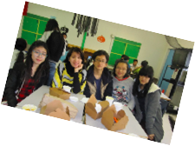
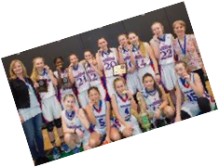
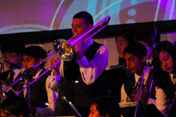
Welcome to Semiahmoo!!
Grade 7 PRESENTATION for September 2023

Slide 2
A word about our name
In 2021/2022, Semiahmoo Secondary changed its mascot to the Thunderbird.
We are no longer the Totems
This renaming was done with our local Semiahmoo First Nation, and better reflects their history and culture here on the peninsula.
Out of respect for the band, we no longer shorten the name Semiahmoo to Semi. Using the unabbreviated word shows respect to the peoples that have allowed us to use their name.
GO SEMIAHMOO THUNDERBIRDS!!!!

Slide 3
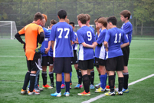
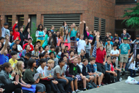
Best Things about SEMiahmoo ~ A change from Elementary School
Multiple classes/multiple teachers
1400 plus students
More Clubs and Teams (Non-Covid times)
Cafeteria
3 gyms/multiple fields/weight room
Youth Room
Semester system

Slide 4
Explore some new Options
For next year, you will choose between two electives for your classes.
Band Elective- Taking Band, choose this option! Your other elective will be an Explorations Elective.
No Band- Explorations Elective ~ choose this option if you are not taking band. (If you don't take Band you will take the Fine Arts Rotation instead)

Slide 5
Option 1: Band
Choose this option on your course selection sheet if you would like Band in grade 8

Slide 6
Option 2: Explorations
Choose this option on your course selection sheet if you would like to explore Fine Arts and Applied Skills

Slide 7
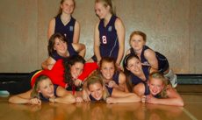
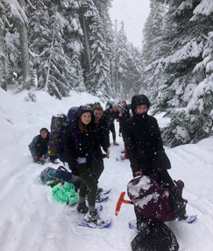
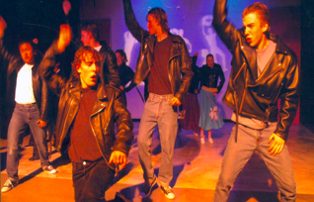
Make your time at Semiahmoo great ~ get involved
Clubs ~ Take your pick, there are so many at Semiahmoo!
Teams ~ play volleyball, basketball, soccer, join track and field etc.
Volunteer and Leadership Opportunities

Slide 8
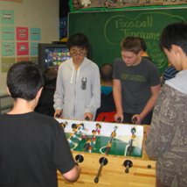
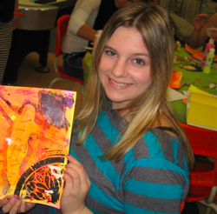
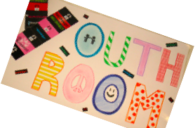
Youth Room
Open at lunch for drop in activities
Full time Youth Care Worker
Girls GAB
Hang out and play foosball, air hockey and video games

Slide 9
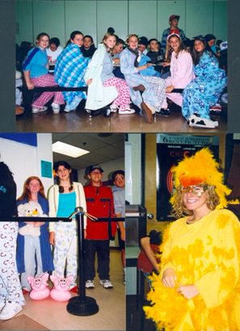
Have Fun!!!
Spirit days
Hoe down
Grade 8 day
Pancake breakfast
Pep rallies
Christmas breakfast

Slide 10
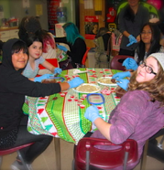
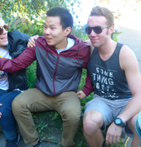
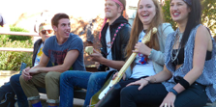
MAKE NEW FRIENDS
Meet new people from many different elementary schools.
Grow lifelong friendships!!
Join the Semiahmoo community
Meet others through TEAMS and CLUBS

Slide 11
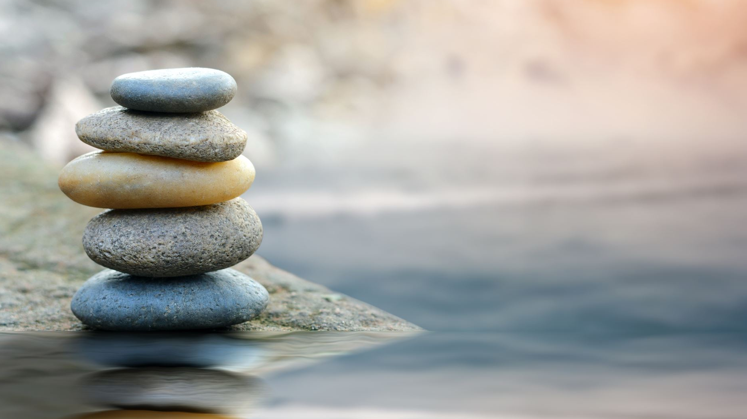
Most Importantly: Have Balance!
Spend time with friends, family, team and classmates
Get outside! Be active!
Regulate your screen time
Homework is important, but down time and fun is just as important. Spend time on both.
If finding balance is difficult, or you feel stressed, talk to a trusted adult, or your counsellor—do this earlier rather than later. We are here for you.

Slide 12
A Video Tour of Semi – made by Grade 7 teachers from Bayridge Elementary (15 min)

Slide 13
FAQs:
1) What does the daily schedule look like?
You will have four courses at a time, for 5 months each. You will have two classes in the morning with a short break in between, then lunch time, then another two classes in the afternoon with a break. After 5 months you will switch to four new classes. You will have a total of 8 classes in grade 8.
2) What about lunch time?
You will have a 40 minute lunch time in the middle of the day. You should bring your own lunch, or you can buy your lunch from the cafeteria. Normally you can eat in the caf, at your locker, The Youth Room, or at a bench in the halls with your friends, but depending on covid, you will need to be spaced out for social distancing.
3) Can I go home for lunch?
Yes, you can go home as long as you will be back in time for your afternoon class. Also, remember a lot of activities happen at lunch, and you might miss out if you are always going home.

Slide 14
FAQs Continued:
4) What if I can't find my classrooms?
DON'T WORRY! Just find a teacher or adult and they will show you where to go. It will take you a few days to find out where everything is, but then you'll be a pro!
5) Will I get stuffed into a locker?
This is a myth! Semiahmoo is a great and caring place, so don't worry!
6) Will I get a locker?
Yes, you will be assigned a locker
7) What else do I need?
If you are in PE, you need to bring a change of clothes, deodorant, runners and a lock etc. This is very important!
You should have a binder separated into four sections (or four separate binders), with lots of lined paper. Pens, pencils, erasers, and a calculator if you have Math. If your teacher wants you to have specific items, they will let you know.

Slide 15
A Very Warm Welcome to our Grads of 2028!! WE CAN'T WAIT TO SEE YOU!!

