Slide 1
GRADE 9 COURSE SELECTION
For 2024/2025 School Year

Slide 2
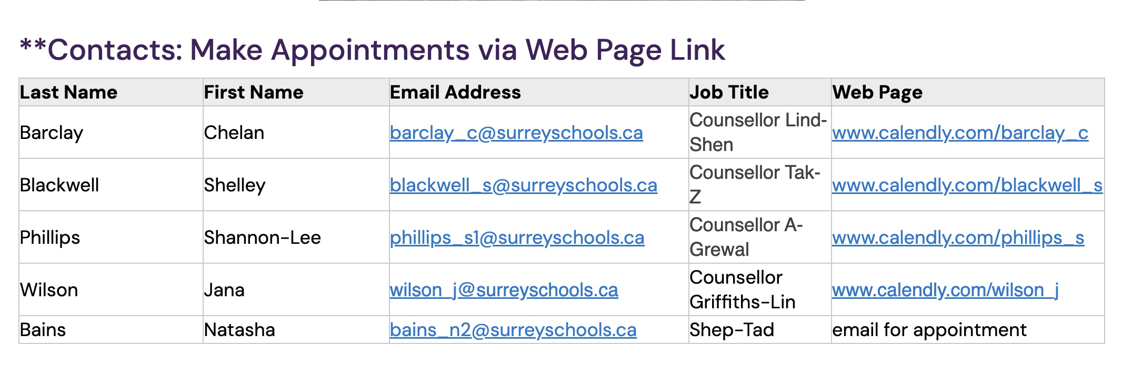
Know who your counsellor is and how you can visit!

Slide 3
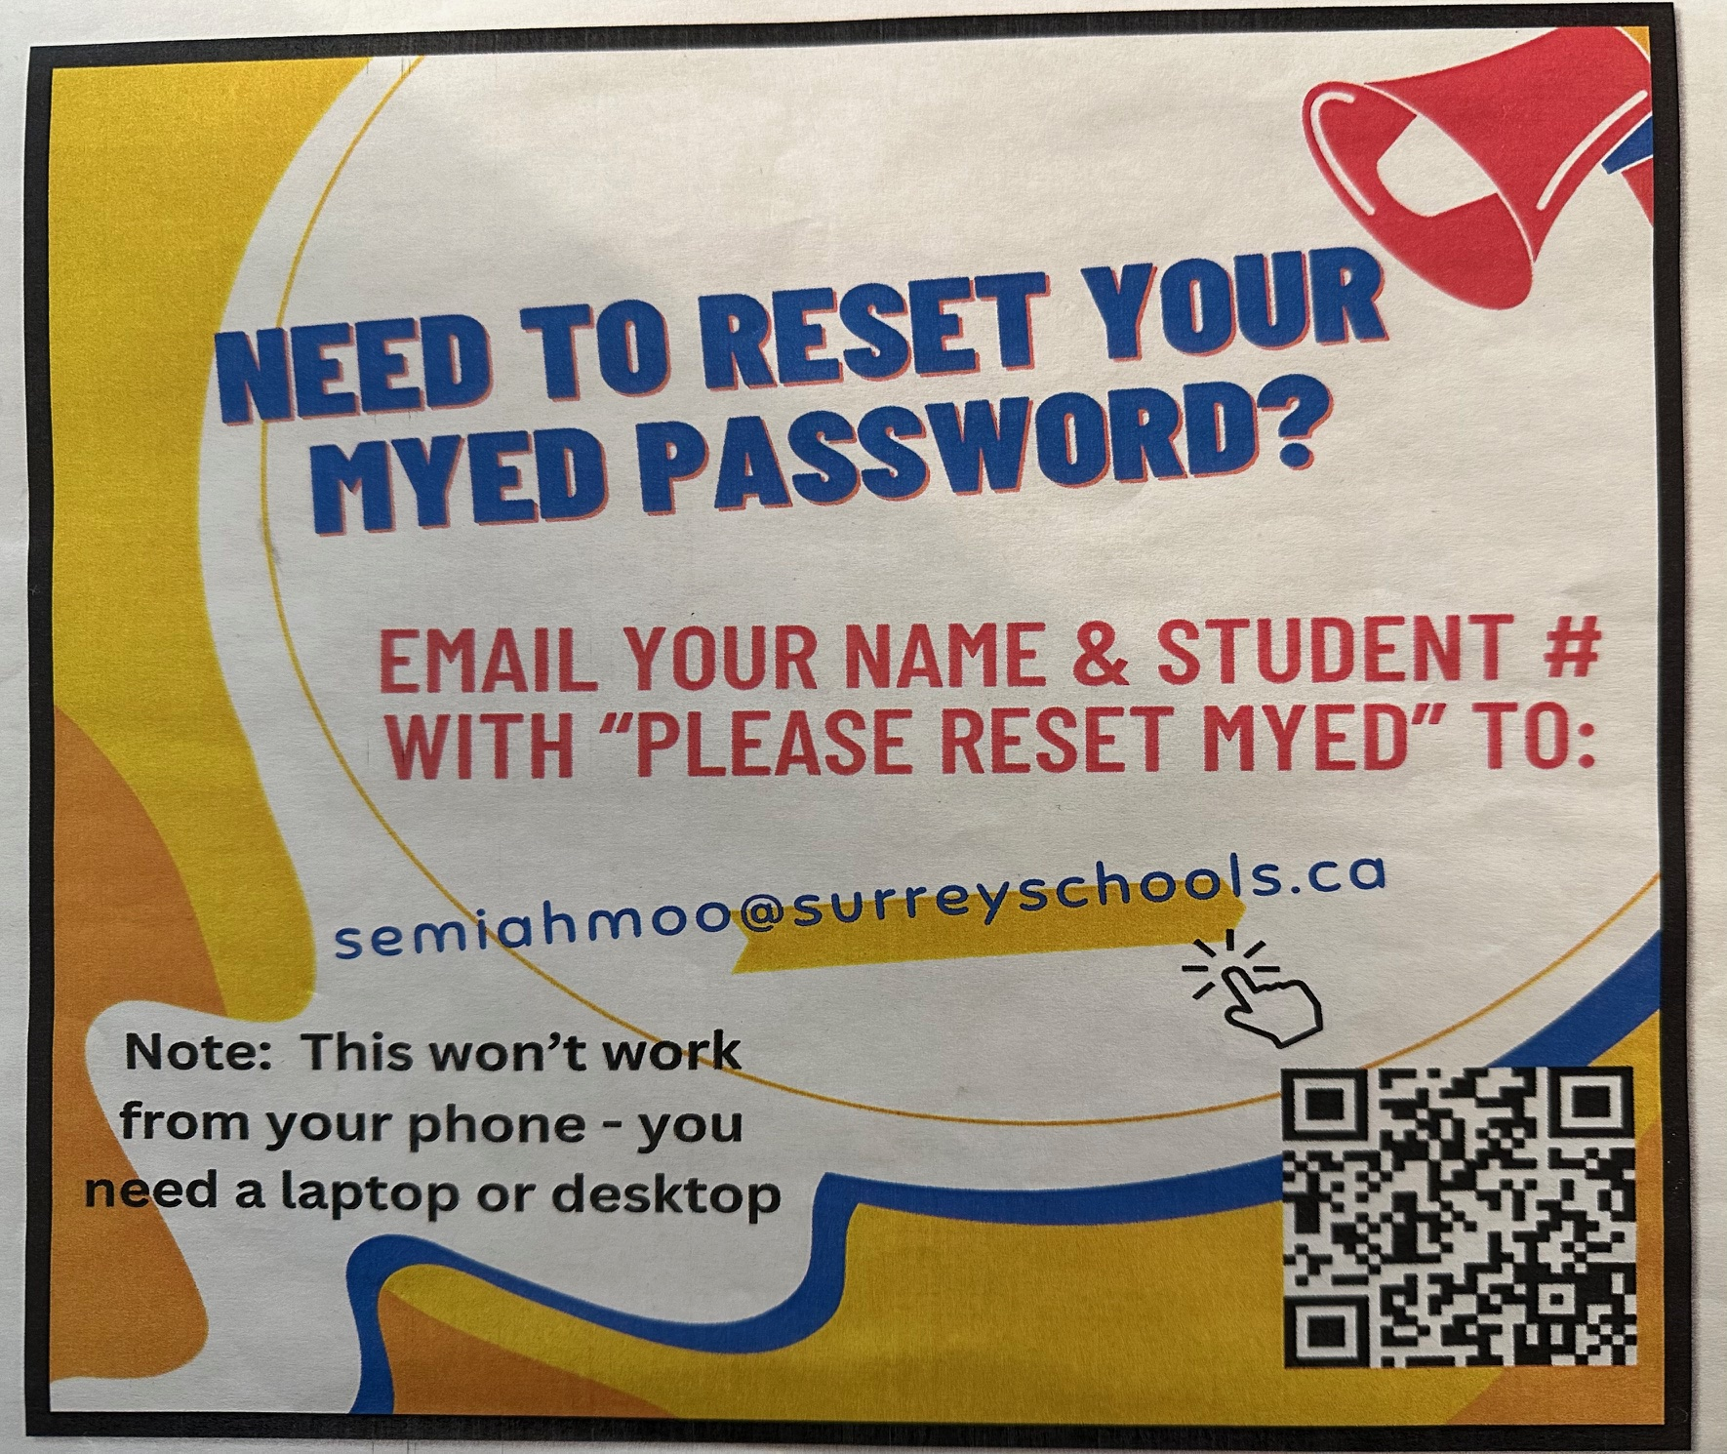
Step One: You have to be able to login to MyEd. If you need help logging in to MyEd, please see the attachment titled “How to Log On to MyEd.

Slide 4
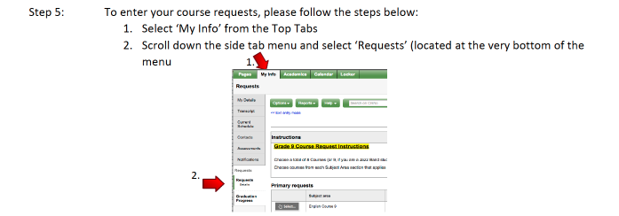

Slide 5
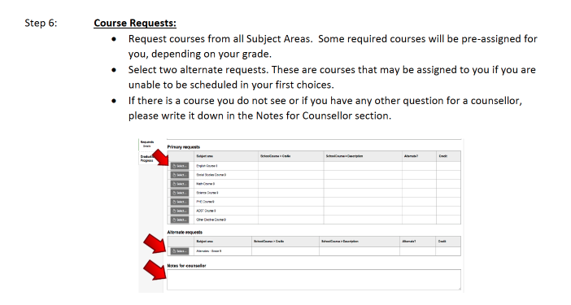

Slide 6
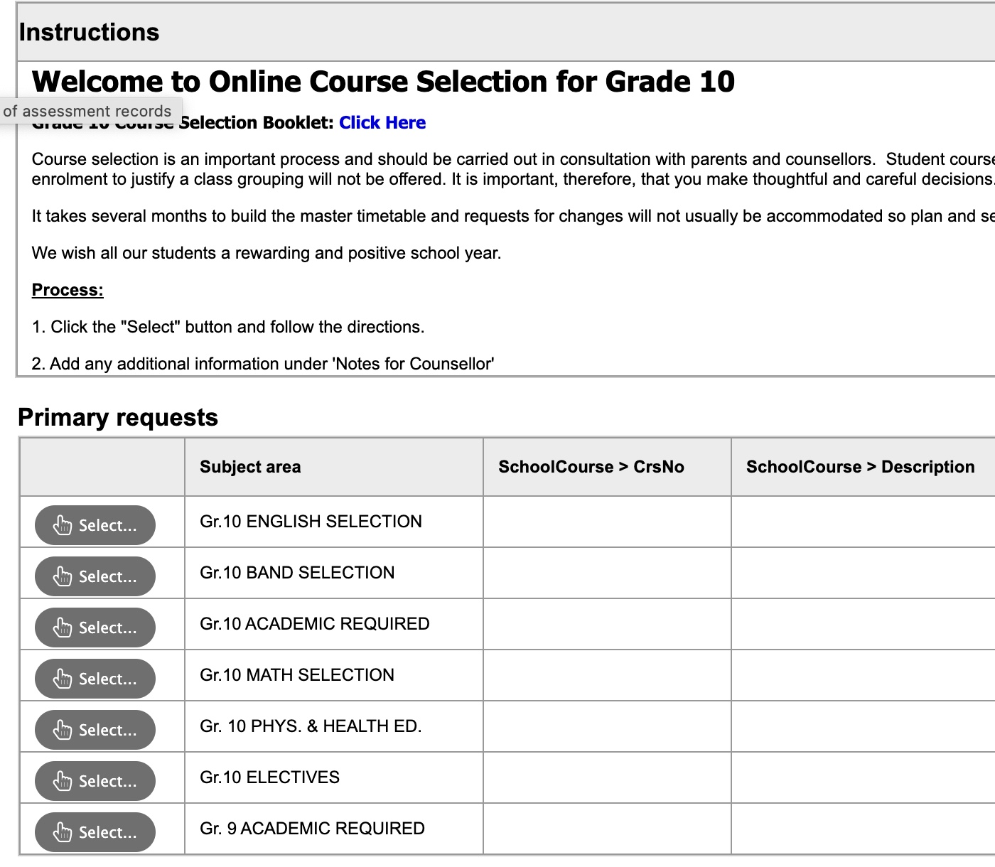
Make sure you choose your 6 required courses, PLUS two electives. Please note: a second language is NOT required to graduate, but it is required for some BC universities (UBC and SFU)
DO NOT forget to choose 2-3 alternates!!!!

Slide 8
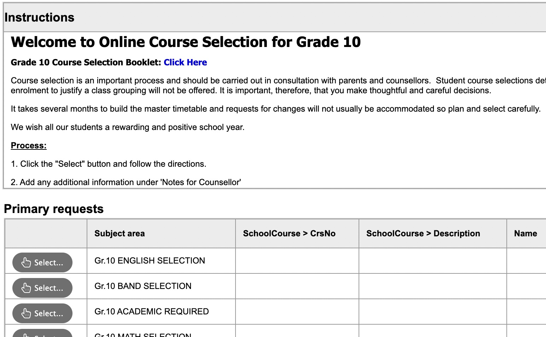
If you are wondering what each course is about (ie: what do we do in Foods 10?) please click here to see the course description booklet.
Please be sure to read course descriptions to make sure you are choosing the course you want, because we will not be able to make changes.

Slide 10
New Requirement!!!
In addition to the courses mentioned, all students will be required to complete a First Peoples credit before graduating. This can be taken in grade 10, 11, or 12 by taking ONE of the following:
English 10 First Peoples
Contemporary Indigenous Studies 12 (you can take this in grade 11 or 12)
OR, English 12 First Peoples

Slide 11
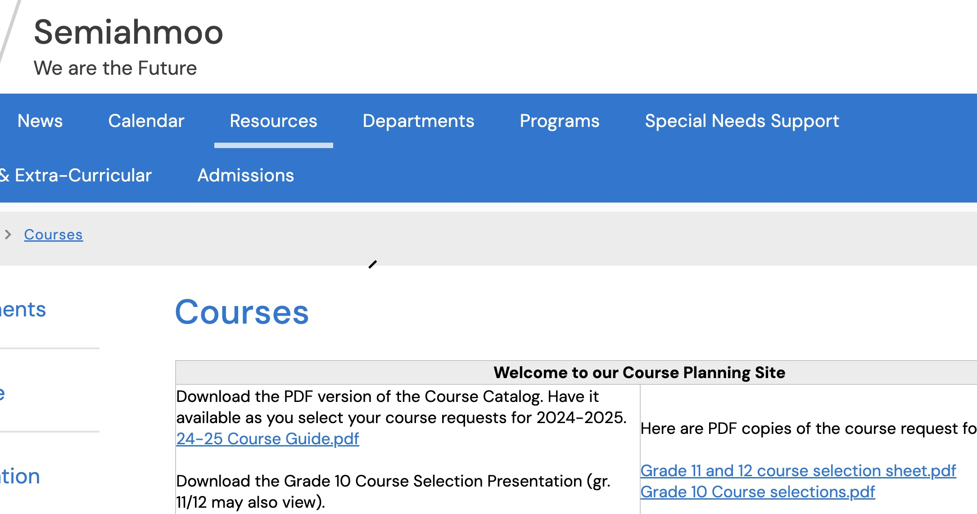
For detailed course descriptions and information, visit: https://www.surreyschools.ca/semiahmoo
Click "Resources” > "Courses"

Slide 12
Course selection tips....
Do not take English, Math or Science in summer school or online
If you are in Band, do not take Socials or Careers ahead of time
If you are looking at IB you should take Precalculus 11 BEFORE IB Math HL and you should take Prec 11 before IB sciences
There is NO NEED to take any other sciences, English, etc.
Before taking IB, ensure you have completed your PE 10, Careers 10 and a fine art or applied skills course.

Slide 13
Things to know…
Make sure you have all the “prerequisite” courses (ie: you cannot take French 10 if you have not taken French 9)
If you go ahead and take Science 10 or Math 10 in Summer School you likely WILL NOT get Senior Sciences or Math next year! We need these spots for our senior students.
The portal is open now for you to do your course selection.
Don’t procrastinate, get it done today! Involve your parents in this process.
If you do not submit your course selections, you may not get the classes that you want.
Choose wisely as you will not be able to change your selections as we will not have space for late changes.
All courses MUST be selected in MyEd by you by March 5th!!!

