Slide 1
Personal Project
Planning

Slide 2
Planning: What are you going to do?
In this stage of the project you will …
Set a learning goal based on a personal interest
State a product goal
Develop success criteria for your product
Make a plan to achieve the product goal

Slide 3
Setting a goal

Slide 4
Setting a goal
The personal project is truly personal because you will set your own goal, based on something that you find interesting. You may draw inspiration from your prior experience in the MYP, such as:
a global context that you find particularly compelling
a service as action experience that you would like to build on
a unit of inquiry that you would like to explore further.
Notes:
Please refer to the “Setting a goal” section of the MYP Personal project guide for more details.

Slide 5
Setting a goal
The goal consists of two interrelated components.
Learning goal
What do you want to learn about?
Product goal
What do you want to create?
Notes:
The overall goal for the personal project consists of two interrelated parts: a product and a learning goal. The product is what students will create and the learning goal is what they want to learn.
Please note that the product may be a tangible artifact such as a sculpture, film, story or model, or it could be a non-tangible result such as an awareness-raising campaign, learning to play a new piece of music or improving athletic performance.

Slide 6
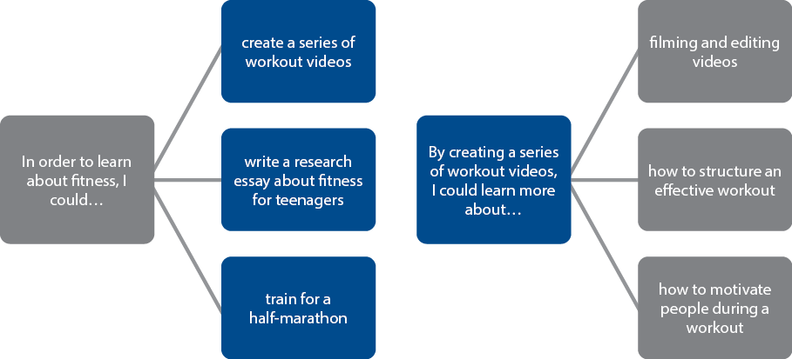
Learning goal ↔ Product goal
Notes:
While some students might begin the goal-setting process with a product in mind, other students will begin with a learning goal from which they will decide what kind of product to pursue. The learning goal that students begin with could lead to a variety of different products, just as a product could relate to a variety of learning goals.

Slide 7
Your turn to discuss…
If your learning goal is to
find out more about making a personal computer
What kinds of product goals could you set?
Notes:
Some possible products:
Sourcing components to make a PC
Producing an instruction manual on how to build a PC
Developing affordable PCs for a local community

Slide 8
Your turn to discuss …
If your product goal is to
create a diet with more plant-based foods
What kinds of learning goals could you set?
Notes:
Some possible learning goals:
Learn about agriculture and nutritional content of plants
Learn about how to grow plants sustainably
Learn about how to create hydroponic plants for eating
Learn about how to develop rooftop gardens for nutrition

Slide 9
Your turn to think …
Inspiration for your personal project can come from all kinds of sources. Let’s start brainstorming possibilities with this activity:
Take 30 seconds to respond to each of the following prompts.
You can discuss your ideas with a partner or write them down in your notebook.

Slide 10
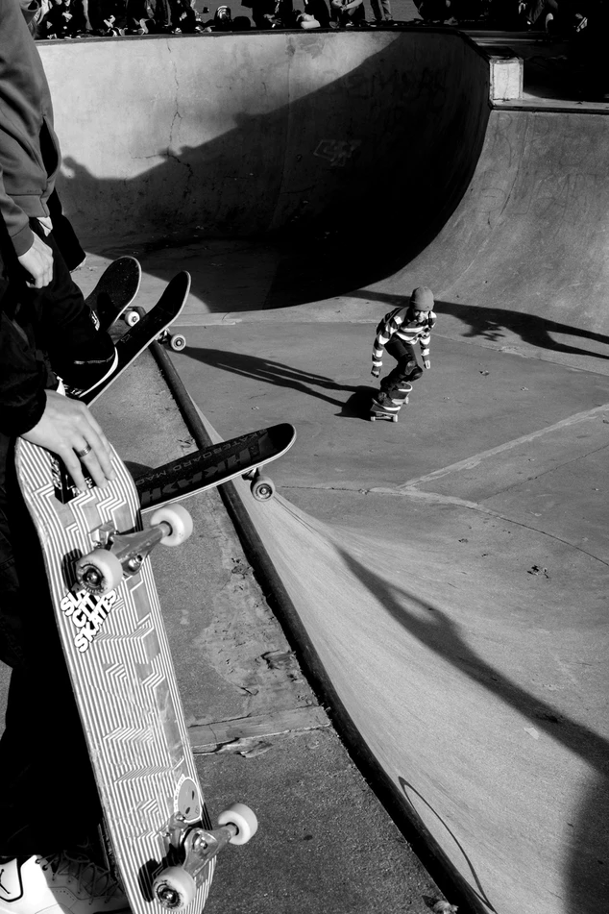
Curiosity
“I have been wondering about ...”
Notes:
Photo by Jay Clark on Unsplash (https://unsplash.com/photos/ud1MTV9_Llg)

Slide 11
Challenge
“I have always wanted to try ...”
Notes:
Photo by x ) on Unsplash (https://unsplash.com/photos/N4QTBfNQ8Nk)

Slide 12
Passion
“I would love to …”
Notes:
Photo by Florian Schneider on Unsplash (https://unsplash.com/photos/2sgELHMCC-0)

Slide 13
Impact
“I can make the world a better place by …”
Notes:
Photo by Shane Rounce on Unsplash (https://unsplash.com/photos/DNkoNXQti3c)

Slide 14
Your turn to choose …
Which of those options is most appealing to you now?
Which of those ideas might hold your interest for the next few months?
Which of those ideas would you like to consider further?
Notes:
Note: Students will probably not be ready to make a choice about their topic or goal right away. For the purpose of this presentation, students might find it useful to have a possible goal in mind, with the understanding that they can change their mind as they go through the planning process.
Photo by fotografierende on Unsplash (https://unsplash.com/photos/2c8ul47Lwxo)

Slide 15
Creating an action plan

Slide 16
This is an iterative process …
Set a goal and develop success criteria
Make a plan
Evaluate the goal and success criteria
Revise the goal and adjust the action plan
What will I learn?
What will I create?
What features will my product have?
What will I need to do to achieve the success criteria?
Can I achieve those criteria in the time that I have?
Do I have the resources that I will need?
What can I do in the time that I have?
What can I achieve with the resources that I have?
Notes:
As students create their action plan, they will gain a sense of whether they can achieve the product within a reasonable time frame and they may revise their learning goal and/or product accordingly.

Slide 17
Success criteria
Recall that you have already created success criteria in MYP design projects.
When creating success criteria you can choose the style which best suits you, but you should make sure their specifications are SMART:
Specific—do I know what I want to do and why?
Measurable—will I be able to tell if the criterion has been met?
Achievable—can I access the resources and skills that I will need?
Relevant—does this make my overall product better?
Time-bound—can I do this within the time that I have?
Notes:
Some examples of success criteria:
Specifications based on ACCESS FM (aesthetics, cost, customer, environment, safety, size, function, materials)
A rubric similar to an MYP assessment rubric
A list of prioritized goals
A traffic light checklist
A checklist, with each goal being set a certain amount of points
A table with each goal as well as a reason and testing methods

Slide 18
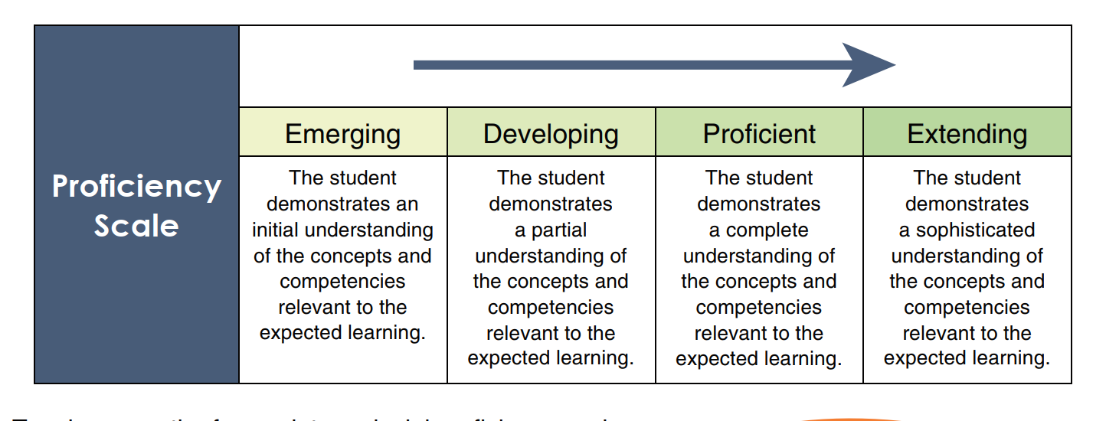
Please see Success Criteria Handout

Slide 19
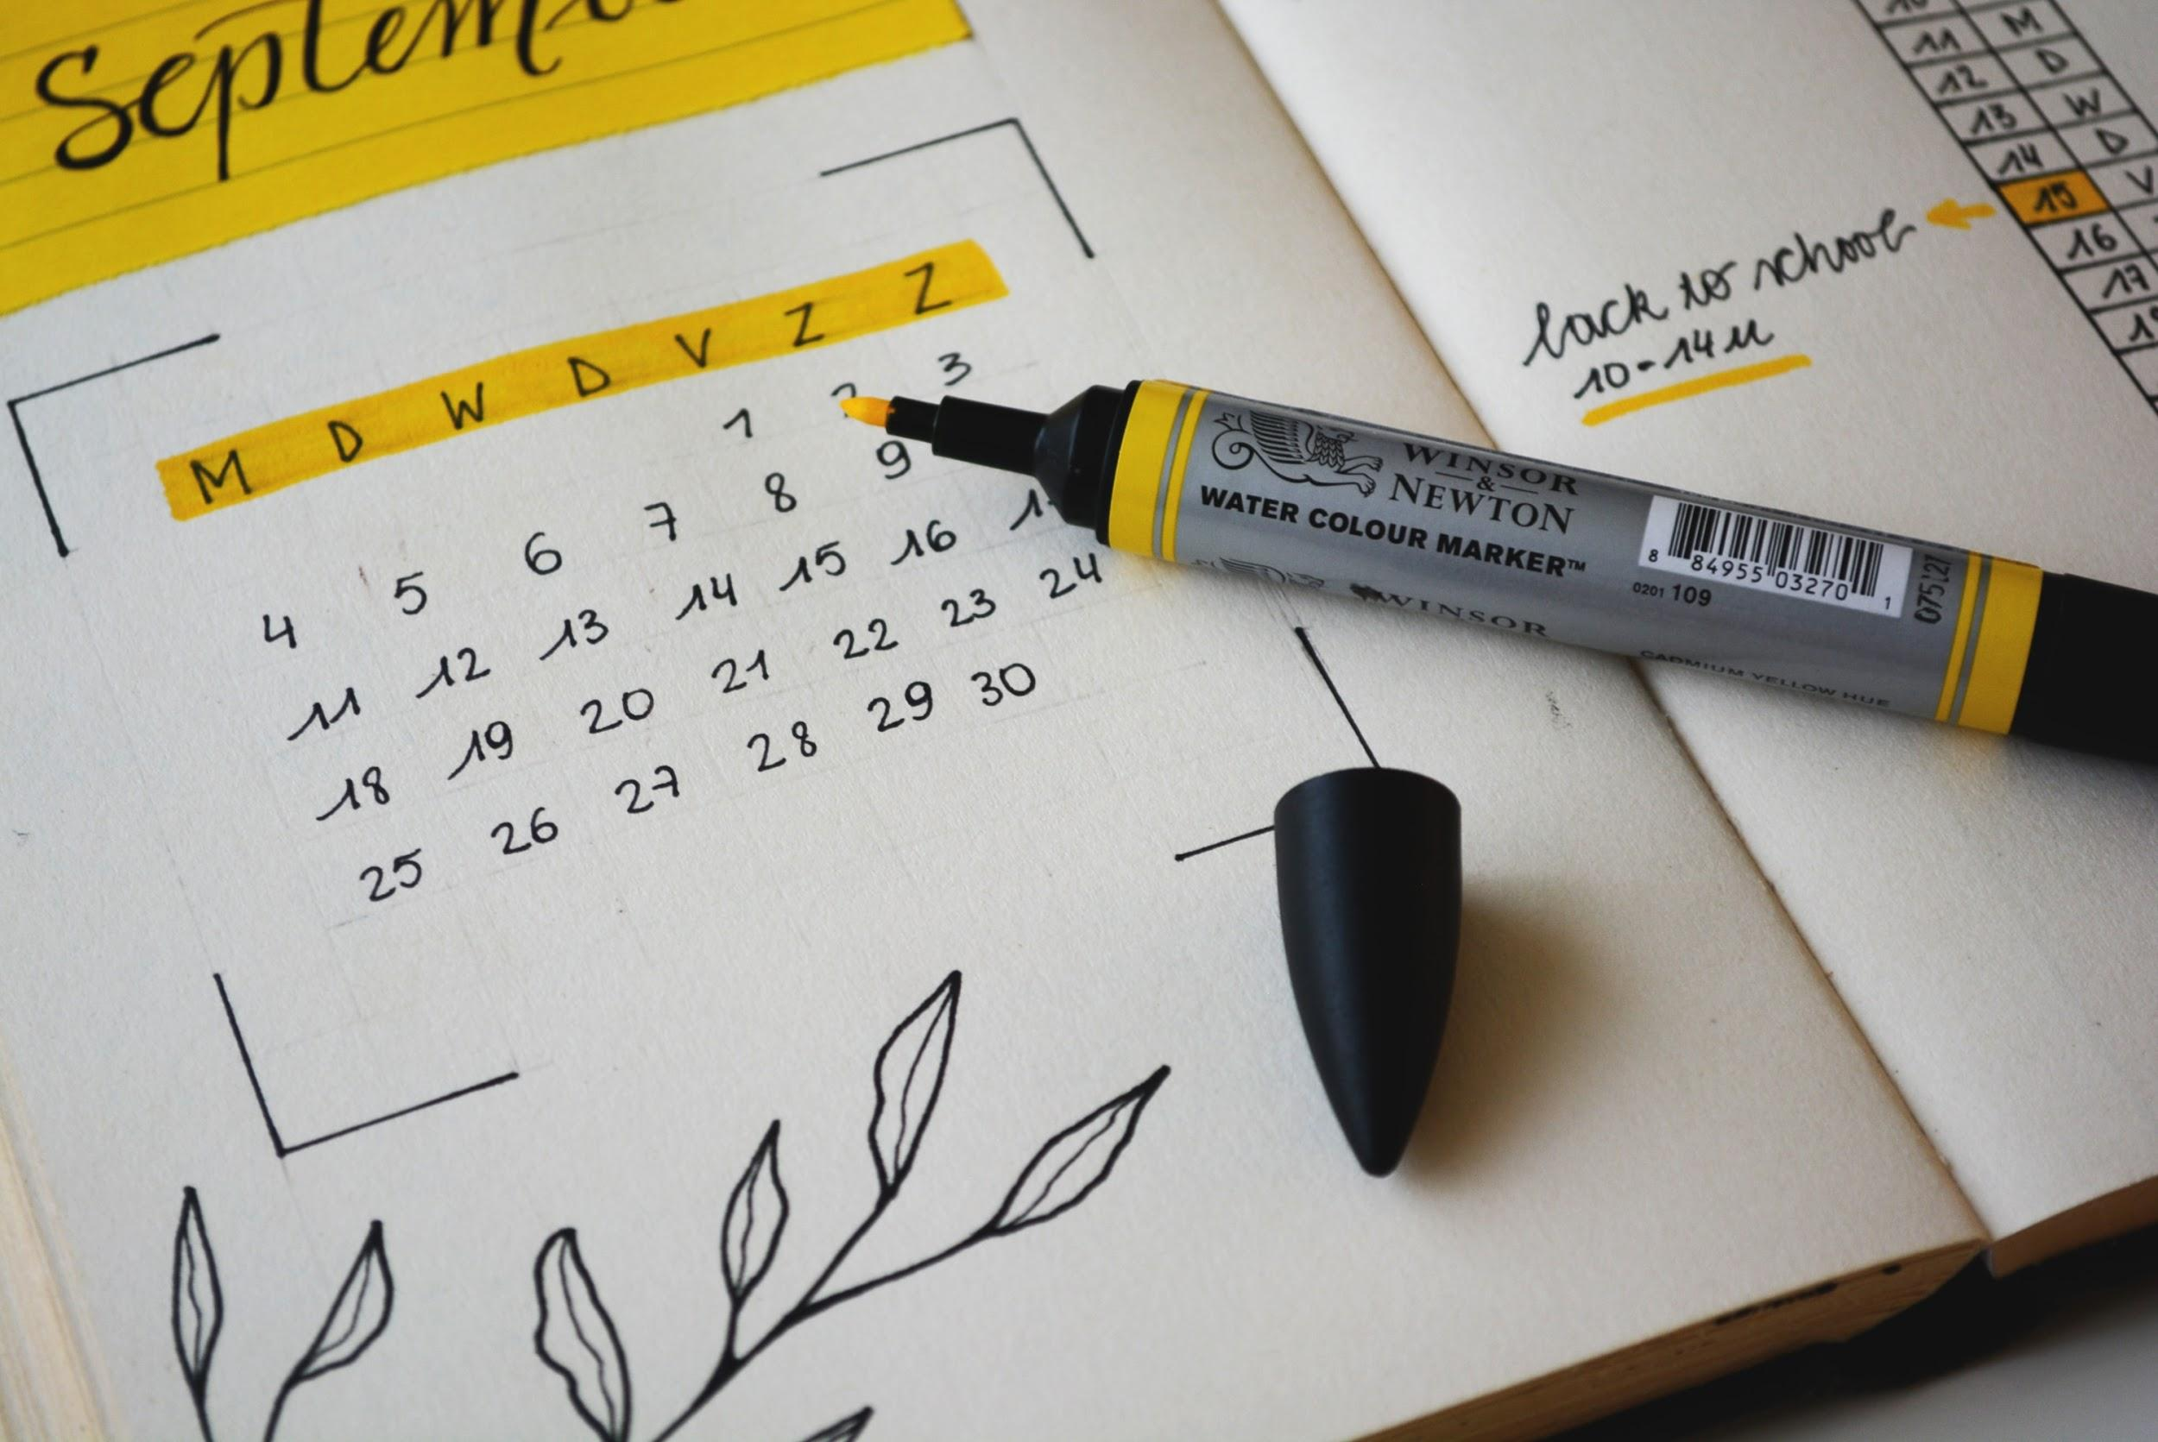
What type of action plan?
You should create an action plan which best suits how you learn best.
Action plans might be or might include: action tables, flow charts, to-do lists, calendar tasks, a step-by-step logical plan, storyboards, graphs, a bullet journal, a spreadsheet, flow charts, equipment and materials lists, slippage chart, goal charts, project timelines.
Notes:
Photo by Estée Janssens on Unsplash (https://unsplash.com/photos/zni0zgb3bkQ)

Slide 20
Action plan top tips
You should take into consideration the time needed to complete the project (25 hours) and may wish to record timings in your action plan.
Consider your approaches to learning (ATL) skills and make a plan that works for you. For example, if you struggle with time-management, you may wish to make an action plan that ensures you complete work early or allows for flexibility.
Different types of projects require research at different stages. Think about when research will be needed in your project.
Recall that you have already created action plans in MYP design and PHE.
Notes:
A note about research:
Research can happen throughout the project. The structure of the project gives students choice in terms of when and how to demonstrate and develop their research skills. For example, students may do quite a bit of research in their planning phase, as they determine what success criteria are feasible and what actions will be necessary to achieve the success criteria. Other students may do more research later in the process, such as learning techniques for creating their product.

Slide 21
YOU NEED TO CREATE
A CALENDAR
ACTION PLAN

Slide 22
In the report
At the end of the personal project, you will submit a report with a section about this phase of the project. You will need to:
state a learning goal for the project and explain how a personal interest led to that goal
state an intended product and develop appropriate success criteria for the product
present a clear, detailed plan for achieving the product and its associated success criteria
support your planning with detailed examples and evidence.
Notes:
Examples of supporting evidence could include:
a list and/or diagram of interests and related learning goals
a list of possible strategies to achieve personal and academic goals
a diagram showing the connections between the learning goal and the product
a series of steps leading to the completion of the product
a timeline for completing short- and long-term tasks.

Slide 23
Share with your partner 3–2–1 Bridge
Thoughts
List three thoughts that you have about the process so far.
Questions
List two questions that you have so far.
Analogy
Find a movie clip that describes your learning so far.
Notes:
https://pz.harvard.edu/sites/default/files/3-2-1%20Bridge_0.pdf

Slide 24
Questions?

