Slide 1


Course Planning:
Grade 10 into 11
February 7, 2024
Notes:
Welcome to Kwantlen Parks course selection presentation for grade 10s going into grade 11 for the 2025-26 school year

Slide 2
Acknowledgement
We would like to acknowledge that the lands on which we work, play and learn, are on the shared traditional territory of the Katzie, Kwantlen, Semiahmoo and other Coast Salish Peoples.

Slide 3
Timeline
Course requests will happen at home (Feb 7 – 28)
Use your Course Planning Sheet before you go online to help you decide which courses you will request.
How To guides and other information are available at https://www.surreyschools.ca/kwantlenpark/page/53496/course-selection
Email your alpha counsellor with any questions
Mr Church A – Dhak
Mr. Sedaros Dhal – Koo
Ms. Bhullar Kor – Rah
Mr. Brar Rai - Z

Slide 4
Graduation Requirements
  80 credits minimum (Each course = 4 credits)
    48 required credits (12 courses)
    28 elective credits (7 courses)
  Numeracy 10 Assessment
  Literary 10 Assessment
  Literacy 12 Assessment
  First Peoples Education Course
  Career Life Education 10 (CLE)
  Career Life Connections 12 (CLC)

Slide 5
Graduation Requirements
English Program
English 10, 11, 12
A Math 10, A Math 11
A Physical & Health Education 10
Career Life Education (CLE) 10
Career Life Connections (CLC) 12 + Capstone
Science 10, A Science 11 or 12
Social Studies 10, A Social Studies 11 or 12
Electives 10, 11, 12 (one must be an ADST course)
French Immersion Program
English 10, 11, 12
A Math 10, A Math 11
Education Physique10
Career Life Education (CLE) 10
Career Life Connections (CLC) 12 + Capstone
Sciences 10, A Science 11 or 12
Science Humaines 10, Histoire 12
Francais Langue 10, 11, 12
Electives 10, 11, 12 (one must be an ADST course)

Slide 6
Grade 11 Courses
English Program
English 11 (Choose one)
Math 11 (Choose one)
A Science 11
A Social Studies 11 or 12
Career Life Connections 12 + Capstone
Other Electives (Choose three)
French Immersion Program
English 11 (Choose one)
Math 11 (Choose one)
A Science 11
Histoire 12
Career Life Connections 12 + Capstone
Français Langue 11
Other Elective (Choose two)

Slide 7
English Language Arts 11
Choose one of the following sEven options:
Literary Studies 11 – specific themes, authors or areas of the world through literary works and media
Literary Studies 11 Hybrid – specific themes, authors or areas of the world through literary works and media
Creative Writing 11 – exploration of personal and cultural identities, memories and stories
Composition 11 – exploring the writing process to refine student’s communication through examination and creation
English First Peoples’ Literary Studies 11 – more focus on authentic First Peoples texts, principles of learning and oral traditions
New Media 11 – a course designed to reflect the changing role of technology in society historically, currently and in the future
Spoken Language 11 – designed to assist students in refining, clarifying and adjusting communication

Slide 8
Social Studies
You require a Socials Studies 11 or 12 credit to graduate in either your grade 11 or 12 year. Choices include:
  Explorations in Social Studies 11
  20th Century World History 12 / Historie 12
  Economic Theory 12
  Law Studies 12
  Philosophy 12
  Physical Geography 12
  Genocide Studies 12
  Contemporary Indigenous Studies 12
  Comparative Cultures 12
  Social Justice 12
  Political Science 12
Do not count as graduation requirement but can be taken as an elective:
  History of Sports
  Table Top Games
  Cultural Influence of Music 12
  Psychology 11
  Psychology 12
  Psychology 12 - Hybrid

Slide 9
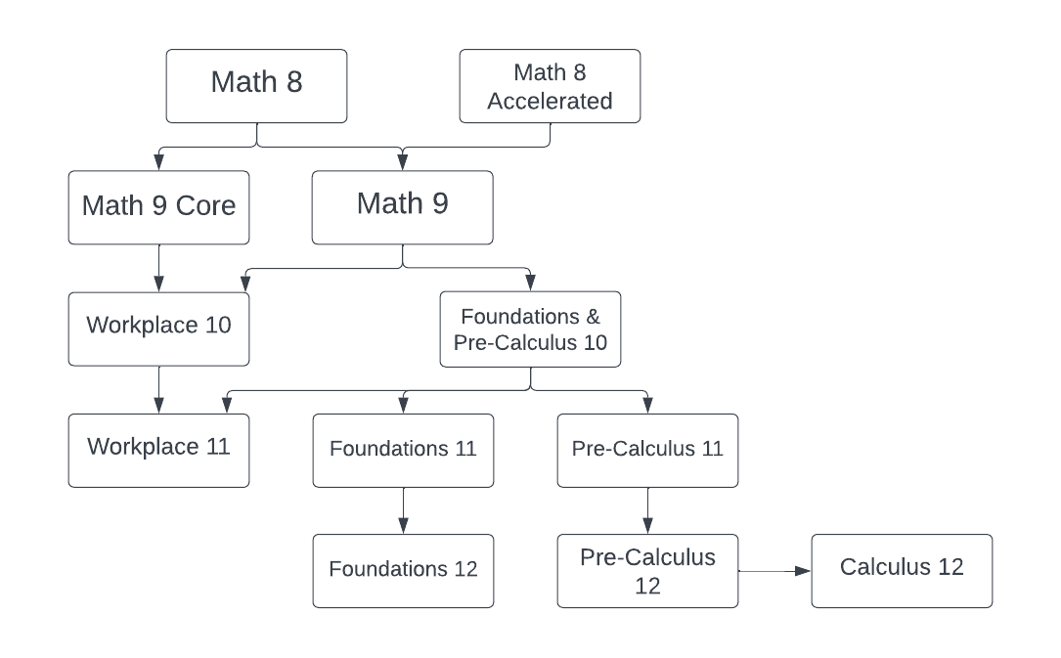
Mathematics

Slide 10
Mathematics 11
Choose one of the following tHree options:
Foundations 11
Intent of this course: This course is designed to prepare students for entry into post-secondary programs such as Economics, Languages, History, Humanities, and Communications. This course leads to Foundations 12.
Pre-Calculus 11
Intent of this course: This course is designed to prepare students for entry into Science or Engineering post-secondary programs. This course leads to Pre-Calculus 12.
Workplace 11
Intent of this course: This course is designed to prepare students for entry into the majority of trade programs, and for direct entry into the work force.

Slide 11
Science 11
Choose one of the following five options:
Life Science 11
This is an introductory course which examines the diversity of life. Evolutionary and ecological relationships are also discussed. Units studied include viruses, bacteria, protists, fungi, higher plants and higher animals.
Earth Science 11
Students will be introduced to diverse aspects of earth and space science. Concepts include rocks and minerals, internal and surface processes, tectonic plates, astronomy, and Earth’s geologic history.
Chemistry 11
This is an introductory course which covers topics on unit conversion, matter, moles, stoichiometry, types of chemical reactions, solution chemistry, atomic theory and models, and organic chemistry.
Physics 11
An introductory course dealing mainly with objects in motion, the forces which cause changes in motion, and the energies associated with these situations.
Science for Citizens 11
This course is a multi-disciplinary course that explores the connections between science and your every day lives, and how we may respond and adapt to changes both locally and globally

Slide 12
English Program - Second Language
We recommend taking a second language through to a Language 11:
  will keep all doors open after high school
  is a requirement for direct entry to some universities
  is great for travel + cultural understanding

Slide 13
Careers Courses
Grade 8 – Careers 8 (Online)
Grade 9 – Careers 9 (Online)
Grade 10 – Career Life Education (CLE) 10
Grade 11 – Career Life Connections (CLC) 12 + Capstone

Slide 14
Electives
One course (4 credits) in Applied Skills in grade 10, 11 or 12 is required by the end of Grade 12
English program students can choose three elective (one of these can be a language)
French Immersion program students can choose one elective
Example of electives: Art, Business, Computers, Drama, Foods, Textiles, Music, Technology Education, Band, Physical Education etc.

Slide 15
Career Education – Science Co-Op
Science Co-op includes:
  Life Science 11
  Chemistry 11
  Physics 11
  CLC 12
  Work Experience 12
**Entry into Science Co-op requires an application form which can be found in the Career Centre

Slide 16
Career Education: District Partnerships
Auto Collision Repair
Auto Refinishing Prep
Auto Service Technician
Baking & Pastry Arts
BCIT Trades Sampler
Canadian Flight Centre
Carpentry
Culinary Arts
Drafting/CADD
Education Assistant
Electrical
Emily Carr Headstart in Art
Hairdressing
Heavy Mechanical Trades
Horticulture
Masonry
Metal Fabrication
Millwright/Industrial Mechanic
NVIT Law Enforcement Prep
Painter/Decorator
Piping
Roofing
Welding
Youth Work in Trades (apprenticeship)
and much more…

Slide 17
External Graduation Credits
Language Challenge
External Credentials
  in sports, languages, music, dance, Scouts, Guides, lifesaving, ICBC driver education, boating, etc.
Partnership programs & Apprenticeships

Slide 18
Two alternate Electives
You are required to request two alternate courses in case your main request cannot be met.
Alternates must be different from the electives you have already requested.

Slide 19
Other Learning Options
Summer School
  Beginning of July to early August
SAIL Distance Education (online)
Night School
  Surrey Continuing Education – two classes per week for one semester
Central City Learning Centre
  Fall and Spring intakes

Slide 20
Post Secondary Options
Work
Travel
Post Secondary Institution such as colleges, technical schools, polytechnical universities, may require:
  High school graduation or age 19+
  Program specific prerequisite course (check institution’s websites)
  Can upgrade courses at college if necessary

Slide 21
Post Secondary Options
University Admissions
  Approved list of courses for University admissions are difference for each institution and need to be researched online
  University admissions offices can be contacted directly for the most up to date information
BC Post Secondary Programs
  www.educationplanner.ca
Canadian Post Secondary Programs
  www.schoolfinder.com
Check individual Post Secondary websites

Slide 22
Getting Involved (NOW!)
Most post-secondary schools are now requiring:
  Extra-curricular involvement (clubs, teams)
  Volunteer work in the school and/or community
  Leadership
  Being “well rounded”
Tips:
  Develop a strong resume
  Start collecting reference letters, certificates
  Start a folder

Slide 23
Scholarships
Grade 11 and 12 marks are important
Start a scholarship file
  Extra-curricular involvement
  Volunteering in school and or the community
  Leadership roles
Check university websites for information
Check the Career Centre and Teams regularly for updates on scholarships

Slide 24
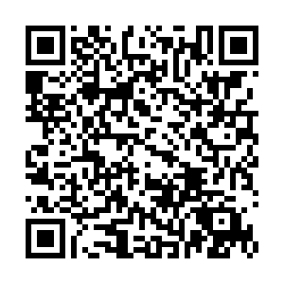
Requests open for online submissions February 7
Ensure you know your myEd password! If you need a reset, please use this QR-Code
Discuss your options with your family

Slide 25
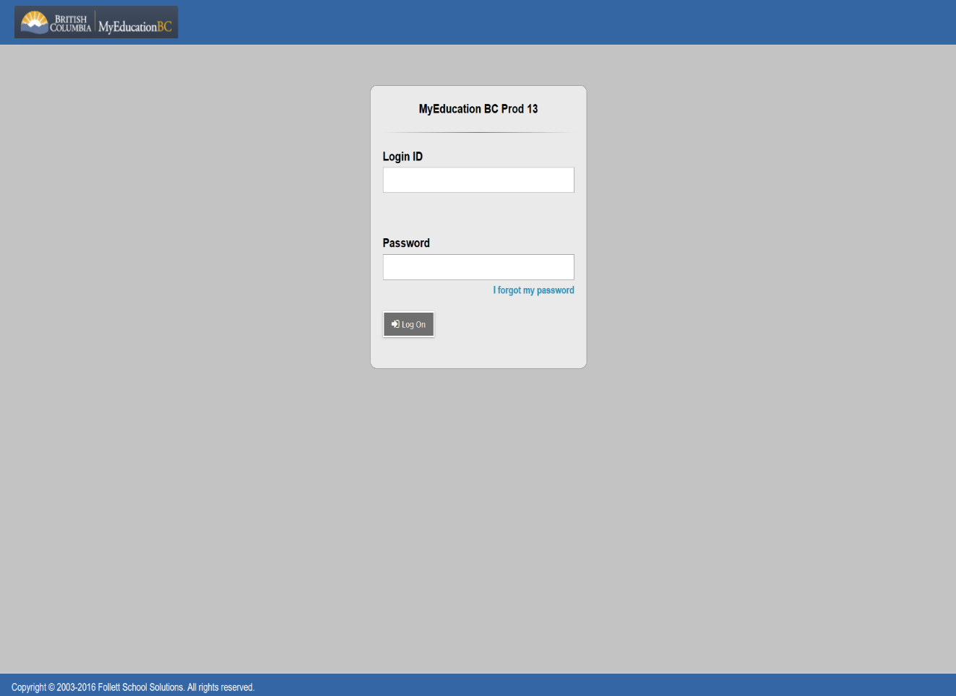
Submitting Course Requests Online
Student Number
Password Rest:

Slide 26
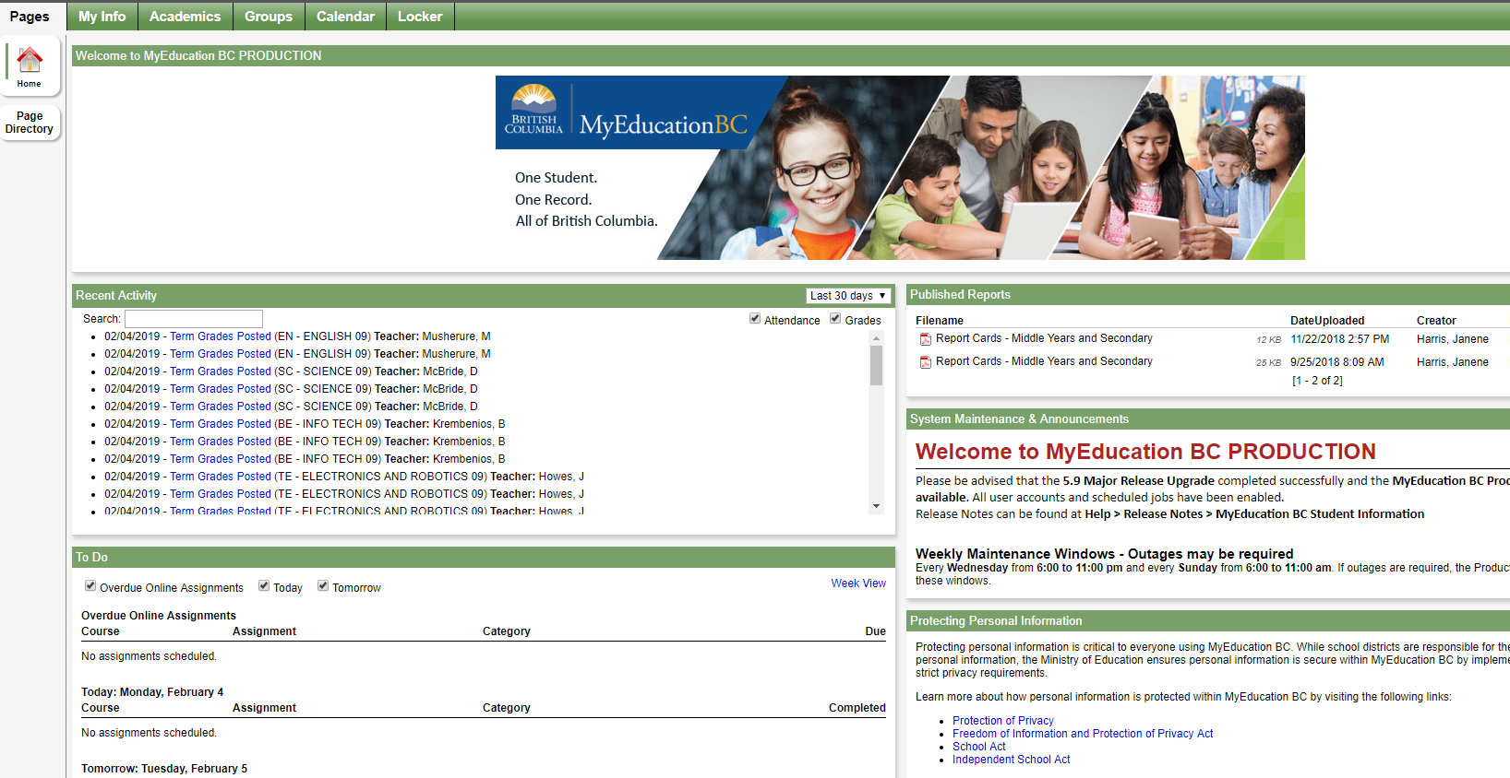
Submitting Course Requests Online

Slide 27
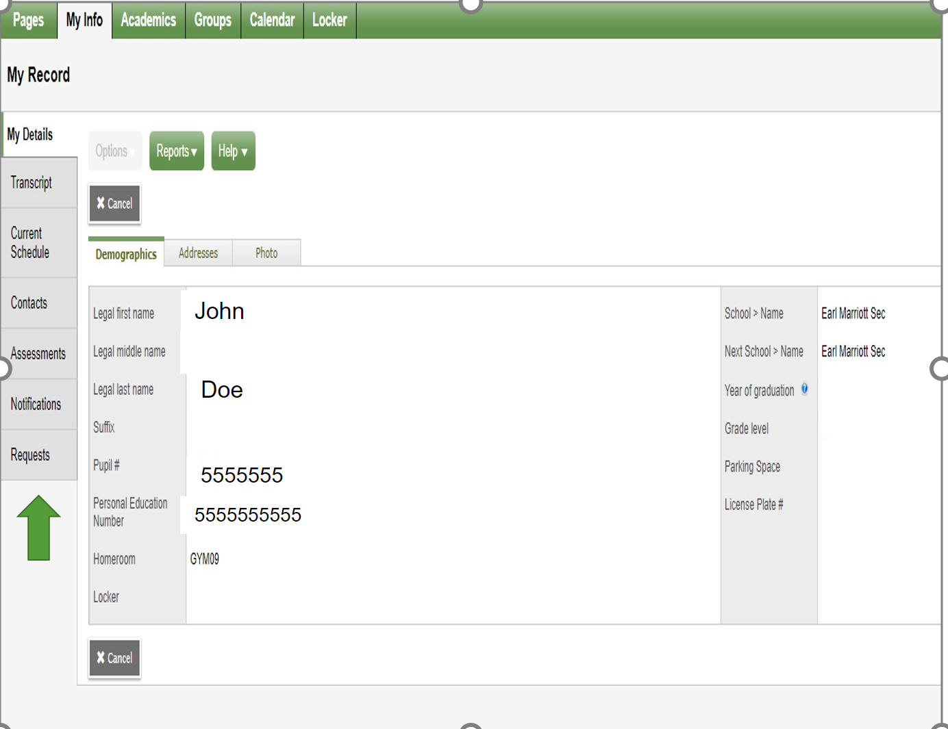
Submitting Course Requests Online

Slide 28
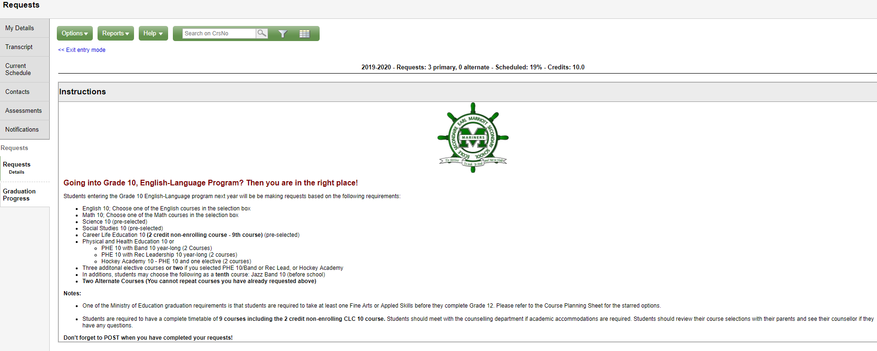
Submitting Course Requests Online

Slide 29
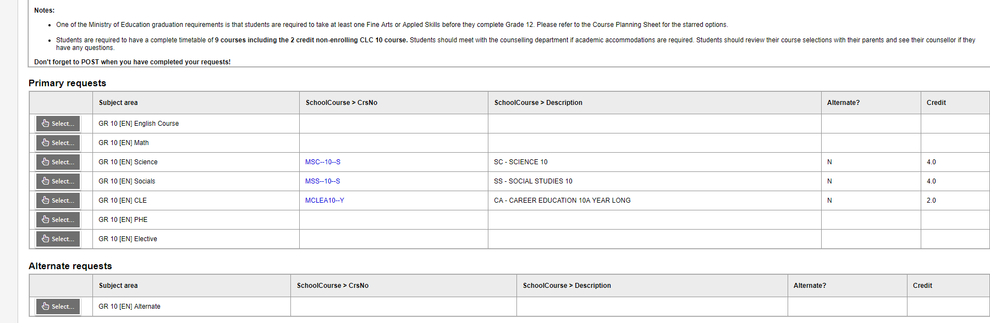
Submitting Course Requests Online

Slide 30
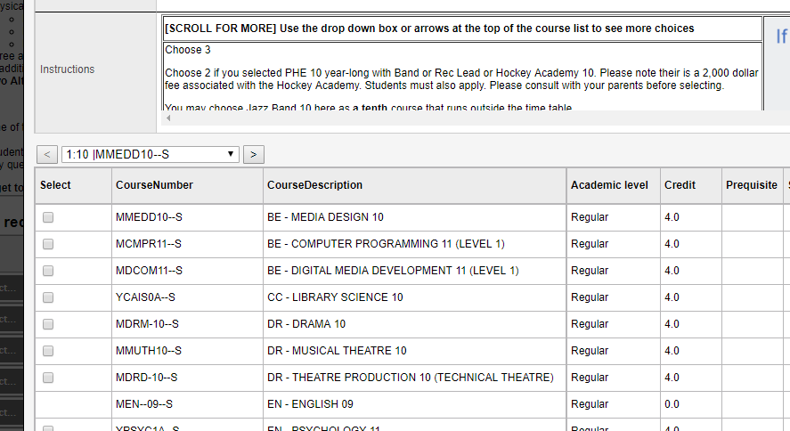
Submitting Course Requests Online

Slide 31
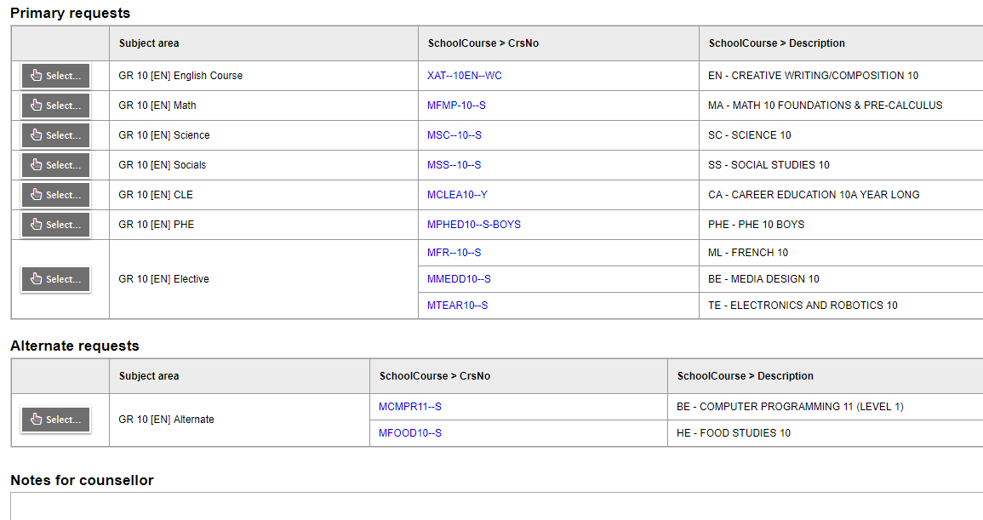
Submitting Course Requests Online

Slide 32
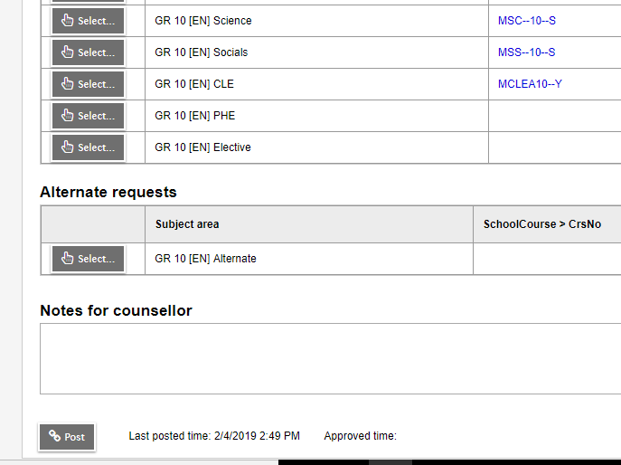
Submitting Course Requests Online

Slide 33
Course Planning Documents
See our website for:
  Course Planning Guide
  Course Catalogue
  Sample Course Selection Planning Sheets
  Student Portal instructions
  Website: https://www.surreyschools.ca/kwantlenpark/page/53496/course-selection

Slide 34
Questions?
Counsellors are currently monitoring and will respond to any questions on the Teams page

