Slide 1


Course Planning:
Grade 11 into 12
February 7, 2024

Slide 2
Acknowledgement
We would like to acknowledge that the lands on which we work, play and learn, are on the shared traditional territory of the Katzie, Kwantlen, Semiahmoo and other Coast Salish Peoples.

Slide 3
Timeline
Course requests will happen at home (Feb 7 – 28)
Use your Course Planning Sheet before you go online to help you decide which courses you will request.
How To guides and other information are available at https://www.surreyschools.ca/kwantlenpark/page/53496/course-selection
Email your alpha counsellor with any questions
Mr Church A – Dhak
Mr. Sedaros Dhal – Koo
Ms. Bhullar Kor – Rah
Mr. Brar Rai - Z

Slide 4
Graduation Requirements
  80 credits minimum (Each course = 4 credits)
    48 required credits (12 courses)
    28 elective credits (7 courses)
  Numeracy 10 Assessment
  Literary 10 Assessment
  Literacy 12 Assessment
  First Peoples Education Course
  Career Life Education 10 (CLE)
  Career Life Connections 12 (CLC)

Slide 5
Graduation Requirements
English Program
English 10, 11, 12
A Math 10, A Math 11
A Physical & Health Education 10
Career Life Education (CLE) 10
Career Life Connections (CLC) 12 + Capstone
Science 10, A Science 11 or 12
Social Studies 10, A Social Studies 11 or 12
Electives 10, 11, 12 (one must be an ADST course)
French Immersion Program
English 10, 11, 12
A Math 10, A Math 11
Education Physique10
Career Life Education (CLE) 10
Career Life Connections (CLC) 12 + Capstone
Sciences 10, A Science 11 or 12
Science Humaines 10, Histoire 12
Francais Langue 10, 11, 12
Electives 10, 11, 12 (one must be an ADST course)

Slide 6
Grade 12 Courses
English Program
English 12 or English First People 12
3 Grade 12 Courses
Other Electives Grade 10-12 (Choose four)
French Immersion Program
English 12 or English First People 12
Français Langue 12
2 Grade 12 Courses
Other Electives Grade 10-12 (Choose four)

Slide 7
English Language Arts 12
Choose one of the following two options:
English 12
English Studies 12 builds on and extends students’ previous learning experiences in ELA and EFP 10 and 11 courses. It is designed for all students and provides them with opportunities to refine their ability to communicate effectively, think critically and creatively, explore texts from a variety of sources, in multiple modes, and that reflect diverse worldviews and deepen their understanding of themselves and others in a changing world.
English First Peoples 12
EFP 12 is grounded in the First Peoples Principles of Learning. It is designed for all students, who are interested in delving deeply into First Peoples oral and written literature and visual texts in a range of media.

Slide 8
Social Studies
You require a Socials Studies 11 or 12 credit to graduate in either your grade 11 or 12 year. Choices include:
  Explorations in Social Studies 11
  20th Century World History 12 / Historie 12
  Economic Theory 12
  Law Studies 12
  Philosophy 12
  Physical Geography 12
  Genocide Studies 12
  Contemporary Indigenous Studies 12
  Comparative Cultures 12
  Social Justice 12
  Political Science 12
Do not count as graduation requirement but can be taken as an elective:
  History of Sports
  Table Top Games
  Cultural Influence of Music 12
  Psychology 11
  Psychology 12
  Psychology 12 - Hybrid

Slide 9
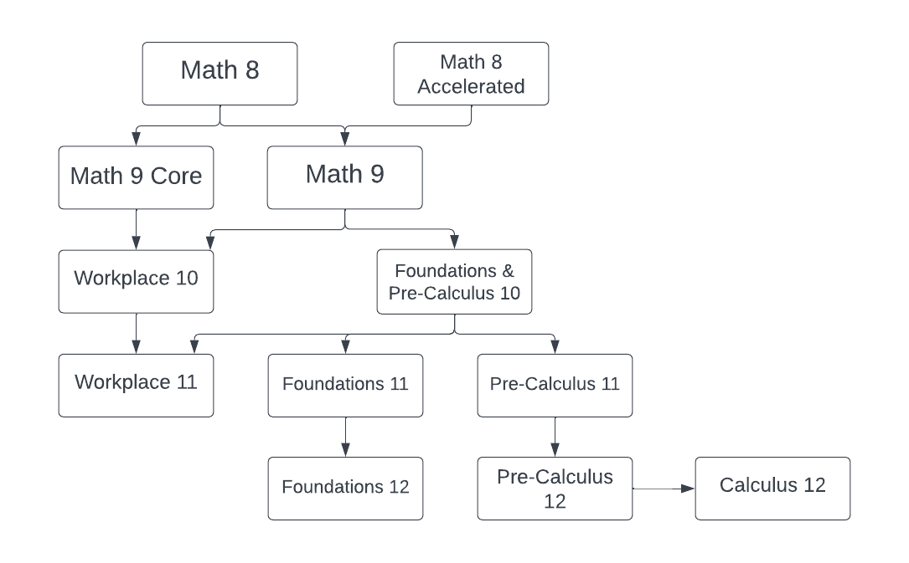
Mathematics

Slide 10
Mathematics 12
Optional
Foundations 12
This course is designed to prepare students for entry into post-secondary programs such as Economics, Languages, History, Humanities, and Communications.
Pre-Calculus 12
This course is designed to prepare students for entry into Science or Engineering post-secondary programs.
Calculus 12
In addition to Pre-Calculus 12, this course is designed to prepare students for entry into Science or Engineering in post-secondary programs. Calculus 12 provides an introduction into Calculus courses in post-secondary.

Slide 11
Science 12 optional:
Anatomy and Physiology 12
Biochemistry, metabolism, and human biology. Students planning to go on in biology at the college or university level or those considering a career in biological sciences should select this elective.
AP Biology 12
AP Biology is the equivalent of a first-year college general biology course. Option of taking the AP exam towards the end of the year.
Physics 12
Physics 12 is a course designed to prepare students entering a college, university, or technical school in science, engineering, and technology fields.
Chemistry 12
Chemistry 12 is a university preparation course emphasizing student discovery along with the discussion of principles. This course is recommended for those students wishing to continue their study of chemistry and related courses at the post-secondary level.
AP Chemistry 12
AP Chemistry is the equivalent of a first-year college general chemistry course. Option of taking the AP exam towards the end of the year.
Geology 12
This is a course that invites students to wonder, inquire and discover the relevancy, applicability, and impact of the vast discipline of geology in today’s world.

Slide 12
English Program - Second Language
We recommend taking a second language through to a Language 11:
  will keep all doors open after high school
  is a requirement for direct entry to some universities
  is great for travel + cultural understanding

Slide 13
Electives
One course (4 credits) in Applied Skills in grade 10, 11 or 12 is required by the end of Grade 12
English program students can choose 7 Academic or Elective courses, with three being at the Grade 12 level
French Immersion program students can choose six Academic or Elective courses, with three being Grade 12 level
Example of electives: Art, Business, Computers, Drama, Foods, Textiles, Music, Technology Education, Band, Physical Education etc.

Slide 14
Career Education: District Partnerships
Auto Collision Repair
Auto Refinishing Prep
Auto Service Technician
Baking & Pastry Arts
BCIT Trades Sampler
Canadian Flight Centre
Carpentry
Culinary Arts
Drafting/CADD
Education Assistant
Electrical
Emily Carr Headstart in Art
Hairdressing
Heavy Mechanical Trades
Horticulture
Masonry
Metal Fabrication
Millwright/Industrial Mechanic
NVIT Law Enforcement Prep
Painter/Decorator
Piping
Roofing
Welding
Youth Work in Trades (apprenticeship)
and much more…

Slide 15
External Graduation Credits
Language Challenge
External Credentials
  in sports, languages, music, dance, Scouts, Guides, lifesaving, ICBC driver education, boating, etc.
Partnership programs & Apprenticeships

Slide 16
Two alternate Electives
You are required to request two alternate courses in case your main request cannot be met.
Alternates must be different from the electives you have already requested.

Slide 17
Other Learning Options
Summer School
  Beginning of July to early August
SAIL Distance Education (online)
Night School
  Surrey Continuing Education – two classes per week for one semester
Central City Learning Centre
  Fall and Spring intakes

Slide 18
Post Secondary Options
Work
Travel
Post Secondary Institution such as colleges, technical schools, polytechnical universities, may require:
  High school graduation or age 19+
  Program specific prerequisite course (check institution’s websites)
  Can upgrade courses at college if necessary

Slide 19
Post Secondary Options
University Admissions
  Approved list of courses for University admissions are difference for each institution and need to be researched online
  University admissions offices can be contacted directly for the most up to date information
BC Post Secondary Programs
  www.educationplanner.ca
Canadian Post Secondary Programs
  www.schoolfinder.com
Check individual Post Secondary websites

Slide 20
Getting Involved (NOW!)
Most post-secondary schools are now requiring:
  Extra-curricular involvement (clubs, teams)
  Volunteer work in the school and/or community
  Leadership
  Being “well rounded”
Tips:
  Develop a strong resume
  Start collecting reference letters, certificates
  Start a folder

Slide 21
Scholarships
Grade 11 and 12 marks are important
Start a scholarship file
Extra-curricular involvement
Volunteering in school and or the community
Leadership roles
Check university websites for information
Check the Career Centre and Teams regularly for updates on scholarships

Slide 22
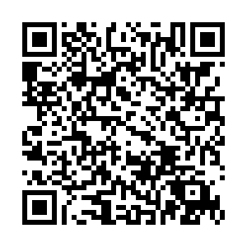
Requests open for online submissions February 7
Ensure you know your myEd password! If you need a reset, please use this QR-Code
Discuss your options with your family

Slide 23
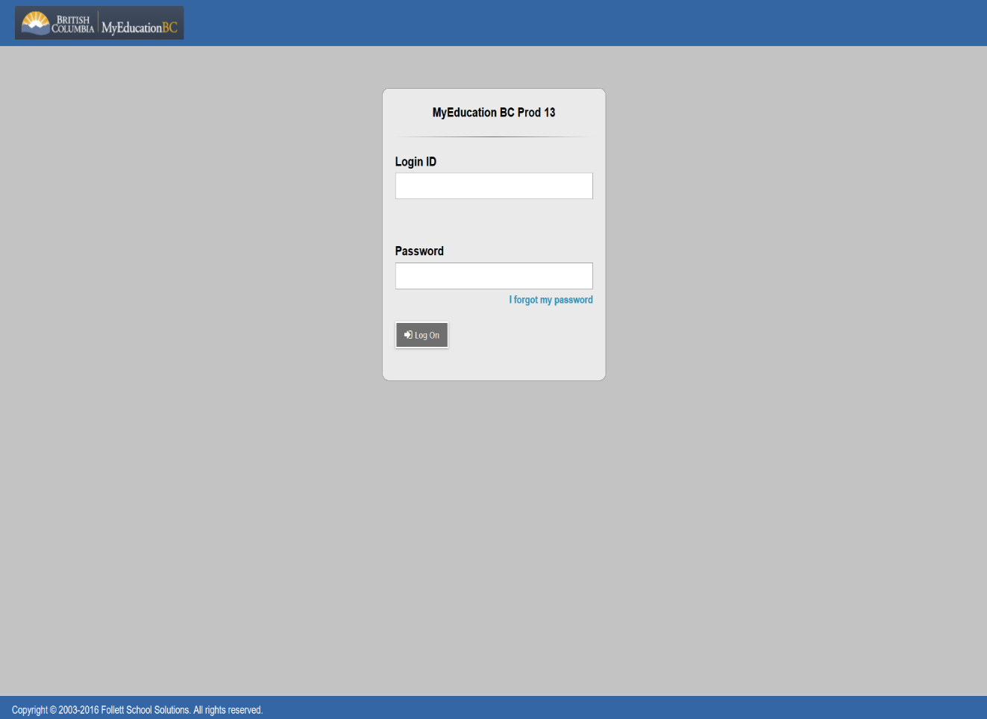
Submitting Course Requests Online
Student Number
Password Reset:

Slide 24
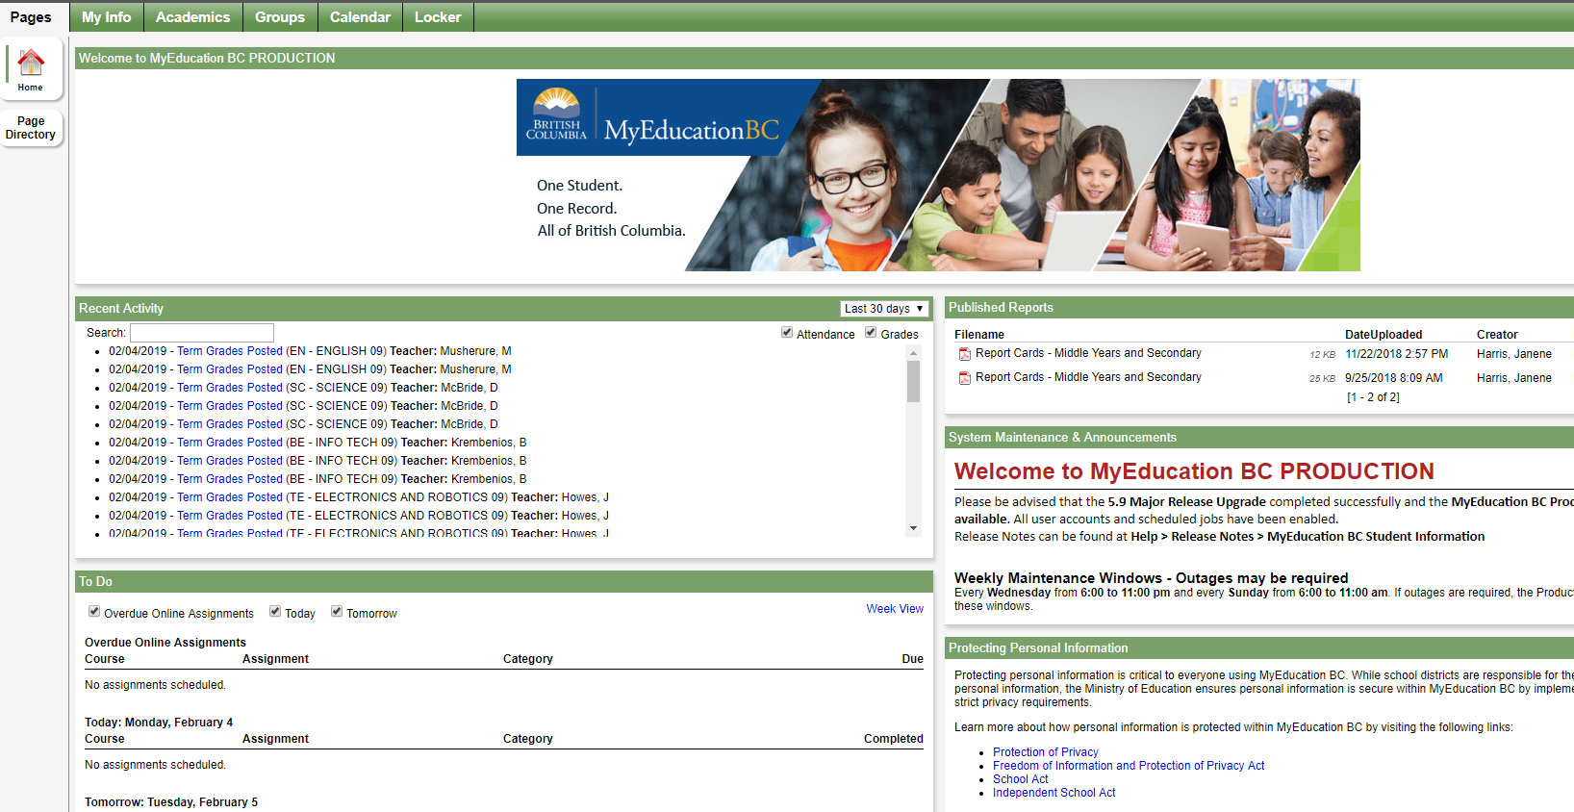
Submitting Course Requests Online

Slide 25
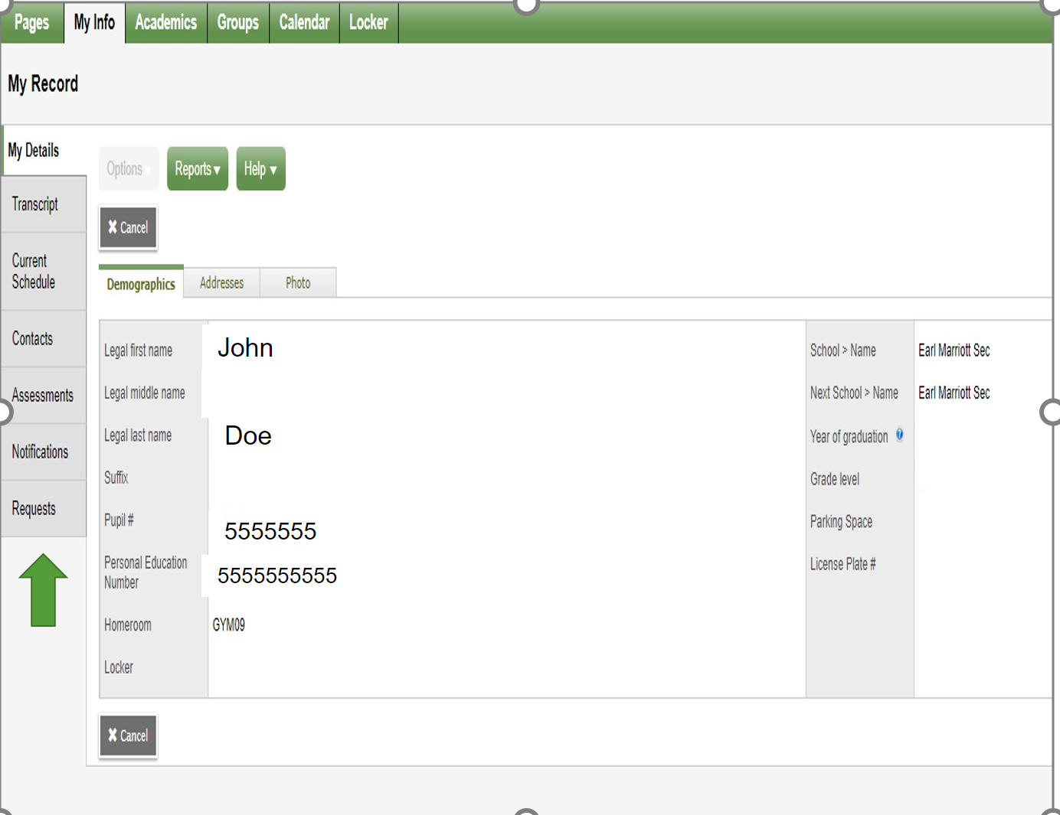
Submitting Course Requests Online

Slide 26
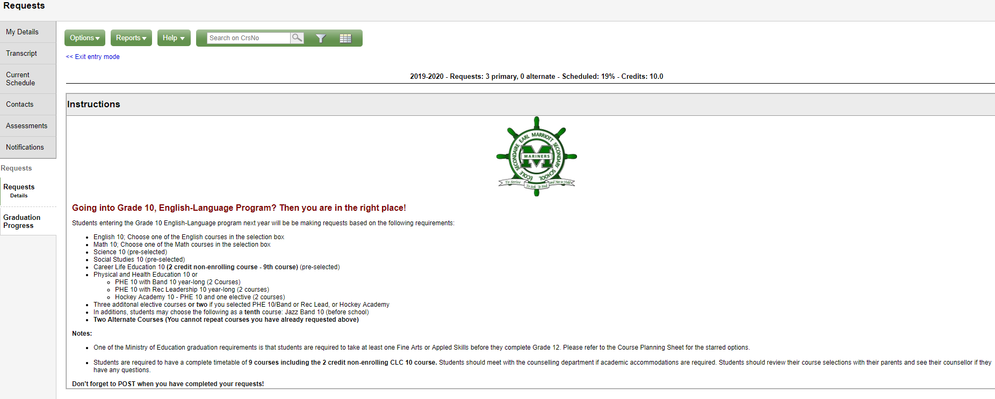
Submitting Course Requests Online

Slide 27
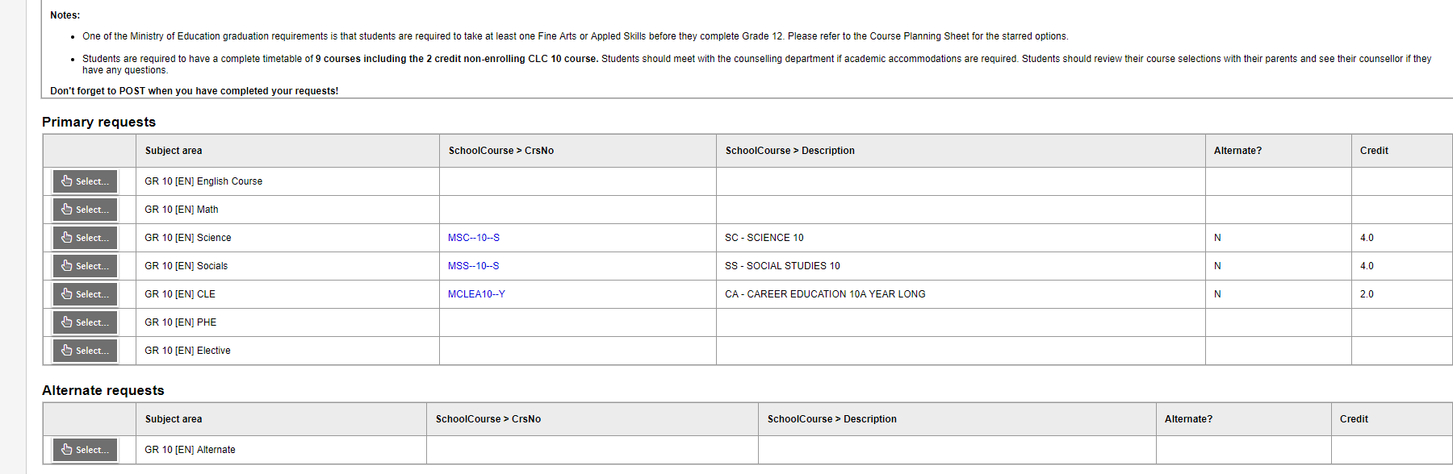
Submitting Course Requests Online

Slide 28
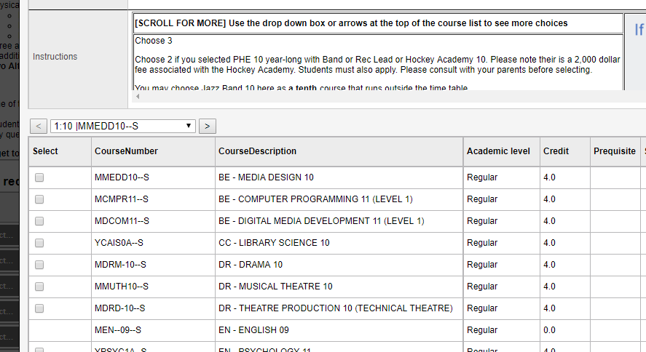
Submitting Course Requests Online

Slide 29
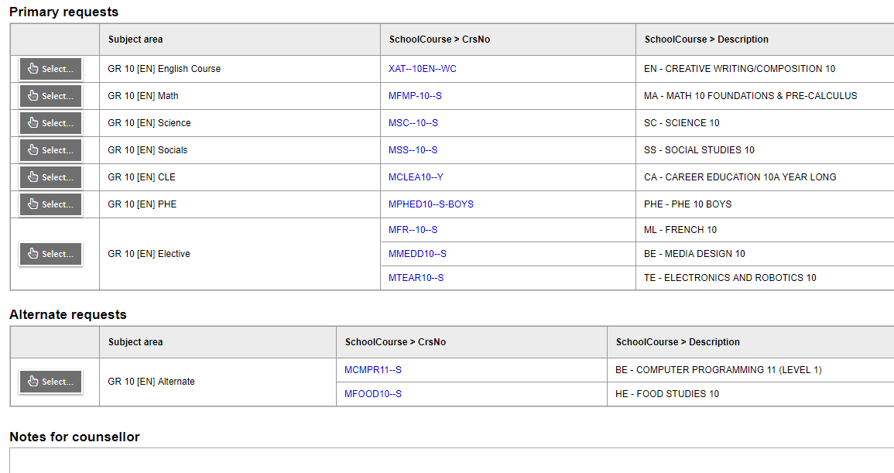
Submitting Course Requests Online

Slide 30
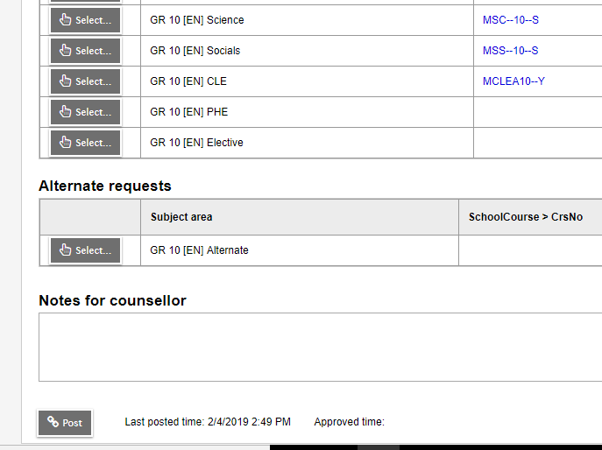
Submitting Course Requests Online

Slide 31
Course Planning Documents
See our website for:
  Course Planning Guide
  Course Catalogue
  Sample Course Selection Planning Sheets
  Student Portal instructions
  Website: https://www.surreyschools.ca/kwantlenpark/page/53496/course-selection

Slide 32
Questions?
Counsellors are currently monitoring and will respond to any questions on the Teams page

