Slide 1


Course Planning:
Grade 8 into 9
February 7, 2025
Notes:
Welcome to Kwantlen Parks course selection presentation for grade 9s going into grade 10 for the 2025-26 school year

Slide 2
Acknowledgement
We would like to acknowledge that the lands on which we work, play and learn, are on the shared traditional territory of the Katzie, Kwantlen, Semiahmoo and other Coast Salish Peoples.

Slide 3
Timeline
Course requests will happen at home (Feb 7 – 28)
Use your Course Planning Sheet before you go online to help you decide which courses you will request.
How To guides and other information are available at https://www.surreyschools.ca/kwantlenpark/page/53496/course-selection
Email your alpha counsellor with any questions
Mr Church A – Dhak
Mr. Sedaros Dhal – Koo
Ms. Bhullar Kor – Rah
Mr. Brar Rai - Z

Slide 4
Grade 9 Courses
English Program
English 9
Math 9
Science 9
Social Studies 9
Physical & Health Education 9
Other Electives (Choose three)
Careers 9 (online)
French Immersion Program
English 9
Math 9
Science 9
Science Humaines9
Education Physique 9
Français Langue 9
Other Elective (Choose 2)
Careers 9 (online)

Slide 5
Careers Courses
Grade 8 – Careers 8 (Online)
Grade 9 – Careers 9 (Online)
Grade 10 – Career Life Education (CLE) 10
Grade 11 – Career Life Connections (CLC) 12 + Capstone

Slide 6
English Program - Second Language
We recommend taking a second language through to a Language 11:
  will keep all doors open after high school
  is a requirement for direct entry to some universities
  is great for travel + cultural understanding

Slide 7
Electives
English program students can choose three electives (one must be an applied skill or design course and one of these can be a language)
French Immersion program students can choose two electives (one must be an applied skill or design course)

Slide 8
Two alternate Electives
You are required to request two alternate courses in case your main request cannot be met.
Alternates must be different from the electives you have already requested.

Slide 9
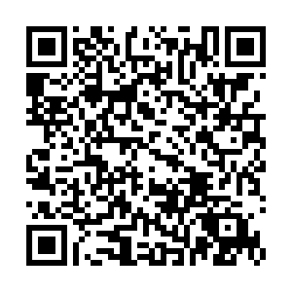
Requests open for online submissions February 7
Ensure you know your myEd password! If you need a reset, please use this QR-Code
Discuss your options with your family

Slide 10
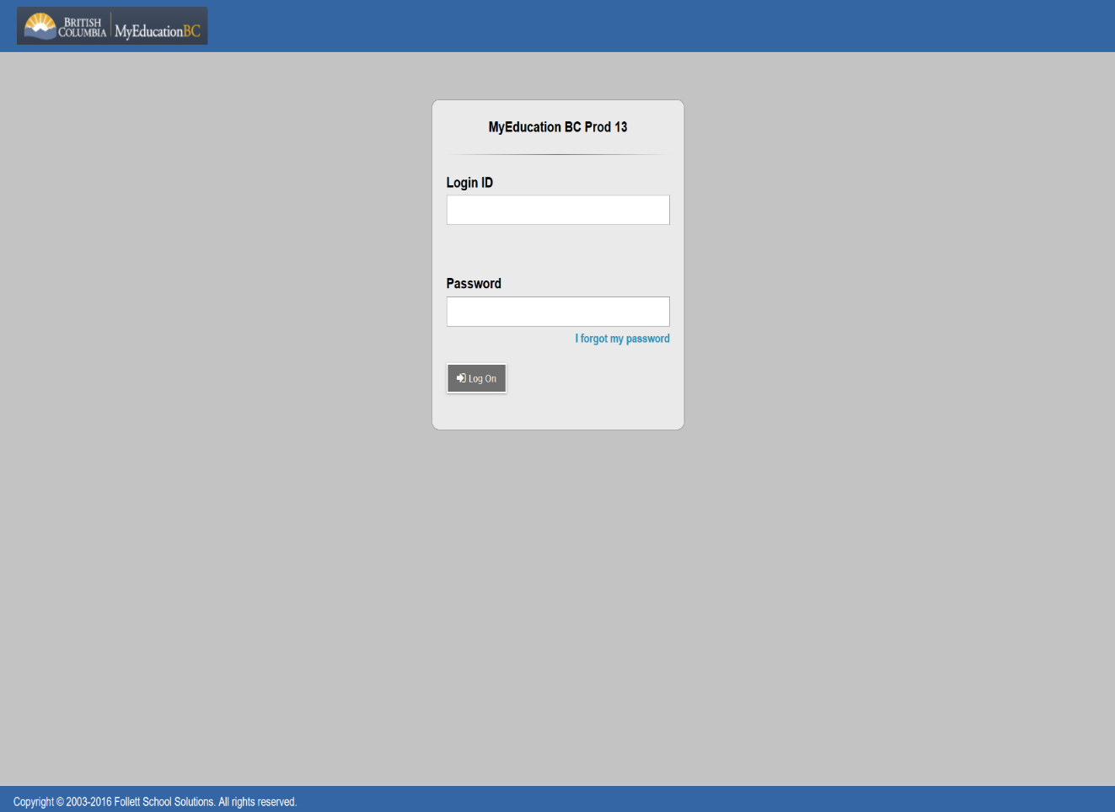
Submitting Course Requests Online
Student Number
Password Reset:

Slide 11
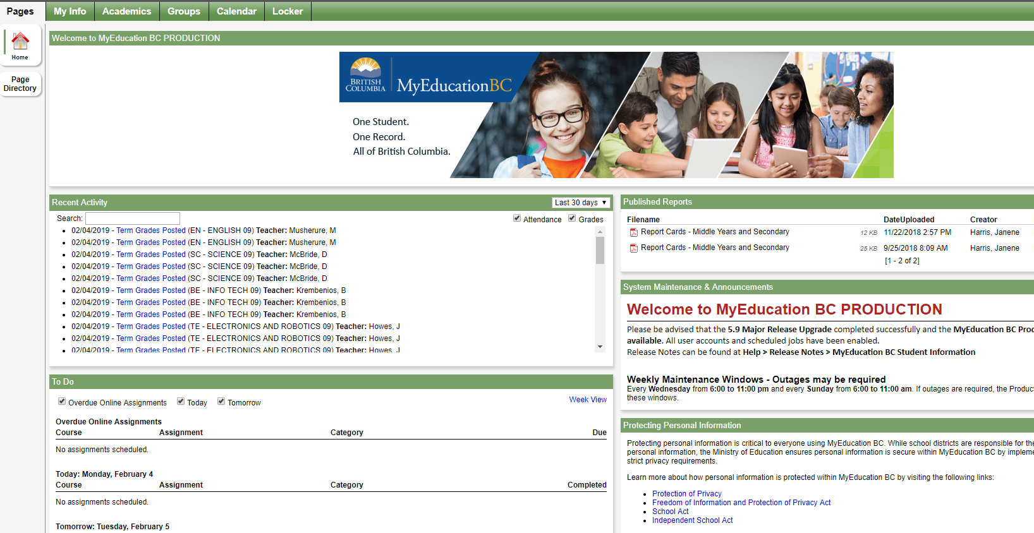
Submitting Course Requests Online

Slide 12
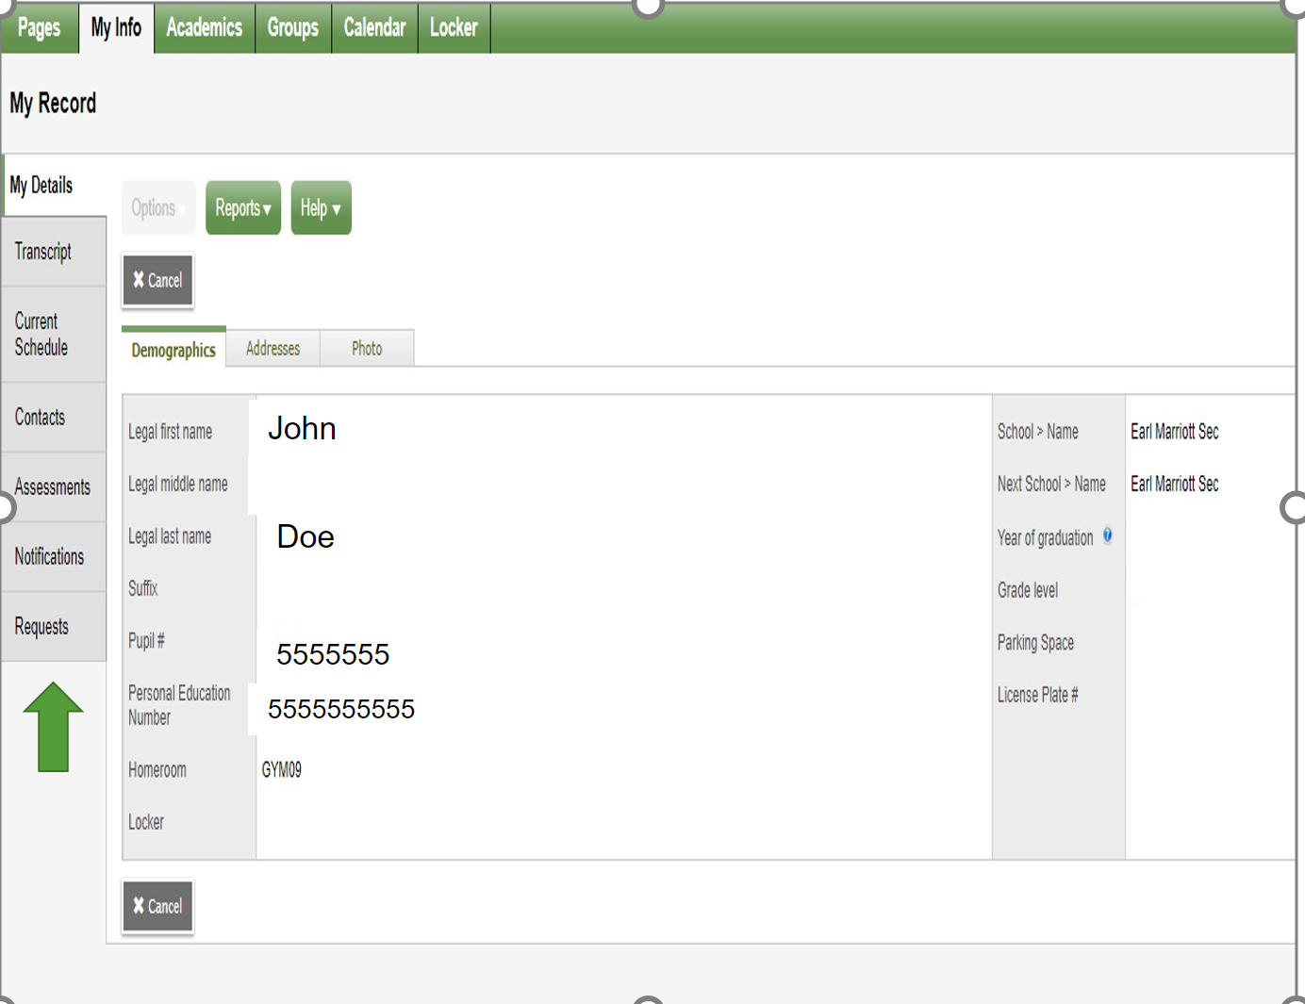
Submitting Course Requests Online

Slide 13
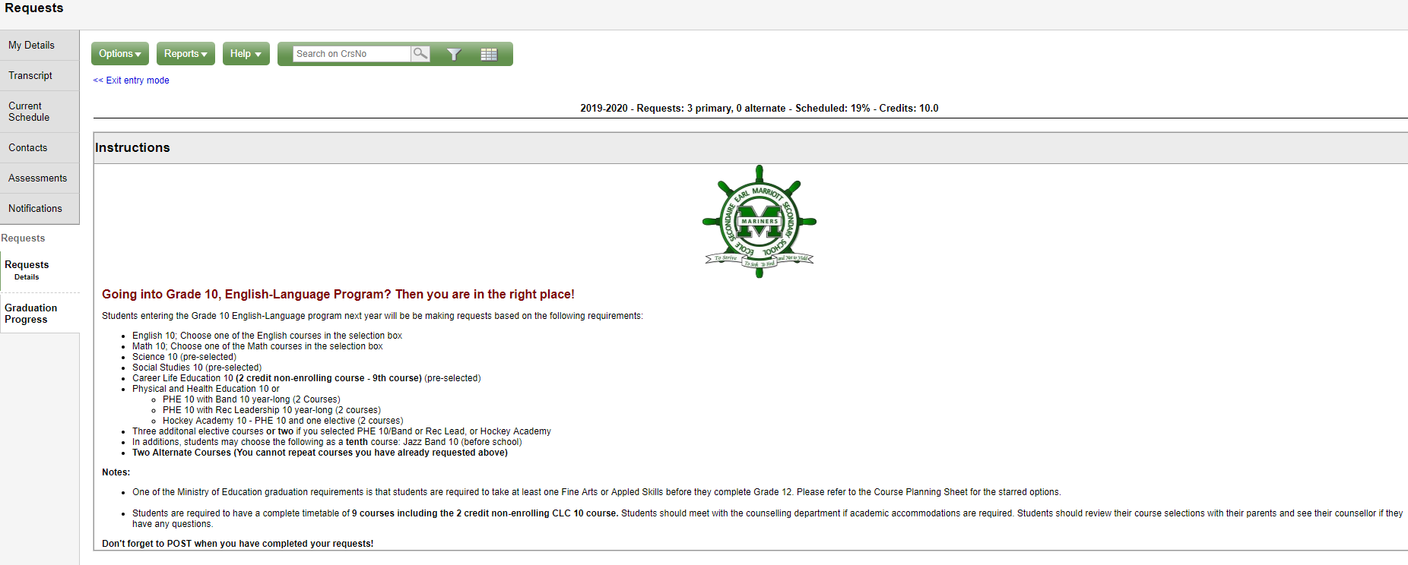
Submitting Course Requests Online

Slide 14
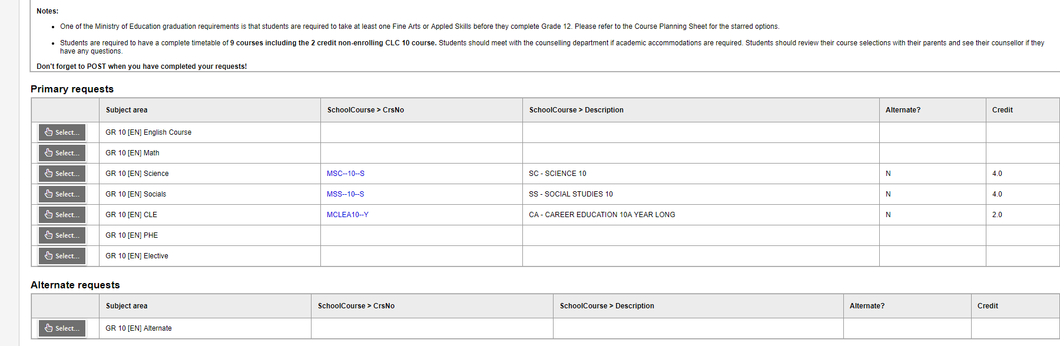
Submitting Course Requests Online

Slide 15
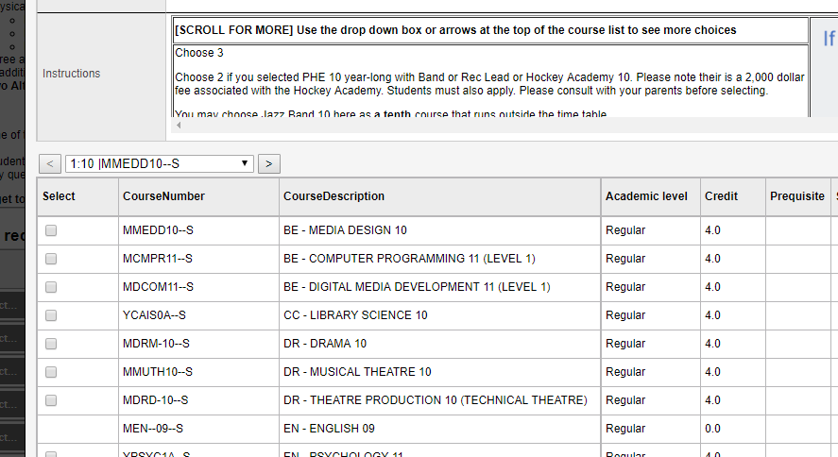
Submitting Course Requests Online

Slide 16
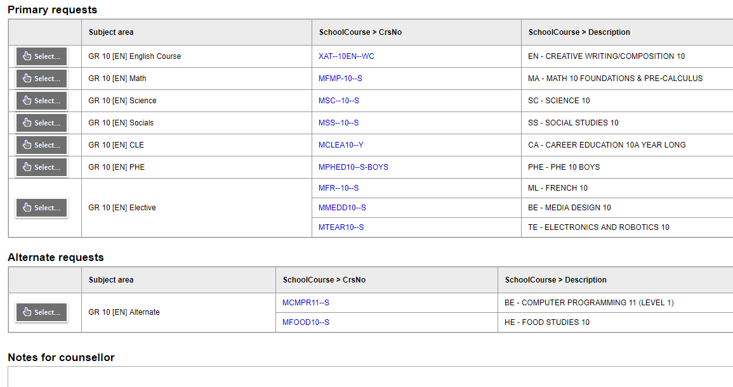
Submitting Course Requests Online

Slide 17
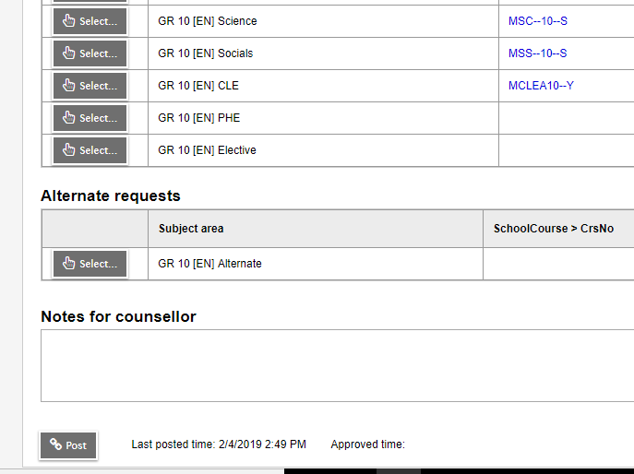
Submitting Course Requests Online

Slide 18
Course Planning Documents
See our website for:
  Course Planning Guide
  Course Catalogue
  Sample Course Selection Planning Sheets
  Student Portal instructions
  Website: https://www.surreyschools.ca/kwantlenpark/page/53496/course-selection

Slide 19
Questions?
Counsellors are currently monitoring and will respond to any questions on the Teams page.

