Slide 1


Course Planning:
Grade 9 into 10
February 7, 2024
Notes:
Welcome to Kwantlen Parks course selection presentation for grade 9s going into grade 10 for the 2024-25 school year

Slide 2
Acknowledgement
We would like to acknowledge that the lands on which we work, play and learn, are on the shared traditional territory of the Katzie, Kwantlen, Semiahmoo and other Coast Salish Peoples.

Slide 3
Timeline
Course requests will happen at home (Feb 7 – 28)
Use your Course Planning Sheet before you go online to help you decide which courses you will request.
How To guides and other information are available at https://www.surreyschools.ca/kwantlenpark/page/53496/course-selection
Email your alpha counsellor with any questions
Mr Church A – Dhak
Mr. Sedaros Dhal – Koo
Ms. Bhullar Kor – Rah
Mr. Brar Rai - Z

Slide 4
Graduation Requirements
  80 credits minimum (Each course = 4 credits)
    48 required credits (12 courses)
    28 elective credits (7 courses)
  Numeracy 10 Assessment
  Literary 10 Assessment
  Literacy 12 Assessment
  First Peoples Education Course
  Career Life Education 10 (CLE)
  Career Life Connections 12 (CLC)

Slide 5
Graduation Requirements
English Program
English 10, 11, 12
A Math 10, A Math 11
A Physical & Health Education 10
Career Life Education (CLE) 10
Career Life Connections (CLC) 12 + Capstone
Science 10, A Science 11 or 12
Social Studies 10, A Social Studies 11 or 12
Electives 10, 11, 12 (one must be an ADST course)
French Immersion Program
English 10, 11, 12
A Math 10, A Math 11
Education Physique10
Career Life Education (CLE) 10
Career Life Connections (CLC) 12 + Capstone
Sciences 10, A Science 11 or 12
Science Humaines 10, Histoire 12
Francais Langue 10, 11, 12
Electives 10, 11, 12 (one must be an ADST course)

Slide 6
Grade 10 Courses
English Program
English 10 (Choose one)
Math 10 (Choose one)
Science 10
Social Studies 10
Career Life Education (CLE) 10
Physical & Health Education 10 (Choose one)
Other Electives (Choose two)
French Immersion Program
English 10 (Choose one)
Math 10 (Choose one)
Science 10
Science Humaines10
Career Life Education (CLE) 10
Physical & Health Education 10
Français Langue 10
Other Elective (Choose one)

Slide 7
English Language Arts 10
Choose one of the following three options:
English First Peoples Literary Studies/Writing
English First Peoples Spoken Language/Writing
English First Peoples New Media/Writing

Slide 8
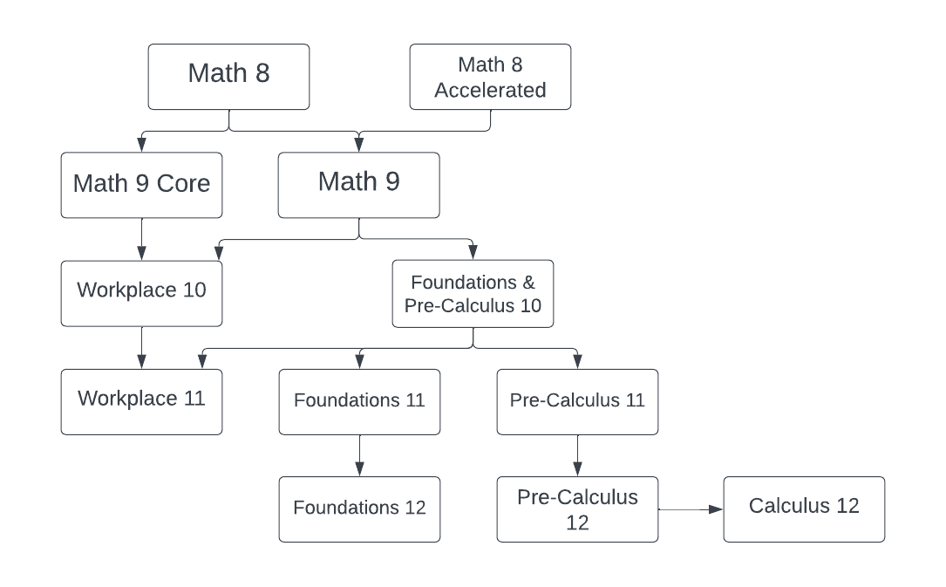
Mathematics

Slide 9
Mathematics 10
Choose one of the following two options:
Foundations & Pre-Calculus 10
Workplace 10

Slide 10
Careers Courses
Grade 8 – Careers 8 (Online)
Grade 9 – Careers 9 (Online)
Grade 10 – Career Life Education (CLE) 10
Grade 11 – Career Life Connections (CLC) 12 + Capstone

Slide 11
English Program - Second Language
We recommend taking a second language through to a Language 11:
  will keep all doors open after high school
  is a requirement for direct entry to some universities
  is great for travel + cultural understanding

Slide 12
Electives
English program students can choose two electives (one of these can be a language)
French Immersion program students can choose one elective

Slide 13
Two alternate Electives
You are required to request two alternate courses in case your main request cannot be met.
Alternates must be different from the electives you have already requested.

Slide 14
Career Education: District Partnerships
Auto Collision Repair
Auto Refinishing Prep
Auto Service Technician
Baking & Pastry Arts
BCIT Trades Sampler
Canadian Flight Centre
Carpentry
Culinary Arts
Drafting/CADD
Education Assistant
Electrical
Emily Carr Headstart in Art
Hairdressing
Heavy Mechanical Trades
Horticulture
Masonry
Metal Fabrication
Millwright/Industrial Mechanic
NVIT Law Enforcement Prep
Painter/Decorator
Piping
Roofing
Welding
Youth Work in Trades (apprenticeship)
and much more…

Slide 15
Getting Involved (NOW!)
Most post-secondary schools are now requiring:
  Extra-curricular involvement (clubs, teams)
  Volunteer work in the school and/or community
  Leadership
  Being “well rounded”
Tips:
  Develop a strong resume
  Start collecting reference letters, certificates
  Start a folder

Slide 16
External Graduation Credits
Language Challenge
External Credentials
  in sports, languages, music, dance, Scouts, Guides, lifesaving, ICBC driver education, boating, etc.
Partnership programs & Apprenticeships

Slide 17
Grade 10 Course Planning Sheet – English / FrIM Program
Please ensure you are working off the correct course planning sheet, either English or FRIM program.

Slide 18
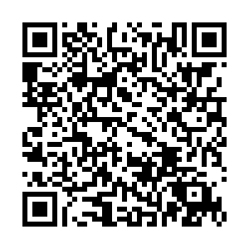
Requests open for online submissions February 7
Ensure you know your myEd password! If you need a reset, please use this QR-Code
Discuss your options with your family

Slide 19
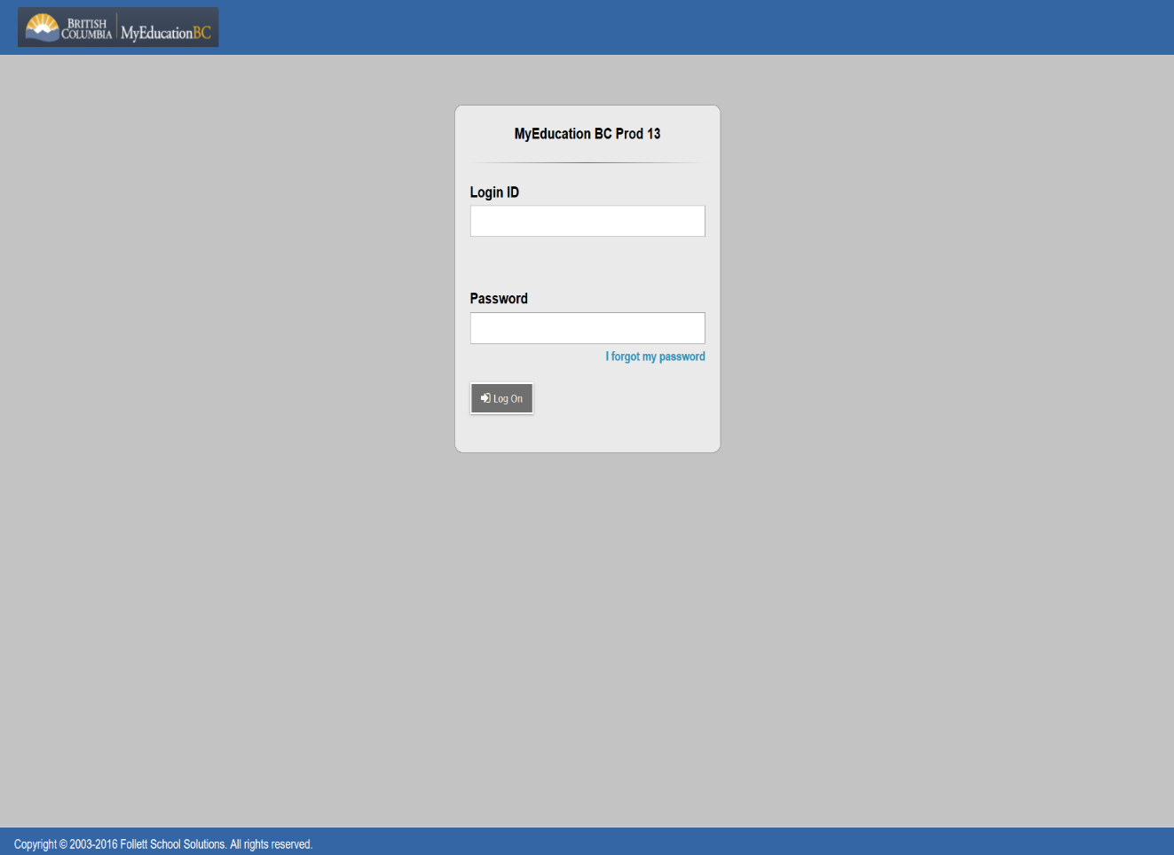
Submitting Course Requests Online
Student Number
Password Reset:

Slide 20
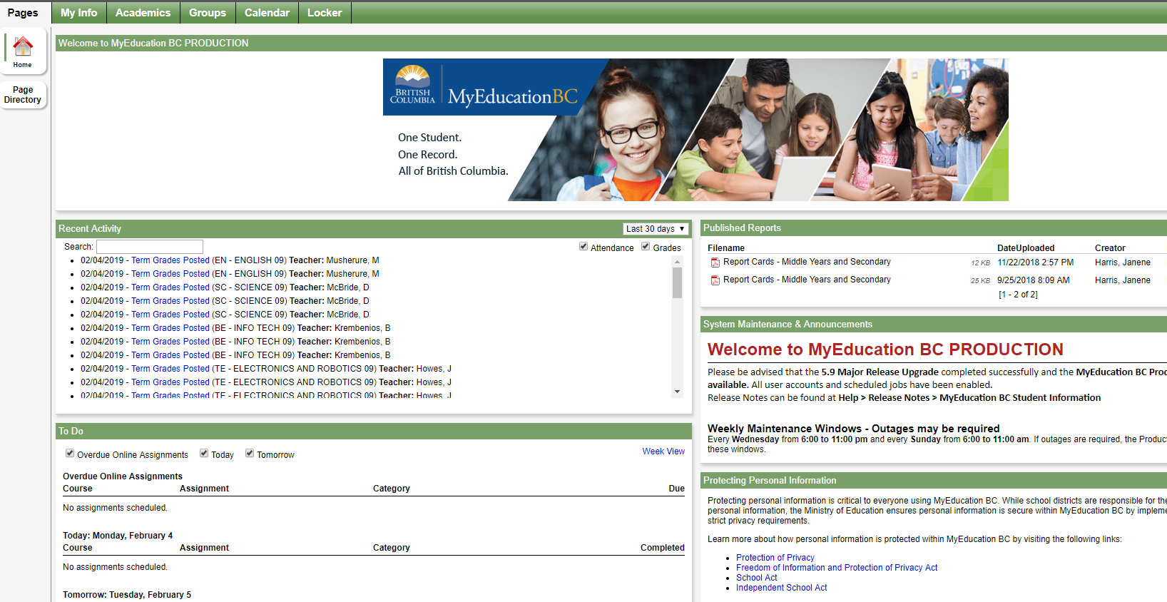
Submitting Course Requests Online

Slide 21
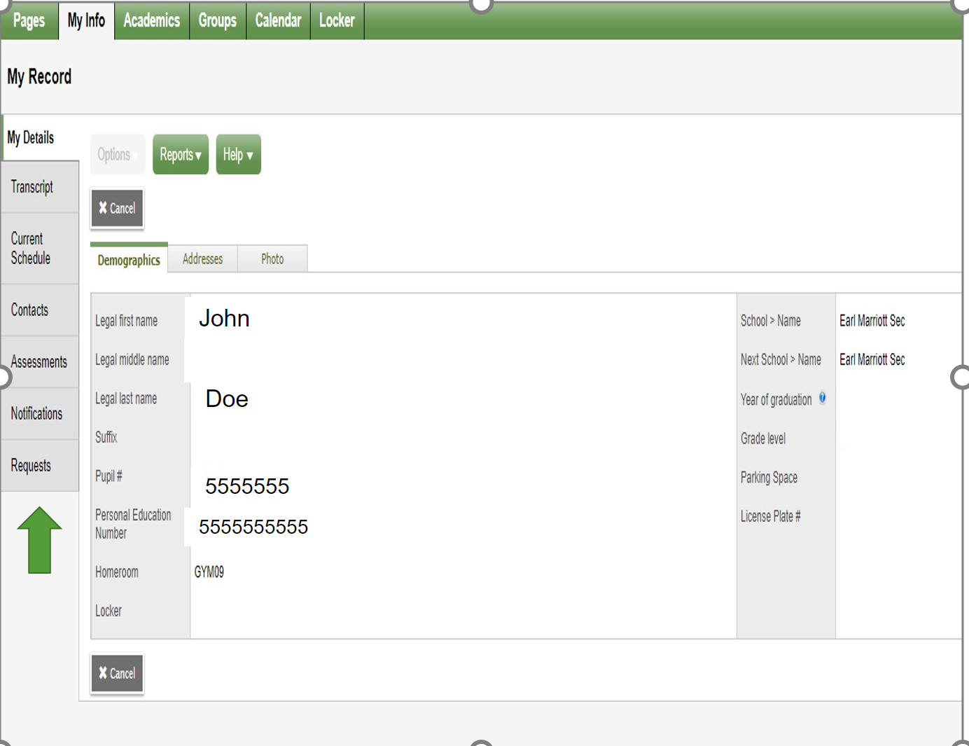
Submitting Course Requests Online

Slide 22
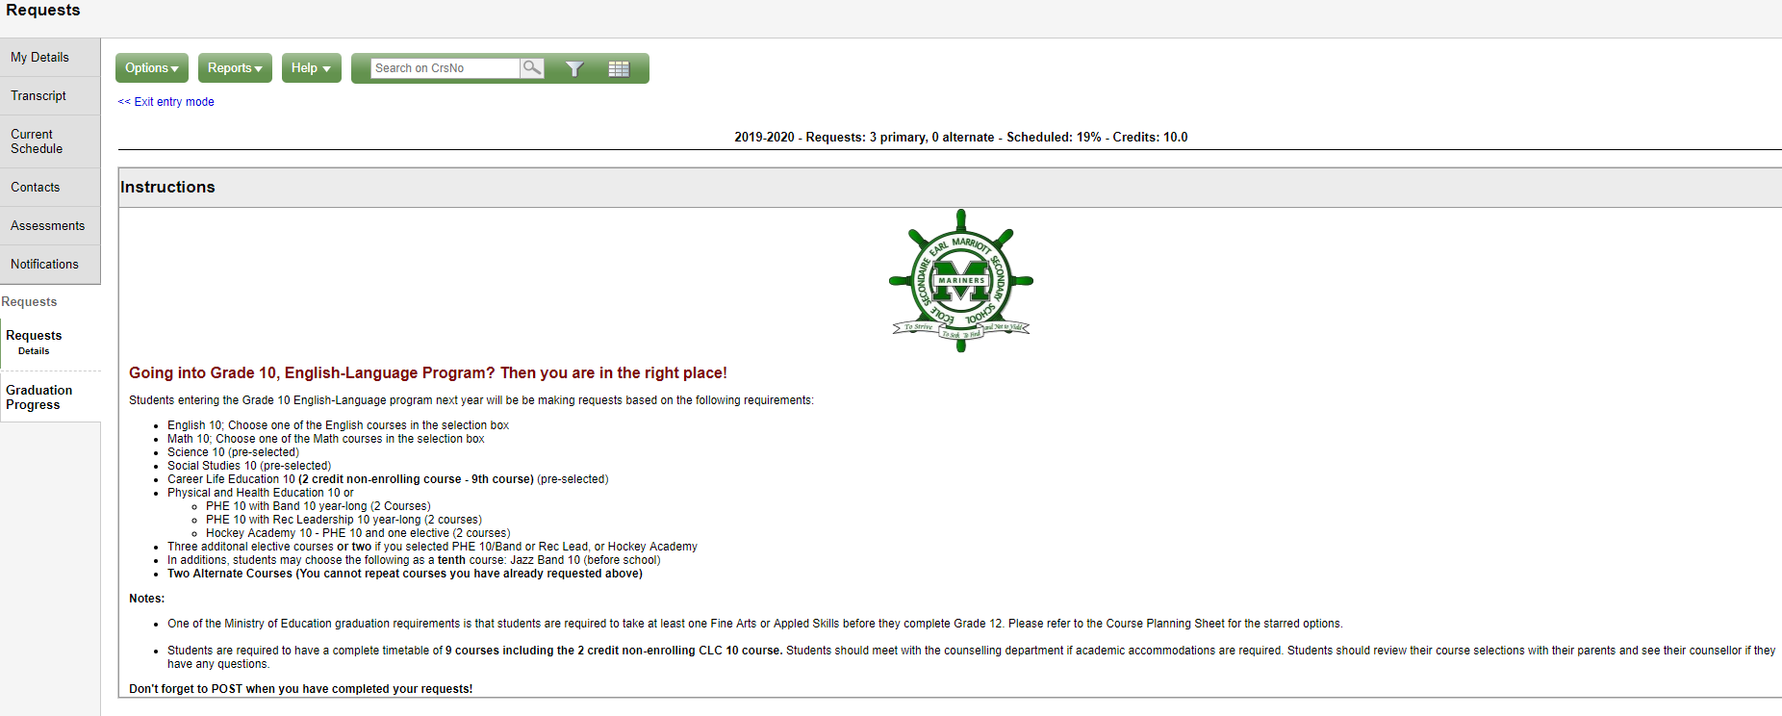
Submitting Course Requests Online

Slide 23
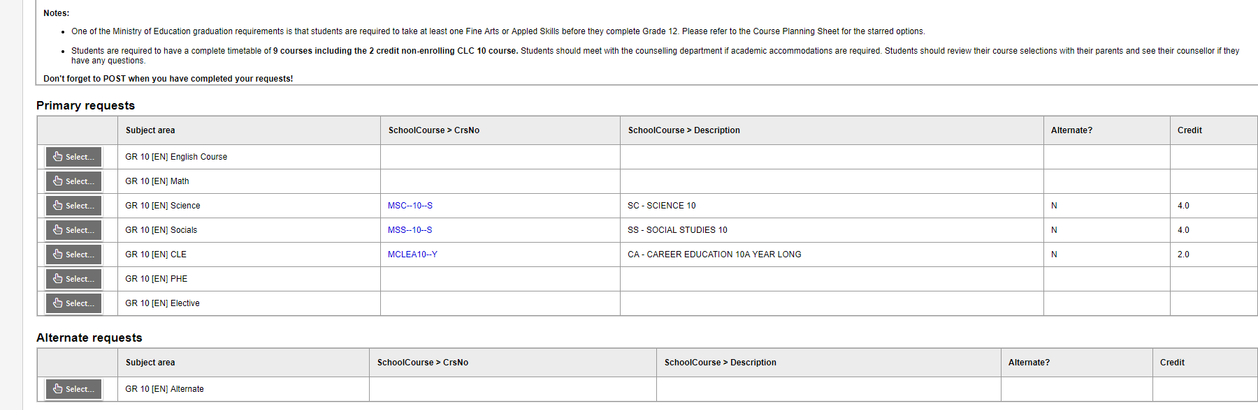
Submitting Course Requests Online

Slide 24
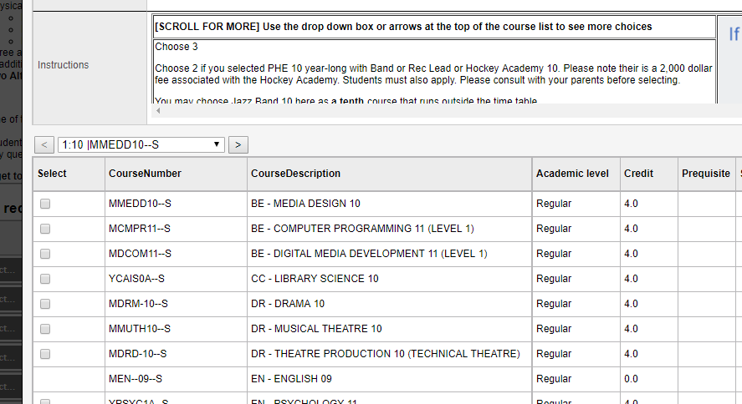
Submitting Course Requests Online

Slide 25
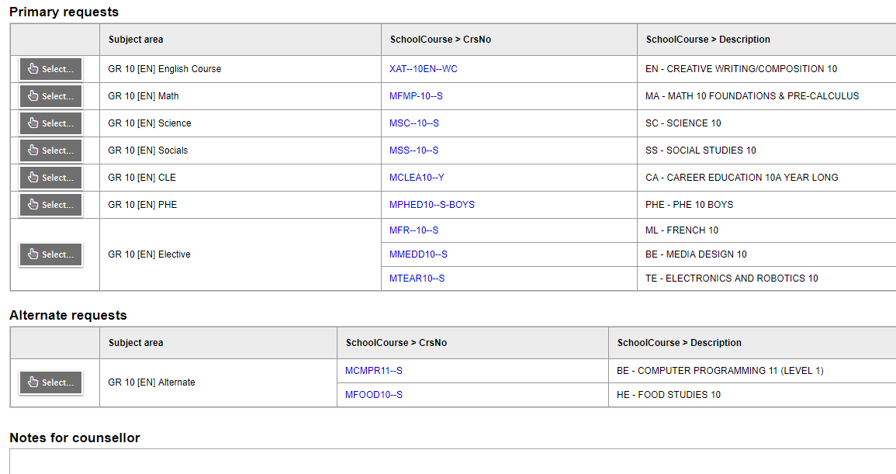
Submitting Course Requests Online

Slide 26
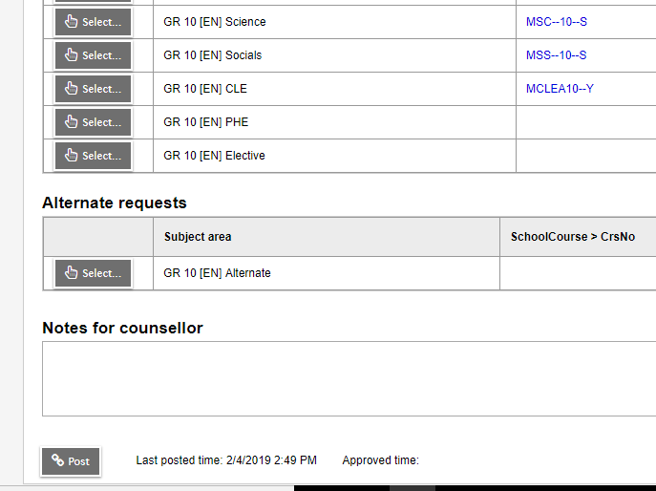
Submitting Course Requests Online

Slide 27
Course Planning Documents
See our website for:
  Course Planning Guide
  Course Catalogue
  Sample Course Selection Planning Sheets
  Student Portal instructions
  Website: https://www.surreyschools.ca/kwantlenpark/page/53496/course-selection

Slide 28
Questions?
Counsellors are currently monitoring and will respond to any questions on the Teams page

