Slide 1

Ecole Panorama Ridge
Course Selection
GRADE 10

Slide 2

Graduation Requirements
1 English 10 (4 options all with composition + a specific focus)
1 Math 10 (3 options)
Social Studies 10
Science 10
Physical Health and Education 10
1 Applied Skill or Fine Art (in grade 10, 11 or 12)
Language 10 (If planning to attend University for Arts)
OR 1 other Elective
Numeracy 10 assessment
Literacy 10 Assessment
Minimum 8 courses
GRADE 10

Slide 3
Graduation Requirements
1 English 11 (4 options – including English First Peoples 11)
1 Socials 12 (Taken in grade 11 or grade 12)
1 Math (3 options)
1 Science (5 Options)
Career Life Education
1 Indigenous Course (Taken in grade 11 or 12)
Language 11 (4 Options - If planning for University Arts)
3-4 Electives (more sciences, socials, fine arts etc.)
No study blocks
Minimum 8 courses
GRADE 11

Slide 4
Graduation Requirements
English 12 OR English First Peoples 12
An Indigenous Studies course (English First Peoples 11 or 12, OR, Contemporary Indigenous Studies 12)
Career Life Connections (which includes the Capstone Project)
A minimum of 2 additional grade 12 courses
Electives to complete required number of credits
Literacy 12 Assessment
Minimum required credits for grades 10-12 is 80
Each course completed counts as 4 credits
GRADE 12

Slide 5

French Immersion Students
Required Courses:
Grade 10: Sciences 10, Sciences Humaines 10, Francais Langue 10, Education Physique 10, a Math 10, an English 10
Grade 11: Histoire du Monde 12, Communication Orale 11, a Math 11, an English 11, a Science 11, CLE
Grade 12: Francais Langue 12, English Studies 12, CLC, Literacy 12 Assessment, Évaluation de Littératie – Immersion 12
* You will also need to take an Indigenous English OR Social Studies course in grade 11 or 12. *

Slide 6

Languages
Please Note: this is NOT a graduation requirement
A language 11 is a requirement to complete a Bachelor of Arts Program at university (and in some cases a grade 12 language is recommended)
Punjabi 10 Spanish 9 and Spanish 10 French 10 OR Intro Spanish 11
Punjabi 11 Spanish 11 French 11
Punjabi 12 Spanish 12 French 12

Slide 7

Language Challenge Exam
An exam done in January at the Delta School District (Registration is at end of October/early November). Message Ms. Wisniewski for information.
Must have documentation of prior learning
Can be used as a grade 12 course for graduation and as an entrance course for some universities
Languages available to Challenge:
French 11/12 Mandarin 11/12
German 11/12 Punjabi 11/12
Japanese 11/12 Spanish 11/12
Korean 11/12

Slide 8

Math Pathways
Linear Math 9 Math 9
Workplace Math 10 Foundations and Pre-Cal 10
Workplace Math 11 Foundations 11 Pre-Cal 11
Foundations 12 Pre-Cal 12
Calculus 12

Slide 9

Courses that Require Applications
Community Leadership (grades 11 & 12) – Mr. Visscher – see next slide
All Coop Programs (grade 11) – Ms. Dudley / Mr. Crosby or Ms. Mangat
All Career Prep Programs (grades 11 &12) – Ms. Martin
Peer Tutoring (grades 11 & 12) – Mr. Lee
Library Science (grades 11 & 12) – Ms. Rudan
Yearbook (grades 11 & 12) – Ms. Mayer
Theatre Company (audition grades 11 &12) – Ms. Coupar
Dance Choreography (10-12) – Ms. Bryson
Choose your courses as if you are not getting into these classes and we will change your schedule once you are accepted!

Slide 10
Leadership Courses
Community Leadership 11/12
Mr. Visscher
Application Course – January 22nd deadline
Plan events within the school (Grade 8 Day, Terry Fox Fun, Spirit Assembly)
Leaders on Student Council
Community Service Component
Athletic Leadership 11/ 12
Mr. Duke
No application - choose on course selection
X Block – happens after school
Run intramurals, scorekeeping, athletics promotion
MUST be available after school and at lunch

Slide 11

Hybrid Learning
Computer Programming 11/12
(Mr. Nordlund)
Students spend 50% of their time in class and 50% working remotely on a personal laptop

Slide 12

Summer School
Full credit courses available (Grades 10-12)
Registration begins in April
Information at Surrey Summer Learning online www.surreysummer.ca
If you enroll in a summer school course, please connect with your counsellor to ensure that your course selection is accurate for the Fall. There will be an opportunity to fill out an Online Course Change Request before the year begins, but it is always best to keep your counsellor informed!

Slide 13


Alternate Learning
Online Courses (SAIL): Must be completed by the end of January of grade 12 to be used for university entrance in September of the same year.
Night School: Can be completed in semester 1 or 2 of grade 12 and be used for university entrance.

Slide 14
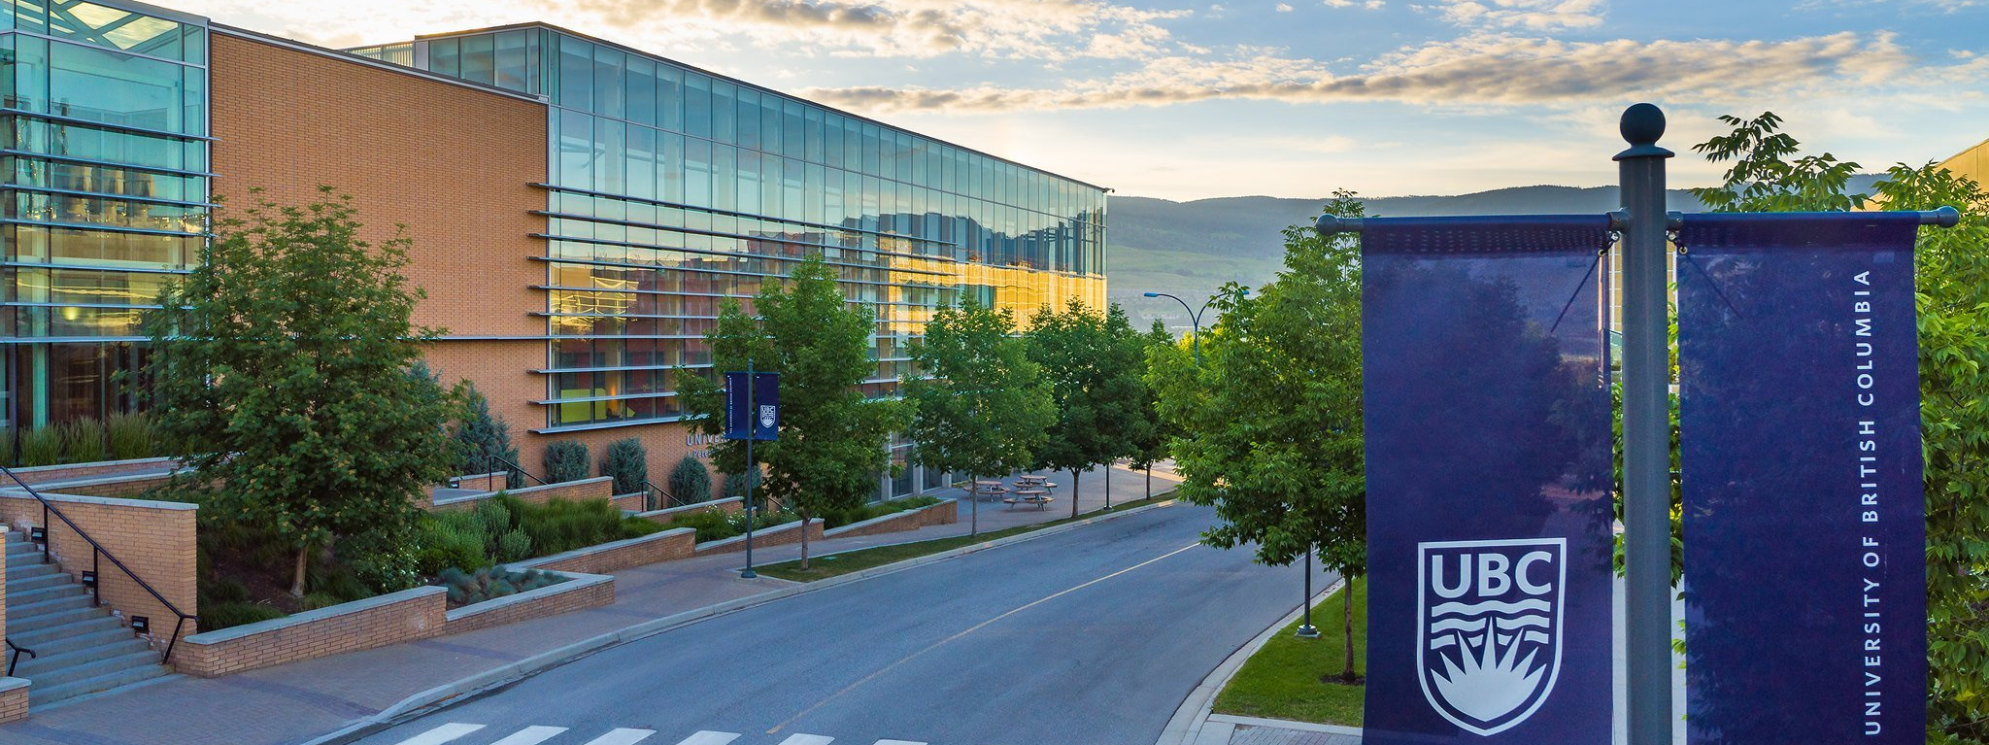
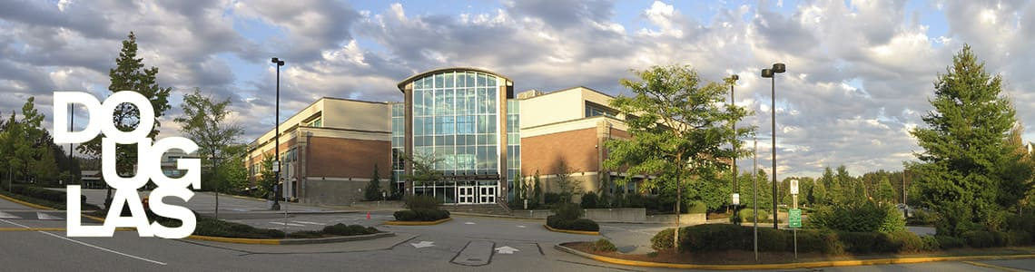
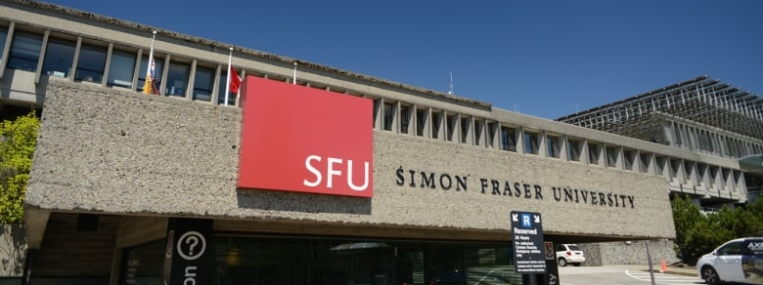
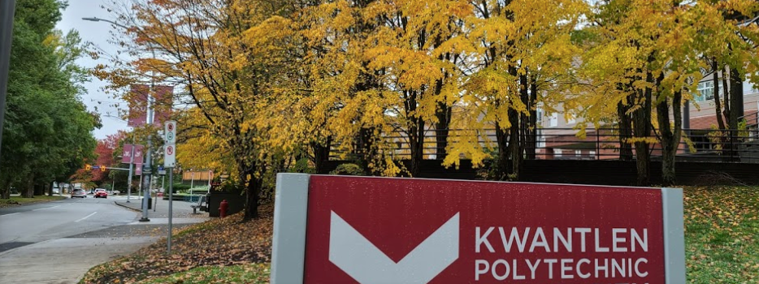
Applying to University
DIRECT ROUTE
Apply DIRECTLY to UNIVERSITY from high school. VERY COMPETITIVE (80%-90% average or higher)
You apply to a FACULTY (Arts, Business, Science, Engineering, Nursing etc.)
INDIRECT ROUTE
Apply to COLLEGE and then TRANSFER to university after 1-2 years (60% in English 12 is the only requirement)

Slide 15


University Degree General Guide
5 (SFU) or 6 (UBC) grade 12 courses
Arts : English 11, Language 11, Science 11, Math 11 (Pre-Calculus or Foundations)
English 12, (Language 12 recommended for UBC), Math or Science 12 (SFU)
Science: English 11, Physics 11, Chemistry 11, Pre-Calculus 11
English 12, Pre-Calculus 12, and two of Biology 12, Chemistry 12, or Physics 12
Business: English 11, Pre-Calculus 11, Science 11
English 12, Pre-Calculus 12 plus other academic Grade 12 courses (Calculus recommended)
Applied Science / Engineering: English 11, Pre-calculus 11, Physics 11, Chemistry 11, English 12, Pre- Calculus 12, Physics 12, Chemistry 12, Calculus 12 (required by some and recommended for others)
Nursing: English 11, English 12, Chemistry 11, Biology 12 (Check institution as there is variation)

Slide 16


Contacting Your Counsellor
If you would like to discuss any of this information in further detail, contact your counsellor on TEAMS to make an APPOINTMENT.
Mr. Holland A – Dhil, A
Ms. Wisniewski Dhil, B – Khal
Mr. Price Kham – Sai
Ms. Kurrein Saj - Z

