Slide 1

Ecole Panorama Ridge Course Selection
GRADE 11

Slide 2

Graduation Requirements Only
1 English 11 (4 options)
1 Socials 12 (taken in grade 11 or grade 12)
1 Math 11
1 Science 11
Career Life Education
3 Electives (many options)
Minimum 8 courses
GRADE 11

Slide 3
Graduation Requirements
English 12 OR English First Peoples 12
One Indigenous Course (English First Peoples or Contemporary Indigenous Studies)
Career Life Connections (which includes the Capstone Project)
A minimum of 2 additional grade 12 courses
Electives to complete required number of credits
Literacy 12 Assessment
Minimum required credits for grades 10-12 is 80
Each course completed counts as 4 credits
GRADE 12

Slide 4

French Immersion Students
Required Courses:
Grade 10: Sciences 10, Sciences Humaines 10, Francais Langue 10, Education Physique 10, a Math 10, an English 10,
Grade 11: Histoire du Monde 12, Communication Orale 11, a Math 11, an English 11, a Science 11, CLE
Grade 12: Francais Langue 12, English Studies 12, CLC, Literacy 12 Assessment, Évaluation de Littératie – Immersion 12
* You will also need to take an Indigenous English OR Social Studies course in grade 11 or 12. *

Slide 5

Languages
Please Note: this is NOT a graduation requirement
A language 11 is a requirement to complete a Bachelor of Arts Program at university (and in some cases a grade 12 language is recommended)
Punjabi 10 Spanish 9 and Spanish 10 French 10 OR Intro Spanish 11
Punjabi 11 Spanish 11 French 11
Punjabi 12 Spanish 12 French 12

Slide 6

Language Challenge Exam
An exam done in January at the Delta School District (Registration is at end of October/early November). Message Ms. Wisniewski if you have questions.
Must have documentation of prior learning
Can be used as a grade 12 course for graduation and as an entrance course for some universities
Languages available to Challenge:
French 11/12 Mandarin 11/12
German 11/12 Punjabi 11/12
Japanese 11/12 Spanish 11/12
Korean 11/12

Slide 7

Math Pathways
Linear Math 9 Math 9
Workplace Math 10 Foundations and Pre-Cal 10
Workplace Math 11 Foundations 11 Pre-Cal 11
Foundations 12 Pre-Cal 12
Calculus 12

Slide 8

Courses that Require Applications
Community Leadership (grades 11-12) – see next slide - Mr. Visscher
All Coop Programs (grade 11) – Ms. Dudley / Mr. Crosby or Ms. Mangat
All Career Prep Programs (grades 11 &12) – Ms. Martin
Peer Tutoring (grades 11 & 12) – Mr. Lee
Library Science (grades 11 & 12) – Ms. Rudan
Yearbook (grades 11 & 12) – Ms. Mayer
Theatre Company (audition grades 11 &12) – Ms. Coupar
Dance Choreography (10-12) – Ms. Bryson
Choose your courses as if you are not getting into these classes and we will change your schedule once you are accepted!

Slide 9
Leadership Courses
Community Leadership 11/12
Mr. Visscher
Application Course – January 22nd deadline
Plan events within the school (Grade 8 Day, Terry Fox Fun, Spirit Assembly)
Leaders on Student Council
Community Service Component
Athletic Leadership 11/ 12
Mr. Duke
No application - choose on course selection
X Block – happens after school
Run intramurals, scorekeeping, athletics promotion
MUST be available after school and at lunch

Slide 10

Hybrid Learning
Psychology 12 (Ms. Pooni)
Prerequisite = Psychology 11
For university / college bound students
In-person and online via Teams (monthly calendar outlines when you MUST be in class each week)
Computer Programming 11/12 (Mr. Nordland)
Students spend 50% of their time in class and 50% working remotely on a personal laptop
CLC 12 (Mr. Crosby)
A combination of online and in-class learning based on a weekly schedule provided by the teacher.

Slide 11

Advanced Placement
AP BIOLOGY
Year-long and includes Anatomy & Physiology 12 and AP Biology 12
opportunity to experience a first-year university course while in high school (& potentially earn university credits for the course you are taking)
AP Exam is written in May (must score 4 or 5 out of 5 to earn university credits)

Slide 12

Study Blocks
Grade 12 students may choose 1 Study Block during online course selection.
Check your credits. You need 80 credits to graduate.
You may APPLY for a 2ND STUDY BLOCK by filling out an application (available in May in the Counselling Office)
Be aware that universities look for a rigorous program (some with a minimum of 6 grade 12 acceptable courses)

Slide 13

Summer School
Full credit courses available (Grades 10-12)
Registration begins in April
Information at Surrey Summer Learning online www.surreysummer.ca
If you enroll in a summer school course, please connect with your counsellor to ensure that your course selection is accurate for the Fall. There will be an opportunity to fill out an Online Course Change Request before the year begins, but it is always best to keep your counsellor informed!

Slide 14


Alternate Learning
Online Courses (SAIL): Must be completed by the end of January of grade 12 to be used for university entrance in September of the same year.
Night School: Can be completed in semester 1 or 2 of grade 12 and be used for university entrance.

Slide 15
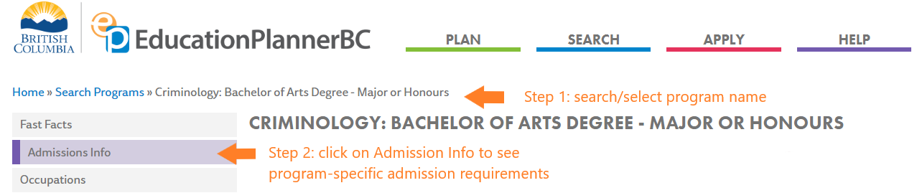

Planning for Post-Secondary
www.educationplannerbc.ca
SEARCH
Type in PROGRAM / CAREER (e.g. Nurse, Architect, Heavy Duty Mechanic, Dental Hygienist)
Choose INSTITUTION of Choice (e.g. BCIT, SFU, KPU)
Click on ADMISSIONS INFO (tab on left side)

Slide 16
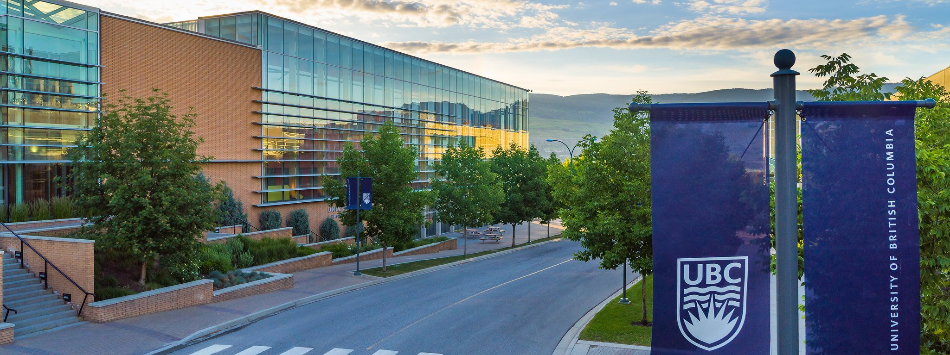


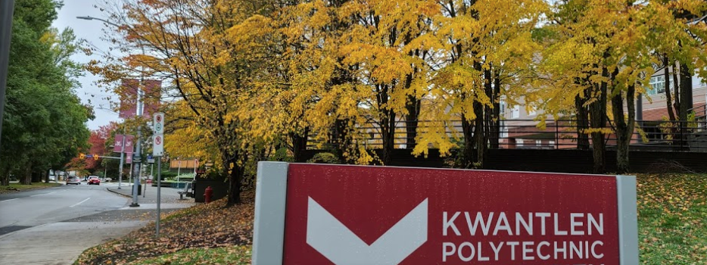
Applying to University
DIRECT ROUTE
Apply DIRECTLY to UNIVERSITY from high school. VERY COMPETITIVE (80% - 90% average or higher)
You apply to a FACULTY (Arts, Business, Science, Engineering, Computer Programming)
INDIRECT ROUTE
Apply to COLLEGE and then TRANSFER to university after 1-2 years (60% in English is the only requirement)

Slide 17


University Entrance General Guide
5 (SFU) or 6 (UBC) grade 12 courses
Arts : English 11, Language 11, Science 11, Math 11 (Pre-Calculus or Foundations)
English 12, (Language 12 recommended for UBC), Math or Science 12 (SFU)
Science: English 11, Physics 11, Chemistry 11, Pre-Calculus 11
English 12, Pre-Calculus 12, and two of Biology 12, Chemistry 12, or Physics 12
Business: English 11, Pre-Calculus 11, Science 11
English 12, Pre-Calculus 12 plus other academic Grade 12 courses (Calculus recommended)
Applied Science / Engineering: English 11, Pre-calculus 11, Physics 11, Chemistry 11, English 12, Pre- Calculus 12, Physics 12, Chemistry 12, Calculus 12 (required by some and recommended for others)
Nursing: English 12, Chemistry 11, Biology 12 (Check institution as there is some variation).

Slide 18


Contacting Your Counsellor
If you would like to discuss any of this information in further detail, contact your counsellor on TEAMS to make an APPOINTMENT.
Mr. Holland A – Dhil, A
Ms. Wisniewski Dhil, B – Khal
Mr. Price Kham – Sai
Ms. Kurrein Saj - Z

