Slide 1

École Panorama Ridge Secondary
Grade 8
Course Selection

Slide 2
Grade 9 Required Courses
English
Mathematics
Physical Education
Science
Social Studies
Elective 1 (Language)
Elective 2
Elective 3

Slide 3
Fine Art Electives
Visual Art 9
Drama 9
Dance 9
Guitar 9
Concert Band / Jazz Band 9

Slide 4
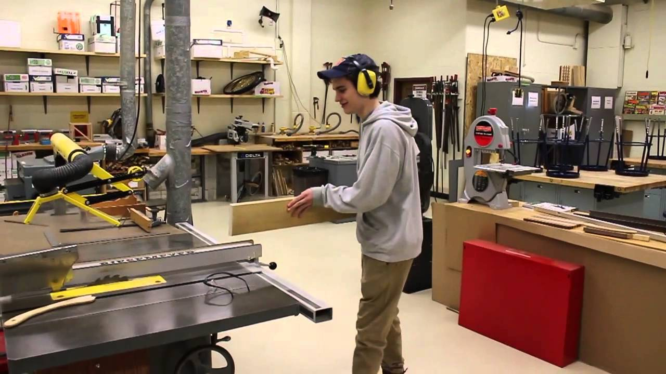
Applied Skills Electives
Computer Programming 9
Digital Media Art 9
Entrepreneurship and Marketing 9
Woodwork 9
Metalwork 9
Drafting and Design 9
Textile Studies 9
Food and Nutrition 9

Slide 5

Math pathways
Linear Math 9 Math 9
Workplace Math 10 Foundations and Pre-Cal 10

Slide 6

Language Options + Leadership
French 9
Spanish 9
Leadership 9

Slide 7

Band
Band 9
English 9
+

Slide 8

French Immersion
For French Immersion students, your course selection includes:
FRIM: Education Physique 9
FRIM: Humanites 9 (Sciences Humaines + Francais Langue)
FRIM: Sciences 9
English Language Arts 9
Mathematics 9
Elective
Elective

Slide 9

Questions?
This Power Point Presentation is available on our website:
www.surreyschools.ca/panoramaridge
Counsellors:
Mr. Holland (A - Dhil, A)
Ms. Wisniewski (Dhil, B - Khal)
Mr. Price (Kham - Sai)
Ms. Kurrein (Saj – Z)

