Slide 1
Course Selection
Grade 9

Slide 2
What do I need to Graduate?
Completion of Grade 9
80 credits from specific courses in Grades 10, 11 and 12
Capstone Project (which is done in Career Life Connections 12)
Numeracy and Literacy Assessments (grades 10 and 12)

Slide 3
What are the 80 credits all about?
Starting in Grade 10 each course you pass will give you 4 credits.
Some courses are required for graduation, and some are taken either because of interest and exploration or for future plans.
The required courses are………

Slide 4
Grade 10
English 10
(5 options)
Math 10
(3 options)
Social Studies 10
PHE 10
Science 10
Numeracy Assessment
One Applied Skill OR Fine Art
Literacy Assessment

Slide 5
Math Pathways
Linear Math 9 Math 9
Workplace Math 10 Foundations and Pre-Cal 10
Workplace Math 11 Foundations 11 Pre-Cal 11
Foundations 12 Pre-Cal 12
Calculus

Slide 6
Languages
In School
Challenge
French 10
Spanish 10 (or Intro Spanish 11)
Punjabi 10
French 11/12
Punjabi 11/12
Spanish 11/12
Mandarin 11/12
Korean 11/12
Japanese 11/12

Slide 7
Grade 11
English 11
(5 options)
Math 11
(3 options)
One Socials (can be done in gr. 11 or 12 - many options)
One Science 11
(Bio, Chem, Phys, Env’tal, Sci for Citizens)
Possible: Indigenous Course (English or Socials)
Career Life Education 11

Slide 8
Grade 12
English 12
Or
First Peoples English 12
Minimum of 3 grade 12 courses
Electives
(can be grade 11 or 12)
Career Life Connections 12 + Capstone Project
Literacy Assessment

Slide 9
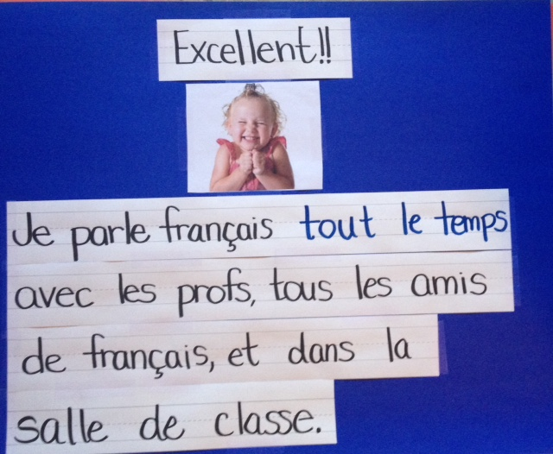
French Immersion Students
GRADE 10
Sciences 10, Sciences Humaines 10, Francais Langue 10, Education Physique 10, a Math 10, an English 10
GRADE 11
Histoire du Monde 12, Communication Orale 11, a Math 11, an English 11, CLE 11 & a Science 11
GRADE 12
Francais Langue 12, English Studies 12, & CLC 12
* You will also need to take an Indigenous English OR Social Studies course in grade 11 or 12. *

Slide 10
Completing your course selection
Brainstorm, plan & research using the Course Selection Handbook. It is on the school website with a description of all courses offered at P.R.
Complete your course requests on MyED
If you have forgotten your password, complete the google form to request a password reset, on our school website:
www.panoramaridge.ca

Slide 11
Contacting Your Counsellor
Don’t hesitate to contact your counsellor on Teams to discuss any questions you might have.
Counsellors’ Alphas:
Mr. Holland: A – Dhil, A
Ms. Wisniewski: Dhil, B – Khal
Mr. Price: Kham - Sai
Ms. Kurrein: Saj - Z

