Slide 1

Course Selection
Choosing my Classes on MyEdBC

Slide 2

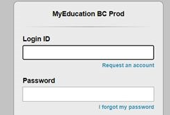
Get out your phones…

Slide 3
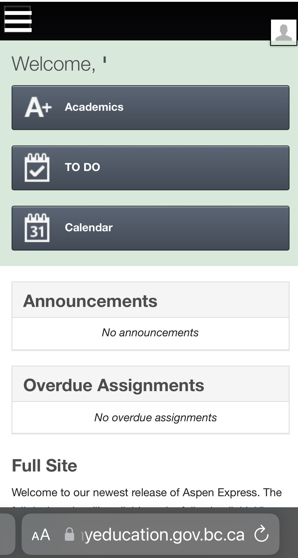
Login to MyedBC at www.myedcuation.gov.bc.ca

Slide 4
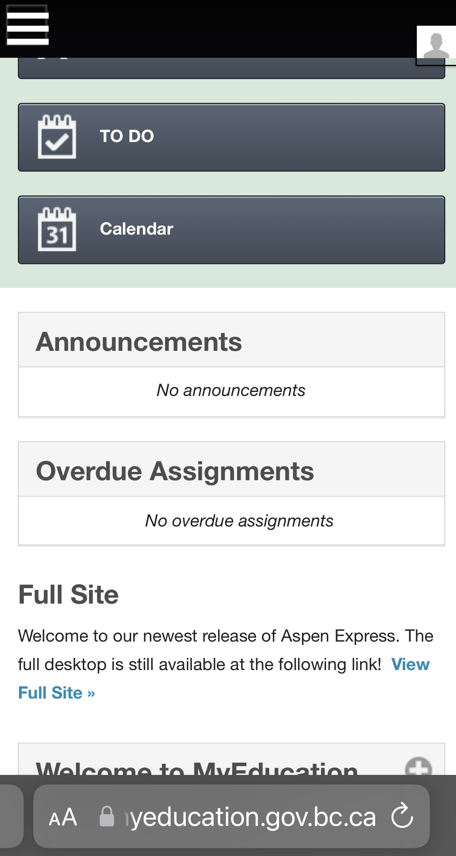
Click on
View Full Site

Slide 5
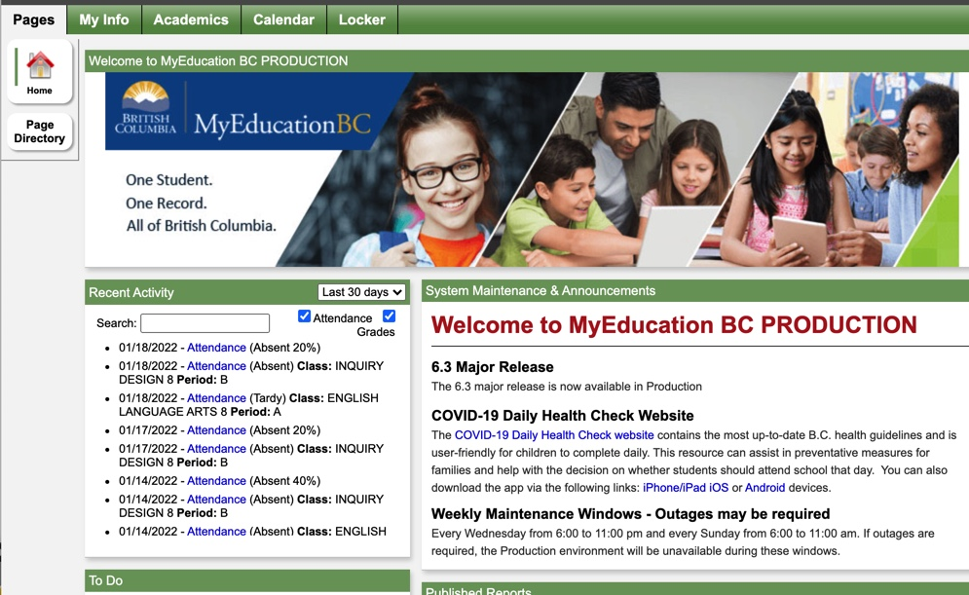
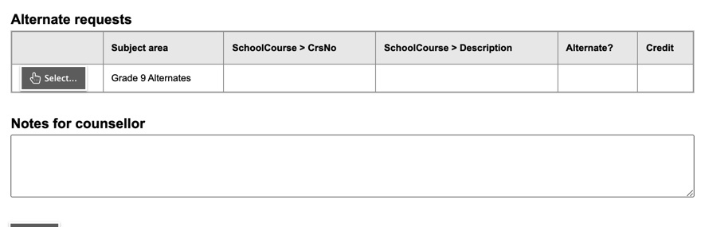
2023-2024 COURSE SELECTIONS
Click MY INFO

Slide 6
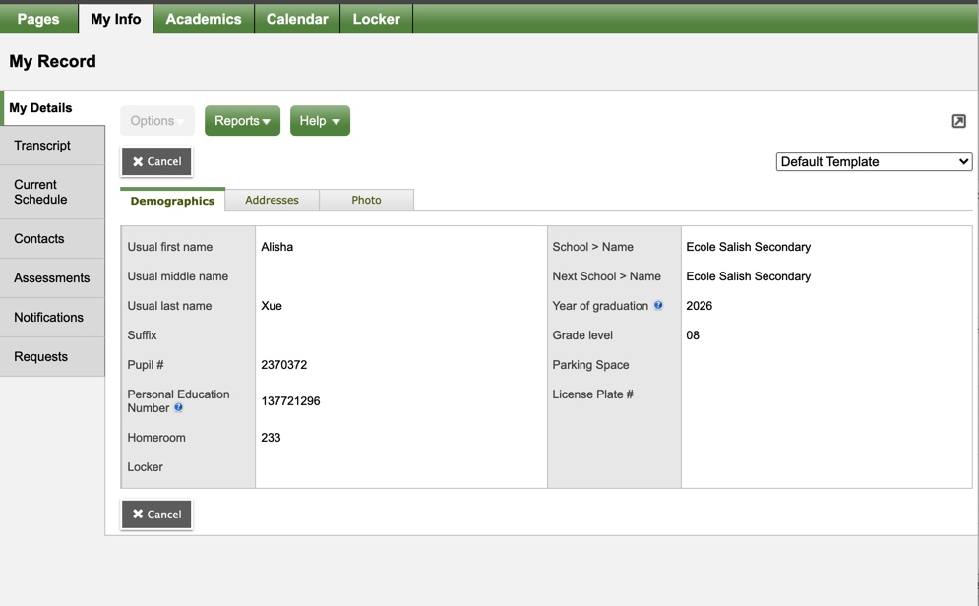
Click REQUESTS

Slide 7
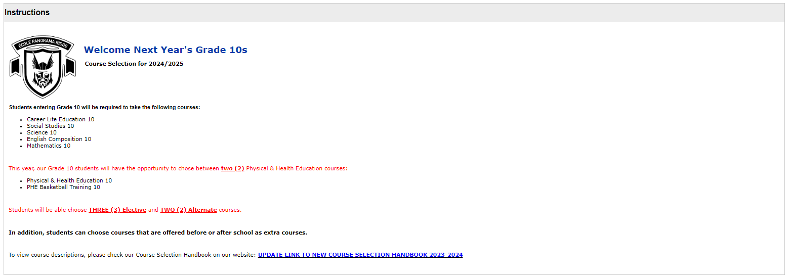
Read the Instructions on this page and then scroll down to select your classes.

Slide 8
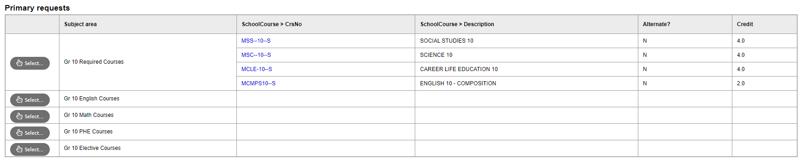
Mandatory courses are already selected for you.
Use each tab to select electives.

Slide 9
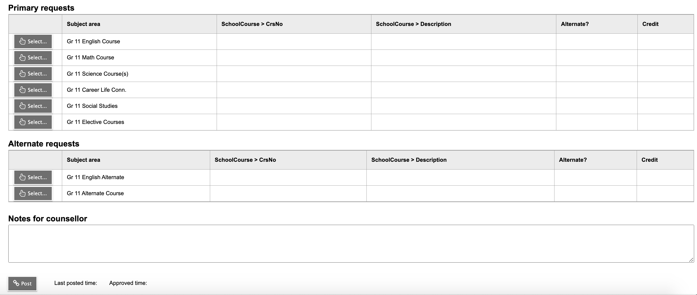
Make sure you choose ALTERNATE COURSES in case the electives you choose are not available

Slide 10

You must complete your course selection…
BY MONDAY MARCH 2ND
YOU DO NOT NEED TO POST!!!

