Slide 1
GRADE 12 GRAD 2023 INFORMATION

Slide 2
Post-Secondary Applications
Grad Post-Secondary Information
Get Post-Secondary Info on-line at https://www.educationplannerbc.ca/
Admission Requirements vary (General, Program Specific)
Application Process/Deadlines (vary)
Open House/Info Session dates: All Post Secondary institutions
Online and Virtual Tours being done so find out dates online.
Some schools are accepting applications now as of Oct. 1st
Some are “first-come, first-served” (e.g. KPU, Douglas, UFV)
Application Deadlines
UBC Early Admission apply now (Dec 1)! Regular Admission Jan. 15, 2023
SFU Jan. 31, 2023
UVIC Jan. 31, 2023
All other BC institutions have varying deadlines depending on the program.

Slide 3
Things change year to year!
You will need to keep checking websites for schools that you are interested in for the most up to date information.
Any new updates or information will given in our GPS meetings and on EMS Post-Secondary Microsoft TEAMS
If you are planning on taking a gap year, please still apply to your intended Post Secondary institutions now! This will help you in the future. You may also be able to defer your start date.

Slide 4
WHERE TO APPLY!
Apply directly to the Post Secondary website.
Go to Apply BC (Education Planner) site at http://www.apply – EducationPlannerBC
For Ontario PSIs go to the OUAC website (105 Form) http://www.ouac.on.ca/
For Alberta PSIs go to the Alberta website https://applyalberta.ca/
TIP: Keep a notebook to track passwords and deadlines!

Slide 5
PSI | Regular Admission Application Deadline | Early Admission Application Deadline | Major Scholarship Deadline | Supplementary documents
UBC | Jan. 15 | By Dec. 1 | Dec. 1 | Personal Profile Questions Due with application
SFU | Jan. 31 | N/A | Dec. 15 | Varies by program
UVIC | Jan. 31 | N/A |  | Varies by program
Kwantlen | June 1 recommended. Aug. 1 final deadline. Health Foundations – Dec. 1 | Limited intake programs – Mar. 1 |  | Varies by program
McGill | Feb. 1 (Music Jan. 15) | Early Self Reporting begins Jan. 6 to Feb. 1 | Feb. 7 | Varies by program
Queens | Feb. 1 | Dec. 1 (if applying for major entrance scholarship) | Dec. 1 | Supplementary Documents required for Commerce / Health Science/ Fine Arts due Feb. 15
Waterloo | Feb. 1 |  |  | Mar. 1
Toronto | Jan. 13 | Nov. 7 |  | Varies by program
McMaster | Jan. 13 |  |  | Varies by program
Western | Applications open and ongoing acceptance until full | Ongoing: Offers Starting in March | Feb. 14 | Varies by program
University of Calgary | Mar. 1
University of Alberta | Application opens Oct. 1- ongoing |  | Jan. 12

Slide 6
UBC
Personal Profile:
- important part of admissions process
Go to website for examples and scoring information
Write your Personal Profile - UBC | Undergraduate Programs and Admissions
https://you.ubc.ca/applying-ubc/how-to-apply/personal-profile
Distributed Learning Courses:
Deadline to complete is June 30, 2023. However, if you want the course to be considered as part of your admission average you must have completed at least 50% of the course by Mar. 1, 2023 and need an interim as proof.
If you need a mid-term mark from an online course, YOU must contact the online school as EMS does not have access to your marks.

Slide 7
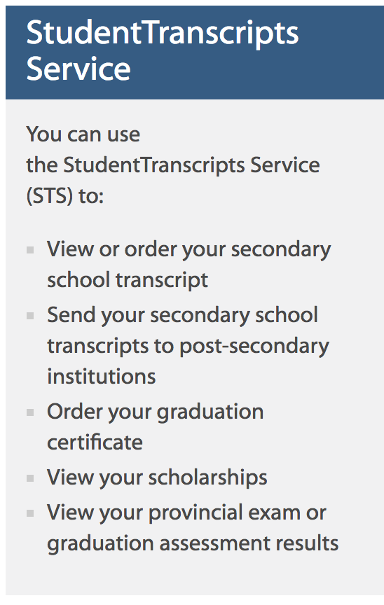
Submitting Final Grades to Universities
https://www.bceid.ca/register/basic/account_details.aspx?type=regular

Slide 8
Submitting Final Grades to Universities
Required: Student Transcript Service (BCeID)
https://www2.gov.bc.ca/gov/content/education-training/k-12/support/transcripts-and-certificates
Most Post-Secondary Institutions access student marks electronically from the Ministry of Education (no paper transcripts)
Students MUST complete their online STS selection to release their marks → link on EMS website under Counselling

Slide 9
Submitting Final Grades to Universities
https://www.bceid.ca/register/basic/account_details.aspx?type=regular
Create a BCeID at above site (wait for e-mail to login)
You will choose from a list (usually 3) Post Secondary institutions
You must still register directly to the Universities. STS will transfer your final marks electronically in July 2023 as soon as they become available.

Slide 10
Why you need to complete the STS:
1. To give the Ministry of Education permission to release your marks to the Post Secondary Institutions (PSIs) that you will be applying to.
2. This will also allow you to review your transcript and refer to it during self reporting. It also gives you the option to download your transcript and send it to your Post Secondary Institutions if needed.
3. This is how you will have access to your transcript after you graduate. EMS will no longer be able to access your transcript.

Slide 11
HELPFUL VIDEO FOR THE (STS) STUDENT TRANSCRIPT SERVICE
https://youtu.be/xJCk3Uj3P0Q

Slide 12
BCeID and STS

Slide 13
NEED HELP?
Email your counsellor with any questions! Or come see us!
There is a lot of information out there so ask questions if you are feeling overwhelmed!

