Slide 1
GRADE 12 GRAD 2023 INFORMATION

Slide 2
Post-Secondary Applications
Grad Post-Secondary Information
Get Post-Secondary Info on-line at https://www.educationplannerbc.ca/
Admission Requirements vary (General, Program Specific)
Application Process/Deadlines (vary)
Open House/Info Session dates: All Post Secondary institutions
Online and Virtual Tours being done so find out dates online.
Some schools are accepting applications now as of Oct. 1st
Some are “first-come, first-served” (e.g. KPU, Douglas, UFV)
Application Deadlines
UBC Early Admission apply now (Dec 1)! Regular Admission Jan. 15, 2023
SFU Jan. 31, 2023
UVIC Jan. 31, 2023
All other BC institutions have varying deadlines depending on the program.

Slide 3
Things change year to year!
You will need to keep checking websites for schools that you are interested in for the most up to date information.
Any new updates or information will given in our GPS meetings and on EMS Post-Secondary Microsoft TEAMS
Join code: 60zqlr5
If you are planning on taking a gap year, please still apply to your intended Post Secondary institutions now! This will help you in the future. You may also be able to defer your start date.

Slide 4
WHERE TO APPLY!
Apply directly to the Post Secondary website.
Go to Apply BC (Education Planner) site at http://www.apply – EducationPlannerBC
For Ontario PSIs go to the OUAC website (105 Form) http://www.ouac.on.ca/
For Alberta PSIs go to the Alberta website https://applyalberta.ca/
TIP: Keep a notebook to track passwords and deadlines!

Slide 5
PSI | Regular Admission Application Deadline | Early Admission Application Deadline | Major Scholarship Deadline | Supplementary documents
UBC | Jan. 15 | By Dec. 1 | Dec. 1 | Personal Profile Questions Due with application
SFU | Jan. 31 | N/A | Dec. 15 | Varies by program
UVIC | Jan. 31 | N/A |  | Varies by program
Kwantlen | June 1 recommended. Aug. 1 final deadline. Health Foundations – Dec. 1 | Limited intake programs – Mar. 1 |  | Varies by program
McGill | Feb. 1 (Music Jan. 15) | Early Self Reporting begins Jan. 6 to Feb. 1 | Feb. 7 | Varies by program
Queens | Feb. 1 | Nov. 20 (if applying for major entrance scholarship) | Dec. 8 | Supplementary Documents required for Commerce / Health Science/ Fine Arts due Feb. 15
Waterloo | Feb. 1 |  |  | Mar. 1
Toronto | Jan. 12 | Nov. 7 |  | Varies by program
McMaster | Feb. 1 |  |  | Varies by program
Western | March 1 | Feb. 1 | Feb. 14 | Varies by program
University of Calgary | Check website- depends on faculty you are applying to |  |  | Personal essay
University of Alberta | Application opens Oct. 1- ongoing |  | Jan. 12

Slide 6
UBC Updates
Apply through Education Planner- note the application will open in October 2022
Early Admission and major entrance scholarships: Deadline to apply is Dec. 1
Regular Admission Deadline: Jan. 15
New Entrance Scholarship this year: Beyond Tomorrow Scholars: open to students who self identify as Black Canadians
For President’s Scholar entrance scholarships: New this year, you must declare intention on application and provide a written statement
Literacy 12 Exam: UBC looking for students to score in the “proficient” range – a score of 3 or higher. Can rewrite exam – last date June 2023
New programs: Two new degree programs:
- Bachelor of Sustainability
- Bachelor of Health and Exercise Sciences

Slide 7
UBC Update Con’t
Personal Profile:
- important part of admissions process
Go to website for examples and scoring information
Write your Personal Profile - UBC | Undergraduate Programs and Admissions
https://you.ubc.ca/applying-ubc/how-to-apply/personal-profile
Distributed Learning Courses:
Deadline to complete is June 30, 2023. However, if you want the course to be considered as part of your admission average the deadline is Feb. 1, 2023.

Slide 8
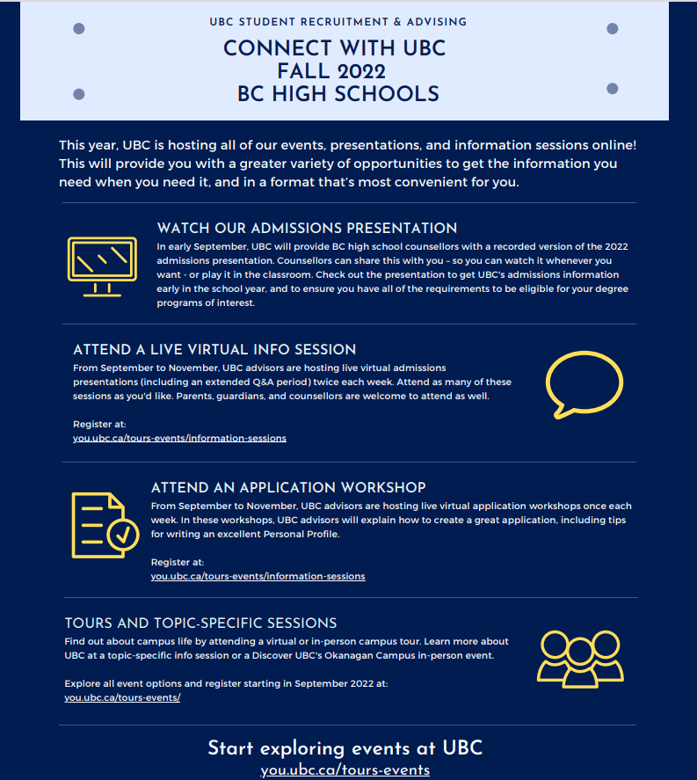

Slide 9
Questions?
Come see your Alpha Counsellor

