Slide 1
COURSE PLANNING 2022-2023
Current Grade 9 students
going into Grade 10

Slide 2
Timeline for Course Planning
Jan. 3: Course planning information letter emailed home.
Feb. 7-11: Grade 9 Course Planning Ppt shown in class
Feb. 14-18: Admin/Couns. Visits to answer questions
Parents/students review course planning information using Learning Guide and NSS Website.
Use the Course Planning Tool.
Feb. 22: Deadline to complete Course Selection in MyEdBC for current Grade 8-11 students.
MyED Password Reset
northsurrey@surreyschools.ca

Slide 3
Course Planning
Welcome to the Graduation Program.
You need to consider 2 things when selecting your classes:
Ministry Graduation Requirements
Post-Secondary Plans:
Working
College
University
Notes:
Counsellors

Slide 4
GRADUATION PROGRAM REQUIREMENTS 80 CREDITS min. (Gr 10 - 12) Each course = 4 credits
GRADE 10
English 10 (options)
Science 10
Math 10 (options)
Socials 10
Physical & Health Ed 10
Career Life Ed
Elective
Elective
GRADE 11
English 11 (options)
Science 11 (options)
Math 11 (options)
Socials 11 or 12 (options)
Elective or CLC
Elective
Elective
Elective
GRADE 12
English Studies 12
Elective 12 or Socials 12
Elective 12
Elective 12
Elective
Elective
Elective
Elective or Career Life Connections
Must have 4 Grade 12 Level Courses
Provincial Assessments
Numeracy Assessment– Grade 10
Literacy Assessments – Grade 10 and 12
Notes:
Counsellors

Slide 5
Students take 8 classes
6 required courses (must take)
2 elective courses (student’s choice)

Slide 6
Required Courses
English 10 – pick an option
Social Studies 10
Science 10
A Math 10 – pick an option
Physical & Health Education 10
Career Life Education

Slide 7
Career Courses
You have completed Careers 8 and 9.
Grade 10 – Career Life Education
Grade 11 or 12 – Career Life Connections
Explore www.educationplannerbc.ca and https://myblueprint.ca/

Slide 8
Choosing the Math course that is right for you:
There are 2 Math classes offered at the grade 10 level:
Foundations of Math and Pre-Calculus 10
Majority of students will take this math
Workplace Math 10
Designed for students who may struggle in math
Designed for entry into many college/trades programs and the work place
How to decide which to take:
If you have Math this semester, talk with your teacher.
If you have math next semester, talk to your teacher from last year or refer to your experience in grade 8 math.
Generally if your mark is in the low 50’s and you have worked hard and completed your homework to the best of your ability, you may be best suited to Workplace.

Slide 9
How to select your two Elective Courses
Think about courses you are interested in.
Review the NSS Learning Guide to get a sense of what courses are about.
Talk to teachers who teach the class to get more information.
Note: Many electives may be taken in grade 10/11/12 without having taken the course in a previous year.
For example:
if you don’t take Art 9, you can still take Art 10
Choose wisely…elective changes may be difficult to accommodate.

Slide 10
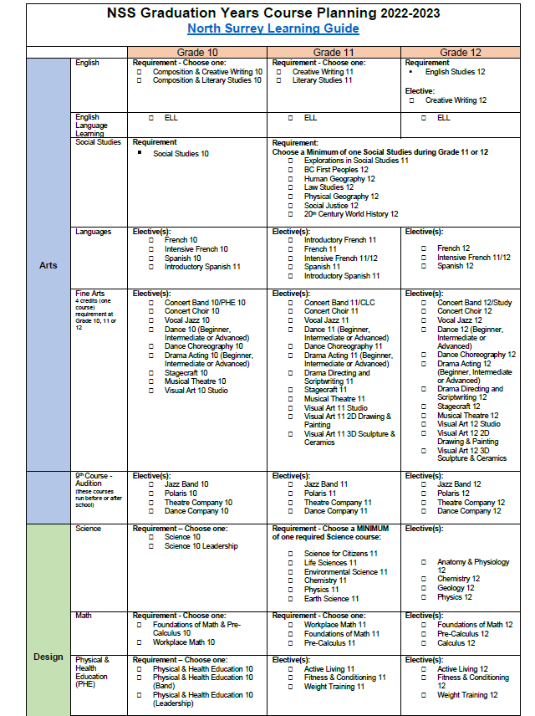
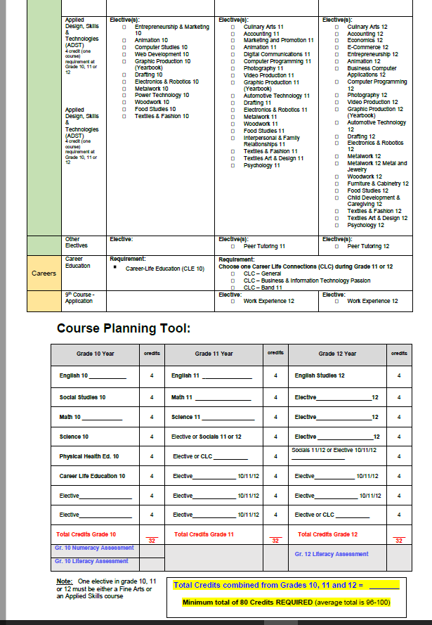

Slide 11
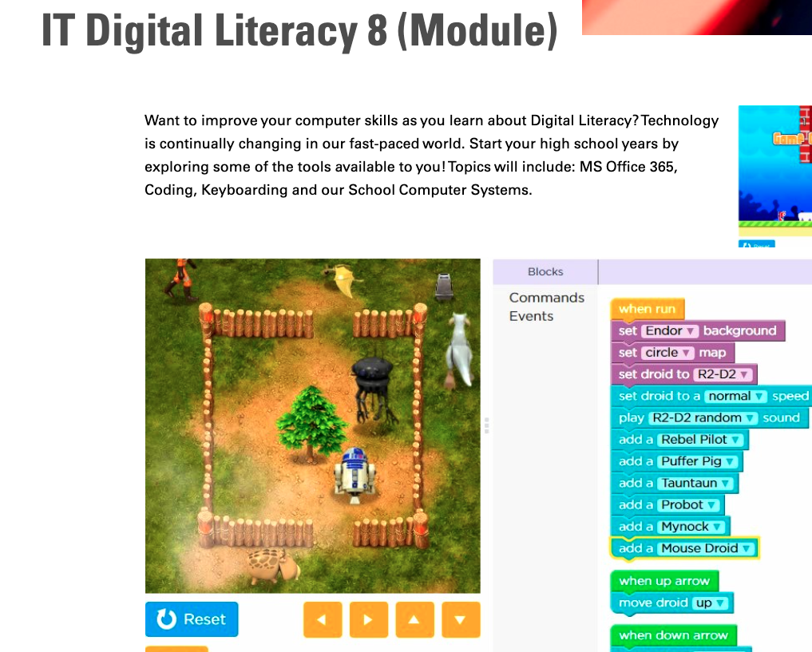
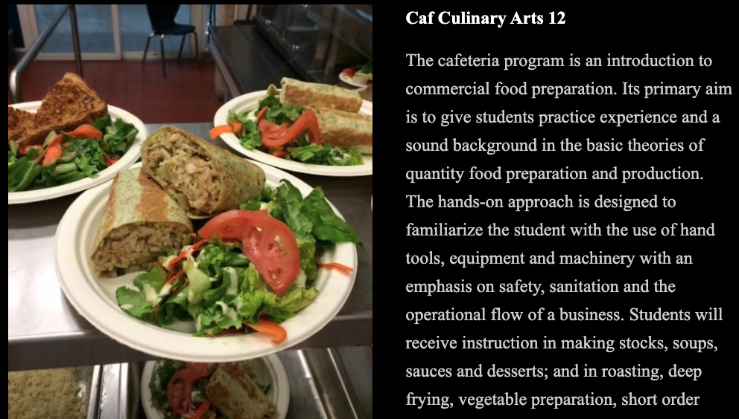
Learning Guide 2022
Please review the NSS Learning Guide to highlight the opportunities for student learning that each of our departments has to offer.

Slide 12
Language Courses
You DO NOT need a Language course to graduate.
Some universities require students to complete a language up to grade 11 for direct entry (you need to verify this).
Some universities require students to complete a language 12 or the university equivalent to complete a degree.
If you are registered in Intensive French 9 the natural progression is Intensive French 10.
If you do not to take a language in Grade 9 you may take Introductory Spanish 11 or Introductory French 11 in Grades 10, 11 or 12.
Notes:
Majority of universities require a full language 11 (not intro 11) for direct entry.

Slide 13
Audition Courses (9th course before or after school)
Students may also select a 9th additional course in the following areas. These courses take place before or after school:
Jazz Band
Polaris (choir)
Theatre Company
Listen to announcements for auditions taking place in the spring. Auditions will determine final class rosters. If you are accepted, the course will be added to your schedule.
Dance Company

Slide 14
There are Other Ways to Get Credits
Take a course during Summer School or Online.
Submit documentation to your counsellor for:
courses completed outside of the district, province or country​
completed external credits – i.e. sports, music, dance, lifesaving, driver’s education (ICBC).​
Please see your counsellor if any of these apply to you, or if you have any questions regarding external credits

Slide 15
Summer School
If you do not meet the learning outcomes of a core academic course, it’s recommended that you speak with your counsellor to review options. One option may be summer school.
Summer school is a BIG decision because it condenses 5 months of school work into 5 weeks.
If you decide to attend summer school please complete the Online-Summer-Study form (O.S.S.).
Please note: taking a summer school course may not guarantee
you a seat in the next level of that academic course.

Slide 16
Online Courses ​
You may choose to cross enroll with an online school to take an additional course, ​advance ahead, or to take a course that you may not have in your schedule. ​
Please complete the Online-Summer-Study form (O.S.S.) if you intend to take an online course.
Please consider the following characteristics of what a successful online learner looks like:​
Independent learner​
Self-motivated ​
Skilled with written communication​
Able to set a schedule and keep it​
Able to meet deadlines​

Slide 17
District Partnership Programs
You may earn post-secondary credits while still in high school.
The following programs are available to grade 11/12 students. If you’re interested, please inquire at the Career Centre.

Slide 18
Where do I find Course Planning Info?
Talk to your Counsellor
Check out the NSS website here
Explore the 2022 Learning Guide
Online-Summer-Study form (O.S.S.) for Summer School or an Online Courses.

Slide 19
Do Not Forget…
To review this PowerPoint.
To review the course planning letter that was emailed home to parents.
To go online into MyEdBC and enter your course selection information.
Course Selection DEADLINE →
February 22, 2022

Slide 20
Counsellors
Ms. McLeod (A, S – Z)
Mr. Orso (C – K and International)
Ms. Vairo (B, L – R)
Ms. Alvaro (Academic advising)
If you have Course planning questions, connect with
your Counsellor through Teams Chat or via email.

