Slide 1
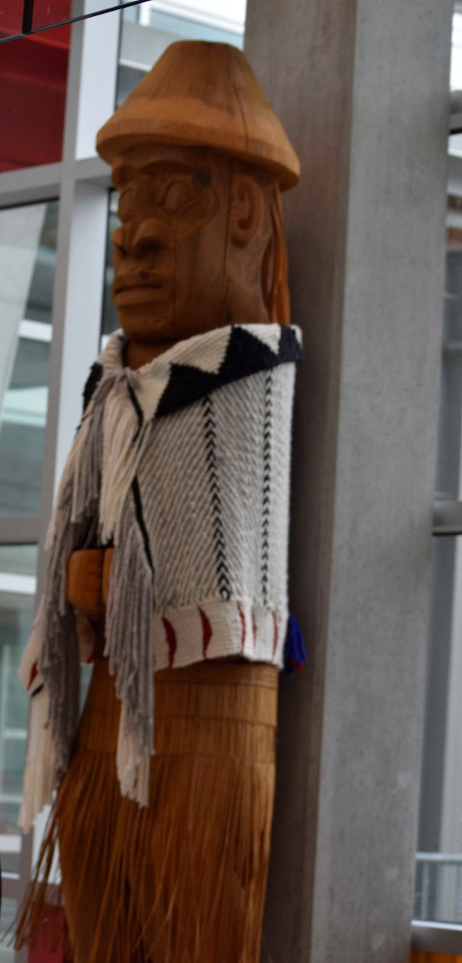
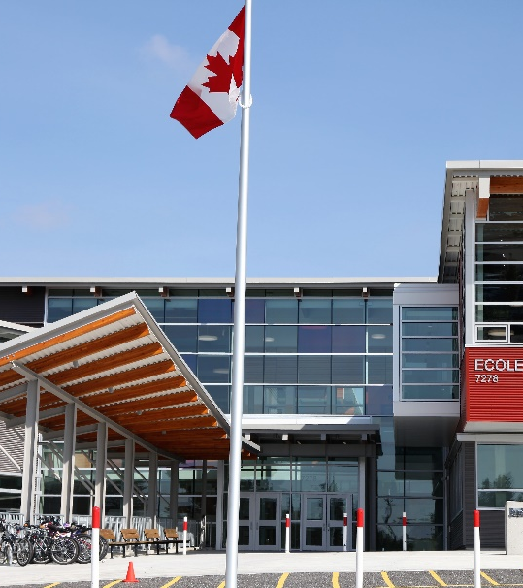
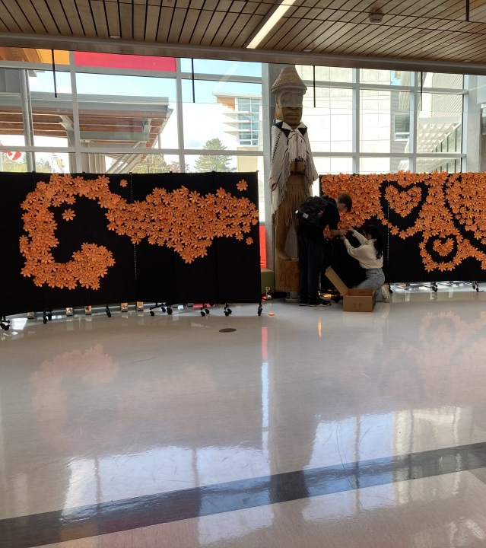
Ecole Salish Secondary
Course Selection 2026 – 2027
We will start at 11:30

Slide 2
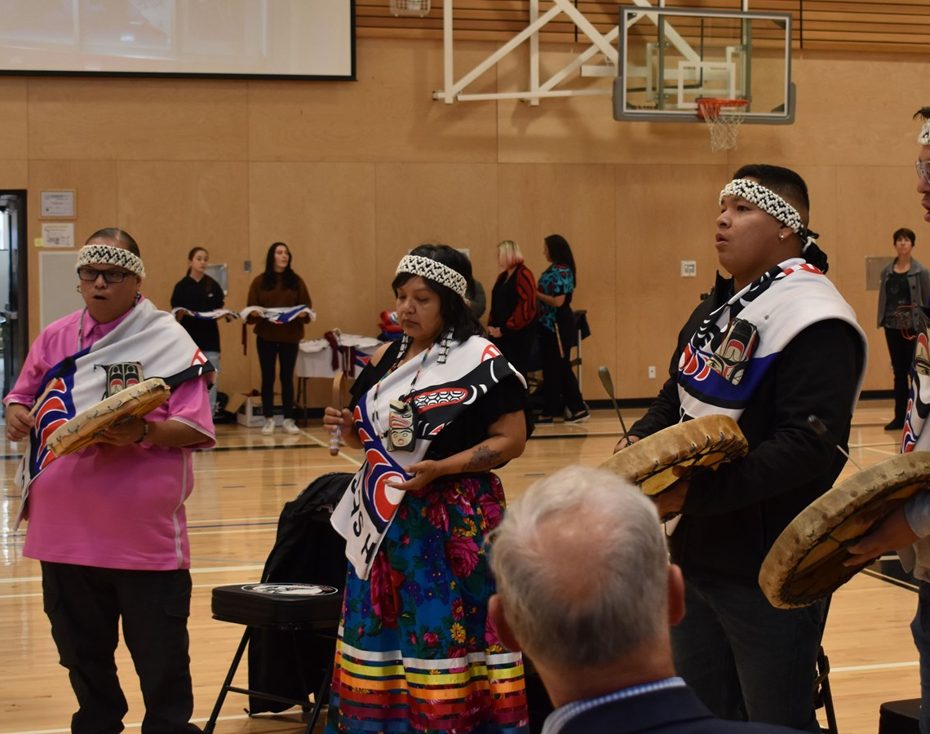
Land Acknowledgement
As we meet today, we acknowledge that we are on the traditional and unceded territory of the Kwantlen, Katzie and Semiamhoo First Nations

Slide 3

Welcome to Course Selection!
Logging in
Grad Program
Extended Day Timetable
English VS French Immersion
Electives
LEAP
Primary Selections
Alternates
Resources
Recap

Slide 4
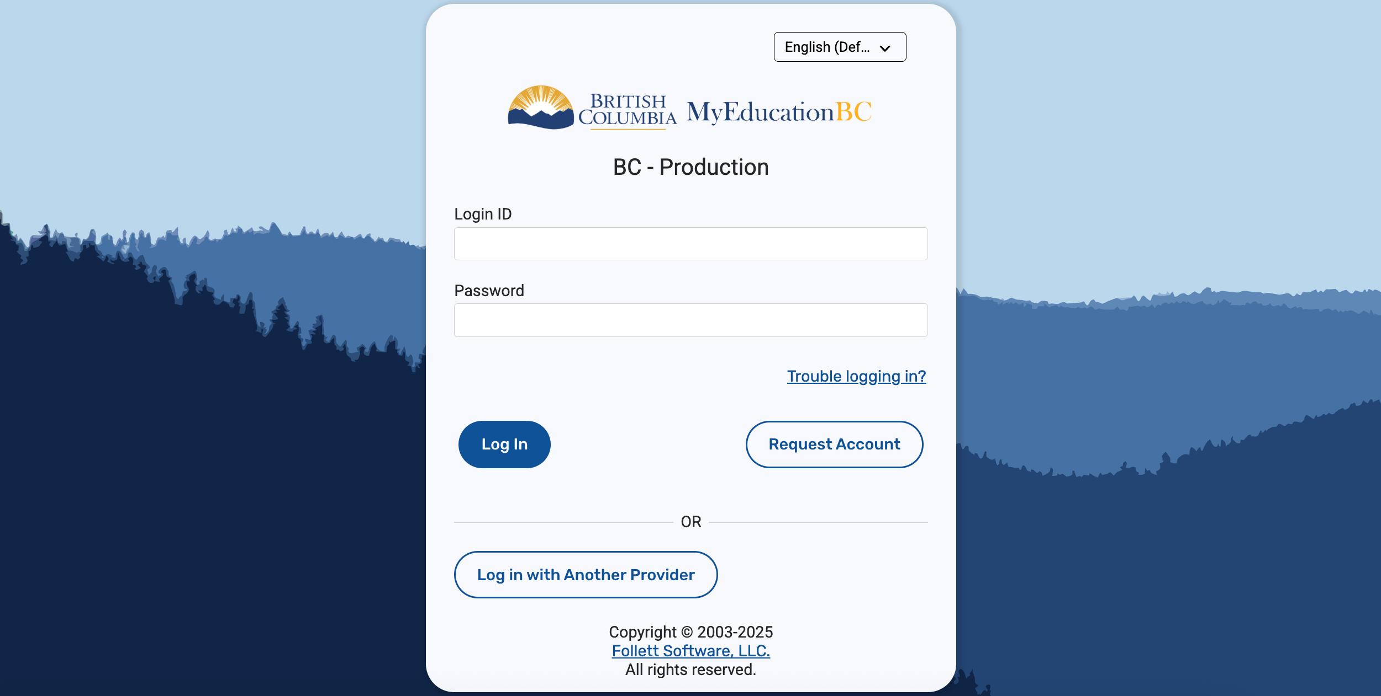
Let's Begin!
Log in to MYEDBC

Slide 5
Forgot Password?
Click Here

Slide 6
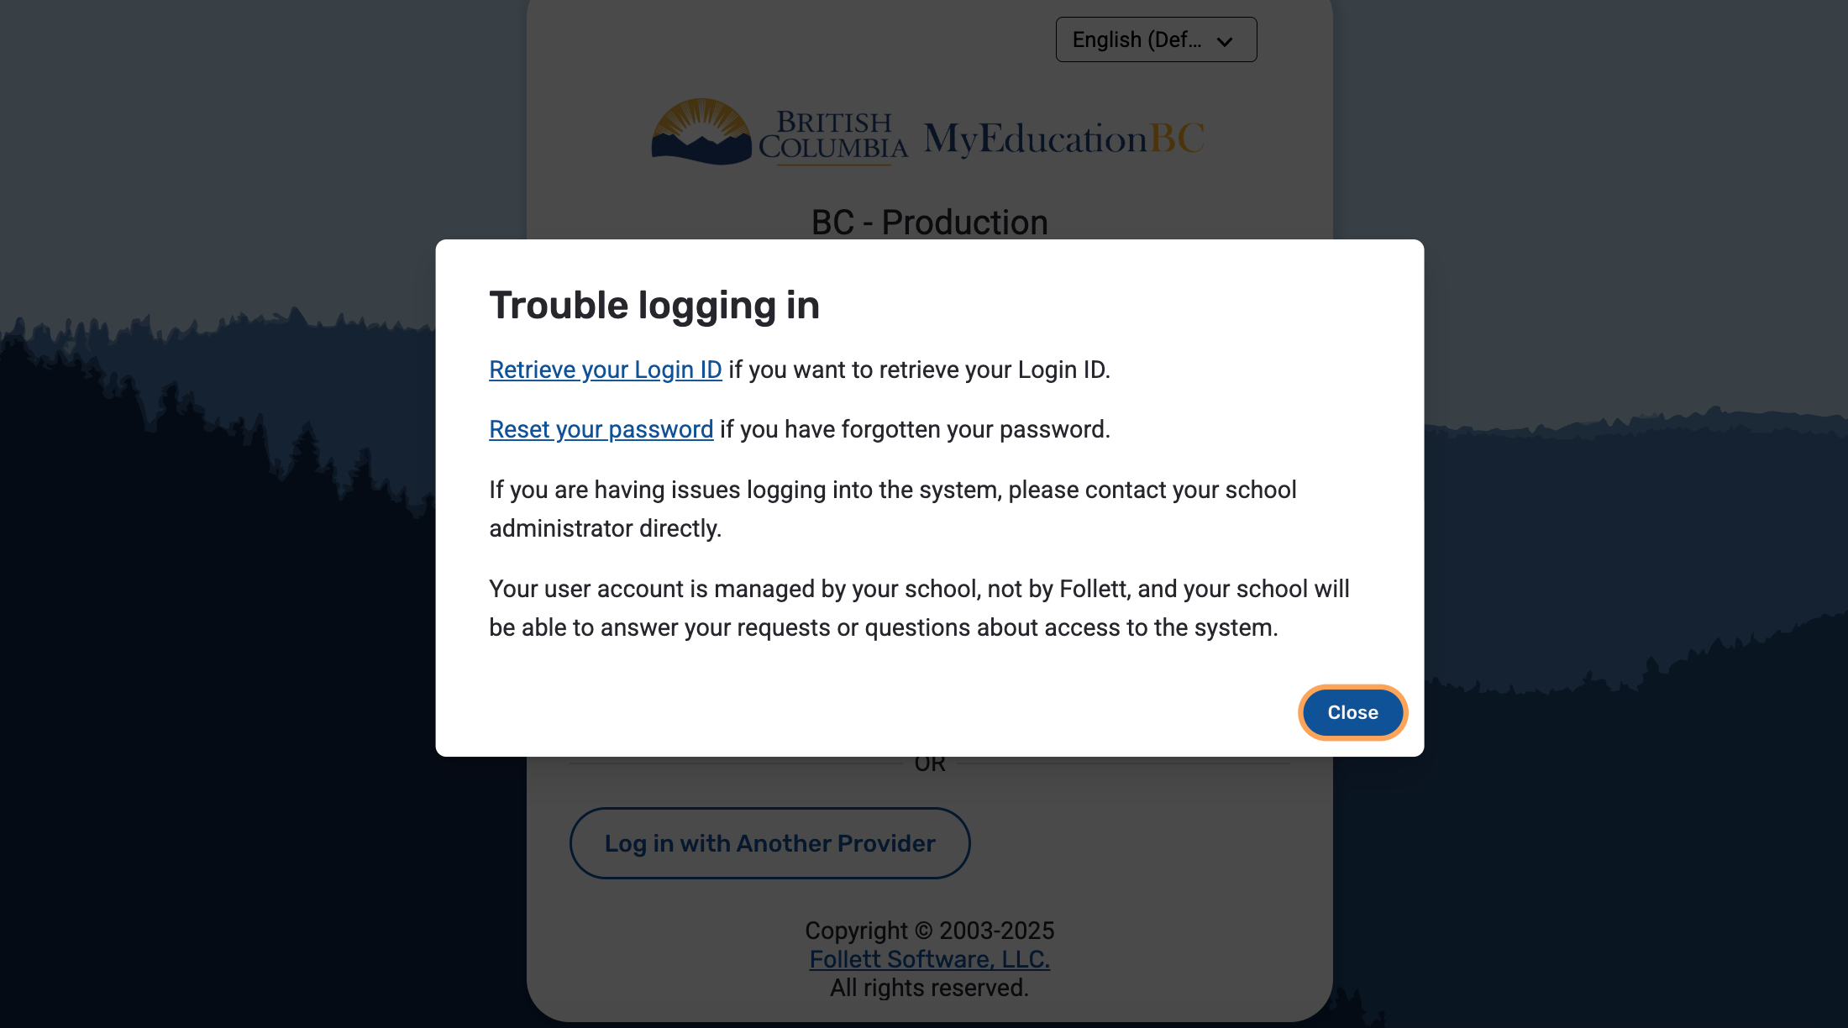
Click on the appropriate link and follow the steps
Click Here

Slide 7

Still can't get in or account is disabled?
Message Ms. Hamilton to reset accounts during the presentation.

Slide 8
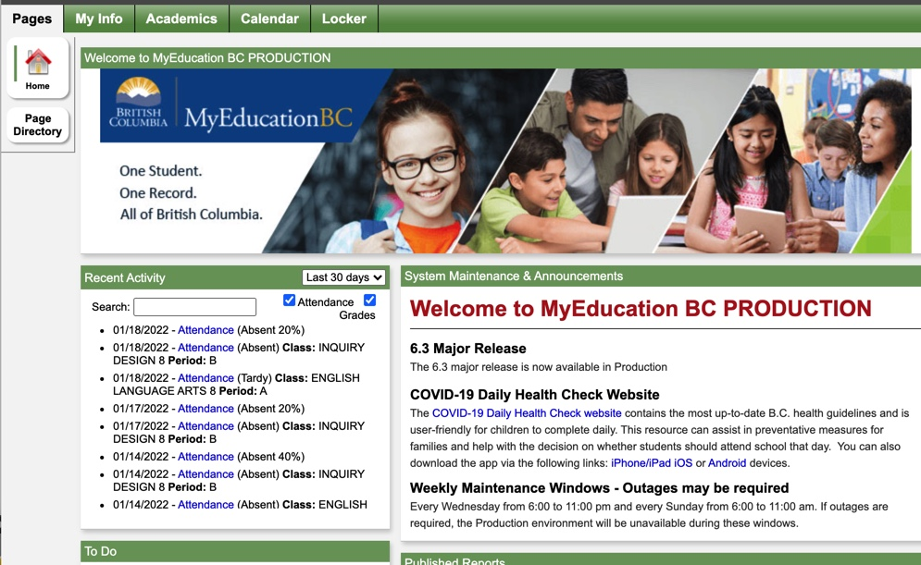
2026-2027 COURSE SELECTIONS
ONCE YOU GET TO THIS LANDING PAGE – STOP HERE FOR NOW

Slide 9
Graduation Program – 80 Credits
1. Required 52 credits:
Language Arts 10, 11, 12 (English) 12 credits
Social Studies 10 4 credits
Social Studies 11 or 12 4 credits
Science 10, 11 8 credits
Mathematics 10, 11 8 credits
Physical Education 10 4 credits
Fine Arts or Applied Skills 10 or 11 or 12 4 credits
Career Life Education 10 4 credits
Career Life Connections 12 ​​​ 4 credits
2. Electives (Grade 10, 11 and 12) 28 credits
TOTAL 80 credits
One course must have an Inidigenous focus (English First Peoples 10)
(A minimum of 16 credits must be at the Grade 12 level)

Slide 10
Grade 10 Programs
English Track
English 10
Math 10
Science 10
Social Studies 10
Physical Health Education 10
Career Education Life 10
1. Language 10 credit is now optional (consider pursuing this pathway if going on to specific post-secondary programs)
2. Students have 2 elective choices and may choose from any of the following categories:
Modern Languages
Design
Art Inquiry
3. Students choose two alternative options different from your primary
French Immersion Track
English 10
Math 10
Career Life Education 10
Français Langue 10
Sciences Humaines 10
Sciences 10
Education Physique et Sante 10
1. Students have 1 primary elective choice and may choose from any of the following categories:
Design
Art Inquiry
***FRIM students may select Spanish 10 as their elective choice
3. Students choose two alternative options different from your primary
COURSE SELECTION PORTAL WILL BE OPEN UNTIL DECEMBER 5TH
ALL SELECTIONS MUCH BE ENTERED BY THAT DATE

Slide 11
Grade 10 Timetable
ECOLE SALISH SECONDARY IS AN EXTENDED DAY SCHOOL
A
D
B
E
Students will be scheduled into either A-D or B-E
We cannot guarantee a particular schedule as there will be fewer blocks offered in both A and E giving us limited space
Certain classes are only scheduled in Block A or E
Students can only have a maximum of 8 courses

Slide 12
ACADEMIC - Required Courses
English 10
Social Studies 10
Active Living 10
Science 10
Math 10 (choose one)
Career Life Education (choose one)

Slide 13

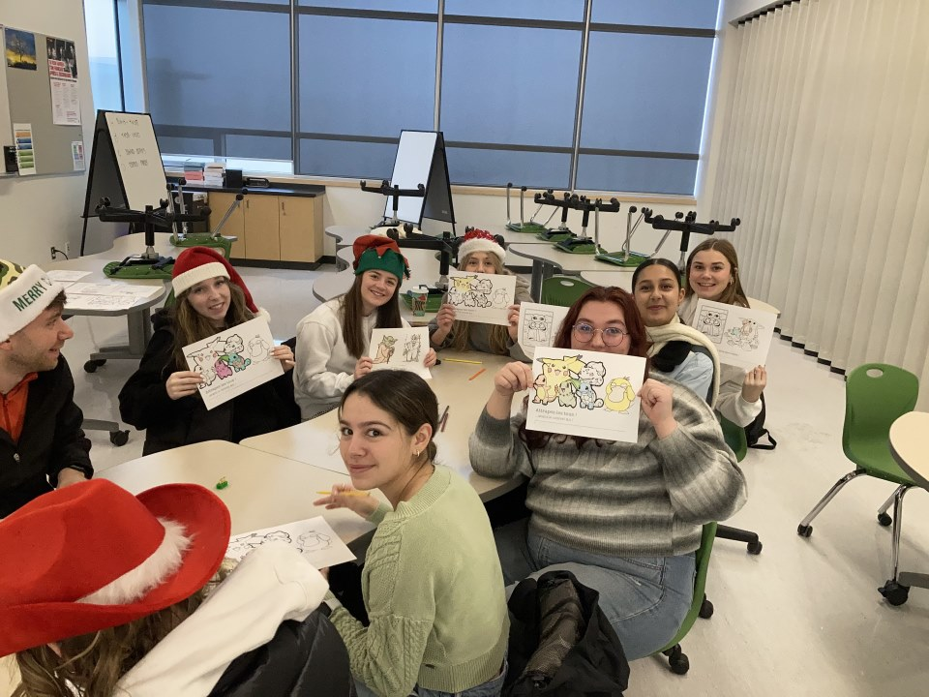
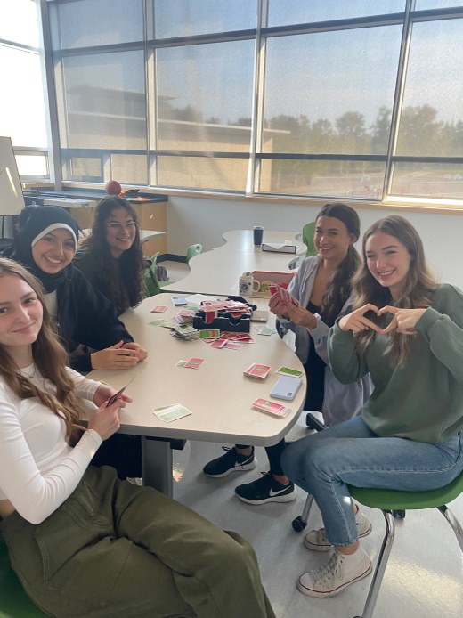
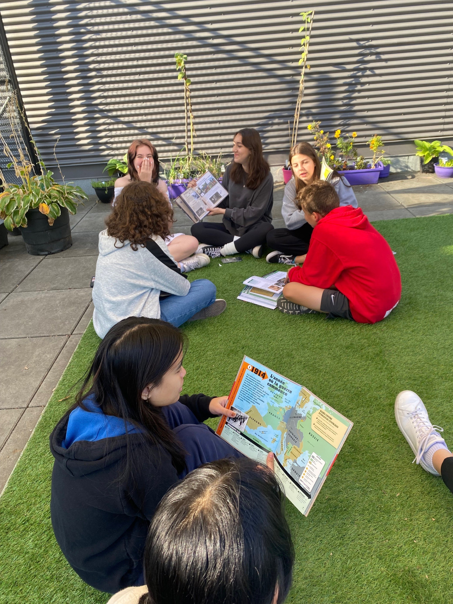
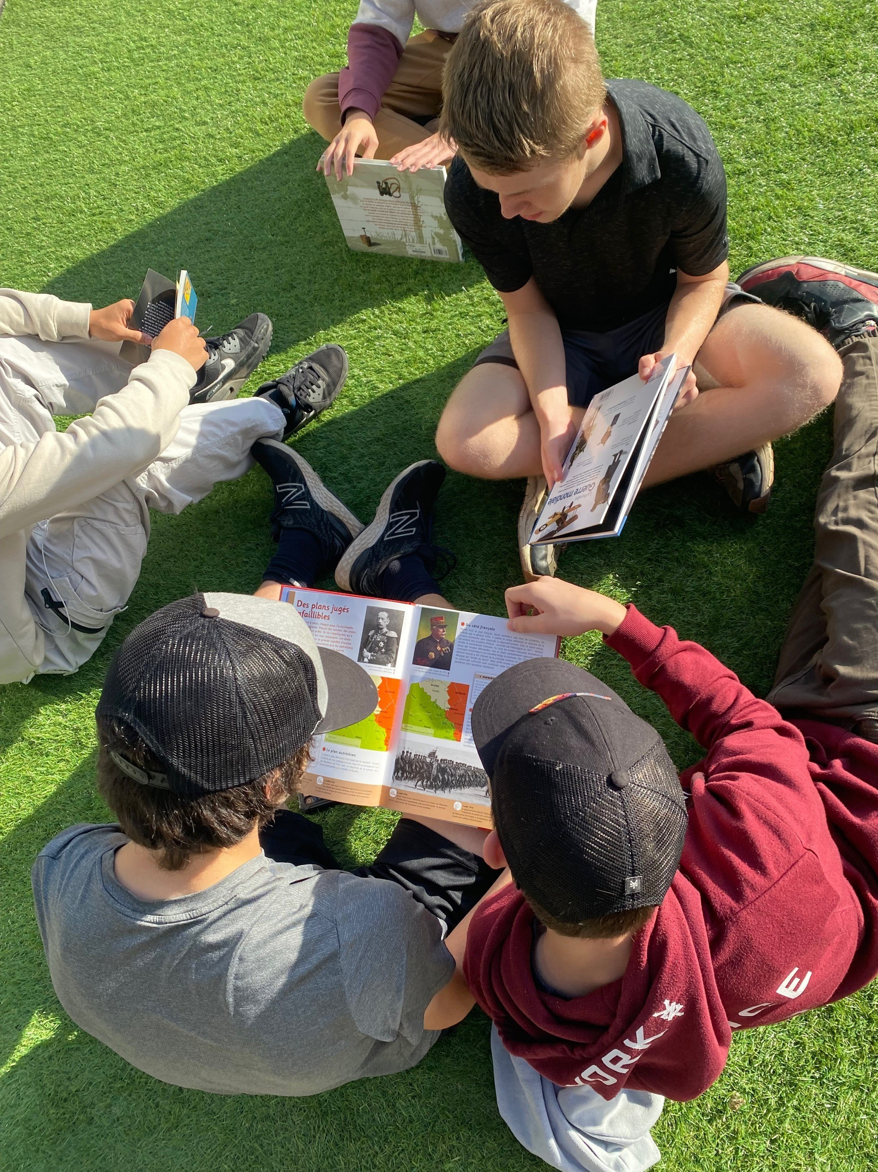
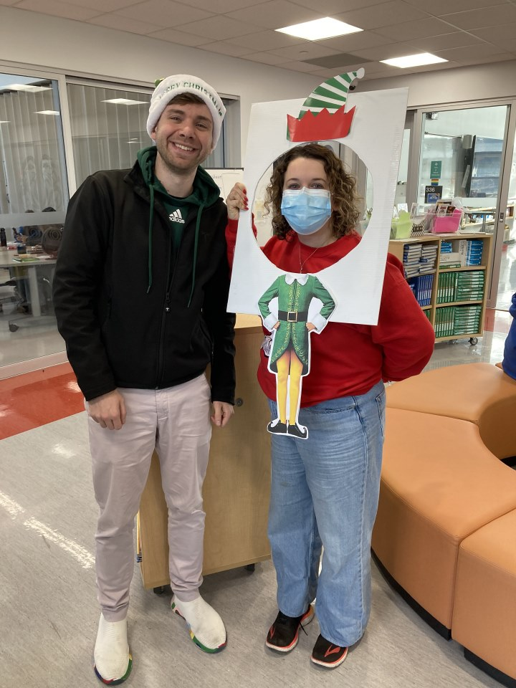
French Immersion
Dual Dogwood
Français Langue 8
Sciences Humaines 8
Education Physique 8
Sciences 8
Français Langue 9
Sciences Humaines 9
Education
Physique 9
Sciences 9
Français Langue 10
Sciences
Humaines 10
Education Physique 10
Sciences 10

Slide 14
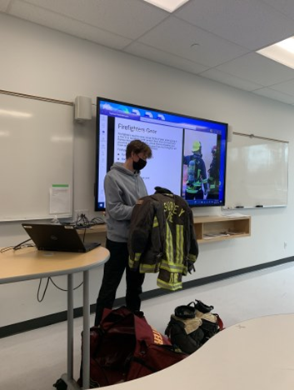


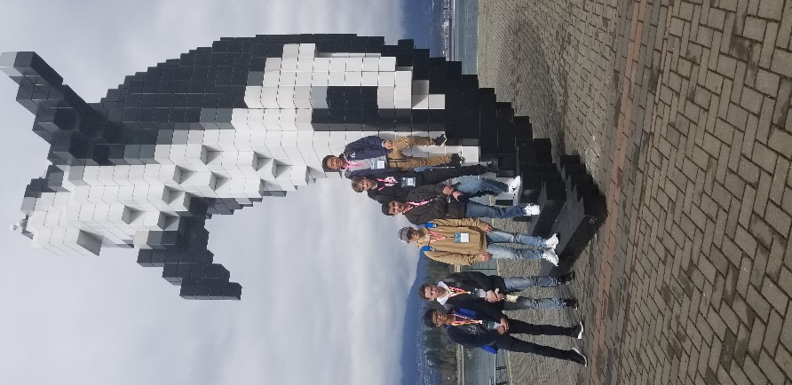


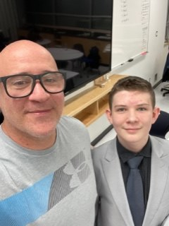
CAREER EDUCATION
Career Education 8
Career Education 9
Career Life Education 10
Career Life Education 10 Leadership

Slide 15
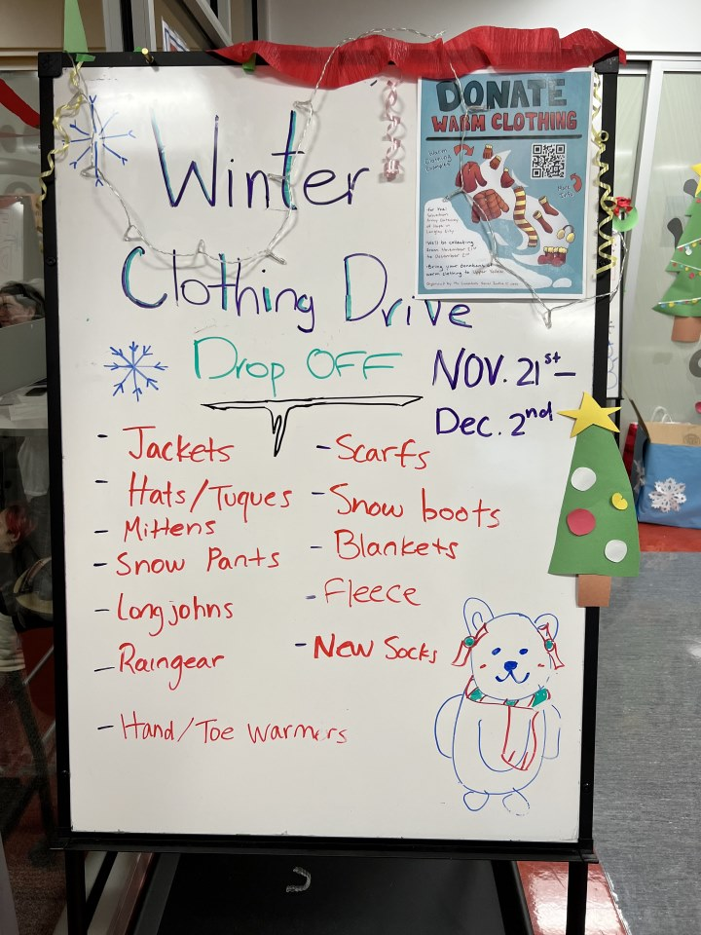

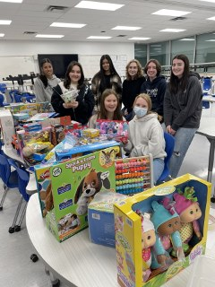
CLE LEADERSHIP
In this class you will explore your own leadership skills, develop activities and programs to build Salish community, and work with community programs like food banks and community outreach activities to build service projects of your choosing.
In the past we have run a toy drive for Christmas, sorted and packed food hampers with the Cloverdale Community Kitchen, trick-or-treated for canned goods on Halloween, and attended conferences in the lower mainland and across Canada.
Students need to be able to work with their peers, be independent and pro-active, and happy to volunteer some time to class projects.
Application required for this course- see Salish website

Slide 16
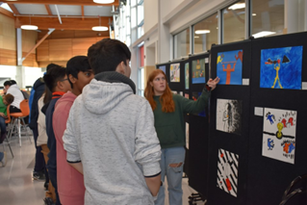
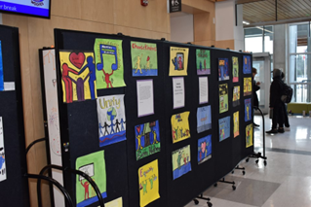
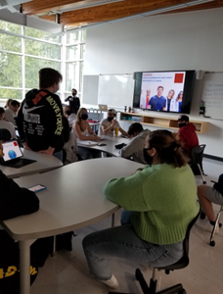
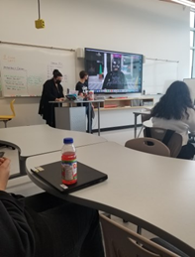
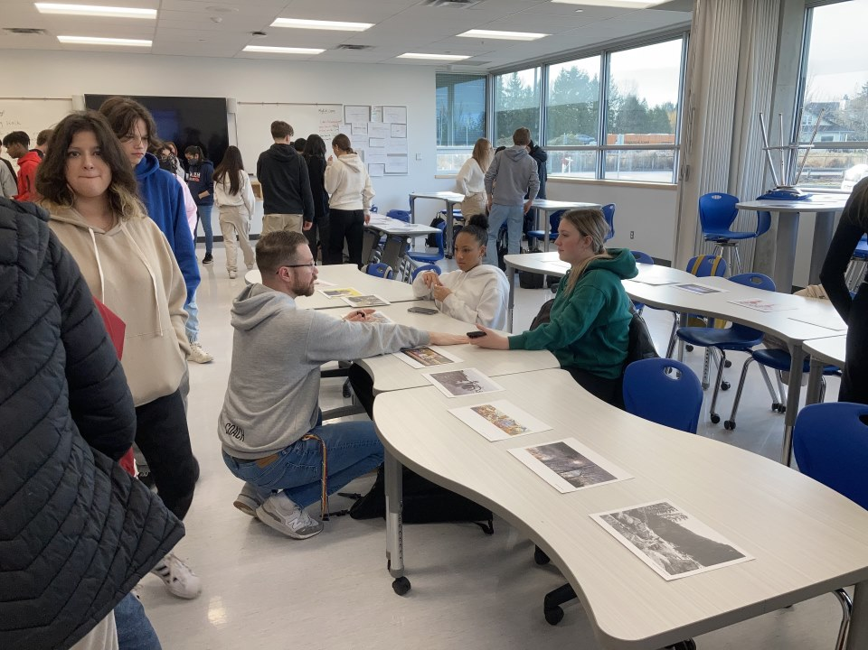
ENGLISH
English 9
English First Peoples 10
4 credit course which satisfies the Indigenous Focused Graduation Requirement
Course Overview
  -Reading, Writing, and Oral Language
  -Primarily authentic Indigenous texts
  -Taught through the lenses of the First Peoples Principles of Learning
  -Place and space-based learning opportunities

Slide 17
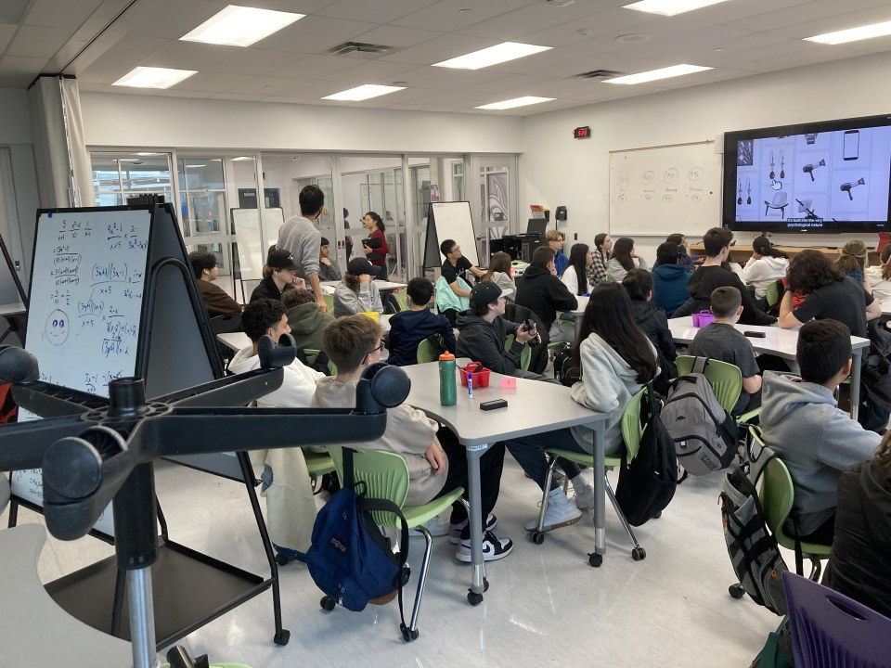
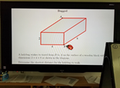
Math Pathways
*Pathways should be chosen in consideration of your post-secondary program requirements
Math 9
Directly attend College or University
Enter workforce after high school, many trades
Foundations and Pre-Calculus 10
Workplace 10
Post Secondary
Arts
Post Secondary
Science, Engineering,
Applied Science
Post Secondary
Engineering or Computing Science
Foundations of Math 11
Pre-Calculus 11
Workplace 11
Foundations of Math 12
*Possible post-secondary requirement but may not be necessary
Computing Science 11
Pre-Calculus 12
Calculus 12/AP
*Optional but strongly recommended
Computing Science AP
Computing Science 12

Slide 18
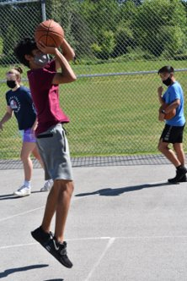
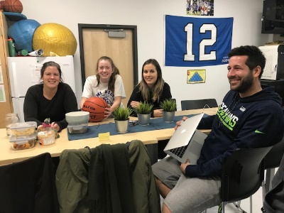
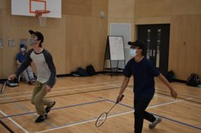
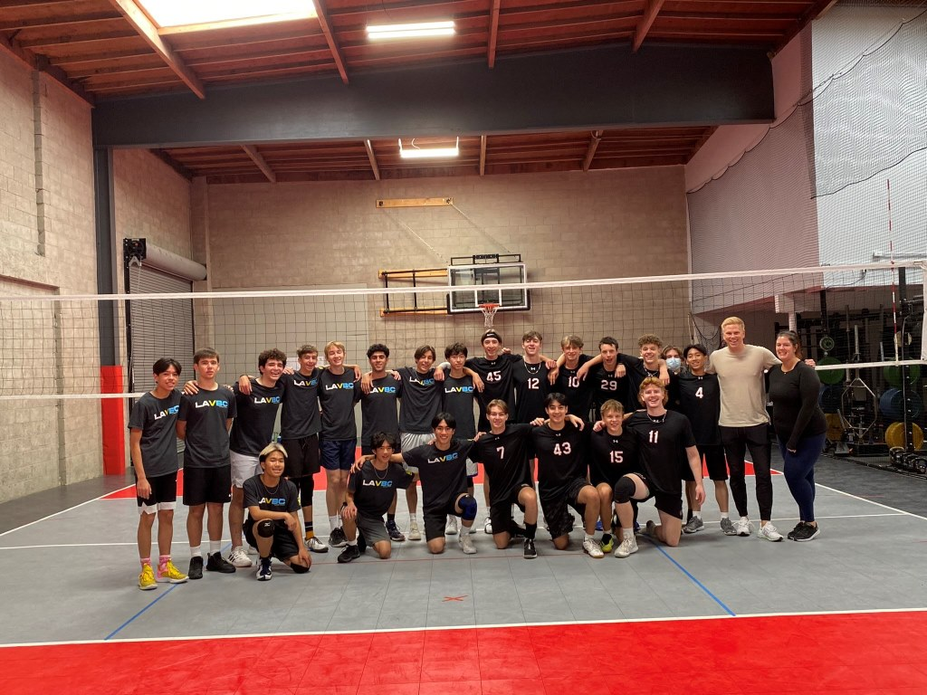
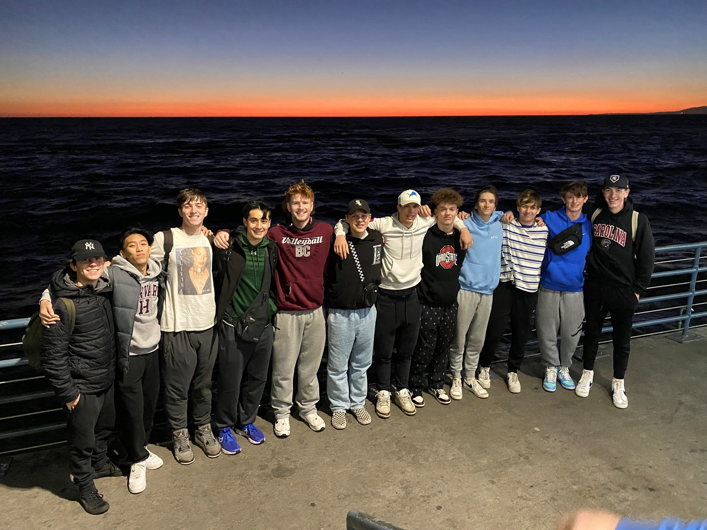
Physical & Health Education
PHE 9
Athletic Leadership 9- 11
E Block- organizing activities for grade 8 students, intramurals, scorekeeping & officiating
(Application required)
Active Living 10
Team / dual sports and activities; individual fitness; leadership development; social responsibility

Slide 19
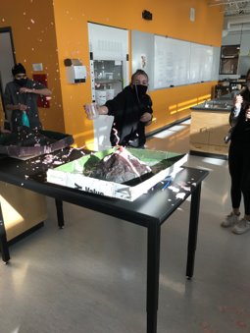
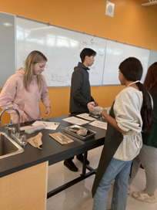
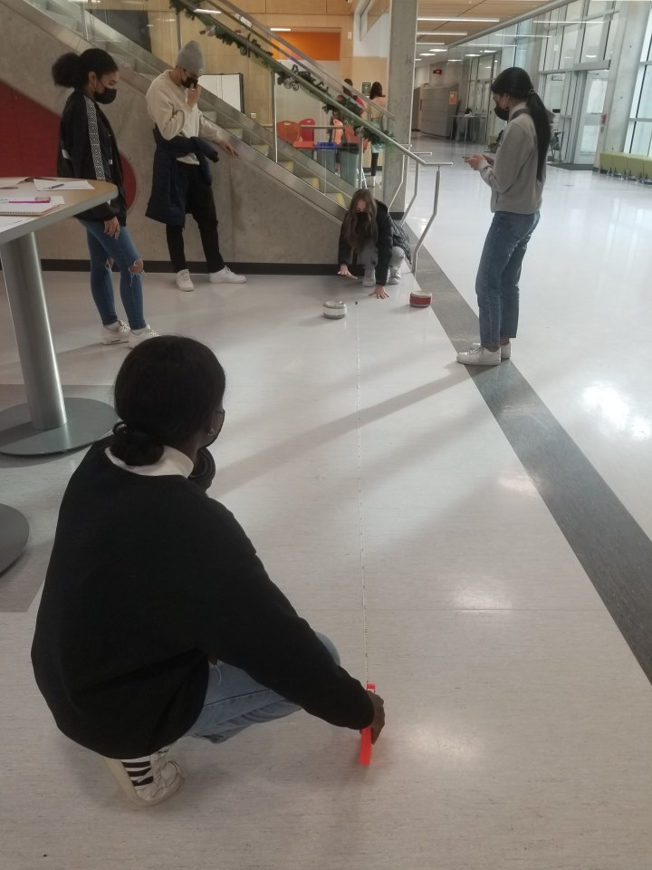

SCIENCE COURSES
Science 9
Science 10
Life Sciences • Chemistry • Physics • Science for Citizens • Earth Science
GRADE 11
ANATOMY & PHYSIOLOGY • CHEMISTRY • PHYSICS
GRADE 12

Slide 20
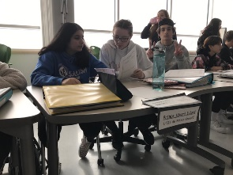
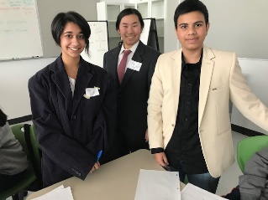
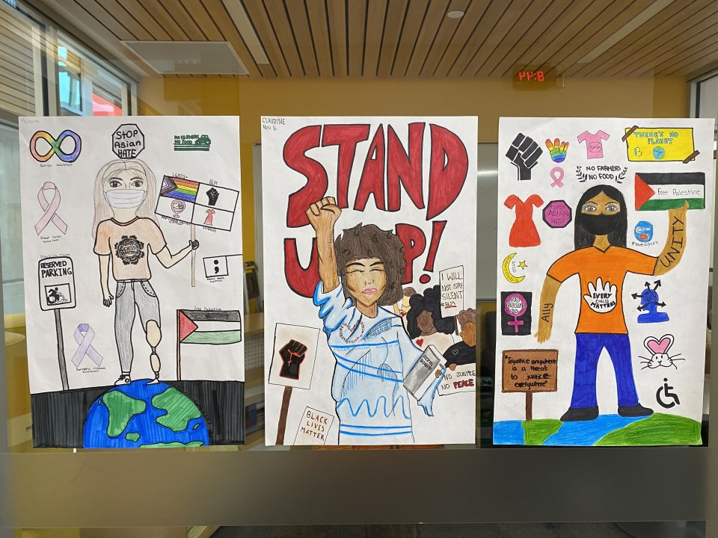
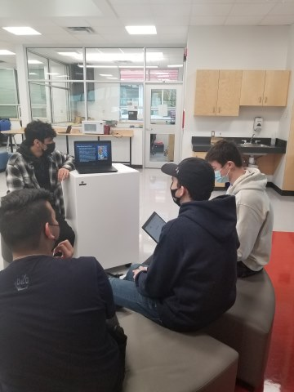
Social Studies
Social Studies 8
Looking at the historcial significance on how specific events relate to Canada: from Medieval Europe to studying indigenous cultures in Canada
Social Studies 9
Looking at cause & consequences; continuity & change: Age of Revolutions to WW I
Social Studies 10
Looking at events from a historical perspective & ethical judgments: 20th Century Canada & beyond!
Social
Justice 12
WW2 Through Film 11
Philosophy
12
Economic Theory 12
Law 12
Black History 12
History 12
Geography 12
Comparative Cultures 12
All students must take at least one of the grade 12 level courses- either in grade 11 or 12.

Slide 21

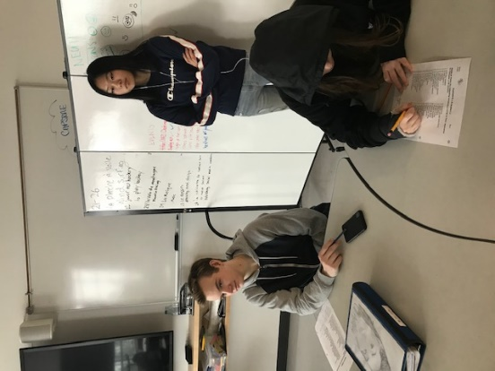
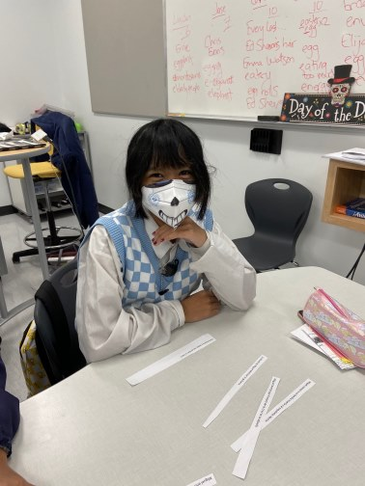
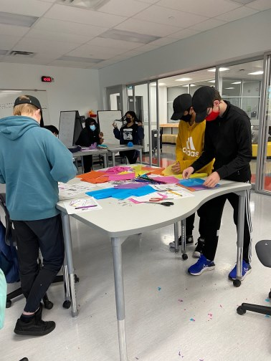
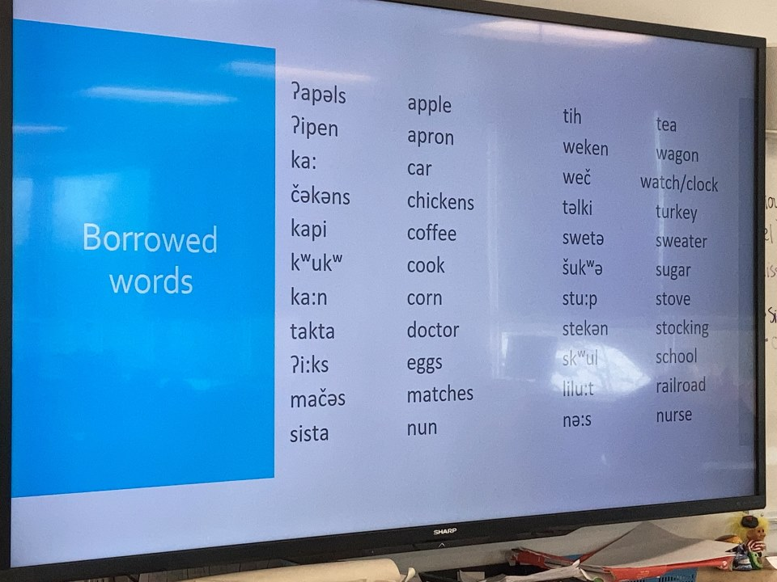
Modern Languages
French 8
Language Challenge & External Language Credits
If you are fluent in a second language or have taken language courses outside of Canada
See your Counsellor
French 9
Spanish 9
French 10
Spanish 10
A language 11 & 12 is needed for some University programs!
Learning a second language creates a skill set that is ideal for many careers!

Slide 22

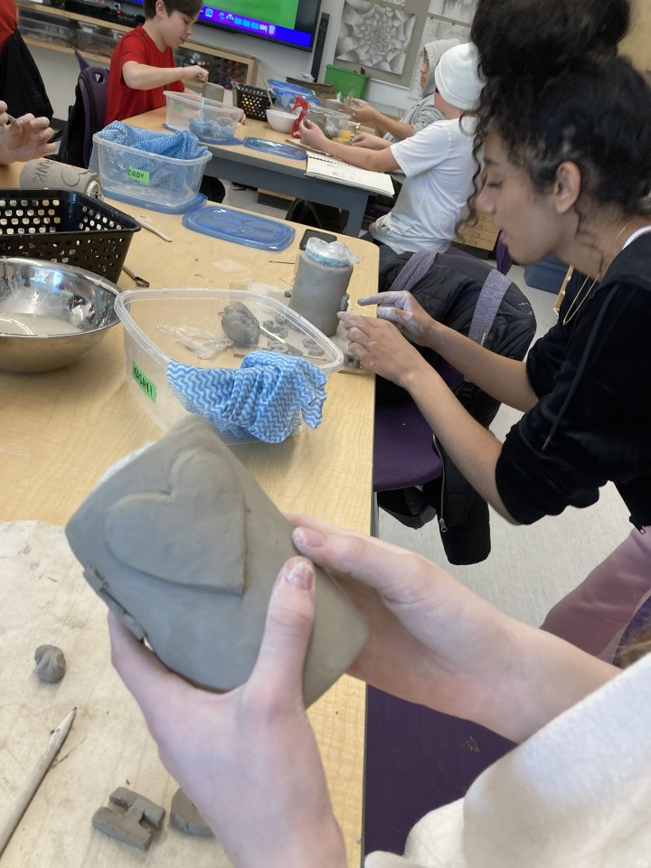
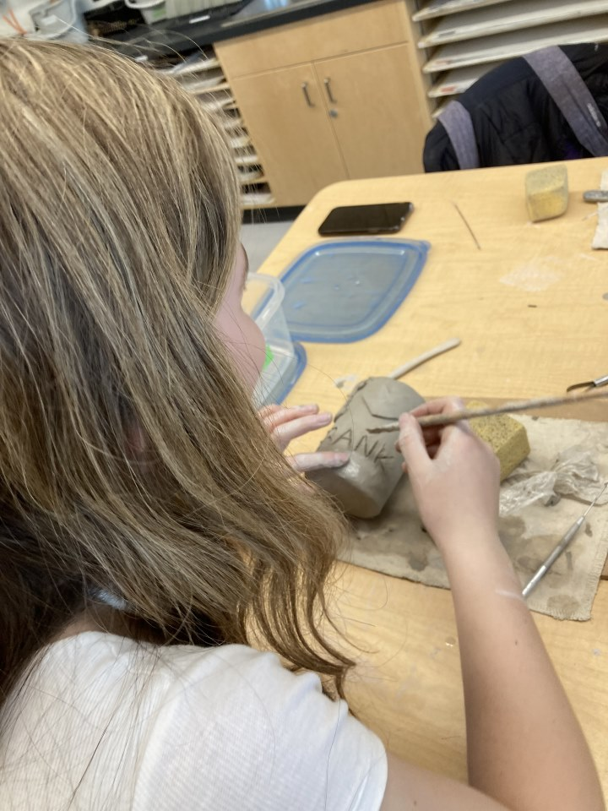
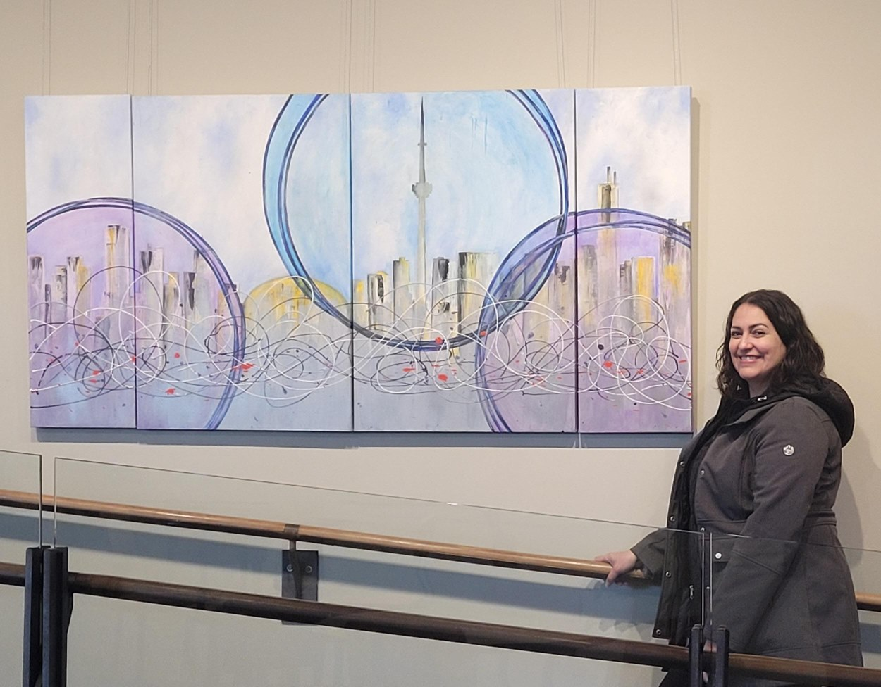
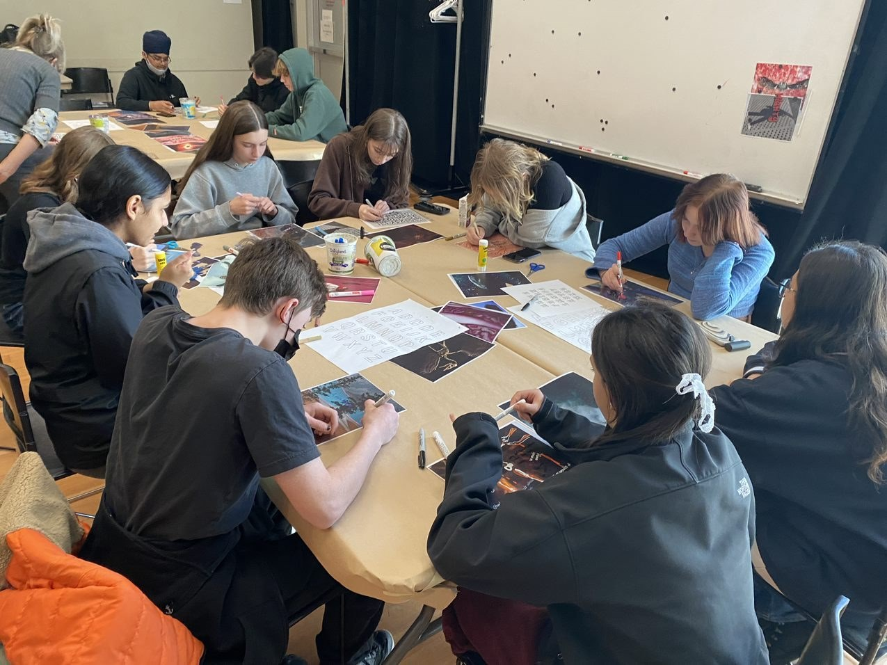
Art and Media
Art Studio
Foundations 9
Media Arts 9
Yearbook Design 10
Art Studio Foundations 10
Media Arts Video Production 10
Media Arts Animation 10
Photography 10

Slide 23
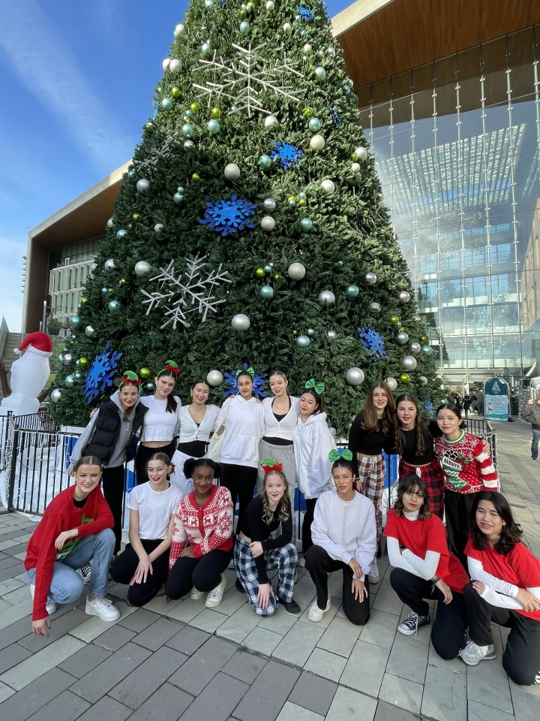
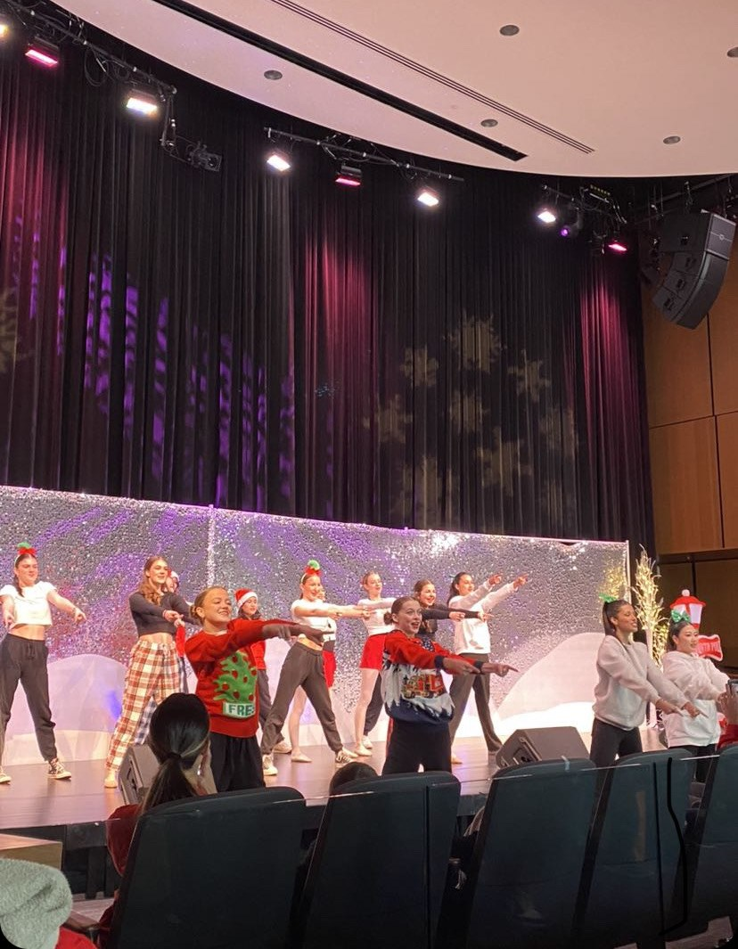
DANCE
DANCE 8
Dance 9
Dance Foundations 10
Dance Company
10

Slide 24

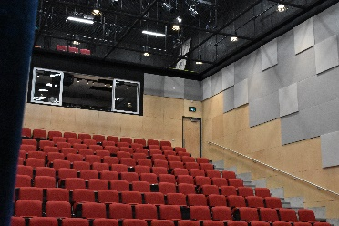
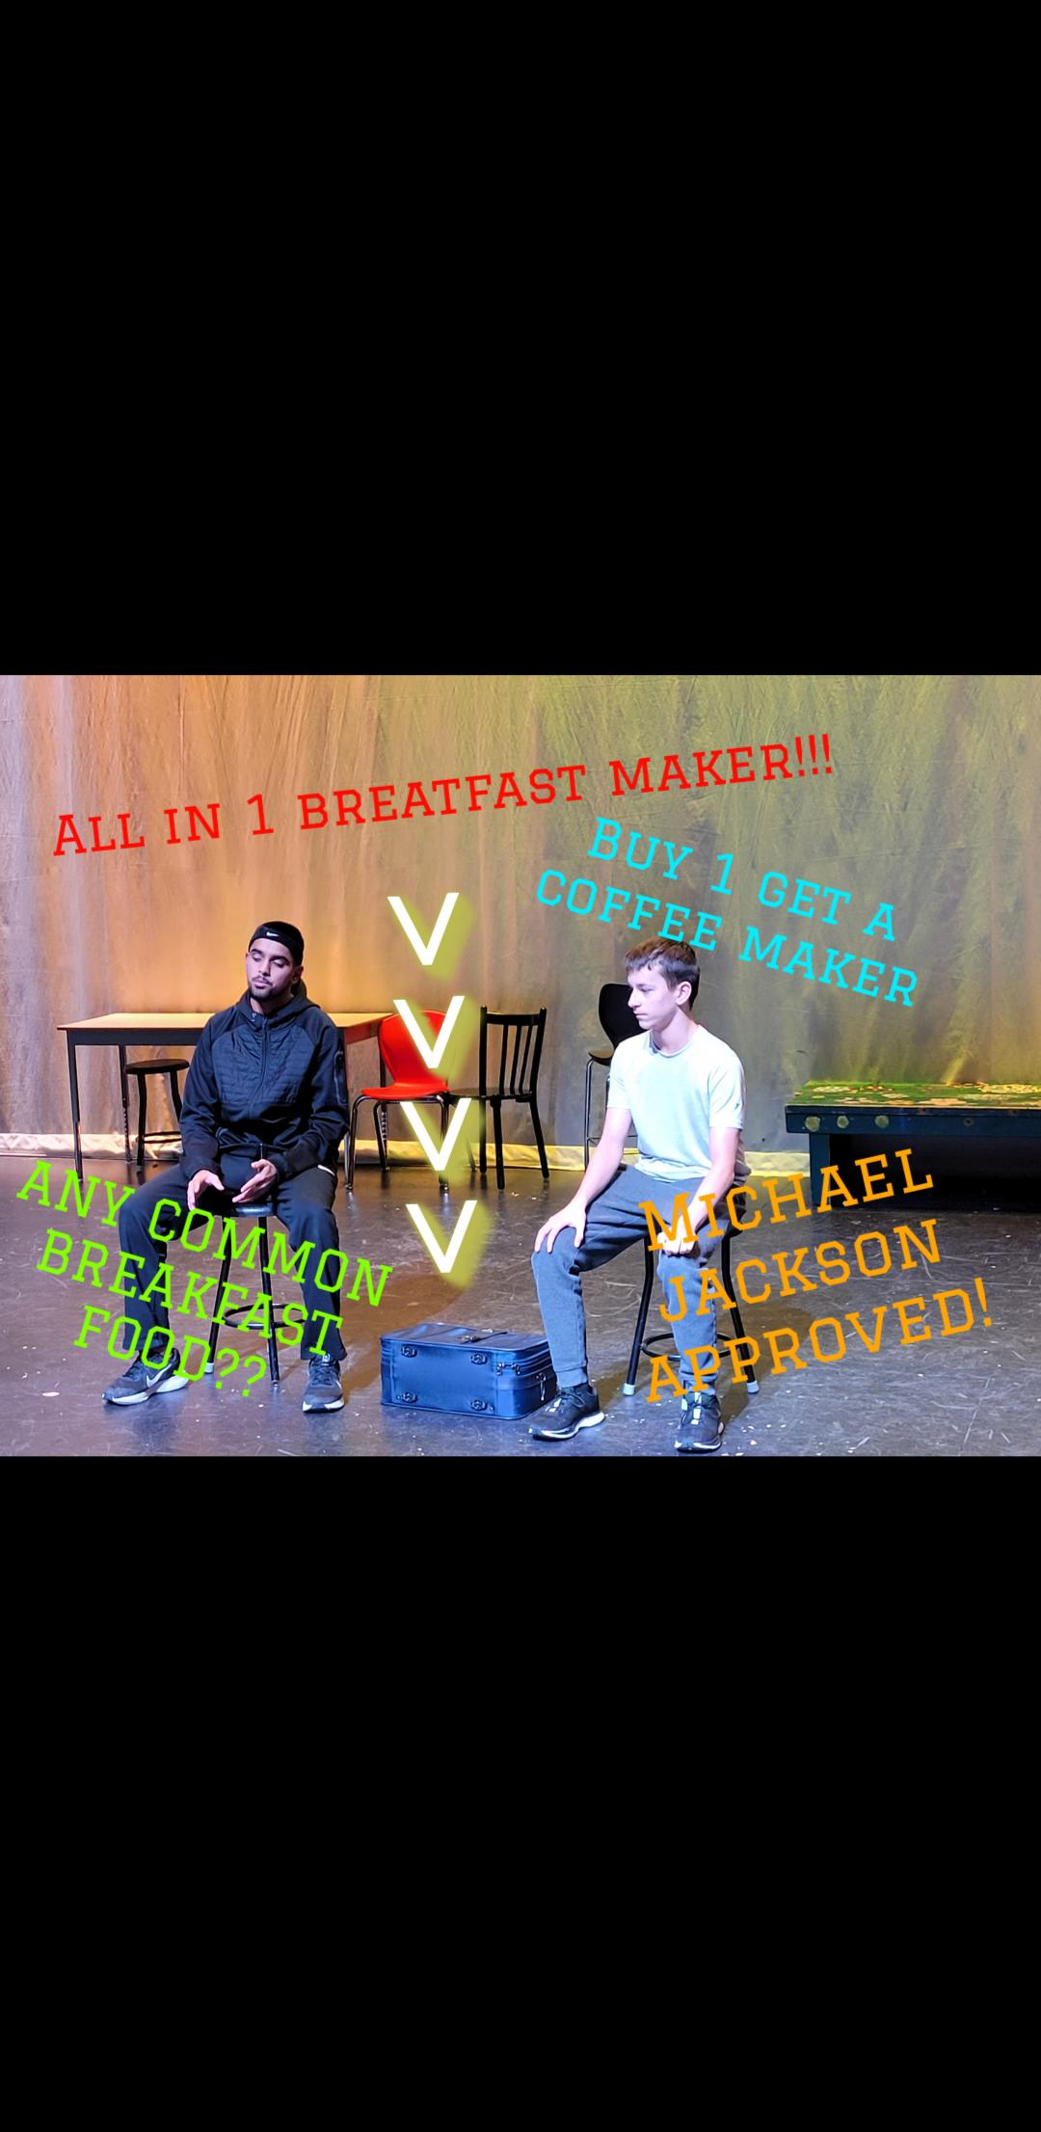
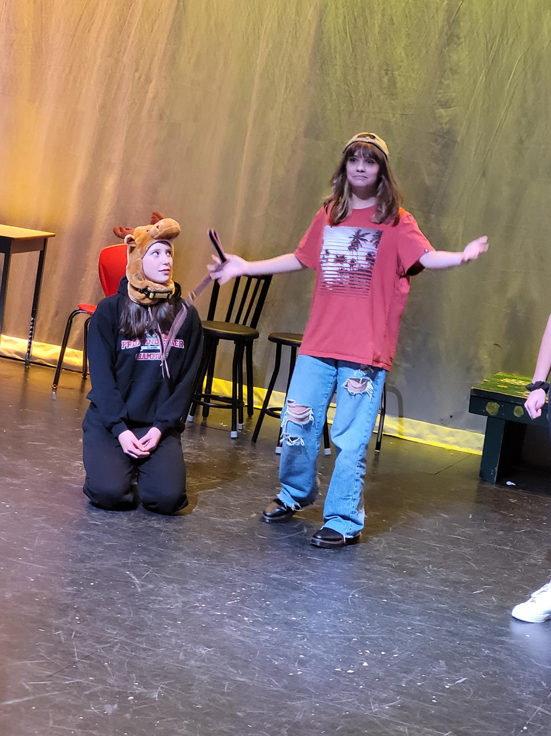
DRAMA
DRAMA 9
DRAMA 10
THEATRE COMPANY 10
E Block

Slide 25
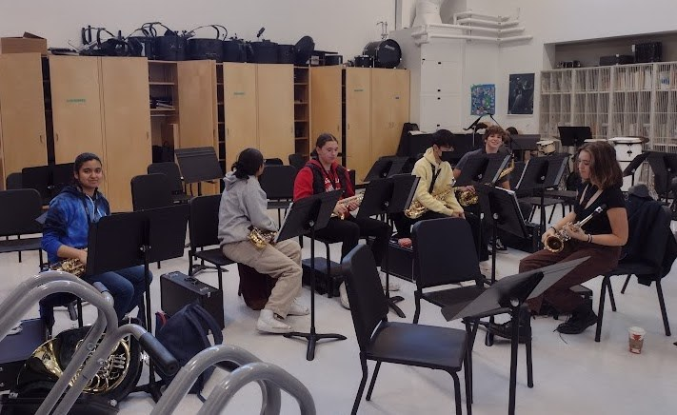


MUSIC
Grade 9 Concert Band
Grade 10 Concert Band
Grade 11/12 Concert Band
Grade 9 Guitar
Grade 10 Guitar
Grade 11/12 Guitar
Choir 9
Choir 10
Choir 11/12
E BLOCK
Jr Jazz Band ( 8-9)
8’s & 9’s who are not in regular band can take this class with director approval
E BLOCK
Sr Jazz Band (10-12)
10’s-12’s who are not in regular band can take this class with director approval

Slide 26




Applied Design, Skills & Technology
Inquiry Design
Metal & Woodwork 8
Robotics & Drafting 8
Robotics 9
Robotics 10
Competitive Robotics 9
(2 courses, one B-D + 1 in E)
Note: Students who complete a Gr 9 Level course will be enrolled in a Level 2 Gr 10-12 course.
Competitive Robotics 10
(2 courses, one B-D + 1 in E)
Drafting & Design 9
Drafting & Design 10
Levels Beg & Int & Adv
Woodwork 9
Woodwork 10-12
Levels Beg & Int & Adv
Metalwork 9
Metalwork 10
Levels Beg & Int & Adv
Art Metal & Jewelry
11/12

Slide 27



Design 8
part of ADST rotation
HOME ECONOMICS
Foods & Textiles
9
Foods
9
Foods & Textiles 10
Foods
10
Foods Leadership
10

Slide 28

FOODS LEADERSHIP
Students will engage in safely planning, preparing and serving food at various events in the school and local community.
During the course they will work towards understanding their relationship with others and the significance of place.
The class will encourage creative thinking and collaboration through the design and execution of different types of menus, based on their own personal values and sense of place.

Slide 29

What is LEAP?
LEAP is an experiential and holistic program, founded in the First Peoples Principles of Learning, for students in grades 8-12. The program offers opportunities to participate in field studies, is geared towards cross-curricular learning, and is routed in strength-based, hands-on learning. LEAP focuses on building strong classroom communities where students are not afraid to take risks in their learning.
LEAP runs for two blocks a day for the full year (Block A and B).
LEAP stands for 'Learning from Experience and Aboriginal Perspectives'.

Slide 30



LEAP
Learning through Experience and
Aboriginal Perspectives
LEAP is a Grade 10 interdisciplinary program. The cohort may include Science 10, Active Living 10, First People’s English 10/Spoken Word 10, Social Studies 10, and Career Life Education.
The goal of the program is to learn Big Ideas and develop Core Competencies through a holistic, hands-on approach, with a strong focus of Indigenous perspectives and building a sense of community.
The program will include themed units related to story telling and communication to investigating major social, economic and political events of the 20th century.
Along with exploring career opportunities and employability skills, this exciting program may include field trips such as snowshoeing, canoeing, hiking, visiting museums and volunteering in the community.

Slide 31

Classroom Learning
The LEAP classroom is set up to provide students with diverse learning activities. The teachers design their lessons to be engaging and active. We will have guest speakers, work with community partners, and invite local societies in, to enhance the curriculum. Your teachers will often co-teach, and we will use the entire pod space as our classroom.

Slide 32
Field Studies
Students in LEAP get to participate in many learning opportunities, including field studies. Some potential field studies:
Vancouver Aquarium - Heppell Potato Farm
Surrey Nature Centre - Longhouse Visit
Ice Skating - Park Exploration
Snow Shoeing - Hiking
High Ropes Course - Fraser River Society
Granville Island Writers Festival - Fort Langley
Tynehead Fish Hatchery - Museum of Anthropology
Etc.

Slide 33




Slide 34





Slide 35
2026-2027 COURSE SELECTIONS
Click MY INFO

Slide 36

Click REQUESTS

Slide 37

Mandatory ACADEMIC courses will be automatically selected
Click on each tab to select electives.

Slide 38
FRENCH IMMERSION
SAME CHOICES AS
ENGLISH STREAM

Slide 39


CAREER LIFE EDUCATION
Make your CLE choice here
CLE 10
OR
CLE 10 LEADERSHIP

Slide 40
LEAP
If you want to select LEAP, click on the menu
ONLY SELECT IF YOU WANT IT

Slide 41
MATHEMATICS
Make your Math selection here
MATH 10 FOUNDATIONS & PRE-CALCULUS
OR
MATH 10 WORKPLACE

Slide 42
ELECTIVES
Make your elective choices here
MAKE 2 CHOICES

Slide 43

ELECTIVES
There are multiple pages of elective options.
Click on the arrow to see and select electives.

Slide 44

ALTERNATES
RANK THEM
Click on this button
MAKE 2 CHOICES –
DIFFERENT FROM YOUR PRIMARY

Slide 45


ALTERNATES
RANK THEM
Make sure you select 2 electives as alternates
(1 Design and 1 Art)
Click arrow to get to second page

Slide 46

COUNSELLOR NOTES
LEAVE A NOTE FOR SPECIAL CIRCUMSTANCES or things for Counsellors to consider when meeting with you

Slide 47



Resources
Myblueprint.ca
  Activation key: salish
  Provide your PEN (Provincial Education #) and your courses & credits will load
  Plan courses, career info, PSI programs
Educationplannerbc.ca
  Search by program, study area
  Resources, application portal
Salish Career Centre, Counselling
https://salishcareercentre.weebly.com

Slide 48
Grade 10 Programs Recap
English Track
English 10
Math 10
Science 10
Social Studies 10
Physical Health Education 10
Career Education Life 10
1. Language 10 credit is now optional (consider pursuing this pathway if going on to specific post-secondary programs)
2. Students have 2 electives and may choose from any of the following categories:
Modern Languages
Design
Art Inquiry
3. Students choose two alternative options different from your primary
French Immersion Track
English 10
Math 10
Career Life Education 10
Français Langue 10
Sciences Humaines 10
Sciences 10
Education Physique et Sante 10
1. Students have 1 elective and may choose from any of the following categories:
Design
Art Inquiry
***FRIM students may select Spanish 10 as their elective choice
3. Students choose two alternative options different from your primary
COURSE SELECTION PORTAL WILL BE OPEN UNTIL DECEMBER 5TH
ALL SELECTIONS MUCH BE ENTERED BY THAT DATE

Slide 49

Questions?

