Slide 1


COURSE SELECTION
For Fall 2026

Slide 2
Semiahmoo Counsellors
A – Gill Ms. Phillips
Gill – Liu Ms. Wilson
Lo - Th Ms. Barclay
Ti - Z Ms. Blackwell

Slide 3
Timeline for Course Selection
Jan.–Mar.
students choose courses
Mar.–May
admin builds the timetable
May–June
adjustments for students that meet criteria--plan to go to summer school, failed a required class, missing requirement etc.
September
NOTE: you will be unable to change courses in September, so make sure you choose correctly and have your courses set in May.

Slide 4

Timeline for Course Selection
End of August:
- schedules available online
Early September:
NO CHANGES, except:
- empty block
- summer school completion
- missing grad requirements

Slide 5

Grad Requirements:
80 Credits (20 courses x 4 credits = 80 credits)
MANDATORY:
English 10, 11, 12
a Math 10 and 11
Physical Education 10
a Science 11
Social Studies 10 & 12
Career Life Educ 10 and Career Life Connections 12
4 Grade 12 courses (English 12 + 3 more)
**1 Fine Arts or Applied Skills course
NEW & MANDATORY:
- 1 First Peoples course (4 credits)
Government Assessments:
Grade 10 Numeracy/Literacy
Grade 12 Literacy

Slide 6
First Peoples Courses:
NEW
Mandatory
Requirement
Choose one
First Peoples course
in either
Grades10, 11 or 12:
Grade 10
English 10 = English First Peoples 10
Grade 12
English 12 = English First Peoples 12
Social Studies 12 =
Contemporary
Indigenous Studies 12

Slide 7
Options for: English, Math & Social Studies
 | ENGLISH | MATH | SOCIAL STUDIES
Grade 11 | Composition 11 Literary Studies 11 | Foundations 11** Pre-Calculus 11 Workplace 11** | See Grade 12
Grade 12 | English Studies 12 English First Peoples 12 | Foundations 12** Pre-Calculus 12 Calculus 12 **does this Math class satisfy the requirements of your post secondary program of choice??? | Political Studies 12 Law 12 Physical Geography 12 Social Justice 12 20th Century World History 12 Contemporary Indigenous Studies 12

Slide 8
Math & Science Choices
Your current Math teacher will consult with you to determine the most suitable course for you
Placement will be based on your achievement and work habits
When selecting your Science and Math requirement, you should consider past achievement, interest & post-secondary plan

Slide 9
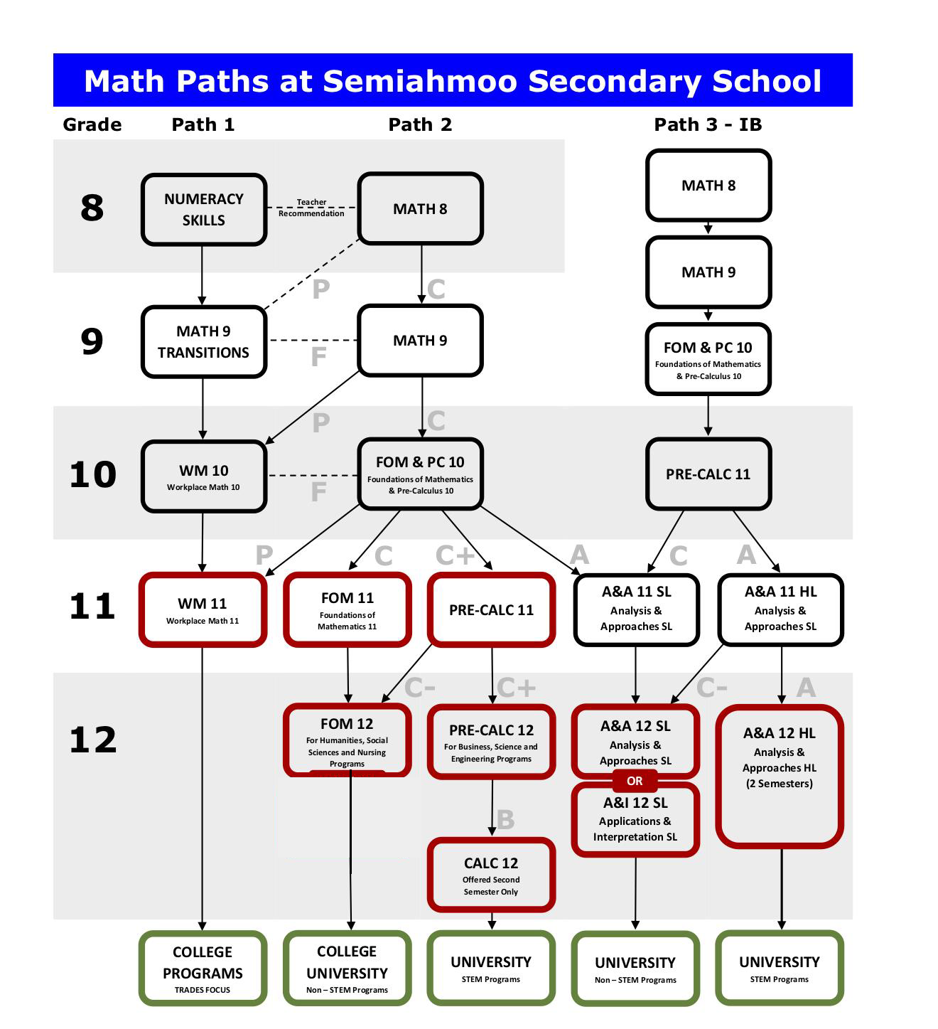
Mathematics Pathways

Slide 10
International Baccalaureate Program (IB)
A choice program for students entering Grade 11.
The Diploma Program is a full two year program that gives students advanced standing at most universities.
The full diploma program is a very rigorous program and students should be very strong academically and in terms of time and stress management, and organization skills.
To prep for the Science Pathways, Grade 10 students should take physics 11 before entering the IB program. IB Math HL students need Prec 11 prior to this course as well.
It is not necessary or even recommended to take Chemistry 11 or Biology 11 before IB as they are not directly connected to the IB curriculum.

Slide 11
International Baccalaureate Program (IB)
Students entering any pathway of the diploma program will also require a second language.
IB candidates should also ensure they have completed their Grade 10 program and grad requirements
Career Life Education (CLE) 10
A Grade 10 PHE course
A Fine Arts or Applied Skill credit
More information is available through the IB Coordinator, Mr. Kenny kenny_david@surreyschools.ca
Or visit the IB website at http://ibsemiahmoo.ca/apply/

Slide 12

District Career Education Programs
Apply to these programs in February for the following year.
When you are in Grade 11 or 12, you attend this program off site for one semester and get post secondary credits PLUS high school credits.
A "C" or better in English 10 and Math 10 are minimum requirements.
Attendance records are very important to qualify for these programs

Slide 13
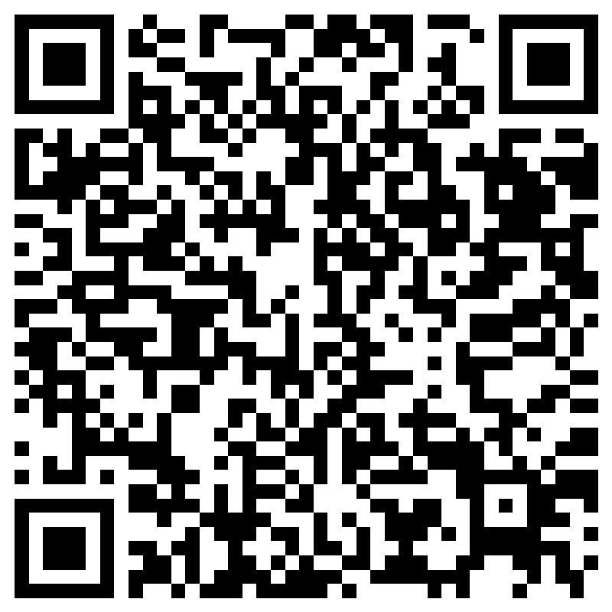
District Career Education Programs
Baking and Pastry Arts
Carpentry
Exploration in Aviation Careers
Culinary Arts
Drafting/CADD
Hairstylist
Horticulture
Metal Fabrication
Painter/Decorator
Tah-tul-ut Indigenous Education Pathway
Automotive Collision and Refinishing
Automotive Service Technician
Electrician
Emily Carr Art Program
Law Enforcement Prep
Masonry/Bricklayer
Millwright/Industrial
Plumbing
Welding
Education Assistant

Slide 14

Other Careers Opportunities
High School on Campus (HSOC)
Study at KPU, SFU or Douglas College while you are still in high school and earn post secondary credits
Work Experience
See Ms. Pajic in the Career Office for more information pajic_l@surreyschools.ca

Slide 15

WHERE DO I GO FROM HERE?

Slide 16
Certificate
1 year at College
Diploma
2 years at College
Start at a College such as KPU, Douglas, UFV, or … and transfer after 30 or 60 credits (1-2 years)
University Transfer
Associates Degree
2 – 3 years College
4 - 5 years
Bachelors Degree
1 – 2 years following a Bachelor’s Degree leads to University “Grad School”
Masters Degree
Doctorate Degree
2-5 years following a Bachelor's or Master's degree

Slide 17

WHAT DO I NEED TO APPLY TO POST-SECONDARY?

Slide 18
COLLEGE REQUIREMENTS
ENGLISH 12 or English First People's 12 is the only course needed for general admission.
Kwantlen requires a minimum grade of 67% (C+)
Douglas College requires a minimum grade of 60% (C)
Langara College requires either a 50% or a 70% in English 12 depending on program.
There are also program specific requirements – especially Math requirements. Find out what you need!

Slide 19
UBC REQUIREMENTS
https://you.ubc.ca/applying-ubc/requirements/canadian-high-schools#british-columbia
SFU REQUIREMENTS
http://www.sfu.ca/students/admission/admission-requirements/canadian-highschool/bc-yukon.html
UVIC REQUIREMENTS
How to apply - Undergraduate admissions – Uvic
Note: NO Second language is required by any university in Canada

Slide 20
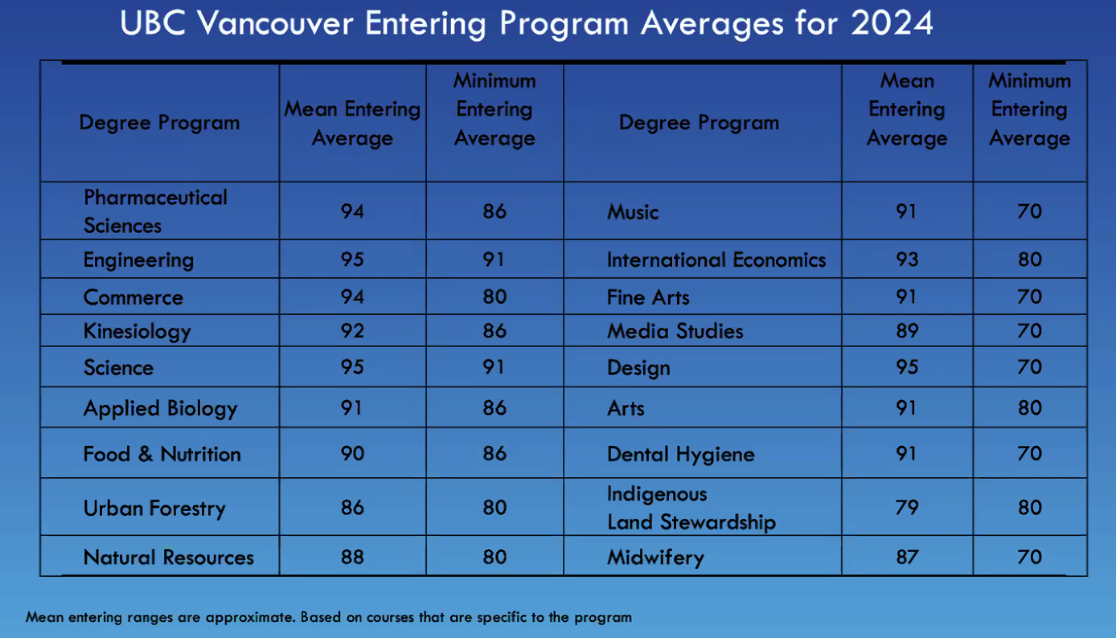

Slide 21
HELPFUL WEBSITES
educationplannerbc.ca – Search careers and programs, admission requirements, tuition costs, length of program etc.
Check out the Counselling tab on the Semiahmoo Secondary website (surreyschools.ca)
Always check the post-secondary institute’s website for up-to-date admission information!

Slide 22
myths You must take English 12 in first semester of gr 12 The more classes you take the better! If you take a class at summer school it doesn’t count Some schools still require a second language The only marks that count are your gr 12 marks
Myths!

Slide 23


Tricks
If you speak/write a 2nd language - take it online and put a strong grade 12 mark in your back pocket – take this BEFORE gr 12.
Take one of your strongest gr 12 courses (i.e a Socials, Math, Sci) in gr 11 and put your best foot forward and lighten your load for gr 12
Apply EARLY – as early as October and definitely before Dec 1!
This gives you earlier possible acceptance, opportunities for scholarships and admission averages usually trend upwards, not lower, so you are more likely to get an earlier “yes”!

Slide 24
Tips
Do NOT take any course online or at summer school that you plan to take at university or college!!
You will not be well prepared. See your counsellor before signing up for online or summer courses.
CLC is not offered at summer school
Gr 11 marks matter!!!! This is what all colleges and universities will see and base their early decisions on

Slide 25
Sample band plus IB schedule (highlighted courses show academics considered for entrance)
Grade 11
IB English HL IB Math HL
Band Band
CLC Science 11
Socials 12 Elective
Grade 12
IB English HL IB English HL
IB Math HL IB Math HL
Band Band
Spare Grade 12 academic or 2nd language

Slide 26
Sample band plus IB Sciences schedule (highlighted courses show academics considered for entrance)
Grade 11
IB Chem IB Physics or Bio
Band Band
CLC Precalculus 11
Socials 12 Eng 11
Grade 12
IB Chem IB Chem
IB Phys or Bio IB Physics or Bio
Band Band
Eng 12 Prec 12
Note: U of T requires Calc 12 and most science programs require physics 11

Slide 27
Sample Humanities Schedule (highlighted courses show academics considered for entrance) Sample Humanities Schedule Grade 11 Eng 11 Math 11(UBC Accepts Any) CLC Sci 11 (UBC Accepts any) Socials 12 Elective Elective Elective Grade 12 Eng 12 Grade 12 academic 2nd Language? Art/Drama/Film/Socials? Gr 12 academic Elective Spare Elective or spare *Some schools want one gr 12 sci or math

Slide 28
Sample Science/Engineering Schedule (highlighted courses show academics considered for entrance)
Grade 11 Eng 11 Precalculus 11 CLC physics 11 (req’d at most univ)
Socials 12 bio 11 or elective Chem 11 Elective Grade 12 Eng 12 Science 12 Prec 12 Elective Science 12 Calc 12
Spare Elective/spare

Slide 29

Link to worksheets and PSI cheat sheet (click, print off and use!!!)
Right click the icon above, choose document object > open
Print off the sheets and use to plan!
If this isn't working, go to https://www.surreyschools.ca/semiahmoo/course-selection where you can find these slides and print them out
These planning sheets are also on the next two slides

Slide 30
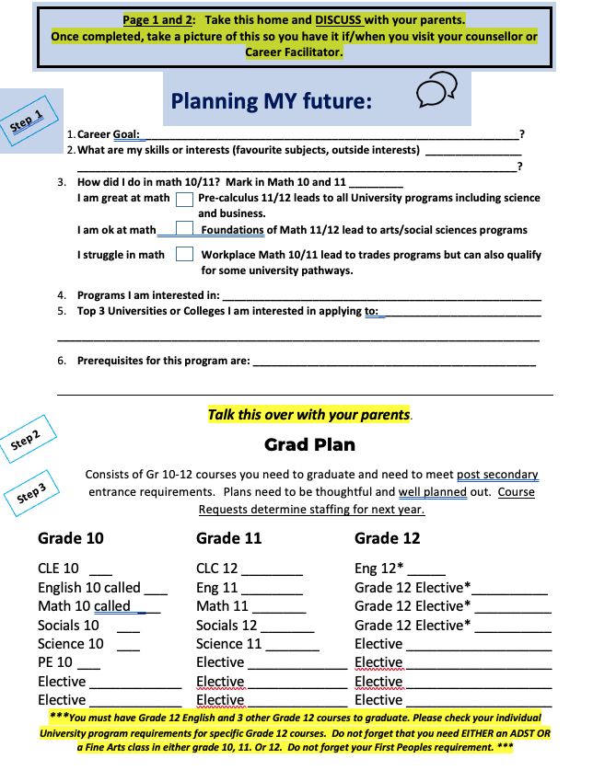
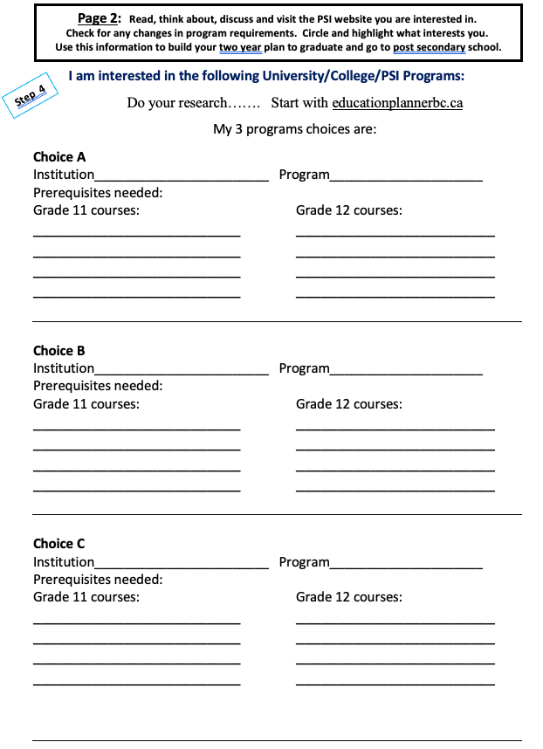
Helpful Worksheets

Slide 31
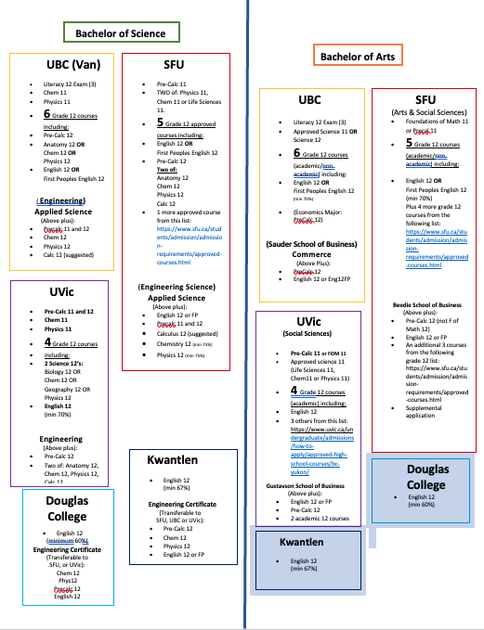
PSI Cheat Sheet ~ at a glance (make sure you verify requirements by visiting PSI website

Slide 32
And now… over to you! Take your time to make thoughtful choices about your plans for next year. Choose wisely because there will be no course changes once selection is complete.

