Slide 1



COURSE SELECTION
For Fall 2026
This presentation has audio, so please make sure to click the audio icon in the lower right corner of each slide, or view it as a slideshow.

Slide 2




Semiahmoo Counsellors
A – Gill Ms. Phillips
Gillespie – Liu Ms. Wilson
Lo – Th Ms. Barclay
Ti - Z Ms. Blackwell

Slide 3
Timeline for Course Selection
Jan.–Mar.
students choose courses
Mar.–May
admin builds the timetable
May–June
adjustments for students that meet criteria--plan to go to summer school, failed a required class, missing requirement etc.
September
NOTE: you will be unable to change courses in September, so make sure you choose correctly and have your courses set in May.

Slide 4

Timeline for Course Selection
End of August:
- schedules available online
Early September:
NO CHANGES, except:
- empty block
- summer school completion
- missing grad requirements.

Slide 5
A Caution on Course Change Requests:
Semiahmoo is currently OVER capacity, which means we have many more students than we built space for in the timetable.
We anticipate this over enrollment to continue as our community grows.
This means that when you are trying to change courses in September, most of our courses will be full and there will be no space to move.
DO NOT expect to be able to change courses after course selection is complete. Choose wisely and thoughtfully NOW, to save yourself the disappointment LATER.

Slide 6

Grad Requirements:
80 Credits (20 courses x 4 credits = 80 credits)
- MANDATORY:
- English 10, 11, 12 - a Math 10 and 11
- PE 10 - a Science 11
- Social Studies 10 & 12 - CLC 12
- CLE 10
- 4 Grade 12 courses (English 12 + 3 more)
**1 Fine Arts or Applied Skills course
in Grades 10, 11 or 12
- NEW & MANDATORY:
- 1 First Peoples course (4 credits)
Government Assessments:
Grade 10 Numeracy/Literacy - Grade 12 Literacy

Slide 7
First Peoples Courses:
NEW
Mandatory
Requirement
Choose one
First Peoples course
in either
Grades10, 11 or 12:
Grade 10
English 10 = English First Peoples 10
Grade 12
English 12 = English First Peoples 12
Social Studies 12 =
Contemporary
Indigenous Studies 12

Slide 8

District Career Education Programs
Apply to these programs in February for the following year.
When you are in Grade 11 or 12, you attend this program off site for one semester and get post secondary credits PLUS high school credits.
A "C" or better in English 10 and Math 10 are minimum requirements.
Attendance records are very important to qualify for these programs

Slide 9
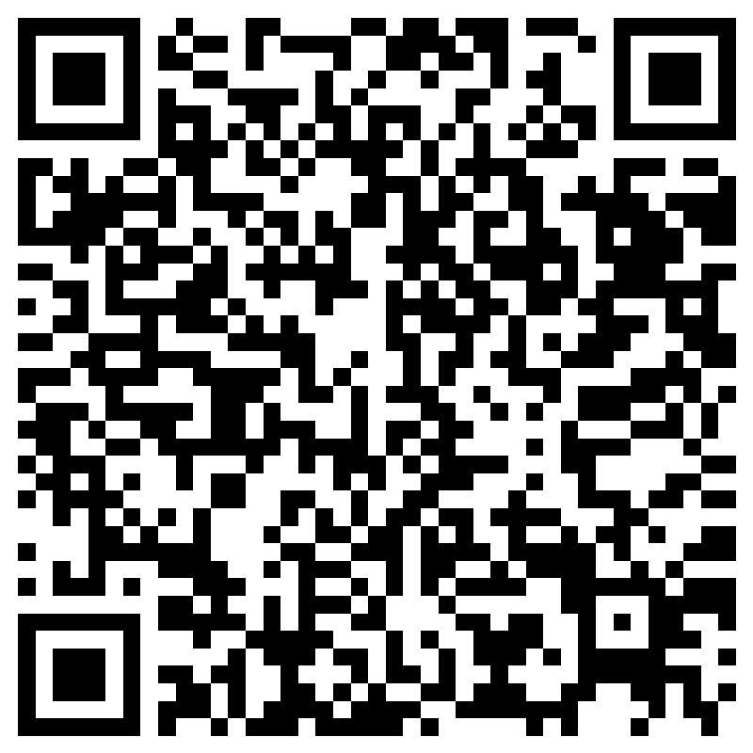
District Career Education Programs
Baking and Pastry Arts
Carpentry
Exploration in Aviation Careers
Culinary Arts
Drafting/CADD
Hairstylist
Horticulture
Metal Fabrication
Painter/Decorator
Tah-tul-ut Indigenous Education Pathway
Automotive Collision and Refinishing
Automotive Service Technician
Electrician
Emily Carr Art Program
Law Enforcement Prep
Masonry/Bricklayer
Millwright/Industrial
Plumbing
Welding
Education Assistant

Slide 10

Other Careers Opportunities
High School on Campus (HSOC)
Study at KPU, SFU or Douglas College while you are still in high school and earn post secondary credits
Work Experience
See Ms. Pajic in the Career Office for more information pajic_l@surreyschools.ca

Slide 11

WHAT DO I NEED TO APPLY TO POST-SECONDARY?

Slide 12
COLLEGE REQUIREMENTS
ENGLISH 12 or English First People's 12 is the only course needed for general admission.
Kwantlen requires a minimum grade of 67% (C+)
Douglas College requires a minimum grade of 60% (C)
Langara College requires either a 50% or a 70% in English 12 depending on program.
There are also program specific requirements – especially Math requirements. Find out what you need!

Slide 13
UBC REQUIREMENTS (MINIMUM ACADEMIC QUALIFICATIONS)
Click on link below for up to date admissions information on UBC. Admissions requirements have changed in recent years, so check often and stay up to date!
https://you.ubc.ca/applying-ubc/requirements/canadian-high-schools#british-columbia

Slide 14
SFU REQUIREMENTS (MINIMUM ACADEMIC QUALIFICATIONS)
Check the following link for up to date information on SFU admissions. Admissions have changed as of fall 2026, so check carefully!
http://www.sfu.ca/students/admission/admission-requirements/canadian-highschool/bc-yukon.html

Slide 15
UVIC REQUIREMENTS
Check the following link for up to date admissions information.
https://www.uvic.ca/undergraduate/index.php

Slide 16
FACULTY REQUIREMENTS
This is a guideline only. Requirements vary by school.
Students are responsible for checking specific program requirements.
PROGRAM | Minimum Pre-Requisite courses | Additional ‘Application Boosters’
Arts | -English 12 -An approved Gr.11 Science -Pre-Calculus 11 or Foundations 12 (UBC) -Pre-calc 11 or Foundations 11 AND -1 Science 12 or Math 12 (includes Geography!) | Language Arts Math & Computation 2nd Languages Social Studies Visual / Performing Arts
Commerce/Business | -English 12 -An approved Gr.11 Science -Pre-Calculus 12 | Language Arts Math & Computation Social Studies
Engineering | -English 12 -Pre-Calculus 12 -Chemistry 12 & Physics 12 | Language Arts Science Math & Computation
Science | -English 12 -Chemistry 11 & Physics 11 -Pre-Calculus 12 -Anatomy & Physiology12, Chemistry 12 or Physics 12 | Language Arts Science Math & Computation

Slide 17
HELPFUL WEBSITES
educationplannerbc.ca – Search careers and programs, admission requirements, tuition costs, length of program etc. This is your one stop shop for all things university admission! Please research on this site—being informed is up to you.
Check out the Counselling tab on the Semiahmoo Secondary website or "Resources" > "Courses" (surreyschools.ca)
Always check the post-secondary institute’s website for up-to-date admission information! Admissions change every year, and there are thousands of different institutions across Canada—it is your future, and your responsibility to check!

Slide 18

FIND INFORMATION TO MAKE GOOD CHOICES!
Talk to parents and family
Discuss with subject teachers
Talk to students who have taken the course
Visit https://www.surreyschools.ca/semiahmoo/page/52871/courses
Contact your counsellor for an appointment!!!

Slide 19
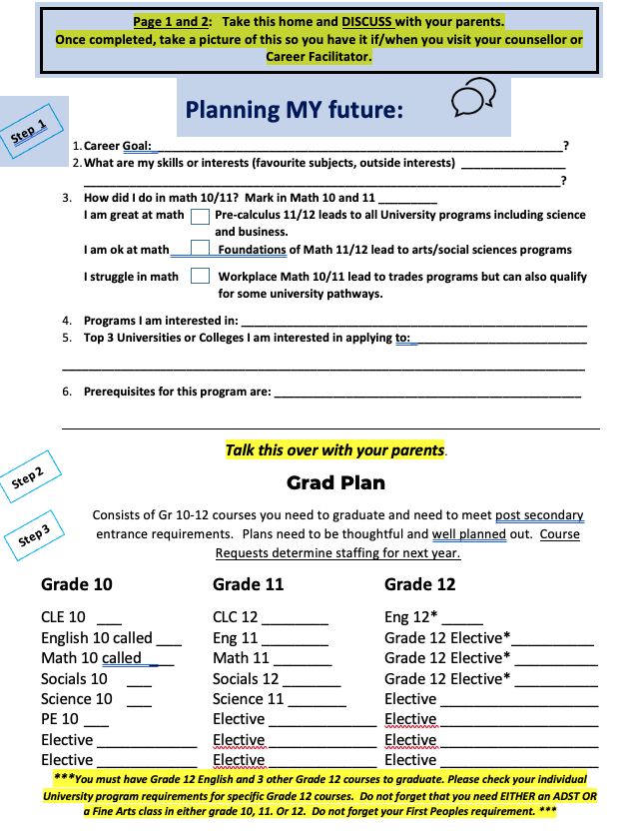
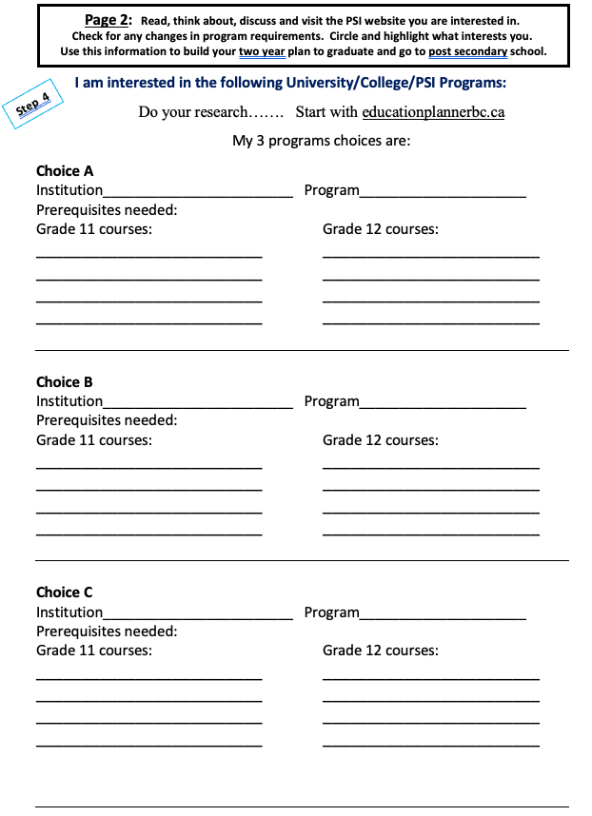
Helpful Worksheets

Slide 20
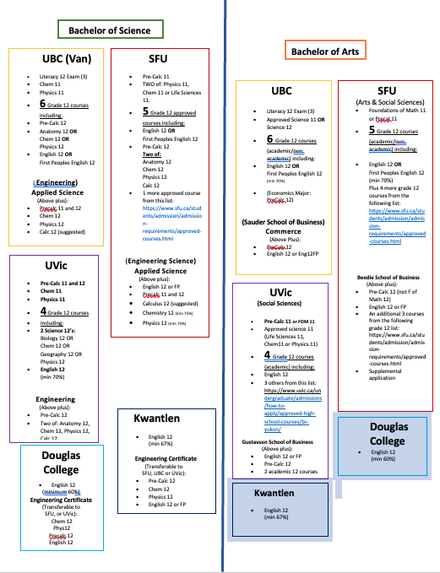
PSI Cheat Sheet ~ at a glance (make sure you verify requirements by visiting PSI website

Slide 21
Link to worksheets and PSI cheat sheet (click, print off and use!!!)
Right click the icon above, choose document object > open
Print off the sheets and use to plan!
If this isn't working, go to https://www.surreyschools.ca/semiahmoo/course-selection where you can find these slides and print them out

Slide 22
Process for Course Selection:
View course selection presentation yourself and with your parents.
Use worksheets and think about your selections thoughtfully. Discuss with your parents.
Login to myed and make your choices ASAP.
If you have questions AFTER using the worksheets, viewing the presentation, visiting educationplannerbc.ca AND looking at post secondary school websites, visit counsellors at lunch in the library on January 12th, 13th or 14th.
If you need further assistance after seeing a counsellor in the library, please make an appointment with your counsellor.

Slide 23
And now… over to you! Take the time to make thoughtful choices about your plans for next year with your parents. Choose wisely because there will be no course changes once selection is complete. This is your future and you need to be responsible for your choices. Counsellors are here to guide and help, but we are not responsible for ensuring you have all the requirements you need~this is your job! ENTER YOUR SELECTIONS ON THE MYED PORTAL ASAP!!

