Slide 1
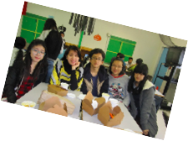
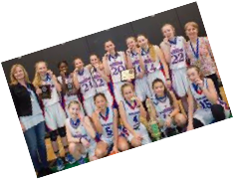

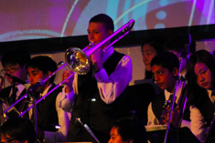
Welcome to Semiahmoo!!
Grade 7 PRESENTATION for September 2026

Slide 2

A word about our name
In 2021/2022, Semiahmoo Secondary changed its mascot to the Thunderbird.
We are no longer the Totems
This renaming was done with our local Semiahmoo First Nation, and better reflects their history and culture here on the peninsula.
Out of respect for the band, we no longer shorten the name Semiahmoo to Semi. Using the unabbreviated word shows respect to the peoples that have allowed us to use their name.
GO SEMIAHMOO THUNDERBIRDS!!!!

Slide 3
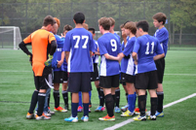
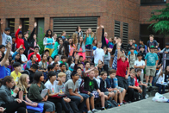
Best Things about SEMiahmoo ~ A change from Elementary School
Multiple classes/multiple teachers
1700 plus students
More Clubs and Teams
Cafeteria
3 gyms/multiple fields/weight room
Youth Room
Semester system

Slide 4

Explore some new Options
For next year, you will choose between two pathways for your classes:
  Band Pathway- Taking Band, choose this option now as it may not have space later and you could be waitlisted!!! Your other elective will be an Explorations Elective. OR
  No Band Pathway- General Explorations ~ choose this option if you are not taking band. (If you don't take Band, you will take the Fine Arts Rotation instead)

Slide 5
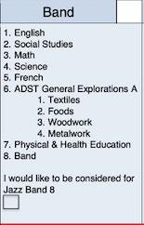
Option One: Band Pathway
Choose this option on the Microsoft Form sent to your parents if you would like Band in grade 8 (If you do not choose it now, you could be waitlisted and not get band).
Note: If you don't take Band in grade 8, you will not be able to choose it in grade 9.
Must take Concert Band to be considered for Jazz Band and Jazz Band runs after school.

Slide 6
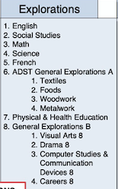
Option Two: General Explorations Pathway
Choose this option on the Microsoft Form sent to your parents if you did not pick the Band Pathway. (Concert Band)
Also, Choose regular PE 8 if you do NOT choose band.

Slide 7
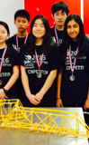
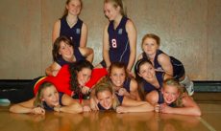
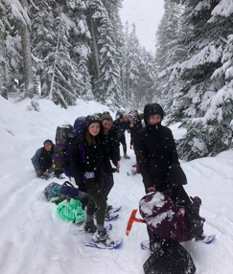
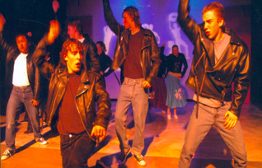
Make your time at Semiahmoo great
Get involved!
Clubs ~ Take your pick! There are so many at Semiahmoo!
Teams ~ play volleyball, basketball, soccer, ultimate, rugby, badminton, join track and field etc.
Volunteer and Leadership Opportunities

Slide 8
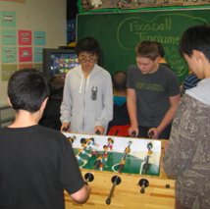
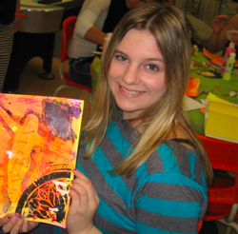

Youth Room
Open at lunch for drop in activities
Full time Youth Care Worker
Hang out and play foosball, air hockey and video games

Slide 9
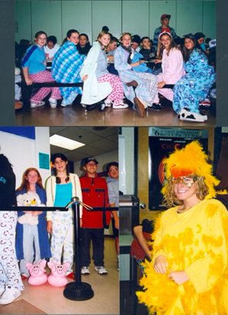
Have Fun!!!
Spirit days
Hoe down
Grade 8 week
Pancake breakfast
Pep rallies
Christmas breakfast

Slide 10
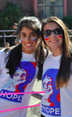
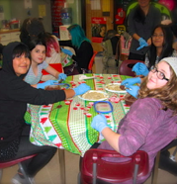
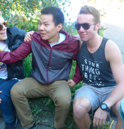
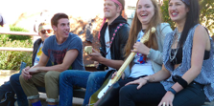
MAKE NEW FRIENDS
Meet new people from many different elementary schools
Grow lifelong friendships!!
Join the Semiahmoo community
Meet others through TEAMS and CLUBS

Slide 11
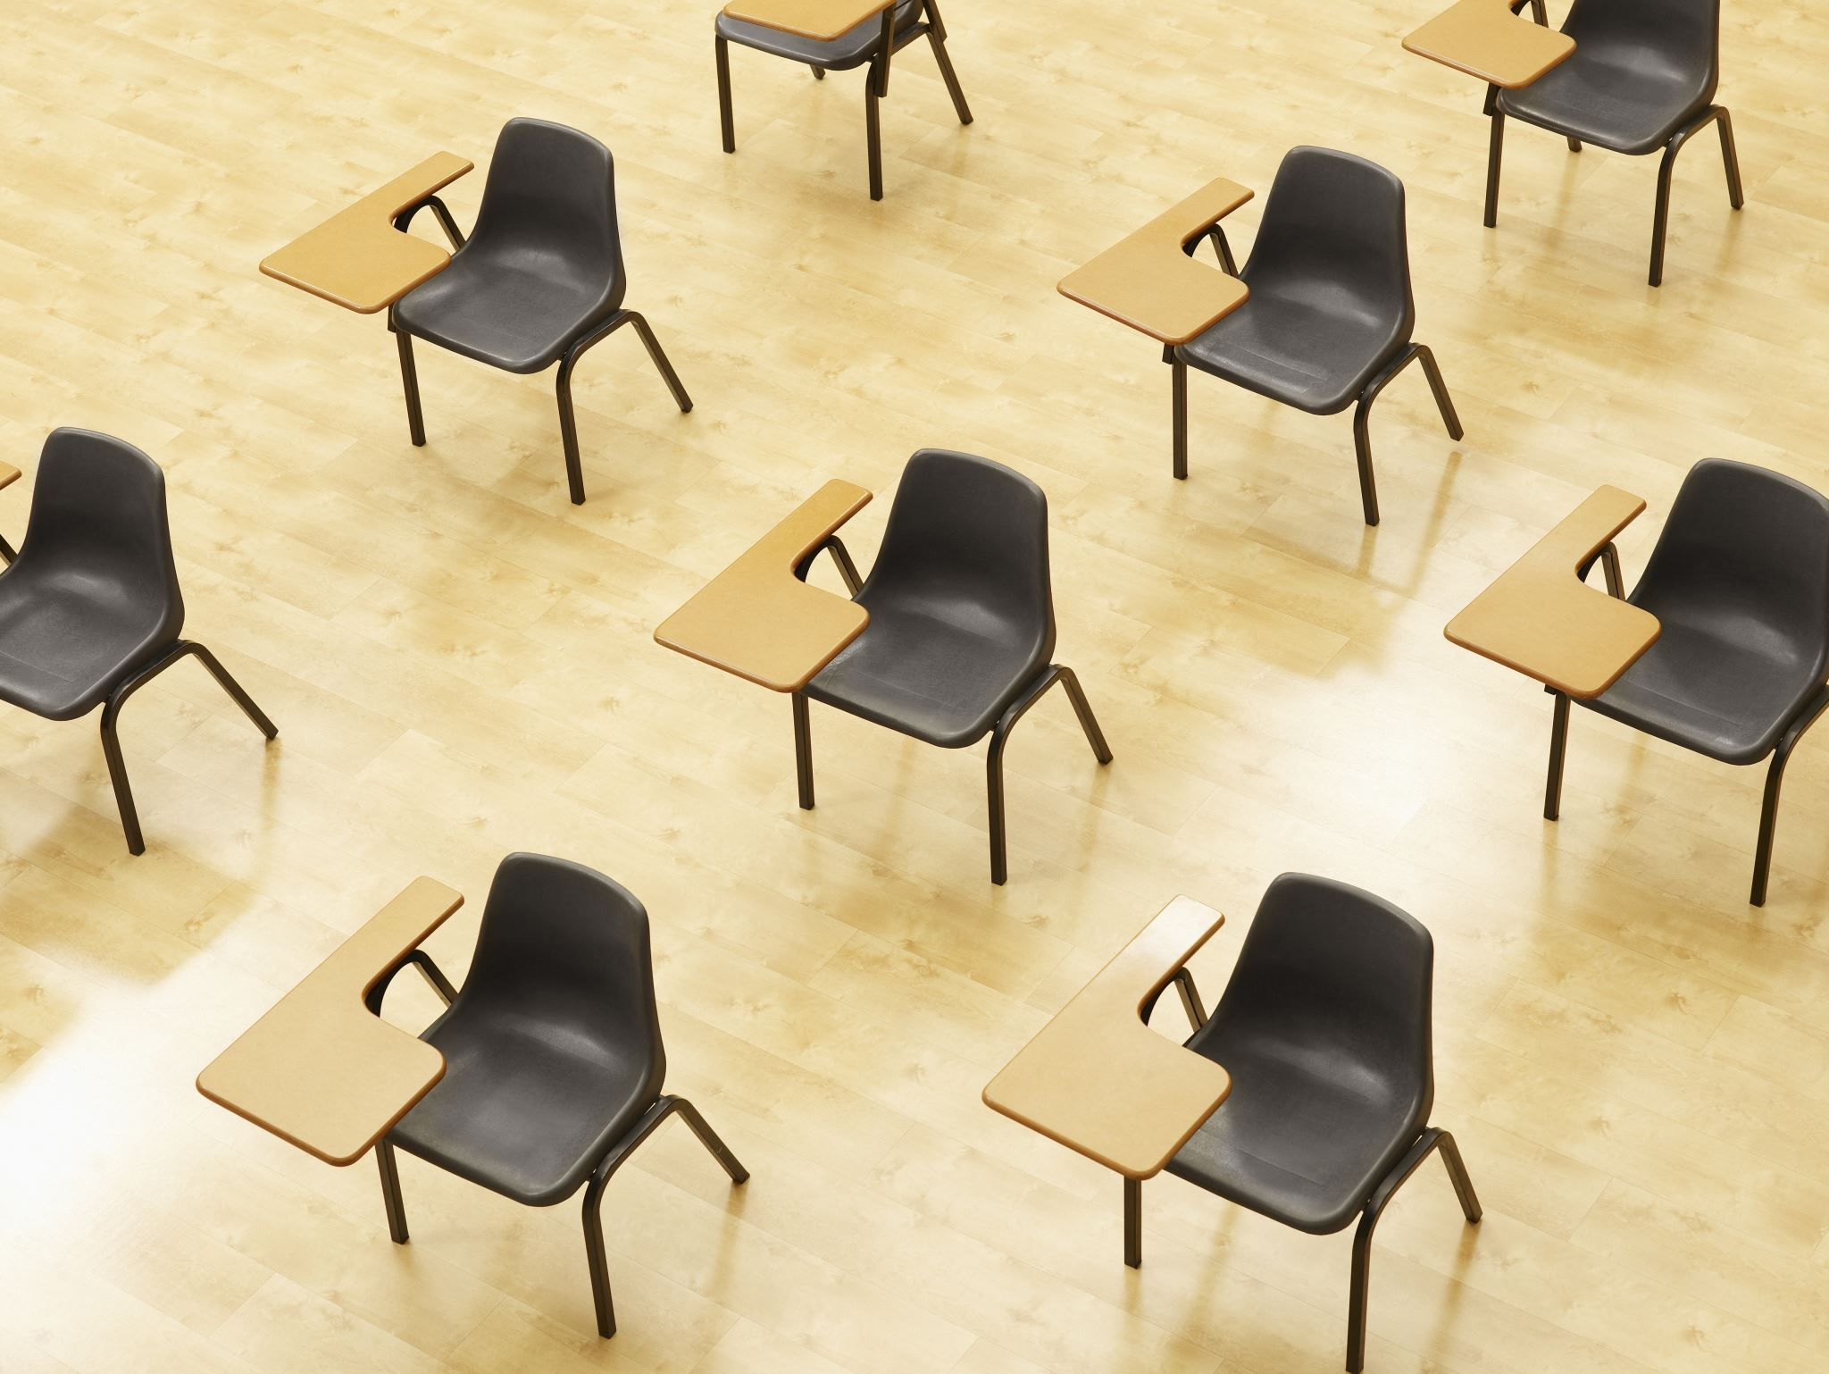
Semiahmoo Grade 7 Day:
In April your teachers will be bringing you to visit Semiahmoo Secondary
You will get a tour of the school, and get to play games with our Leadership students.
There will be a separate Parent Night on May 13 6pm – 7:30pm so parents do not attend Grade 7 Day, but you can attend this Gr 7 night with your parents.

Slide 12

Most Importantly: Have Balance!
Spend time with friends, family, team and classmates
Get outside! Be active!
Regulate your screen time
Homework is important, but down time and fun is just as important. Spend time on both.
If finding balance is difficult, or you feel stressed, talk to a trusted adult, or your counsellor—do this earlier rather than later. We are here for you.

Slide 13

A Video Tour of Semiahmoo – made by Grade 7 teachers from Bayridge Elementary (15 min)

Slide 14
FAQs:
1) What does the year look like?
You will have four courses at a time, for 5 months each:
Semester 1 = September, October, November, December, January
Semester 2 = February, March, April, May, June
2) What does the daily schedule look like?
You will have two classes in the morning with a short break in between, then lunch time, then another two classes in the afternoon with a break. After 5 months you will switch to four new classes, (Semester 2). You will have a total of 8 classes in Grade 8.

Slide 15
FAQs:
3) What about lunch time?
You will have a 40 minute lunch time in the middle of the day. You should bring your own lunch, or you can buy your lunch from the cafeteria. Normally you can eat in the caf, on the floor by your locker, the Youth Room, or at a bench in the halls with your friends.
4) Can I go home for lunch?
Yes, you can go home. Please be sure to be back in time for your afternoon class.

Slide 16
FAQs:
5) Is there anything to do at lunch besides eat?
Clubs and sports activities often occur during lunchtime. Or, you can socialize and have fun with friends.
6) What if I can't find my classrooms?
DON'T WORRY! Just find a teacher or adult and they will show you where to go. It will take you a few days to find out where everything is, but then you'll be a pro!

Slide 17
FAQs Continued:
7) Will I get a locker?
Yes, you will be able to sign up for a locker online in late August/early September.
8) What else do I need?
If you are in PE, you need to bring a change of clothes, deodorant, runners and a lock etc. This is very important!
You should have a binder separated into four sections (or four separate binders), with lots of lined paper. Pens, pencils, erasers, and a calculator if you have Math. If your teacher wants you to have specific items, they will let you know.

Slide 18
A Very Warm Welcome to our Grads of 2031!! WE CAN'T WAIT TO SEE YOU!!

