Slide 1


GRADE 8 COURSE SELECTION
For 2026/2027 School Year

Slide 2

Counsellor | Alpha | Email
Ms.Phillips | A - Gill | Phillips_s1@surreyschools.ca
Ms. Wilson | Gillespie - Liu | Wilson_j@surreyschools.ca
Ms. Barclay | Lo - Th | Barclay_C@surreyschools.ca
Ms.Blackwell | Ti - Z | Blackwell_s@surreyschools.ca
Know who your counsellor is and how you can visit!

Slide 3
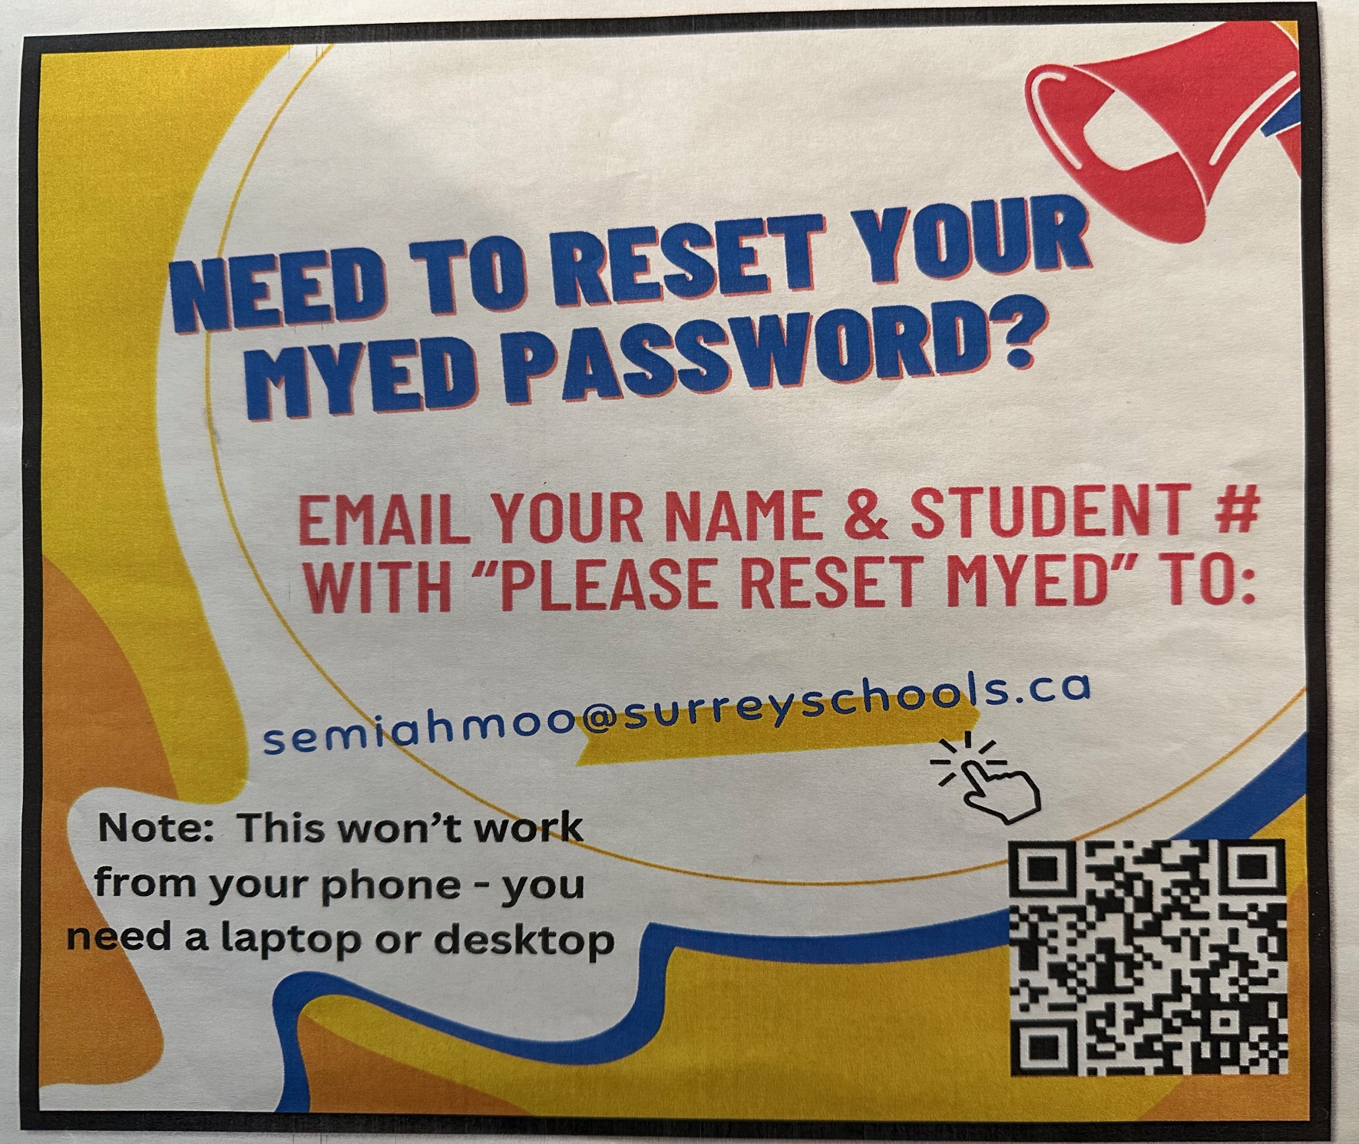
Step One: You have to be able to login to MyEd. Refer to the attachment titled "How to Log Onto MyEd"

Slide 4
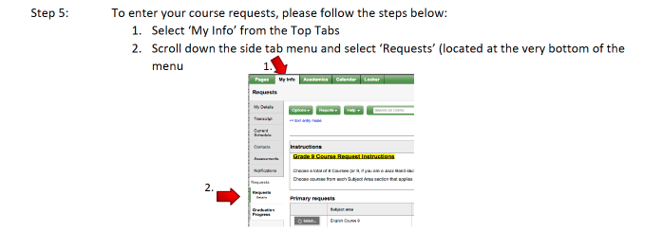
Once you are logged into MyEd, follow the instructions above.

Slide 5
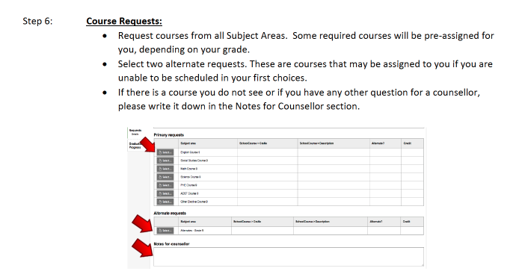

Slide 6
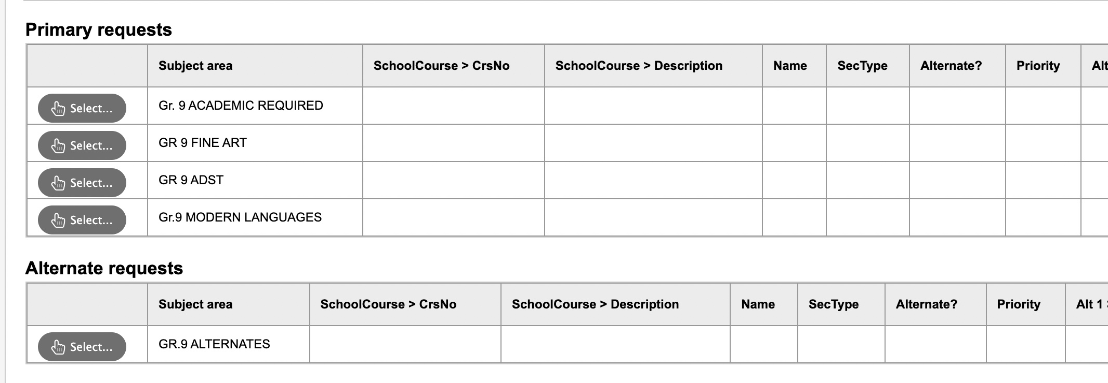
Make sure you choose your 5 required courses, PLUS three electives. Please note: a second language is NOT required to graduate or for post secondary (unless you would like to study languages)
DO NOT forget to choose 2-3 alternates!!!! These are used if there is a conflict in your schedule and we cannot provide you with one of your elective choices.

Slide 7
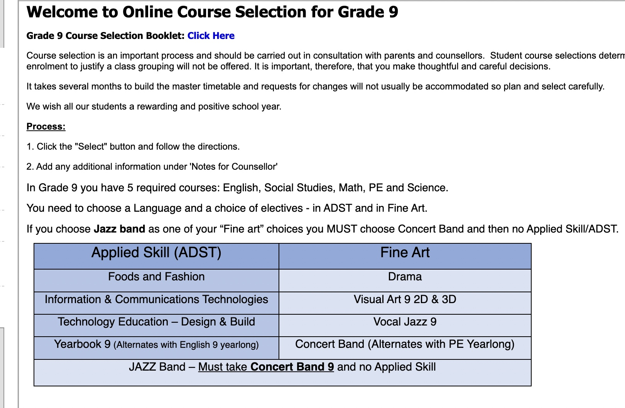
If you are wondering about what is involved in a certain course (ie: what you do in Foods and Fashion 9), you can view the course description booklet here.
Please be sure to read course descriptions to make sure you are choosing the course you want, because we will not be able to make changes.

Slide 8
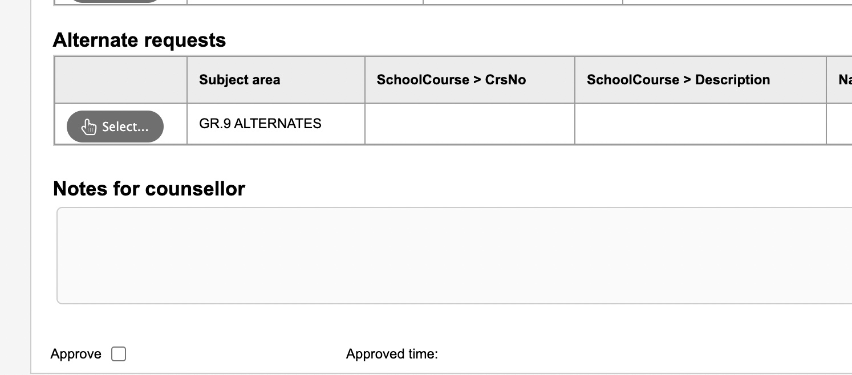
If you are taking any classes out of grade level (for example, you took French 9 this year because you were in immersion in grade 7) and you need a grade 10 class next year, please make a note of this in the counsellor's notes at the bottom of the course request page.
If you are currently receiving ELL or LST support, please make a note in the counsellor's notes as well.

Slide 9
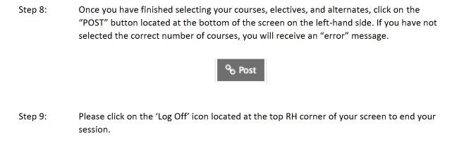

Slide 10
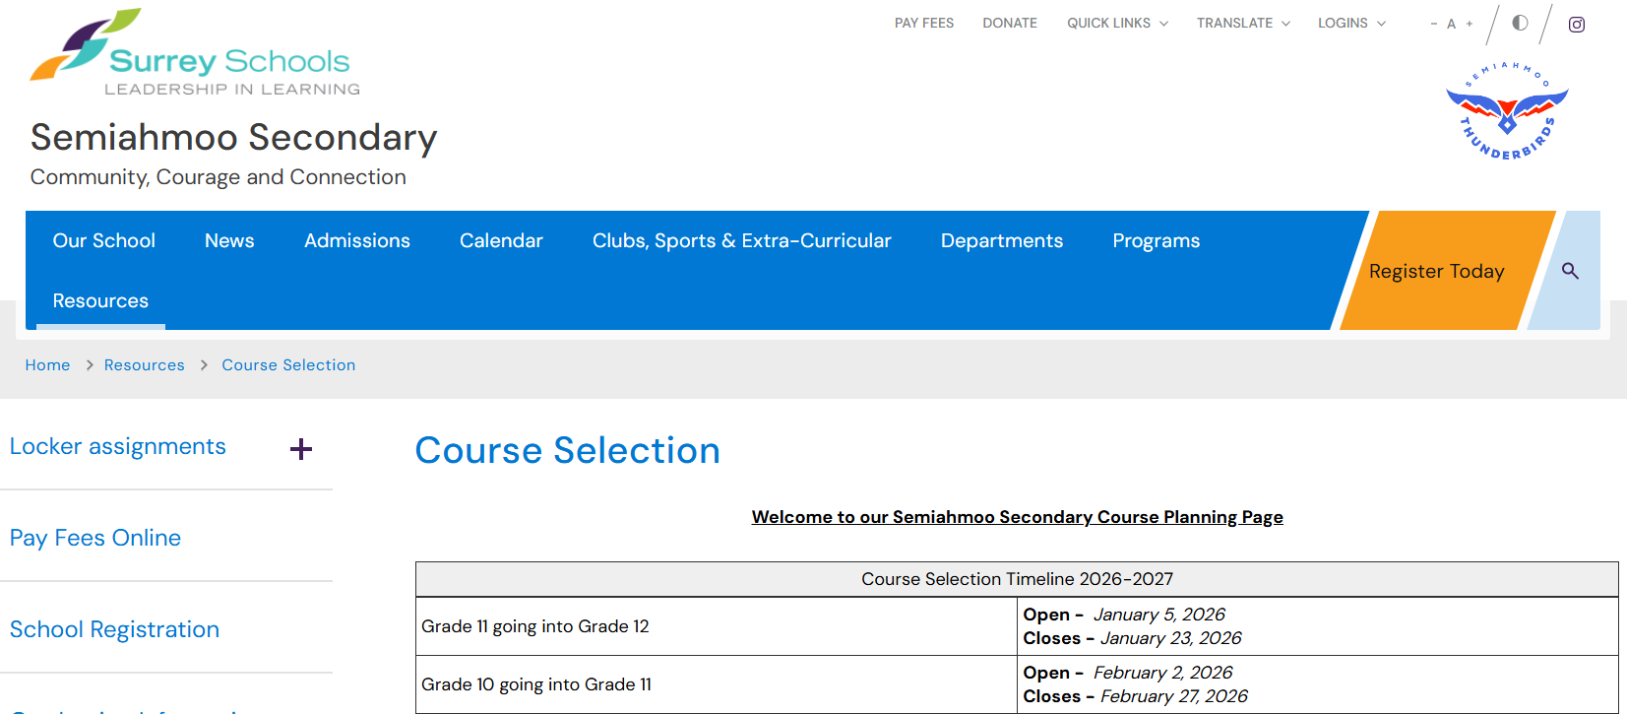
For detailed course descriptions and more information, visit: https://www.surreyschools.ca/semiahmoo
Click "Resources” > ”Course Selection”

Slide 11
Things to know…
Make sure you have all the “prerequisite” courses (ie: you cannot take French 9 if you have not taken French 8)
It should be noted that a second language (French or Spanish) is not required to graduate, or for post secondary admissions.
The portal is open now for you to do your course selection.
Don’t procrastinate, get it done today! Involve your parents in this process. All courses MUST be entered by you into MyEd by March 6th!!!!!
Choose wisely as you will not be able to change your selections as we will not have space for late changes.
Schedules will be published to students/families on MyEd in late August.

