Slide 1


GRADE 9 COURSE SELECTION
For 2026/2027 School Year

Slide 2
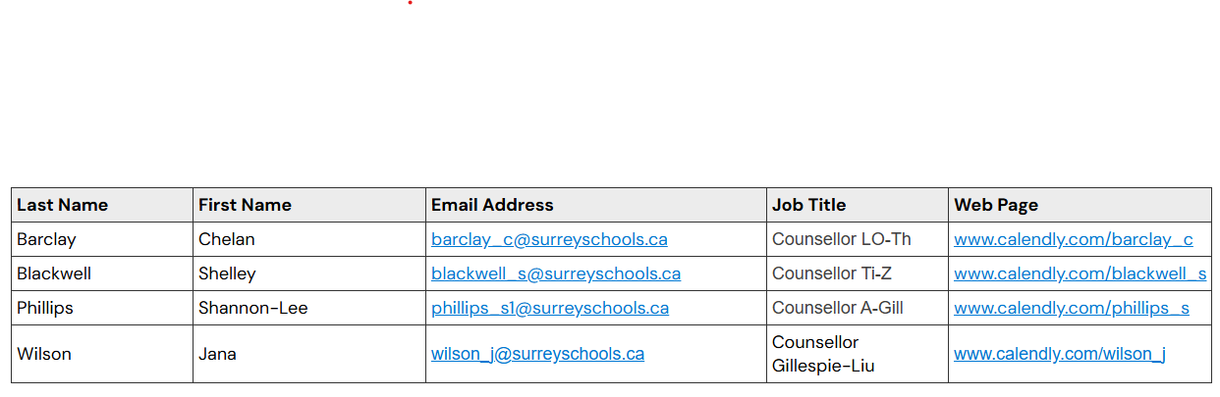

Know who your counsellor is and how you can visit!

Slide 3
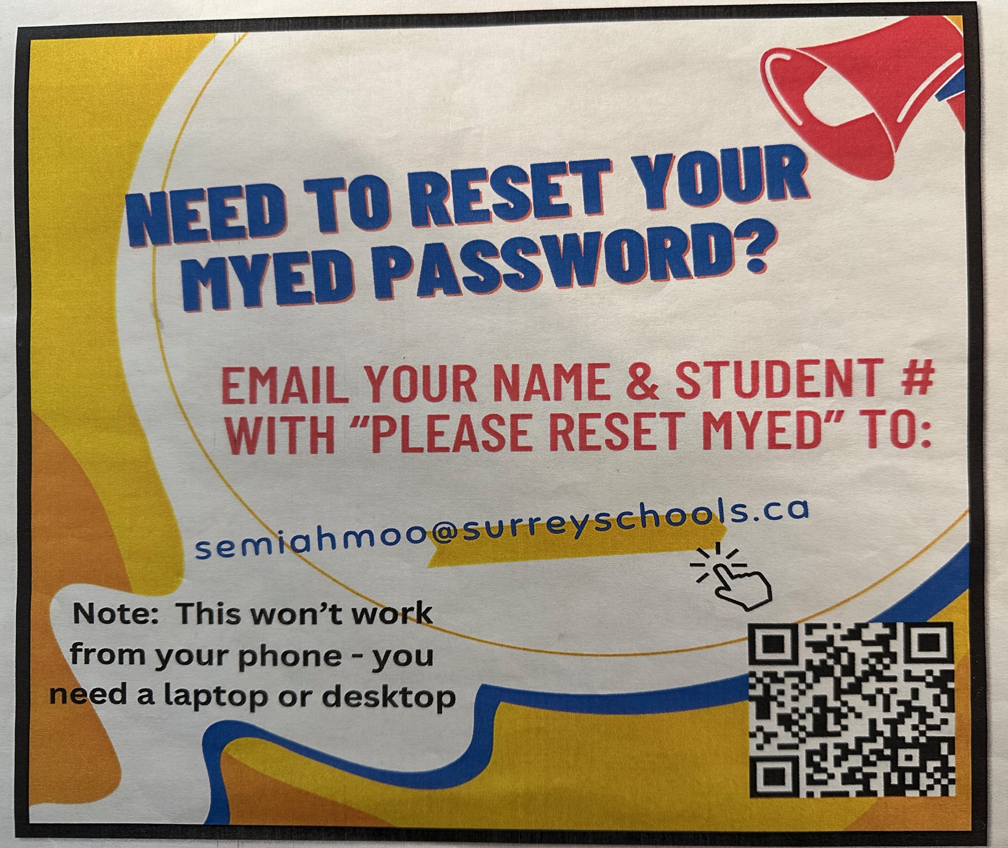
Step One: You have to be able to login to MyEd. For detailed video instructions visit
How to log onto MyEd with voiceovers 2024-1.ppsx

Slide 4
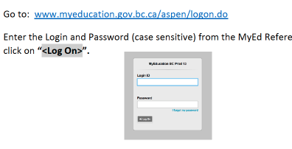
Step Two:
You need to be able to login to myed!!!! This is how you can view your report cards, check your schedule, and choose your classes. It is ESSENTIAL!

Slide 5
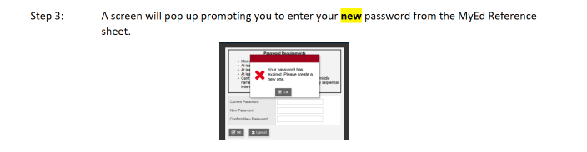

Slide 6
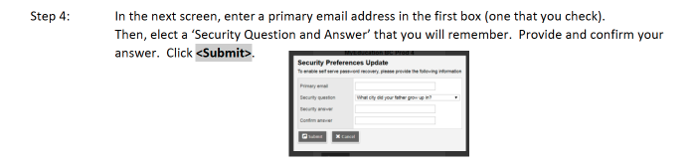

Slide 7
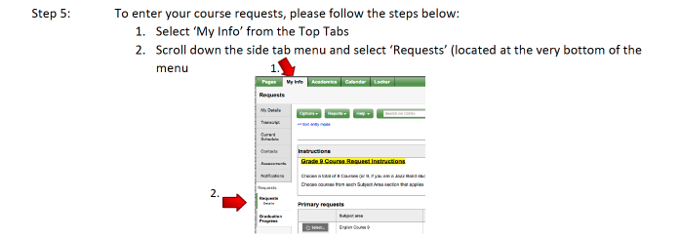

Slide 8
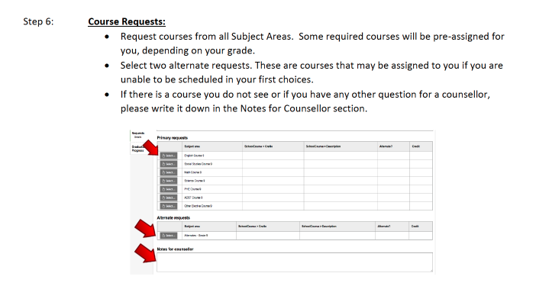

Slide 9
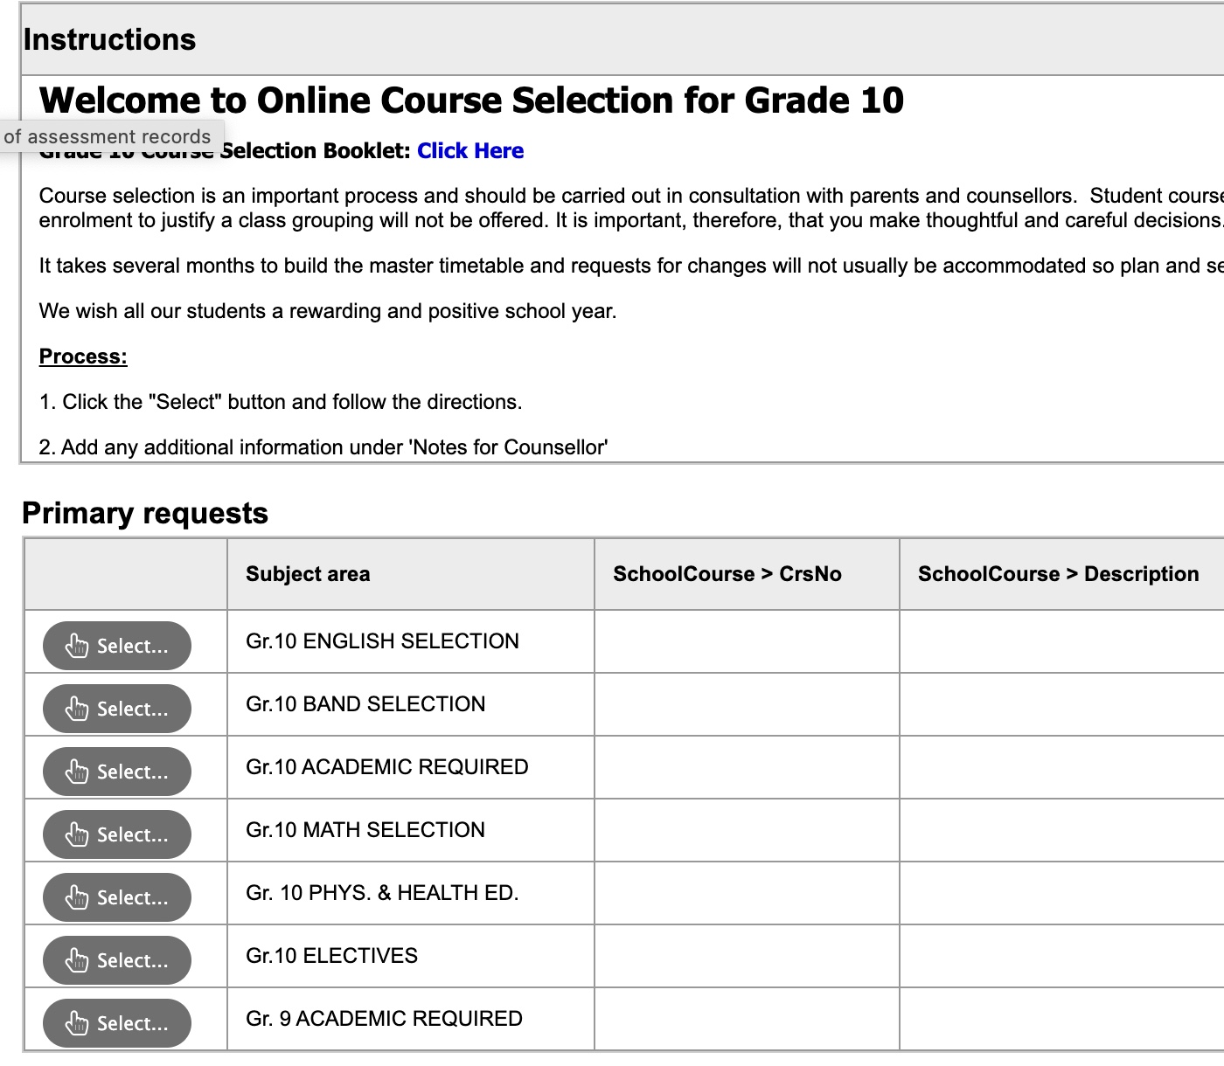
Make sure you choose your 5 required courses, PLUS three electives. Please note: a second language is NOT required to graduate or for post secondary admissions.
DO NOT forget choose 2 alternates!!!!

Slide 10
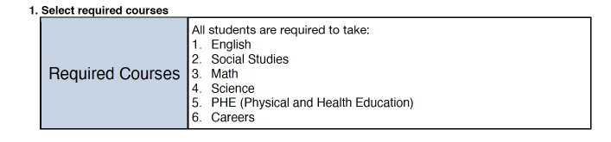

Slide 11
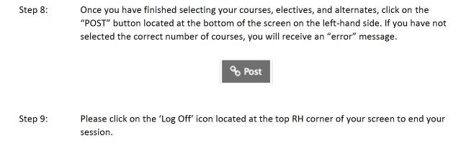

Slide 12
In addition to the courses mentioned, all students will be required to complete a First Peoples credit before graduating. This can be taken in grade 10, 11, or 12 by taking ONE of the following:
English 10 First Peoples
Contemporary Indigenous Studies 12 (you can take this in grade 11 or 12)
OR, English 12 First Peoples (when you are in grade 12).

Slide 13
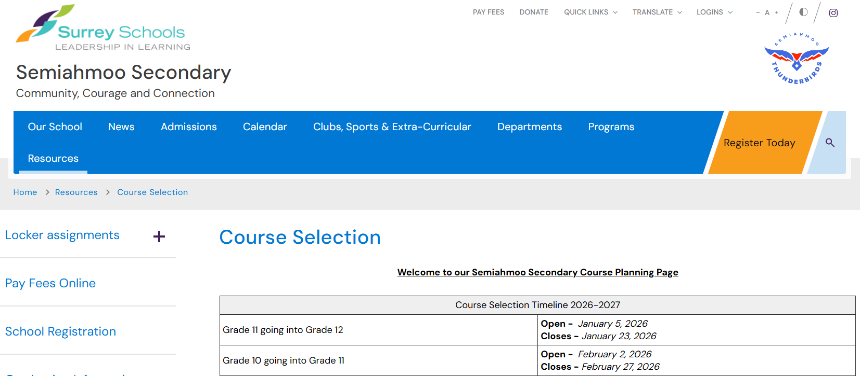
For detailed course descriptions and information, visit:
Course Selection

Slide 14
Course selection tips....
Do not take English, Math or Science in summer school or online
If you are in Band, do not take Socials or Careers ahead of time
If you are looking at IB you should take Precalculus 11 BEFORE IB Math HL and you should take Prec 11 before IB sciences
There is NO NEED to take any other sciences, English, etc.
Before taking IB, ensure you have completed your PE 10, Careers 10 and a fine art or applied skills course.

Slide 15
Things to know…
Make sure you have all the “prerequisite” courses (ie: you cannot take French 10 if you have not taken French 9). A second language is not required for graduation or for post secondary admissions.
If you go ahead and take Science 10 or Math 10 in Summer School you likely WILL NOT get Senior Sciences or Math next year! We need these spots for our senior students.
The portal is open now for you to do your course selection.
Don’t procrastinate, get it done today! Involve your parents in this process.
If you do not submit your course selections, you may not get the classes that you want.
Choose wisely as you will not be able to change your selections as we will not have space for late changes.
All of your selections need to be entered into Myed by March 6th.

