Slide 1
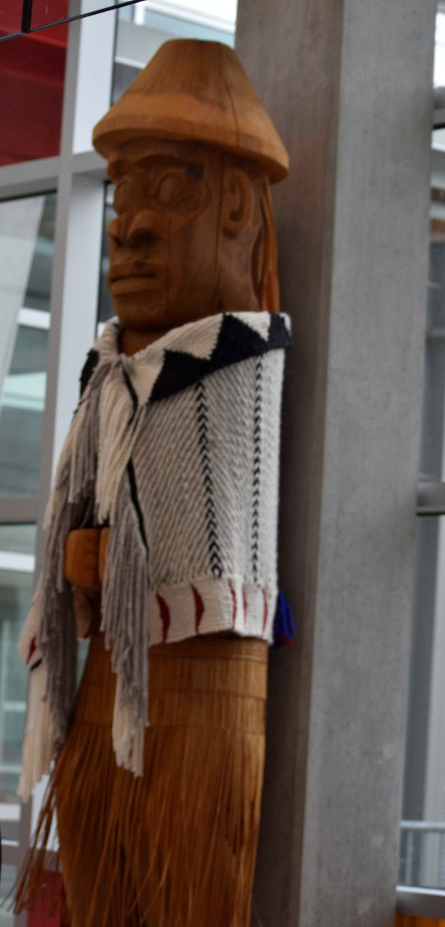

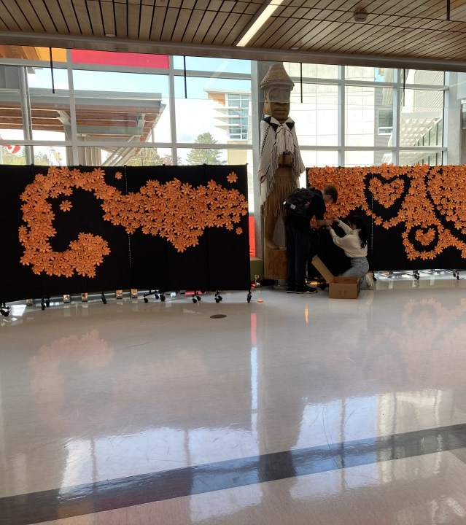
Ecole Salish Secondary
Course Selection 2026 - 2027

Slide 2
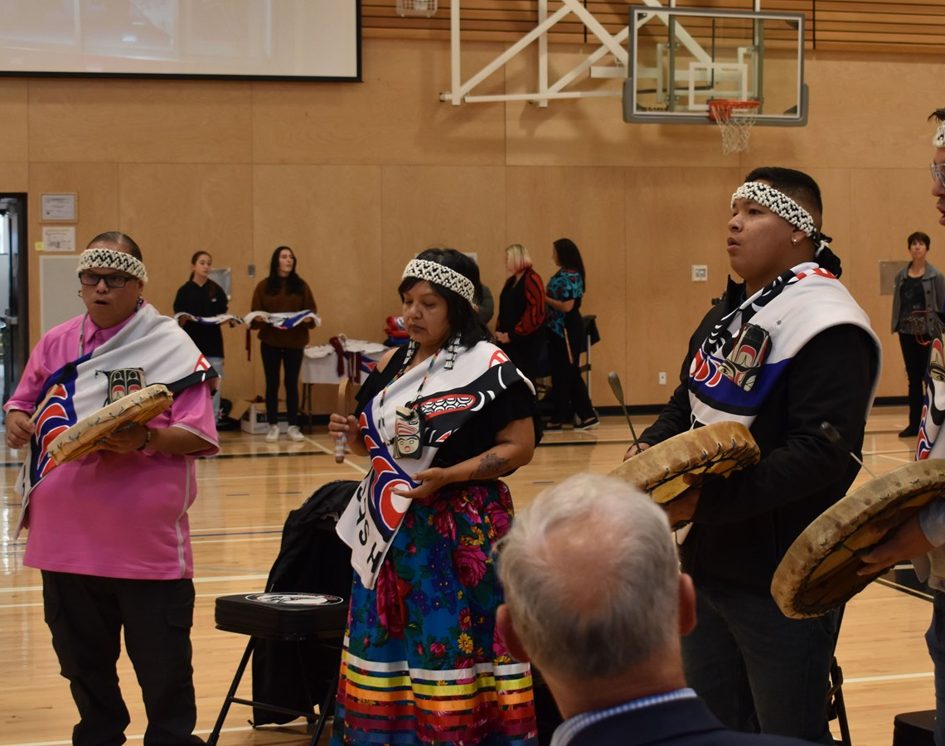
Land Acknowledgement
As we meet today, we acknowledge that we are on the traditional and unceded territory of the Kwantlen, Katzie and Semiamhoo First Nations

Slide 3
Welcome to Course Selection!
Shape of the Day
Login to MYEDBC
English VS French Immersion
LEAP Program
Elective Choices
ADST
Fine Arts
Modern Languages
E Block Options
Alternatives
One ADST
One Fine Arts

Slide 4
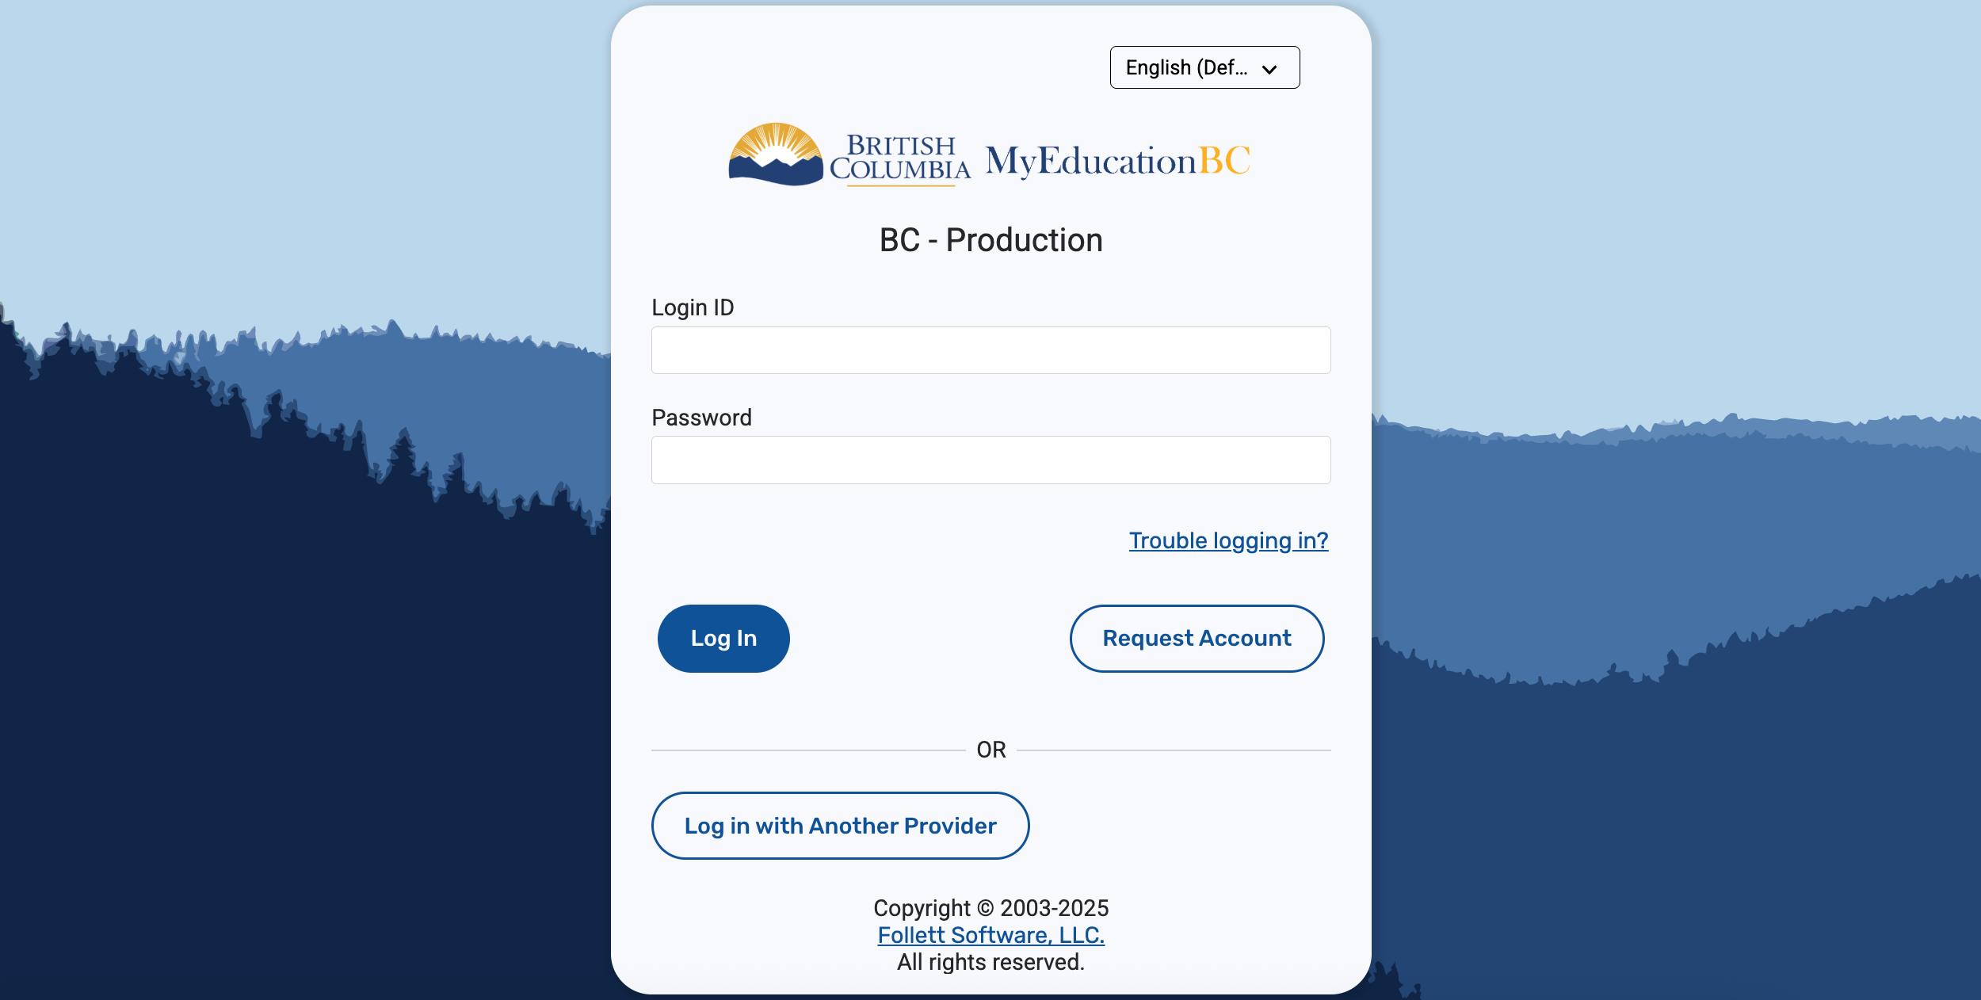
Let's Begin! Log in to MYEDBC

Slide 5
Forgot Password?
Click Here

Slide 6
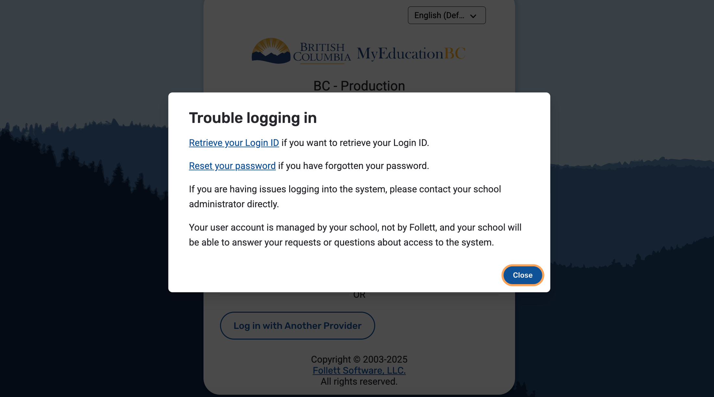
Click on the appropriate link and follow the steps
Click Here

Slide 7

Still can't get in or account is disabled?
Message Ms. Hamilton to reset accounts during the presentation.

Slide 8
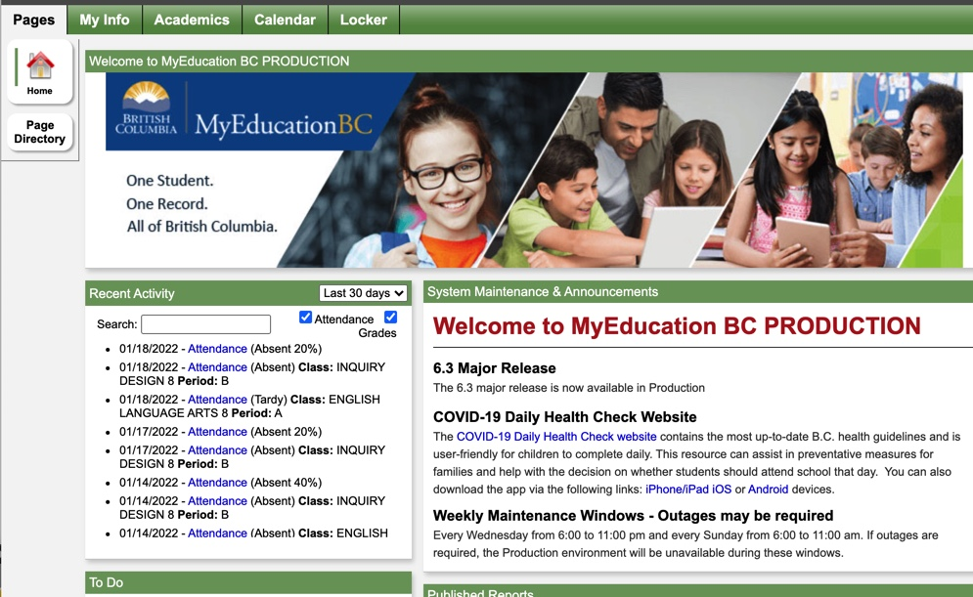
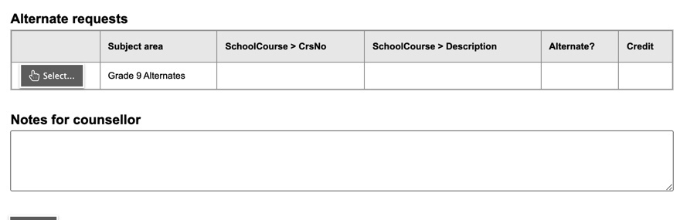
Once you are in:
Click MY INFO

Slide 9
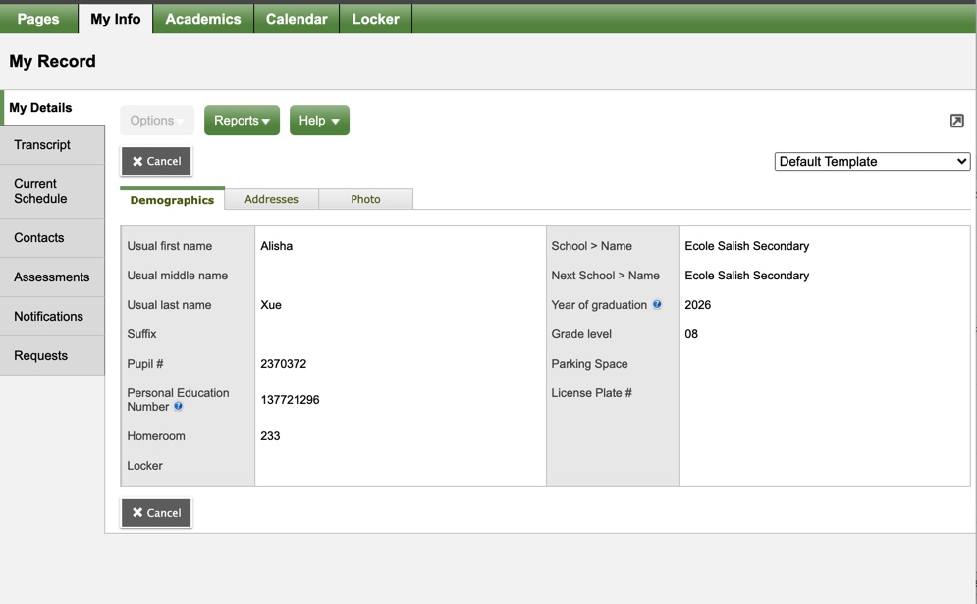
Click REQUESTS

Slide 10
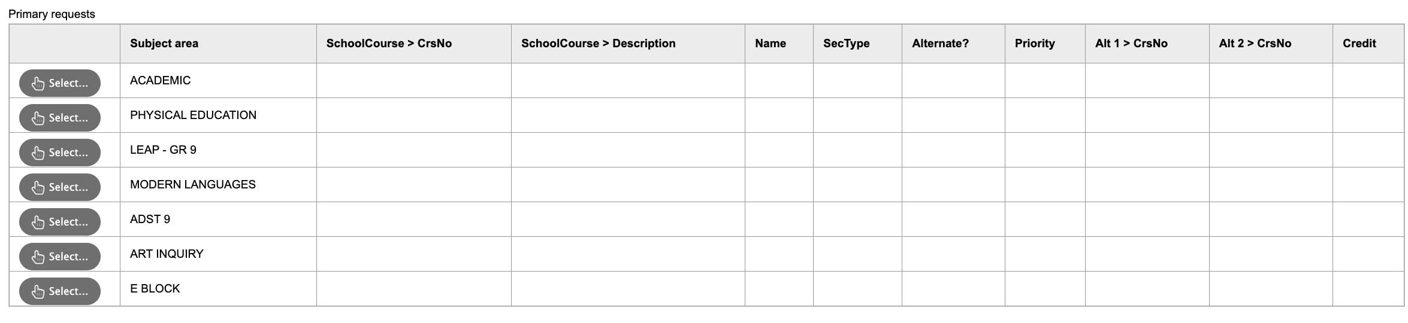
Students in the ENGLISH Stream are going to select LEAP if you would like it; ACADEMIC choices will be selected for you

Slide 11
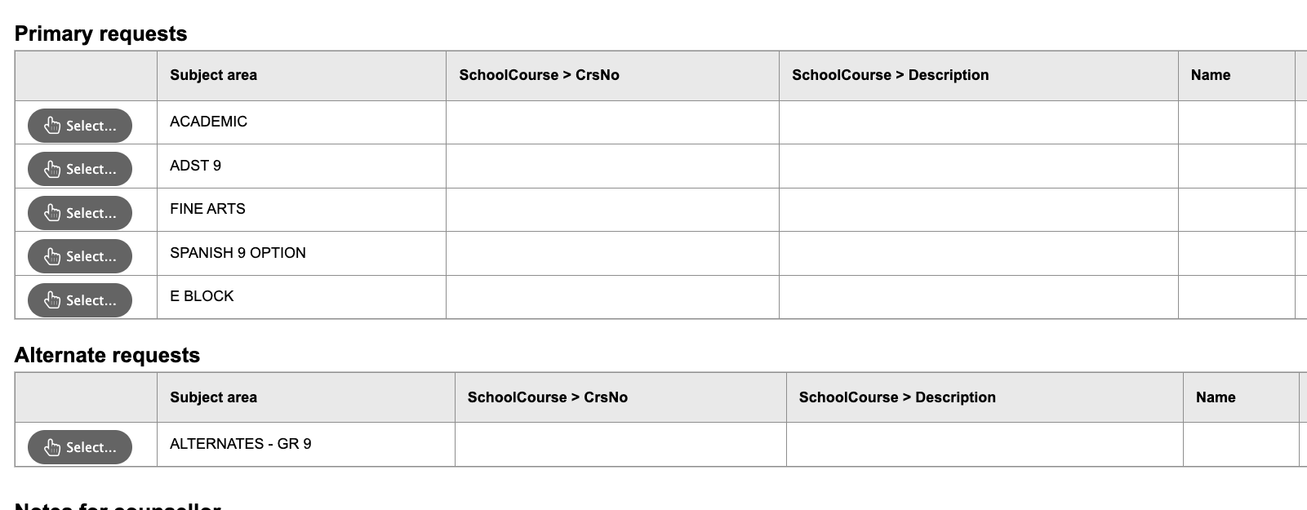
Students in the FRENCH IMMERSION Stream are going to have ACADEMIC courses selected for you

Slide 12

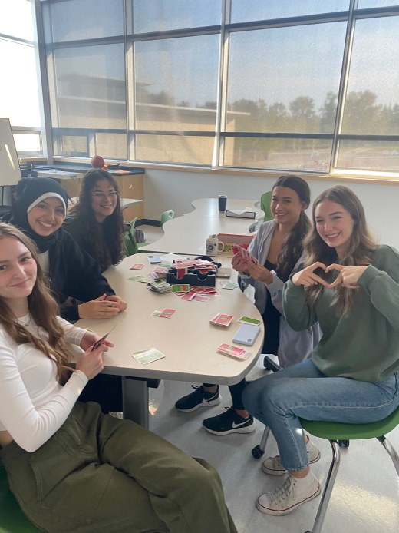
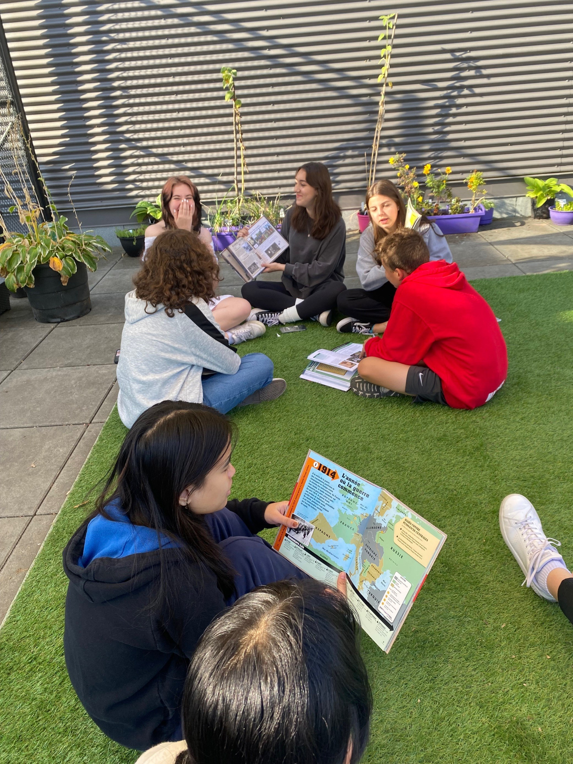
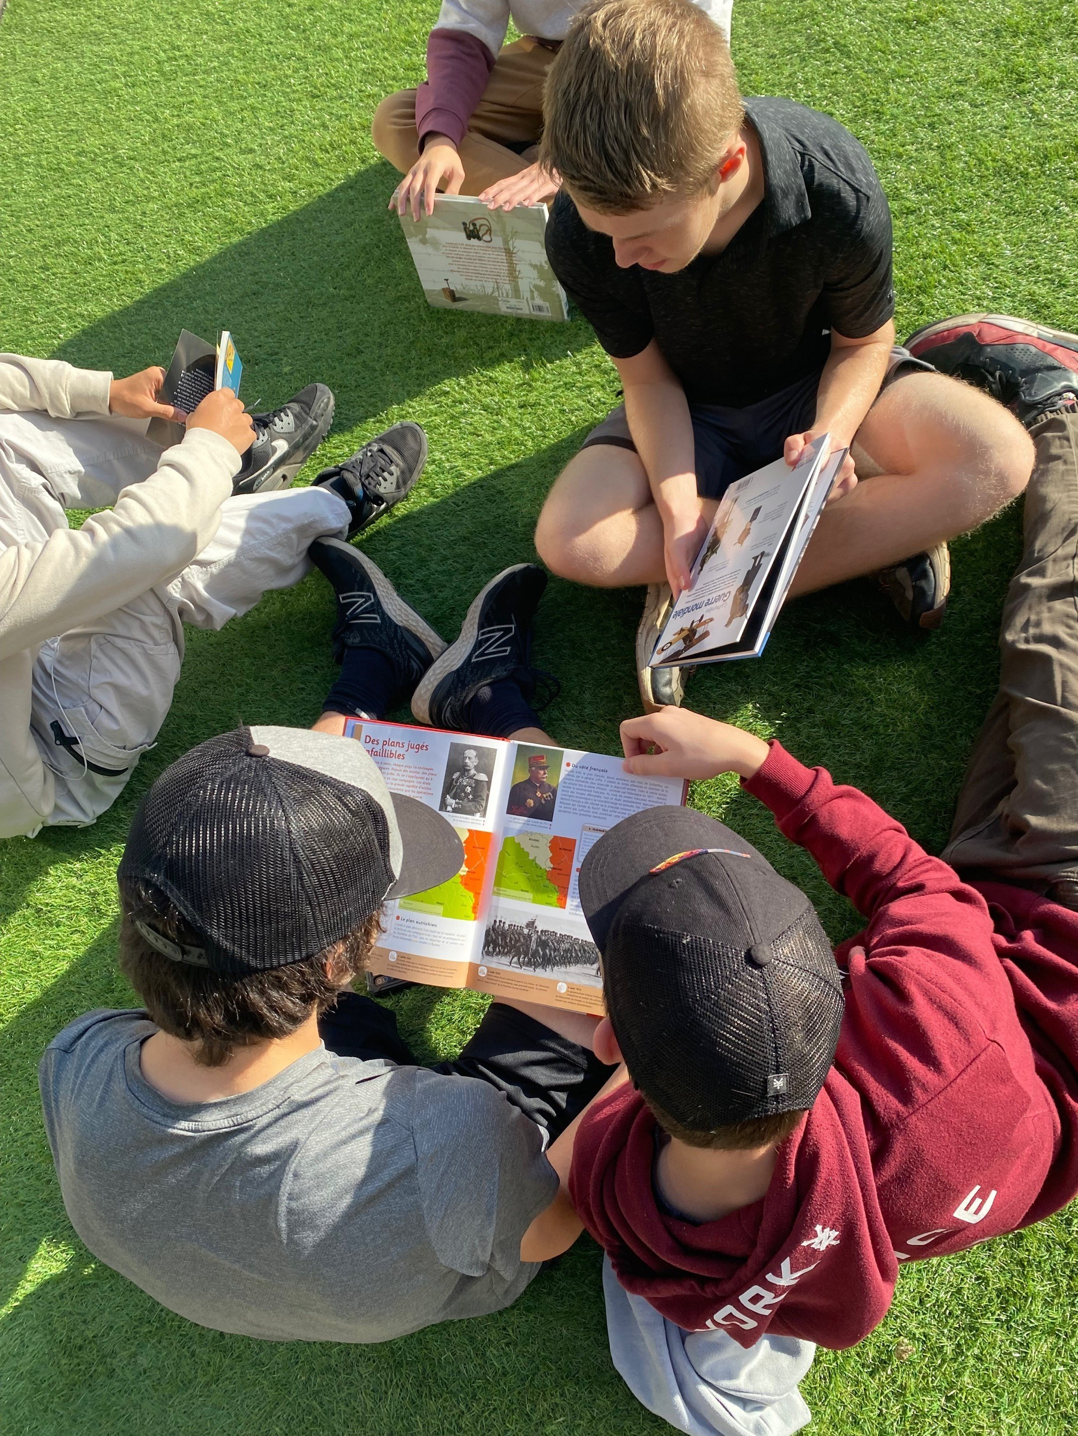
French Immersion
Dual Dogwood
Français Langue 8
Sciences Humaines 8
Education Physique 8
Sciences 8
Français Langue 9
Sciences Humaines 9
Education
Physique 9
Sciences 9
Français Langue 10
Sciences
Humaines 10
Education Physique 10
Sciences 10

Slide 13
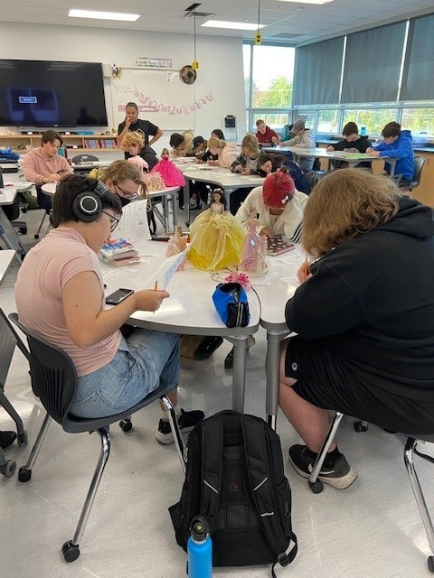
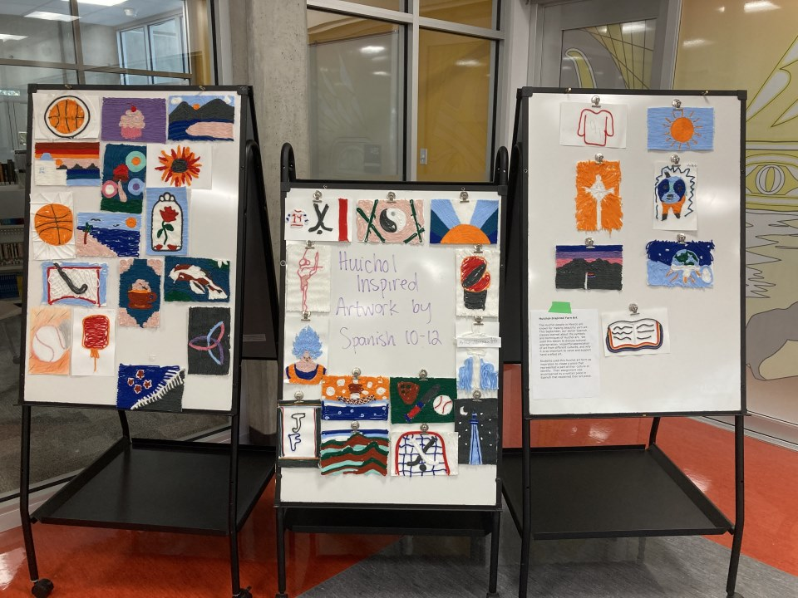
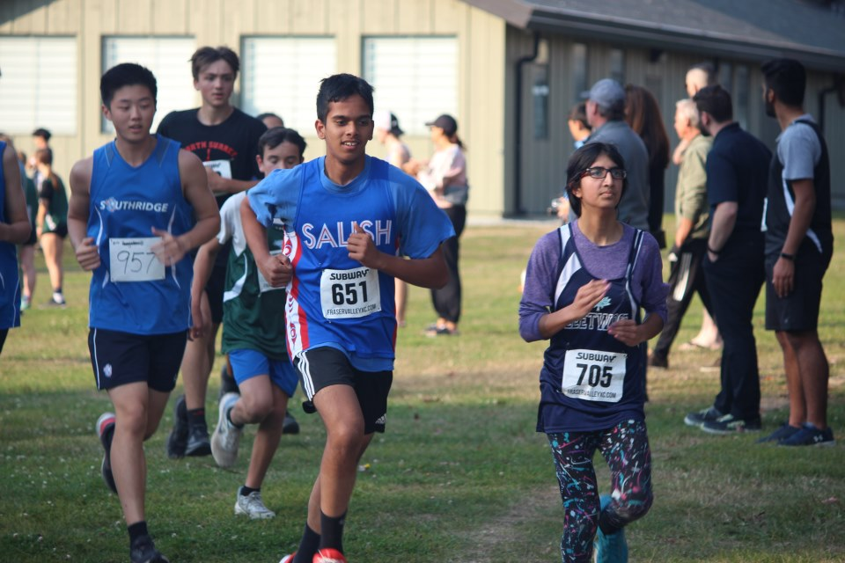
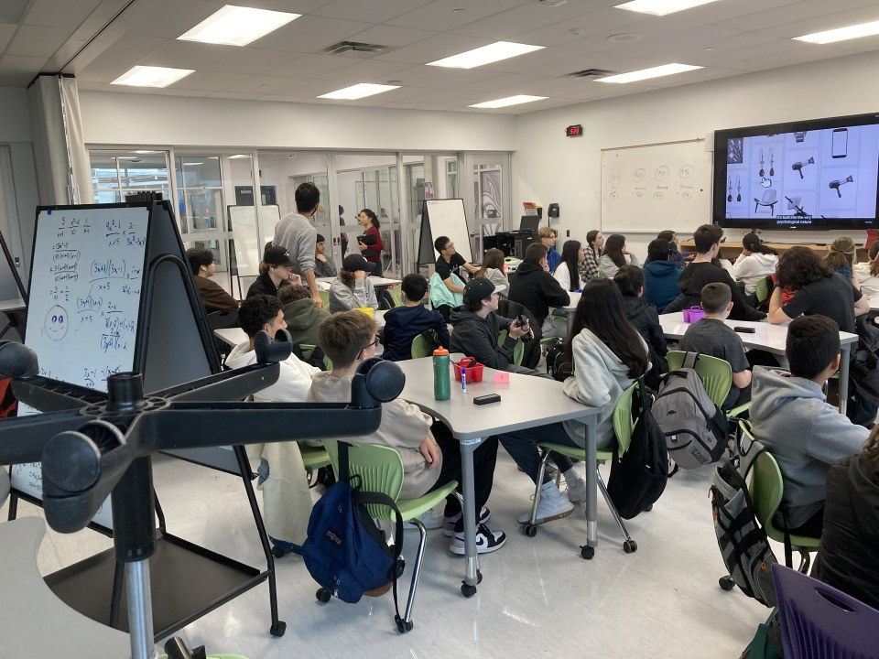
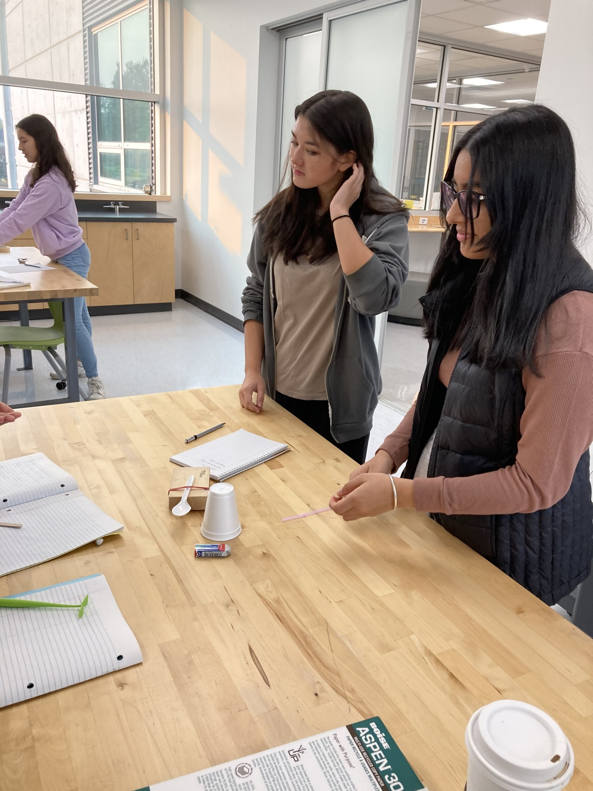
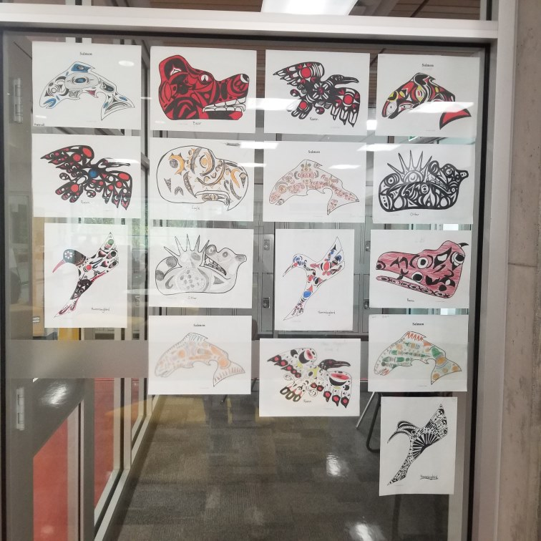
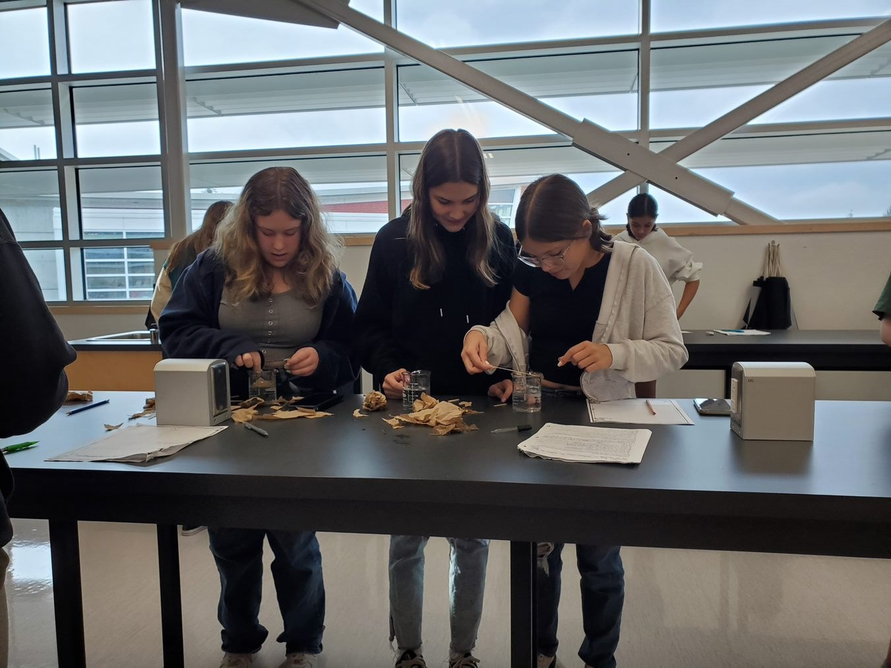
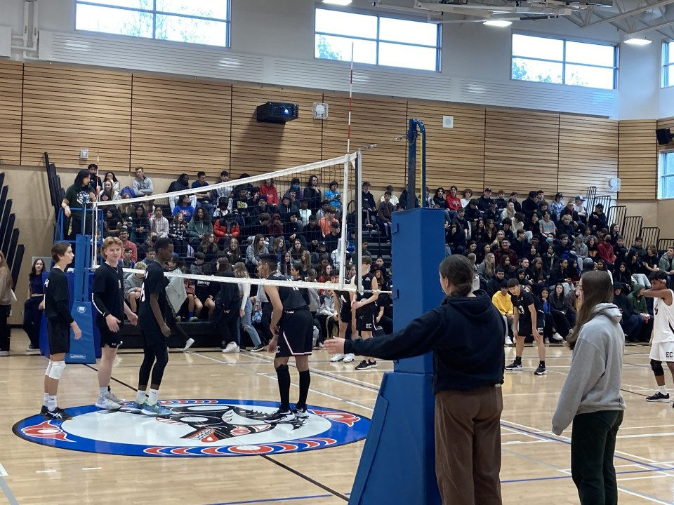
ACADEMIC PKG (English Stream) Required Courses
Math 9
English 9
Social Studies 9
Science 9
Career Education 9

Slide 14
ACADEMIC PKG (English Stream) PHE – Choose Either
Physical Health Education 9
OR
Physical Health Education 9 – Unified Games
Through fun, collaborative sports and games, students will grow as leaders while building an inclusive, supportive community where neurotypical and neurodiverse peers thrive together.

Slide 15


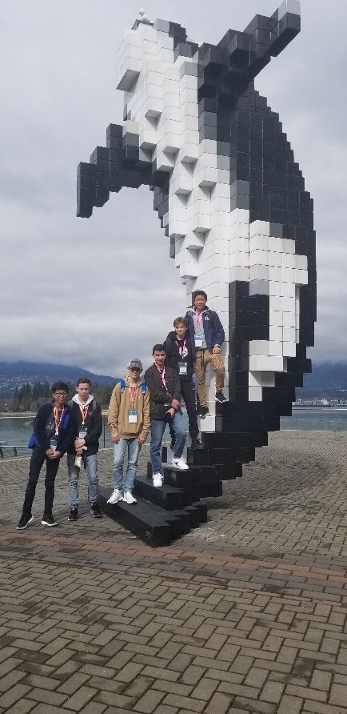

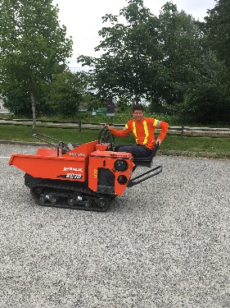
CAREER EDUCATION
Career Education 8
Career Education 9
Career Life Education
(Typically taken in Grade 10)

Slide 16
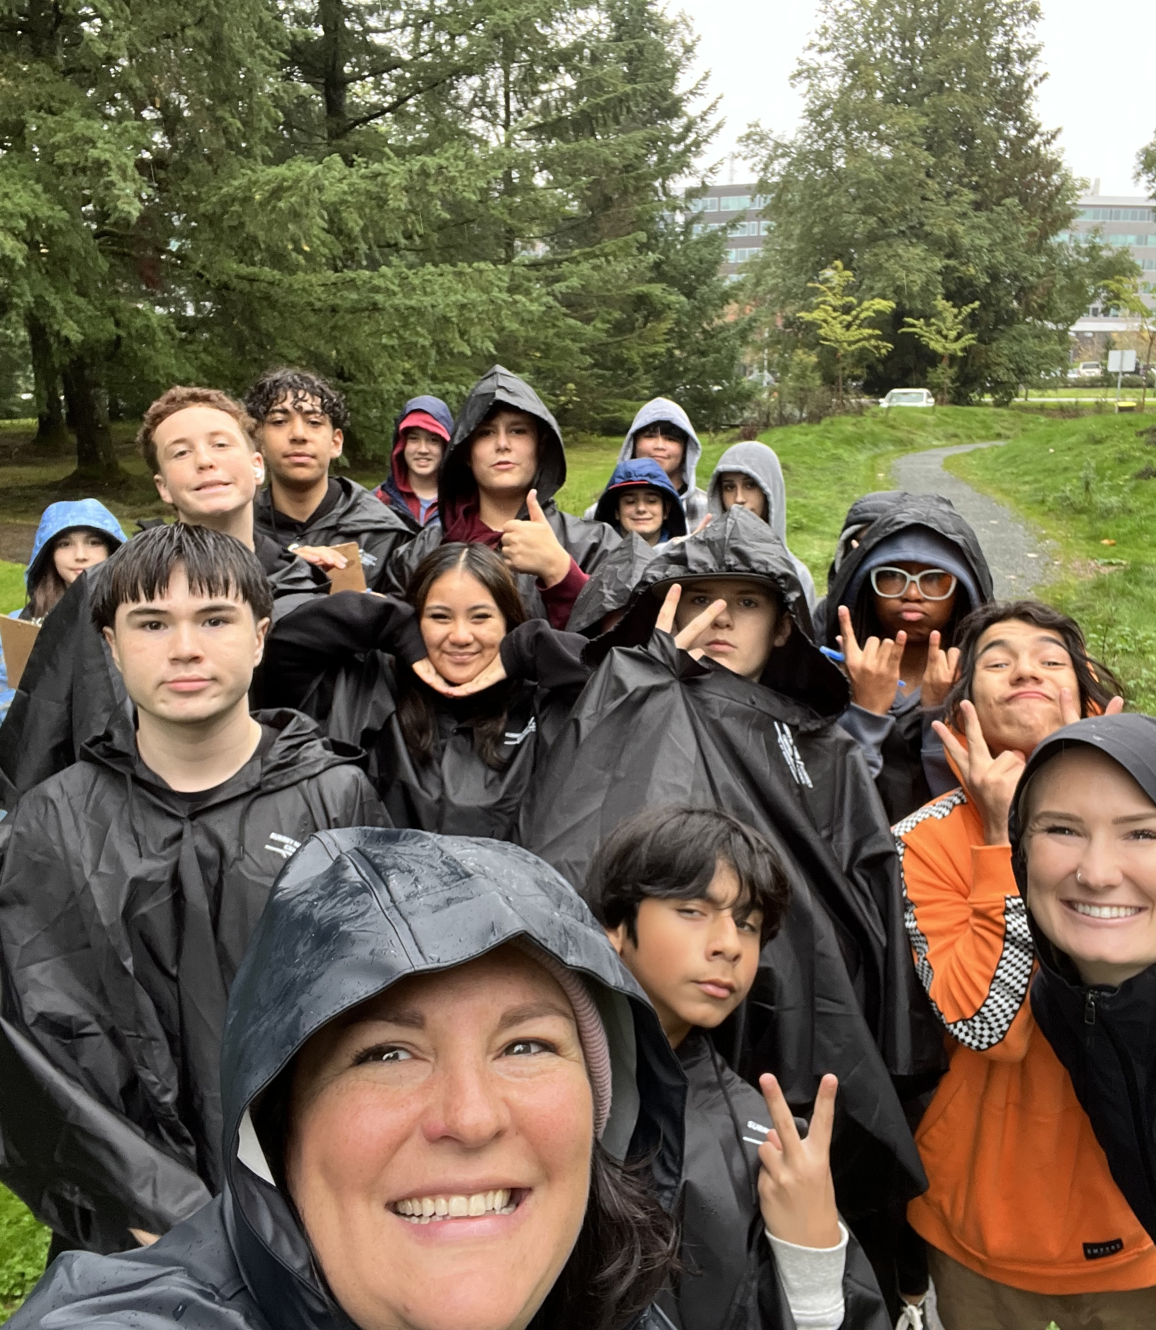
What is LEAP?
LEAP is an experiential and holistic program, founded in the First Peoples Principles of Learning, for students in grades 8-12. The program offers opportunities to participate in field studies, is geared towards cross-curricular learning, and is routed in strength-based, hands-on learning. LEAP focuses on building strong classroom communities where students are not afraid to take risks in their learning.
LEAP runs for two blocks a day for the full year (Block A and B).
LEAP stands for 'Learning from Experience and Aboriginal Perspectives'.

Slide 17
LEAP Junior Program – Grades 8 and 9
Grade 8 courses Grade 9 Courses
English 8 English 9
Social Studies 8 Social Studies 9
Physical Education 8 Physical Education 9
Applied Design and Tech 8 Applied Design and Tech 9
Careers 8 Careers 9
All of the above courses are requirements for all grade 8/9 students.

Slide 18
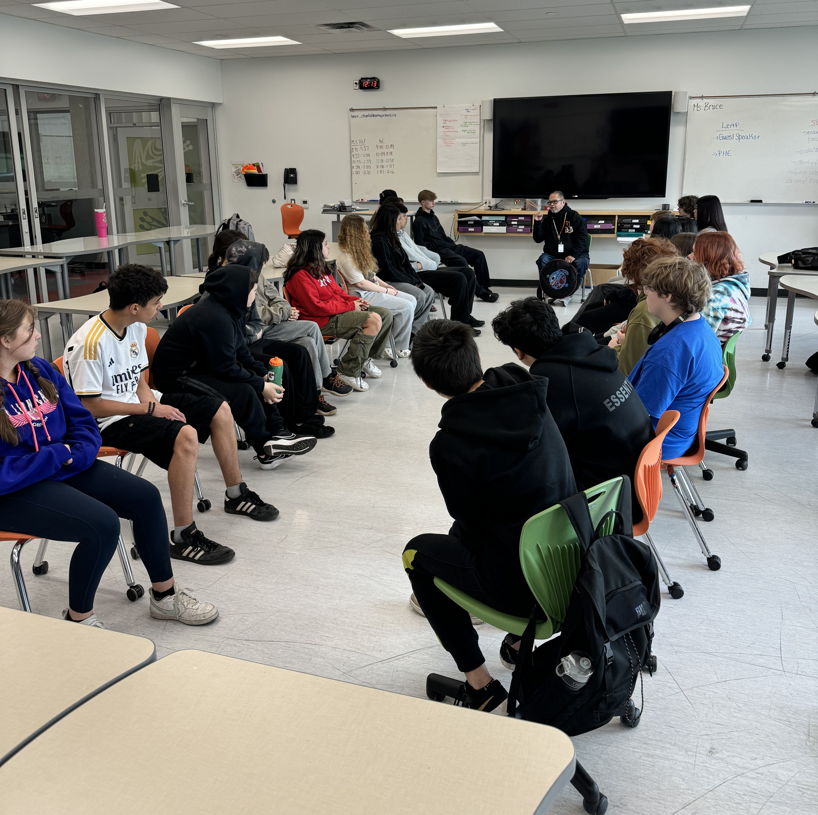
Classroom Learning
The LEAP classroom is set up to provide students with diverse learning activities. The teachers design their lessons to be engaging and active. We will have guest speakers, work with community partners, and invite local societies in, to enhance the curriculum. Your teachers will often co-teach, and we will use the entire pod space as our classroom.

Slide 19
Field Studies
Students in LEAP get to participate in many learning opportunities, including field studies. Some potential field studies:
Vancouver Aquarium - Heppell Potato Farm
Surrey Nature Centre - Longhouse Visit
Ice Skating - Park Exploration
Snow Shoeing - Hiking
High Ropes Course - Fraser River Society
Granville Island Writers Festival - Fort Langley
Tynehead Fish Hatchery - Museum of Anthropology
Etc.

Slide 20
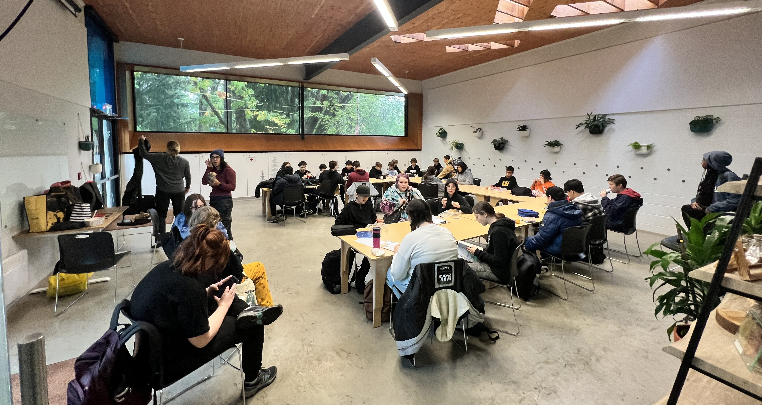
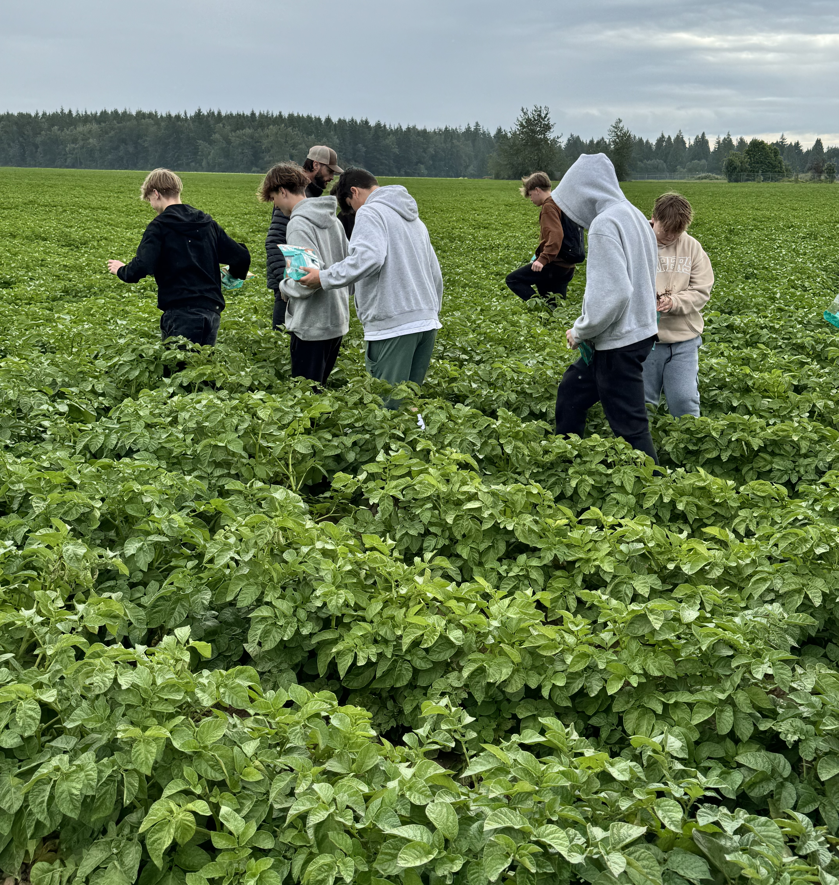
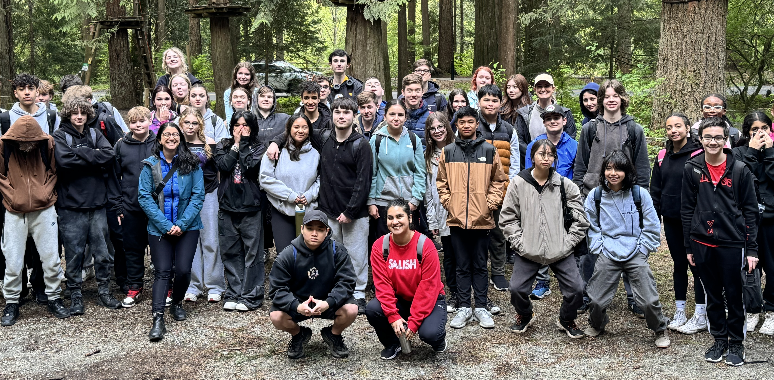

Slide 21
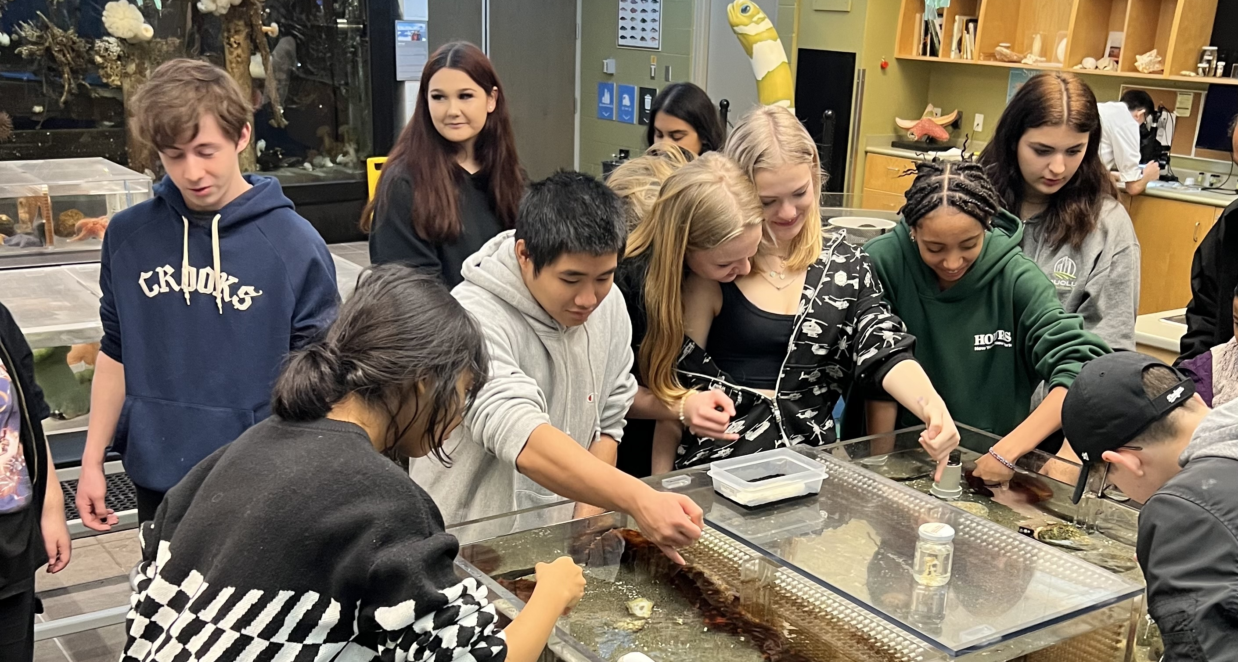
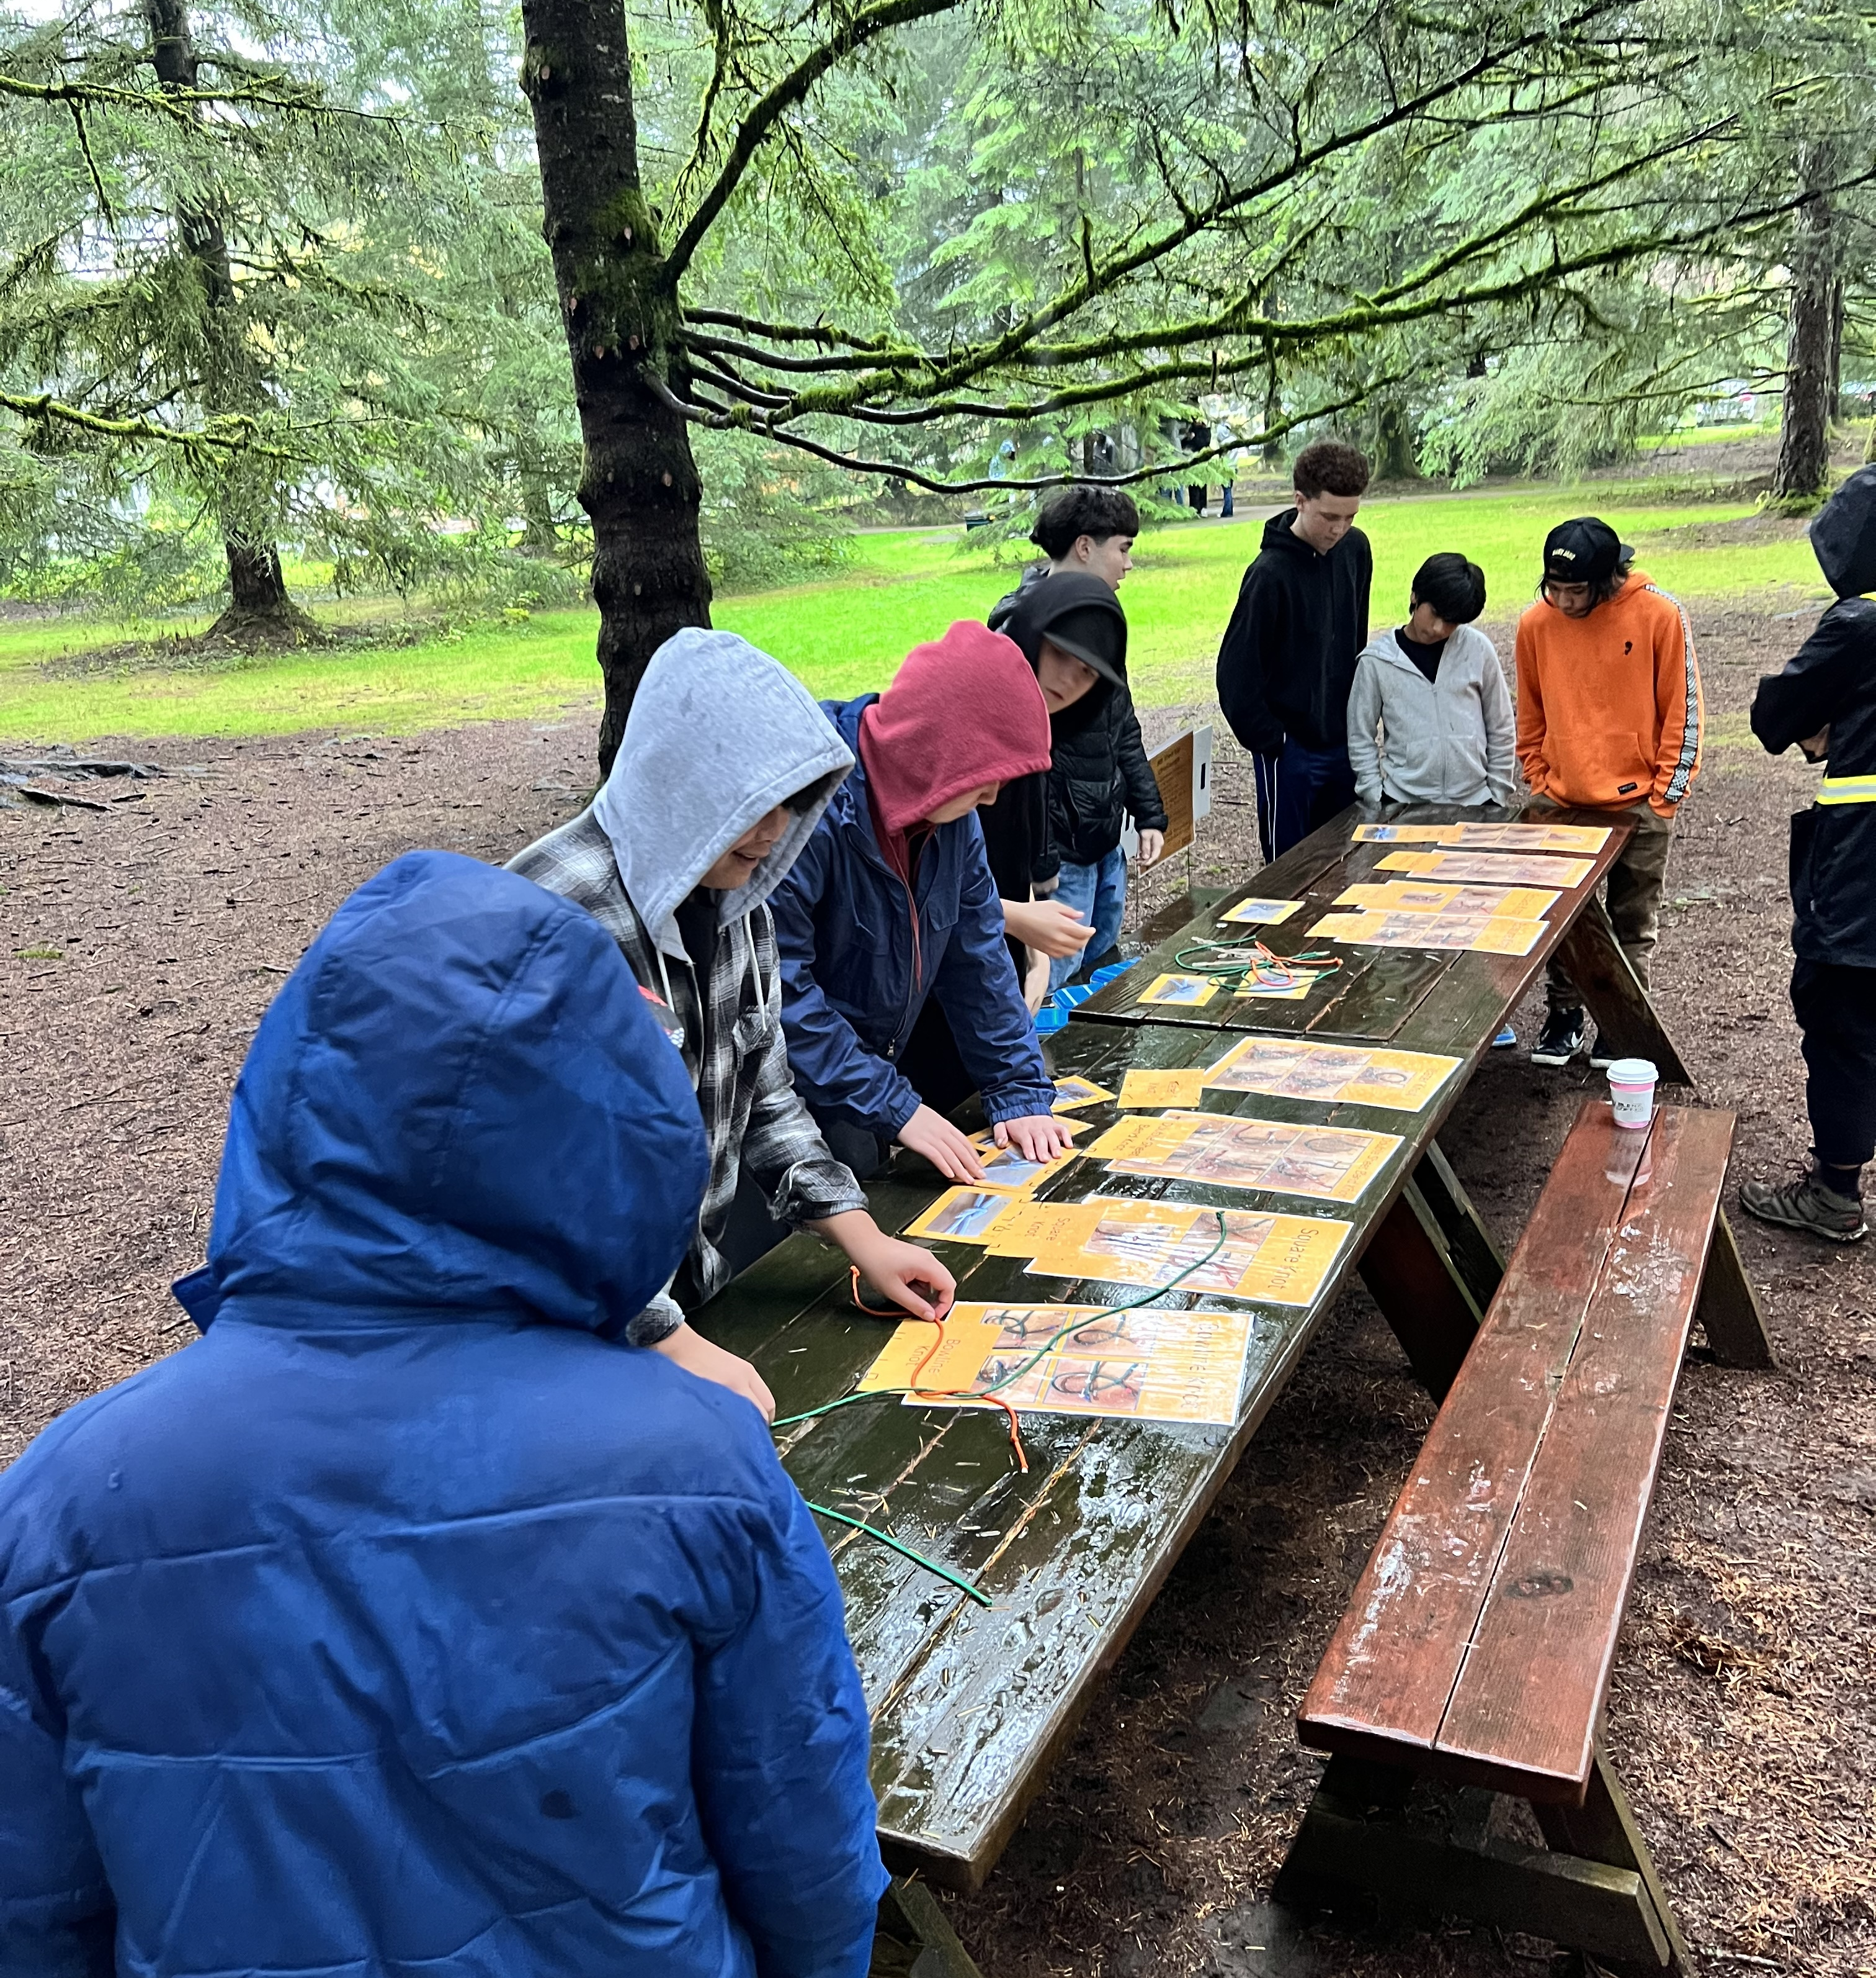
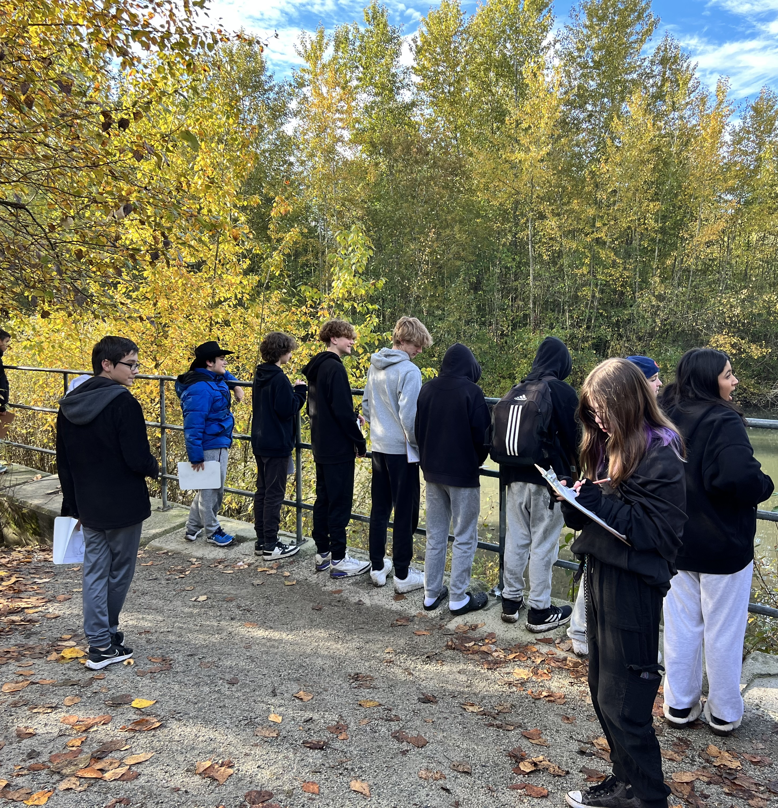
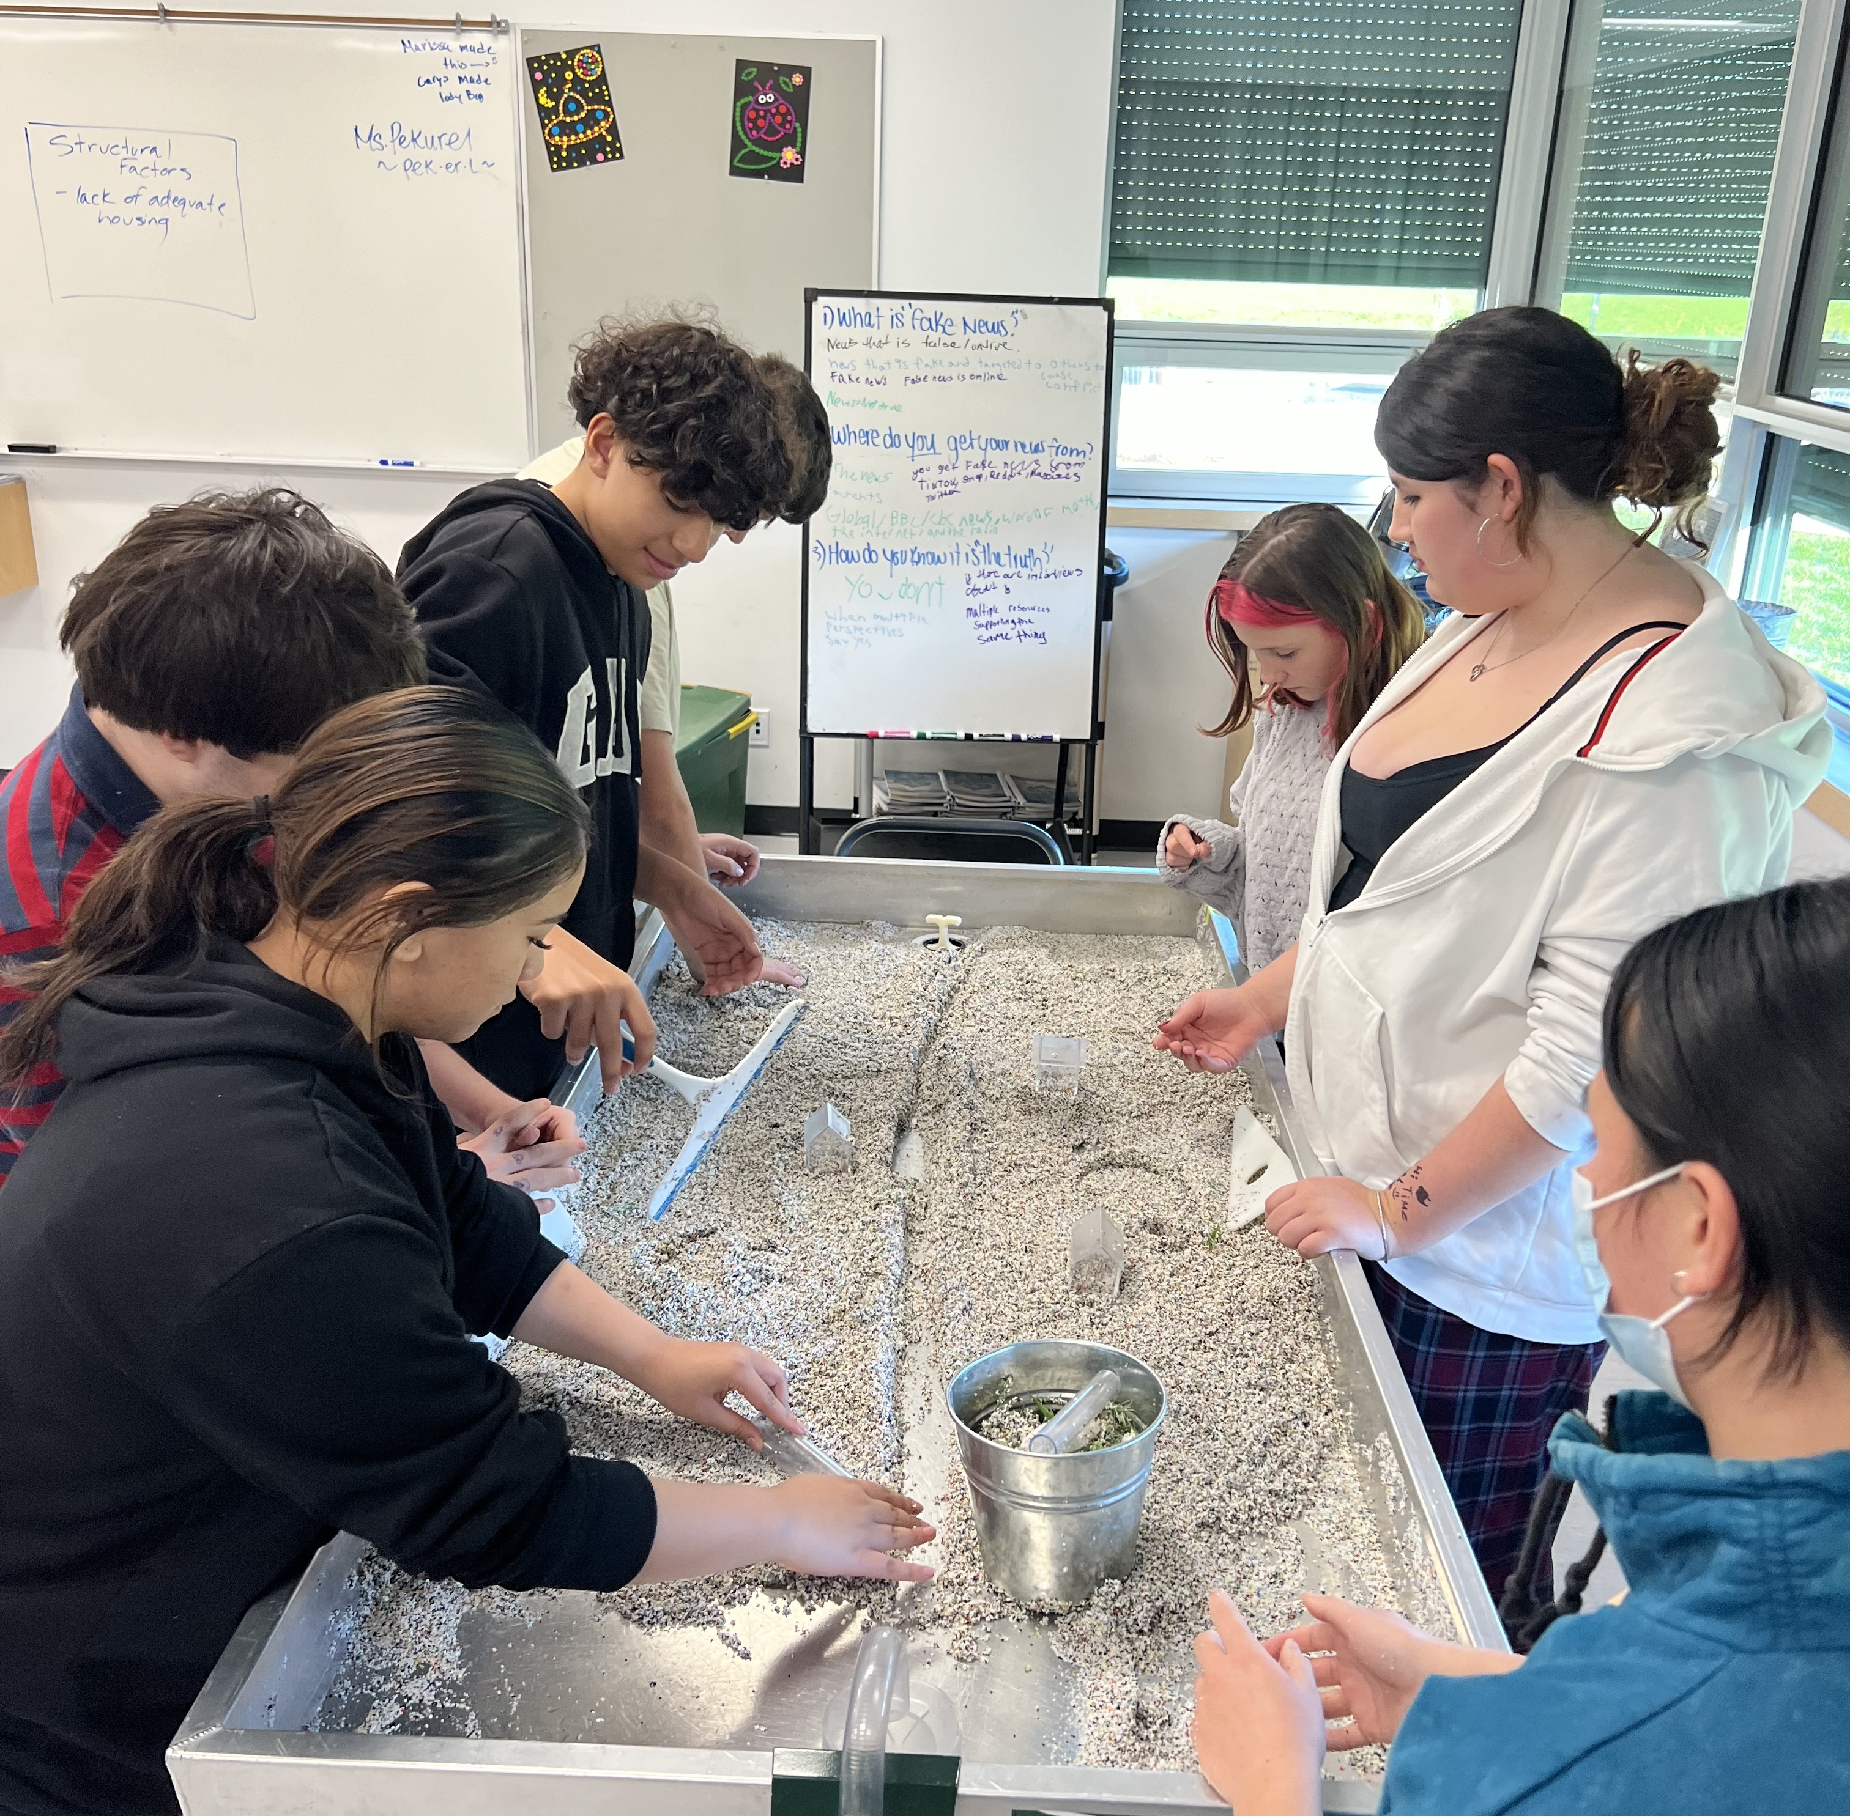

Slide 22
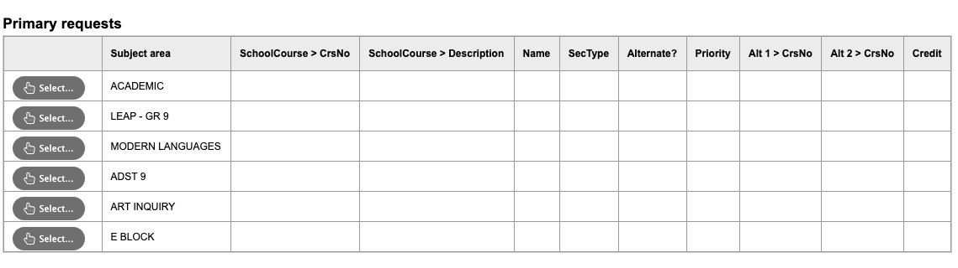
LEAP
If you want to select LEAP, click on the menu

Slide 23
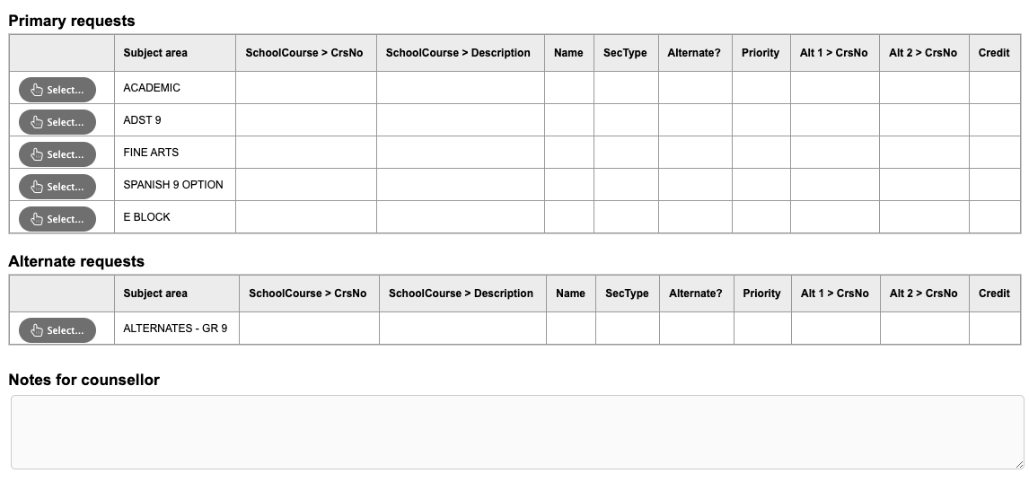
ADST 9
ELECTIVES COME IN THREE CATEGORIES: ADST 9, FINE ARTS, MODERN LANGUAGES

Slide 24
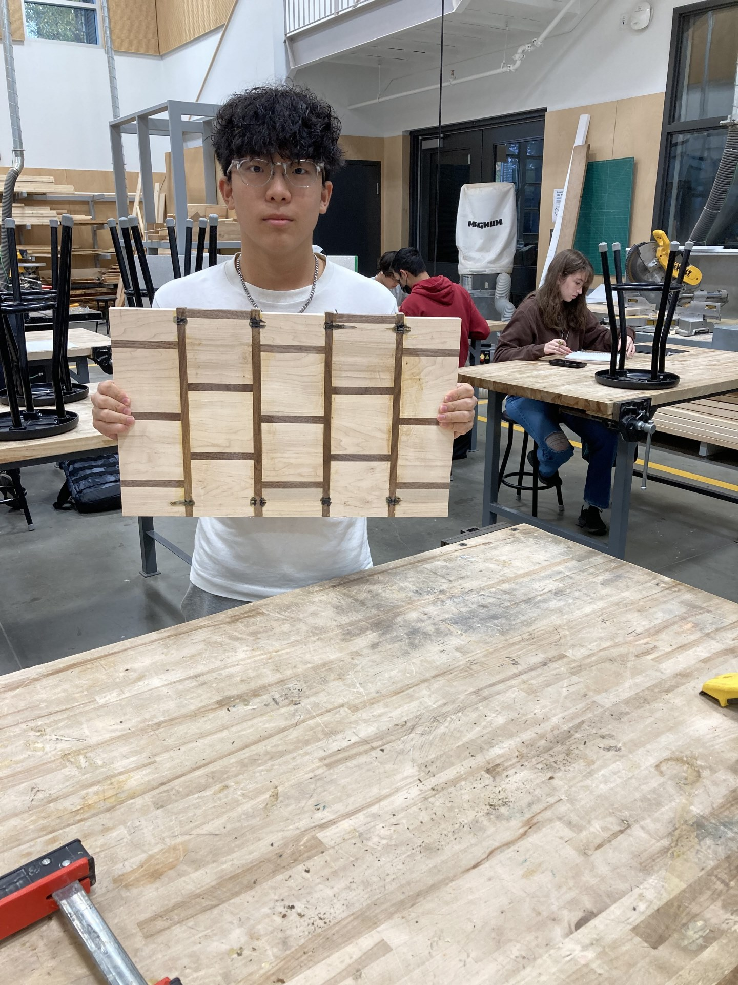
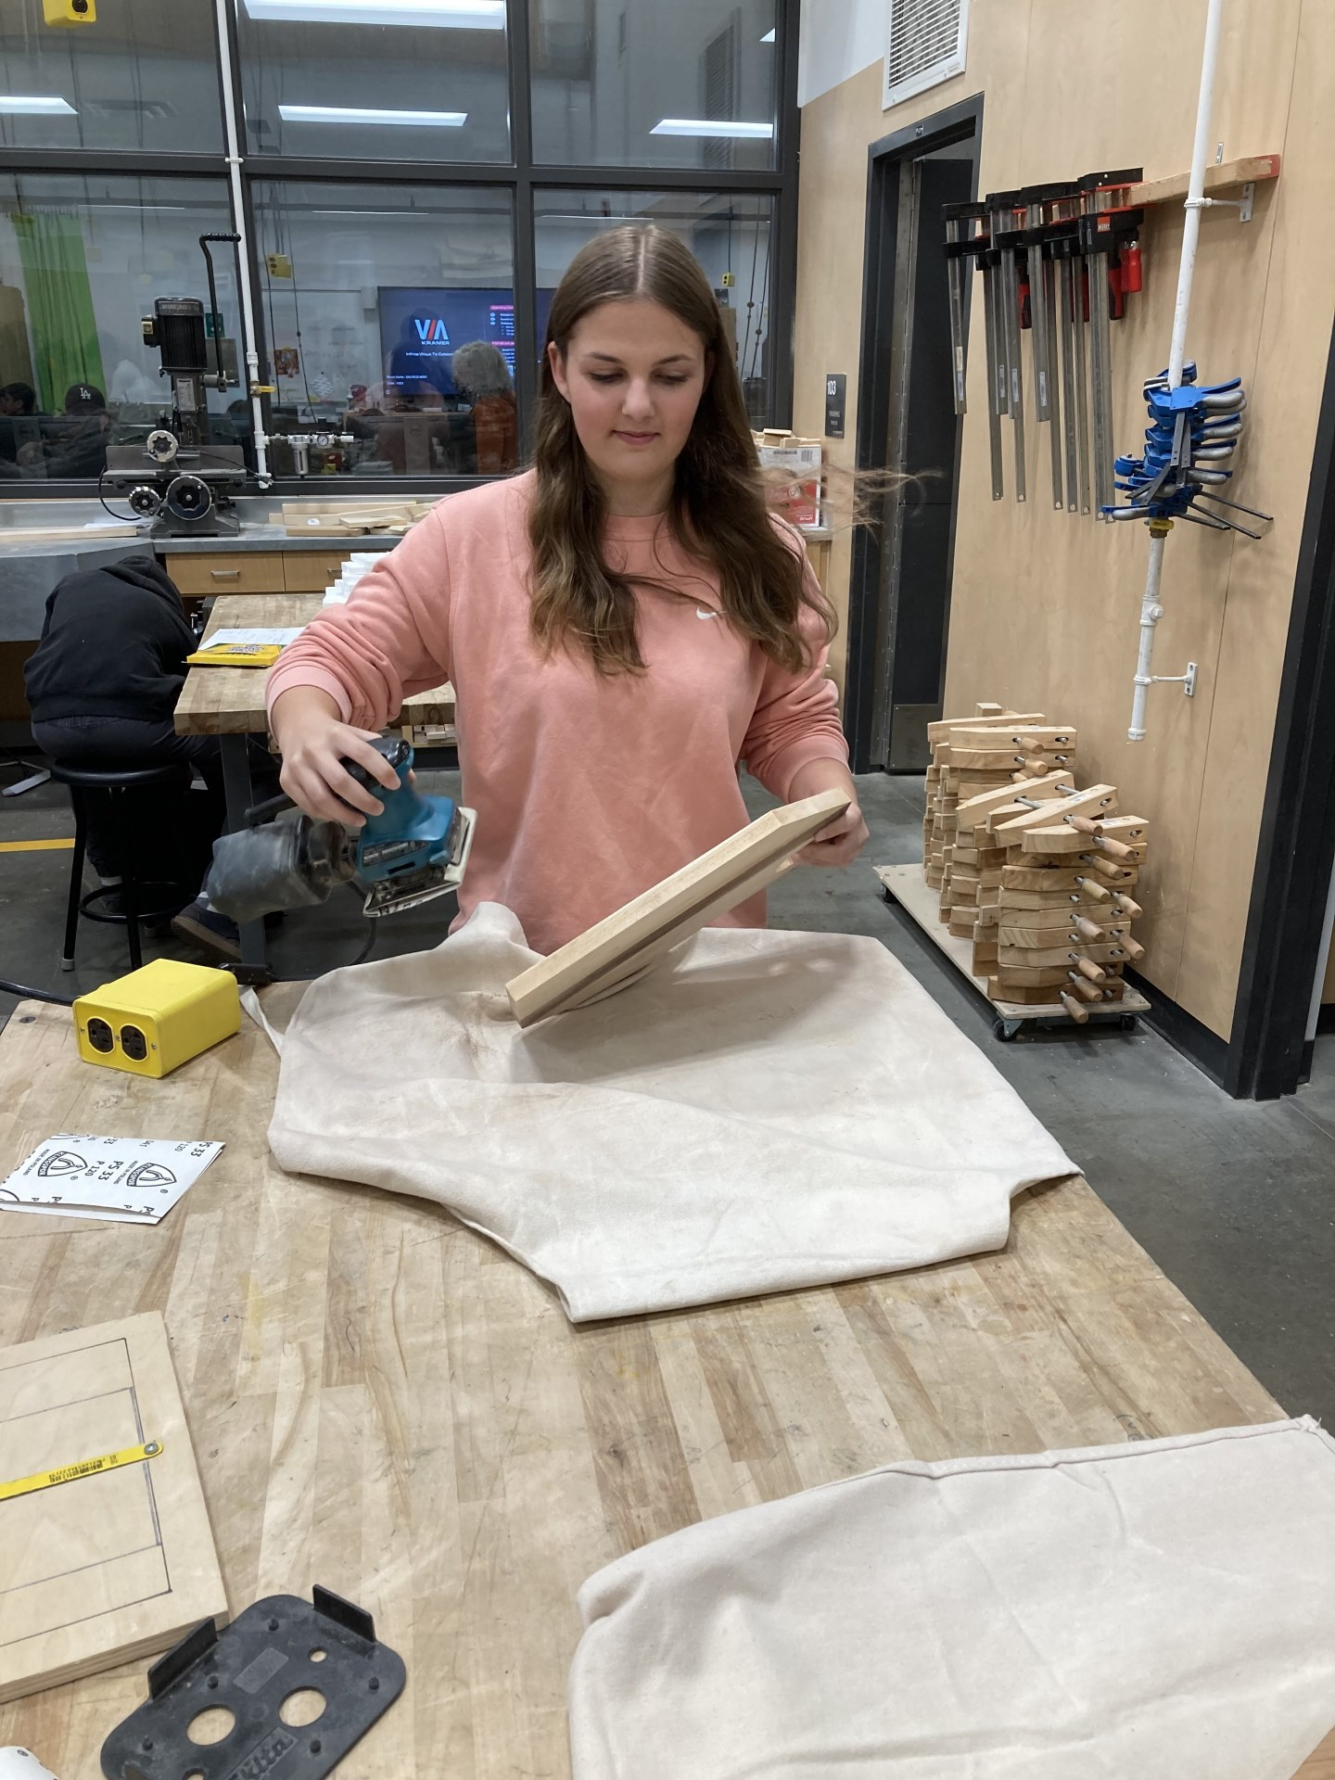
Applied Design, Skills & Technology
Inquiry Design
Metal & Woodwork 8
Robotics & Drafting 8
Robotics 9
Robotics 10
Levels 1 & 2
Note: Students who complete a Gr 9 Level course will be enrolled in a Level 2 Gr 10-12 course.
Drafting & Design 9
Drafting & Design 10
Levels 1 & 2
Woodwork 9
Woodwork 10-12
Levels 1 & 2
Metalwork 9
Metalwork 10
Levels 1 & 2
Competitive Robotics 9
(2 Courses, 1 in Block E)
Art Metal & Jewelry
10-12
Level 1
Competitive Robotics 10
Levels 1 & 2

Slide 25
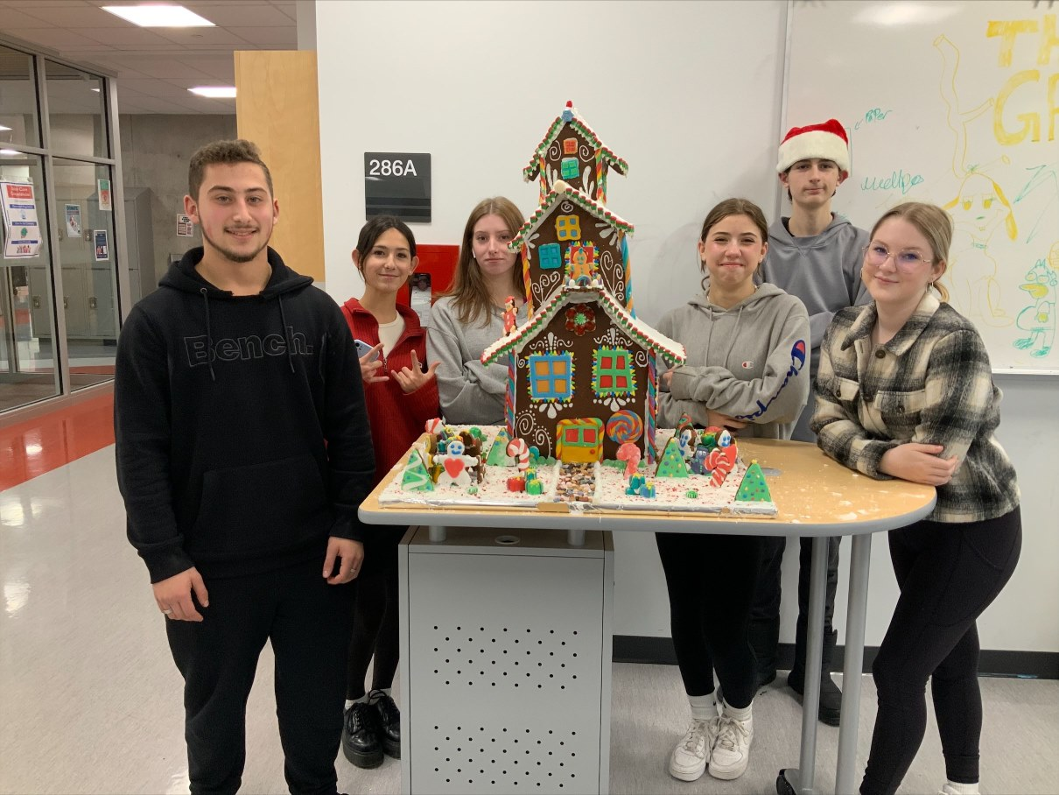
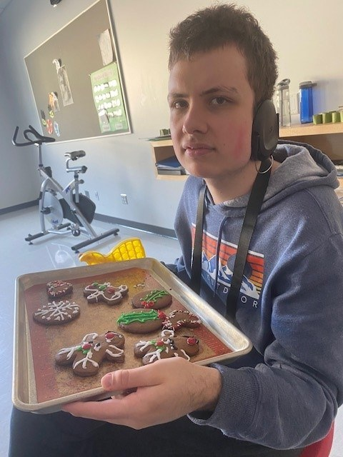
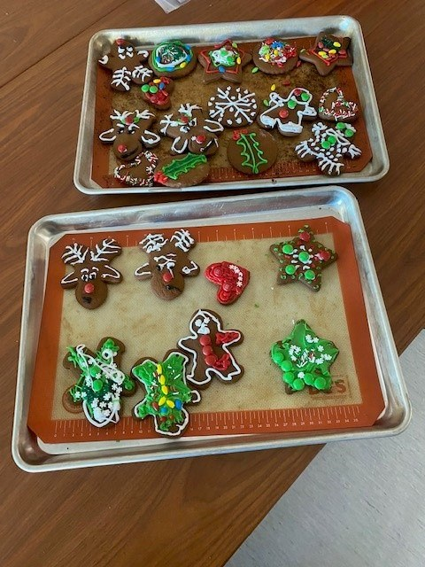
Design 8
part of ADST rotation
HOME ECONOMICS
Foods & Textiles
9
Foods
9
Foods & Textiles 10
Foods
10

Slide 26
ART INQUIRY 9
ELECTIVES COME IN THREE CATEGORIES: ADST 9, ART INQUIRY, MODERN LANGUAGES

Slide 27
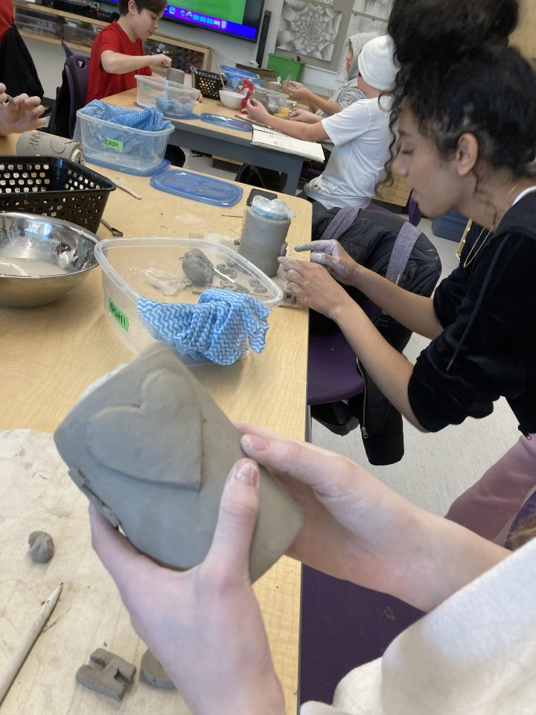

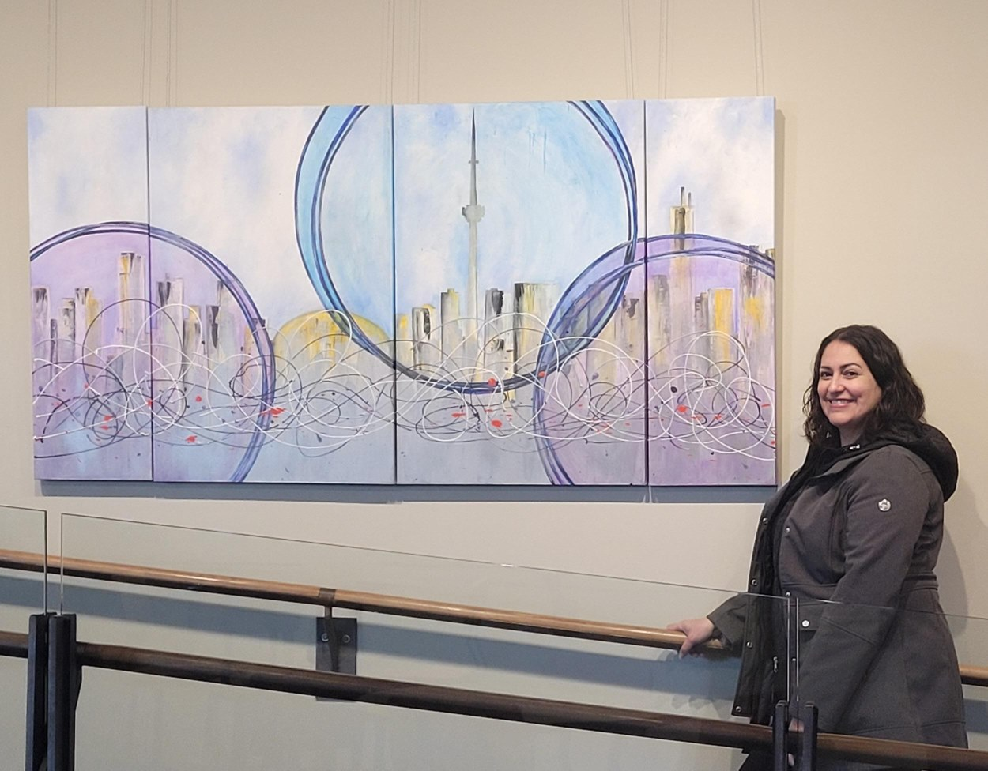
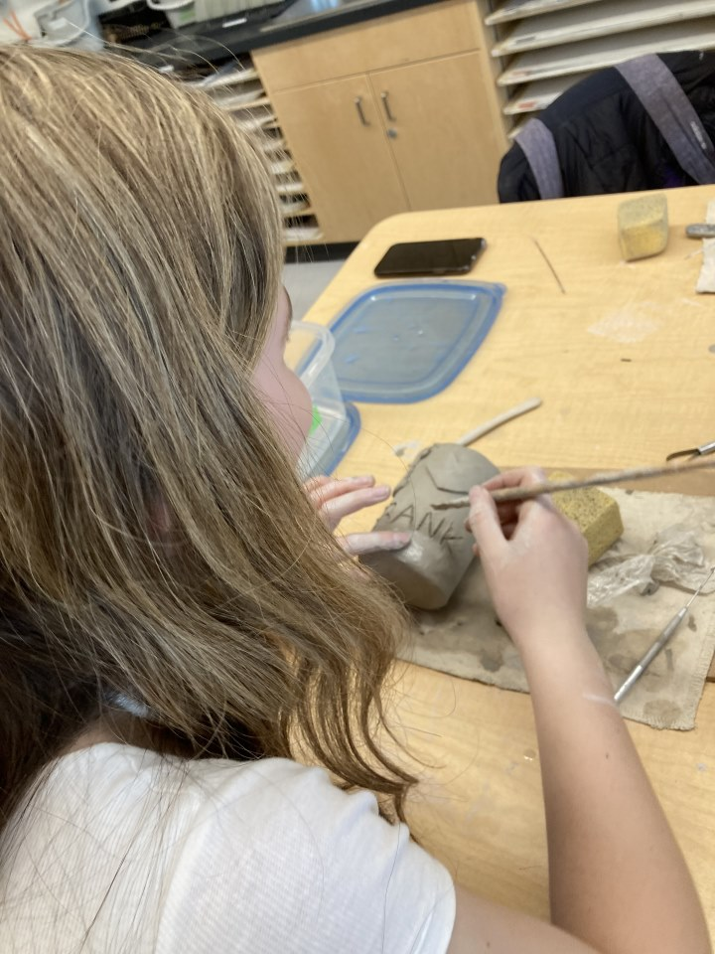
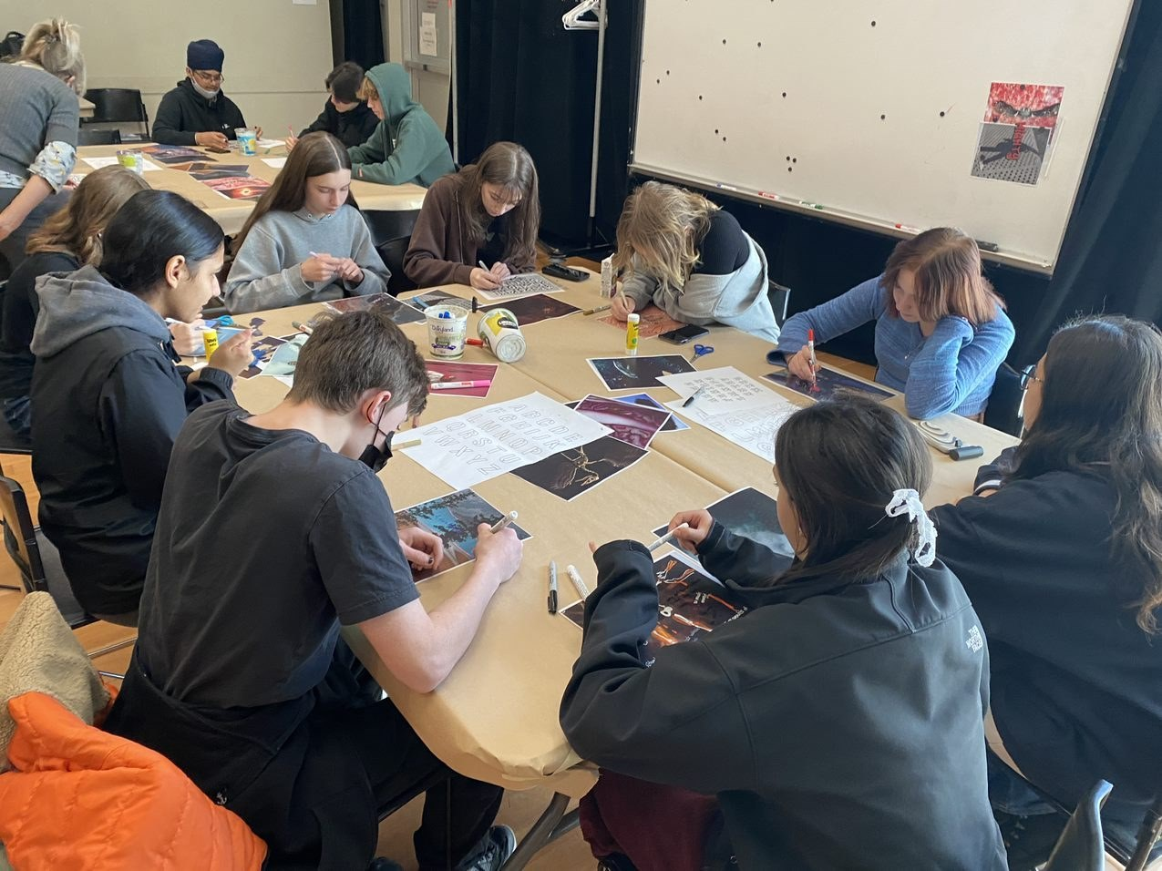
Art 9
Art Studio
Foundations 9
Art
Studio Foundations10

Slide 28

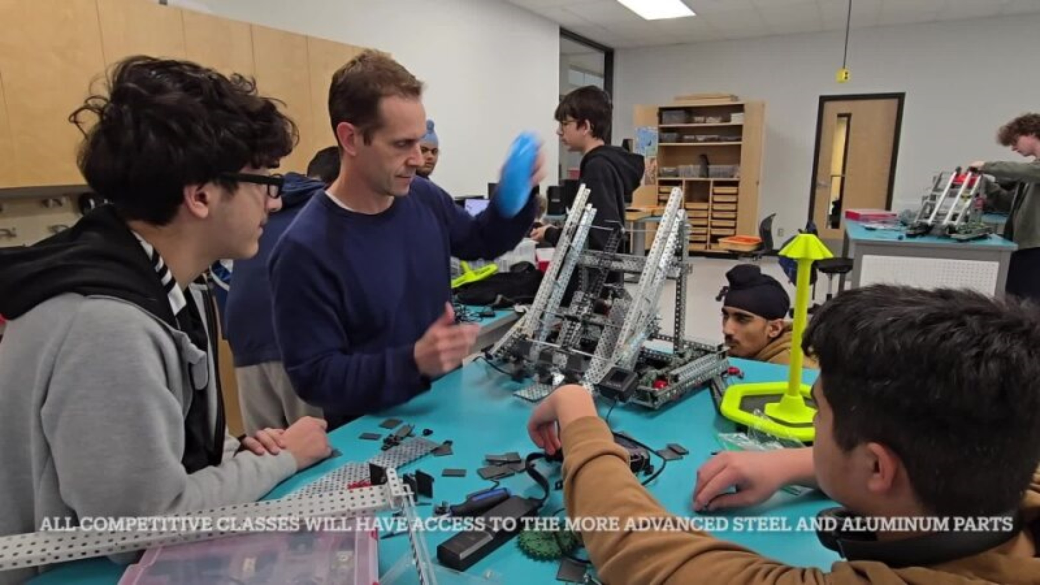

Media Arts 9
Photography 10
Video Production 10
Animation 10

Slide 29
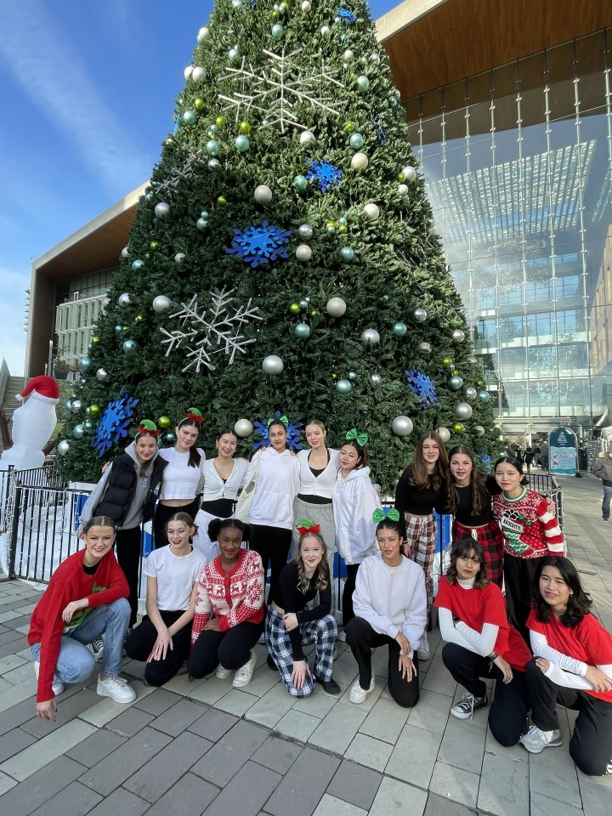
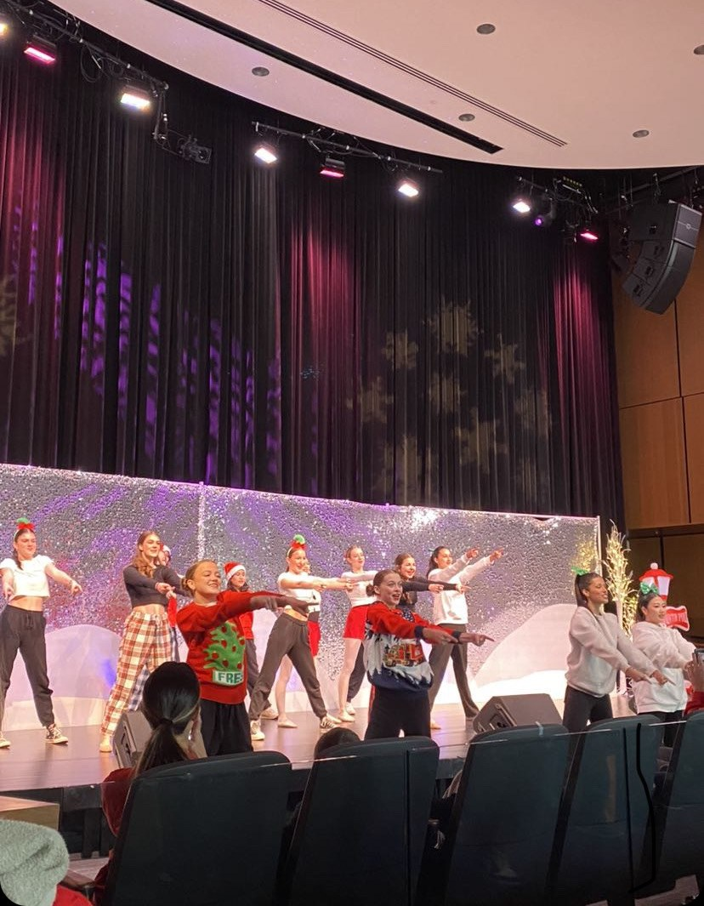
DANCE
DANCE 8
Dance 9
Dance 10
Dance Company 10
**Application**

Slide 30
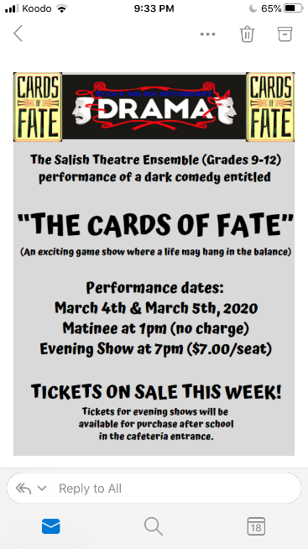
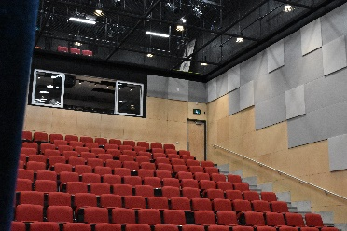
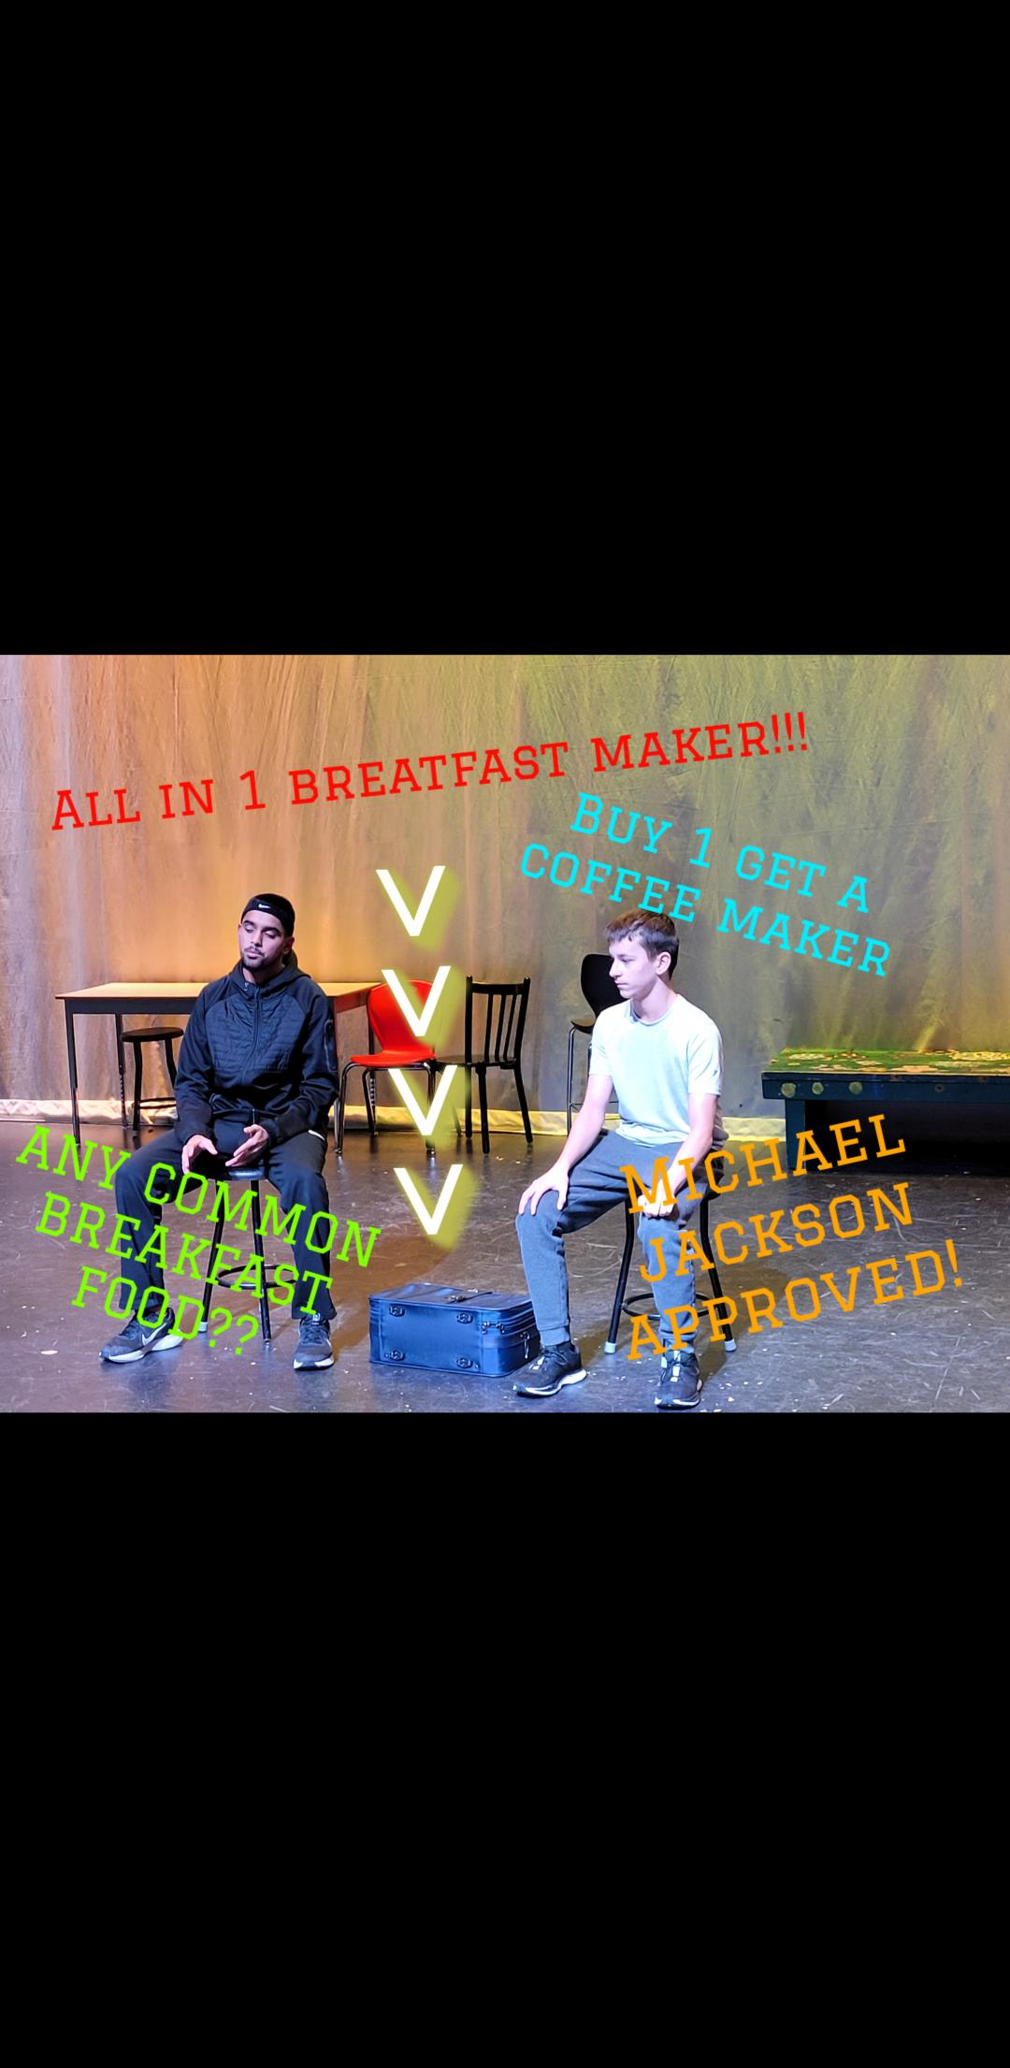
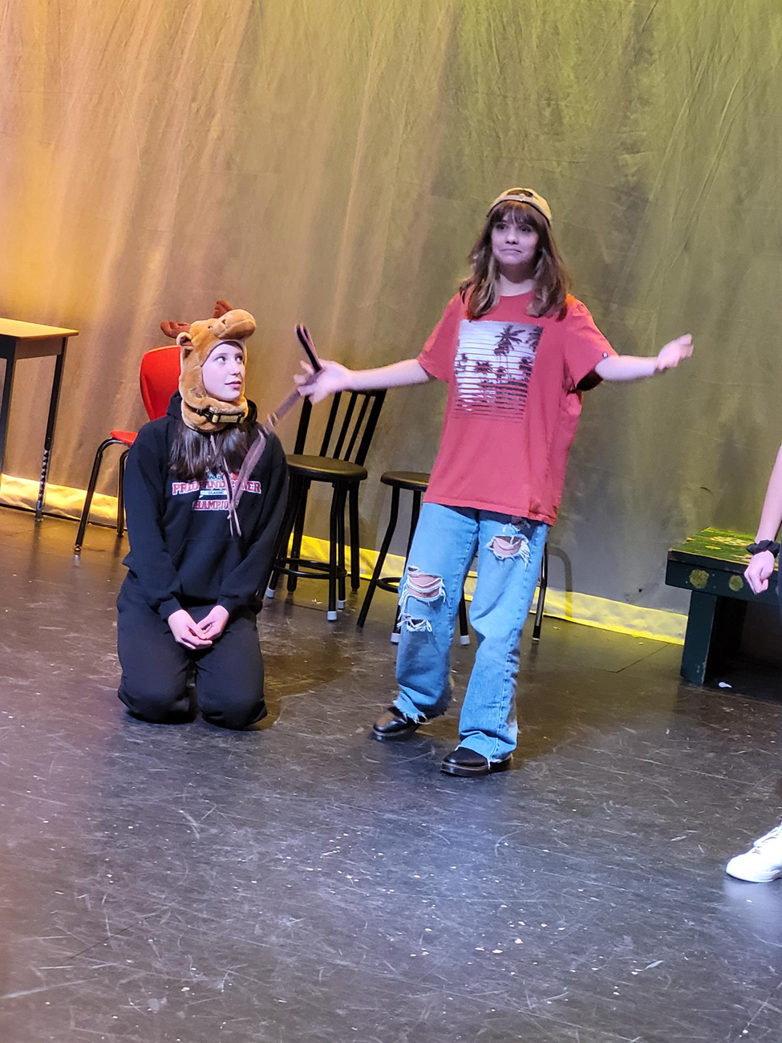
DRAMA
DRAMA 8
DRAMA 9

Slide 31



MUSIC
Grade 8 Concert Band
Grade 9 Concert Band
Grade 10 Concert Band
Grade 9 Guitar
Grade 10 Guitar
Grade 9 Choir
Grade 10 Choir
E BLOCK
Jr Jazz Band ( 8-9)
8’s & 9’s who are not in regular band can take this class with director approval
E BLOCK
Sr Jazz Band (10-12)
10’s-12’s who are not in regular band can take this class with director approval

Slide 32
MODERN LANGUAGE
ELECTIVES COME IN THREE CATEGORIES: ADST 9, ART INQUIRY, MODERN LANGUAGES

Slide 33
FRENCH IMMERSION
SAME SETUP AS
ENGLISH STREAM
SPANISH CAN REPLACE AN ART OR DESIGN ELECTIVE

Slide 34
E BLOCK
THESE BLOCKS RUN DURING BLOCK E: Jazz Band or Athletic Leadership

Slide 35

ALTERNATES
CHOOSE TWO OR MORE ALTERNATES IN CASE YOUR FIRST CHOICE IS NOT AVAILABLE
DO NOT PUT IN YOUR FIRST CHOICE AGAIN
EX: If I can't get Metalwork, I will take Metalwork...
1 ADST, 1 ART INQUIRY

Slide 36


ALTERNATES
RANK THEM
Make sure you select 2 electives as alternates
(1 Design and 1 Art)
Click arrow to get to second page

Slide 37

COUNSELLOR NOTES
LEAVE A NOTE FOR SPECIAL CIRCUMSTANCES ie. replacing French/Spanish with another elective (this is NOT recommended and only an option in special situations)

Slide 38
Grade 9 Programs
English Track
English 9, Math 9, Science 9, Social Studies 9, Career Education 9 (Not an enrolling class) are all required
1. Students must choose between PHE 9 or PHE 9 Unified Games
2. Students must choose between French 9 or Spanish 9
3. Students have 2 electives and may choose from each of the following categories:
Design (students must choose 1)
Art Inquiry (students must choose 1)
4. Students wishing to take an additional Design OR Art course; type in the request under 'Counsellor Information'. This additional course will remove your language 9 request.
5. Students can select an “E” block course (Jazz Band/Athletic Leadership).
6. Students choose two alternative options (One Fine Arts, One Design)
French Immersion Track
English 9, Math 9, Career Education 9 (non-enrolling), Français Langue 9, Sciences Humaines 9, Sciences 9, Education Physique et Sante 9
1. Students have 2 electives and may choose from each of the following categories:
Design (students must choose 1)
Art Inquiry (students must choose 1)
***FRIM students may select Spanish 9 as one
of their elective choices
2. Students can select an “E” block course (Jazz Band/Athletic Leadership).
3. Students choose two alternative options (One Fine Arts, One Design)

Slide 39
Choose what courses you want to take
You do NOT need to hit the POST button
Changes can be made until December 5th
Reminders

Slide 40

Questions?

