Slide 1
Welcome to Kindergarten Big Steps for Little Learners

Slide 2
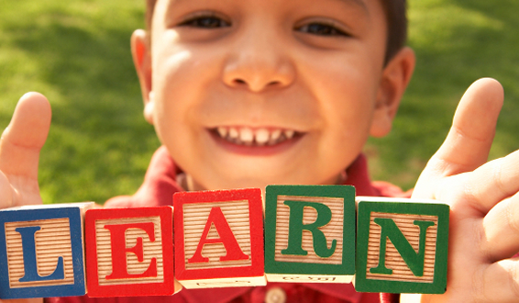
Welcome to (School Name)
Add school Info.
Notes:
Provide a welcome and school information.

Slide 3
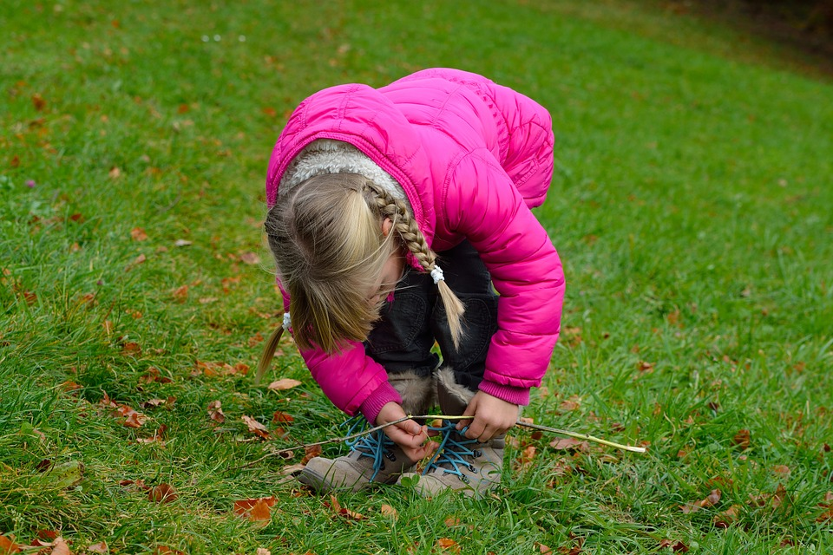
Common Myths About Kindergarten
My child must:
* Know the alphabet
* Know how to print her/his name
* Know how to count to 10
* Know how to solve problems independently
* Be independent (e.g. tie shoes)
Notes:
Your child does not have to complete a checklist to be ready for kindergarten. Each child enters kindergarten at various entry points. We learn about each child - their passions, interests, abilities, challenges and we plan our instruction to meet their needs and foster success. Education is not a one size fits all model. Our curriculum allows for multiple entry points and teachers are prepared to support the learning needs of all students. What matters is building a relationship between home and school so that we work together to support our little learners and that lines of communication are always open.

Slide 4
Things We Know To Be True Early Learning Framework, 2019 First People's Principles of Learning
Families are the first and most important teacher
Children are strong, capable and full of potential
Transitions look different for every child
Schools are ready for your children to arrive
Notes:
What we know to be true. And this is true for all children.
* Families are the most important teacher – You know your child best . You have the most important role in promoting your child's well being and learning. We know this at the school and what we can learn from you is incredibly important in easing the transition into kindergarten. Building relationships and collaborating with families is extremely important in this transition.
* Each child is a gift full of potential – they have their own passions, interests, and ways of learning. We do not have cookie cutter kids where they are all the same. Learning is different for each child, and teachers are ready to address the unique needs of all students.
* Transitions look different for each child. Your confident child may suddenly cling to you for comfort and be fearful of this new transition. Or, conversely, your fearful child may confidently break from you and embrace this new experience. Some children may not exhibit separation anxiety until a few weeks into school, or some may be confident throughout the day and then meltdown during pickup. But with lots of love and confidence in the process, they will get through this milestone experience.
* Schools are ready to welcome your child. There is no hurry to ensure they are "ready for school". There is no entrance exam. We are thrilled to be welcoming all children and we want to learn about them, learn with them and support them in every way as they transition into school.

Slide 5
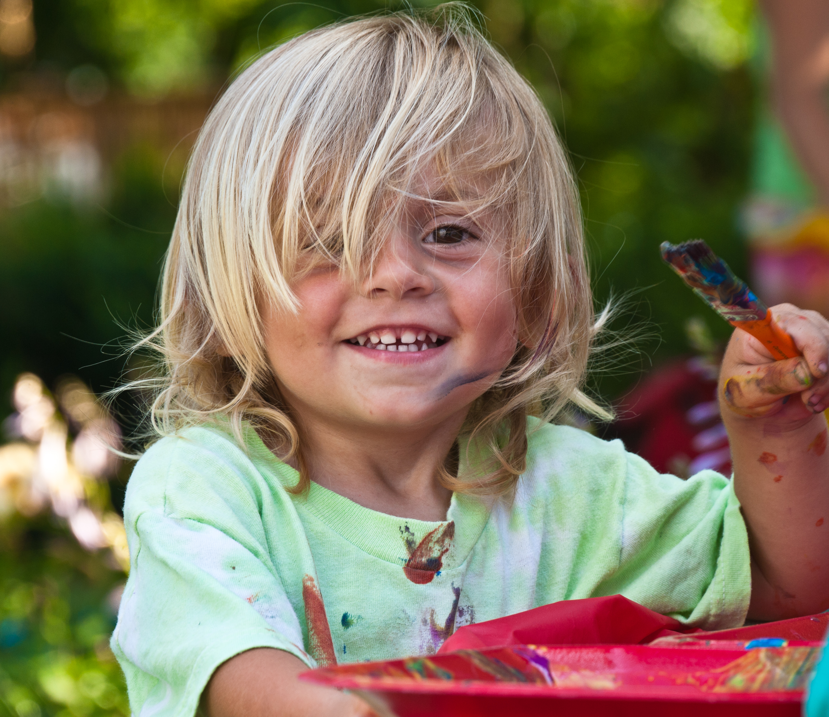
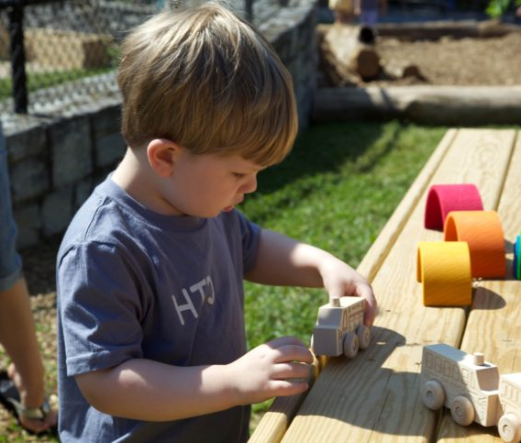
The Importance of PLAY!
Play is an essential element that runs through each aspect of development
Notes:
Playmaking brings children a greater awareness and understanding of the world in which they live (Burke, 2019). It is integral to well-being and learning and is social in nature.
When you enter a kindergarten class you will notice, see, hear and feel many things:
* You will notice books, play centers, creative materials, and science exploration tools.
* You will see your child participating in many forms of play which involve creating, exploring, dramatizing, observing, building and more.
You will hear them socializing with others as they exchanging ideas, solve problems and communicate.
You will hear them asking questions and express delight as they create something new.
* And you will feel a mix of emotions as your child embarks on this new journey.
The new Early Learning Framework is from 0-8 and play is embedded in all early learning and beyond. Older children tinker, create, explore.
Play can reduce stress, increase calmness, maintain social and emotional equilibrium, build coping skills and resilience, produce subjective feelings of well-being. Children's play promotes optimal language development, thinking skills, creativity, and physical, social and emotional skills in early and middle childhood (Early Learning Framework).

Slide 6
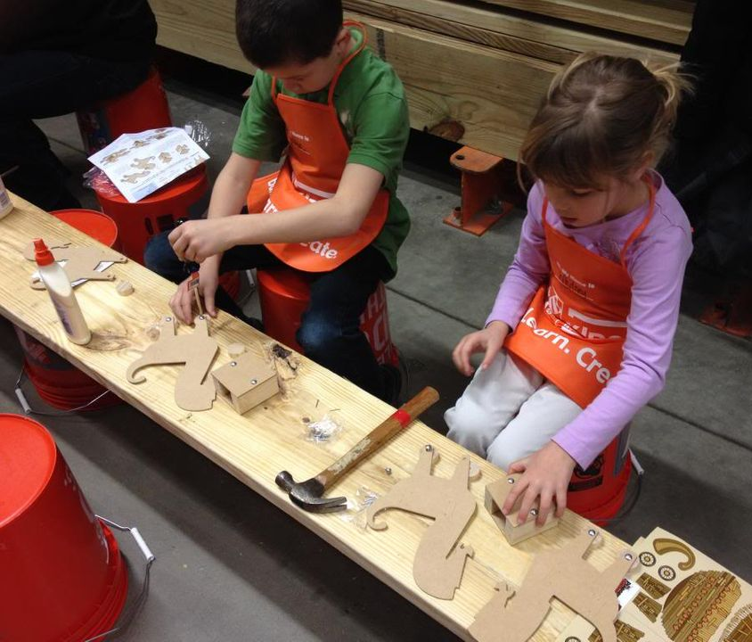
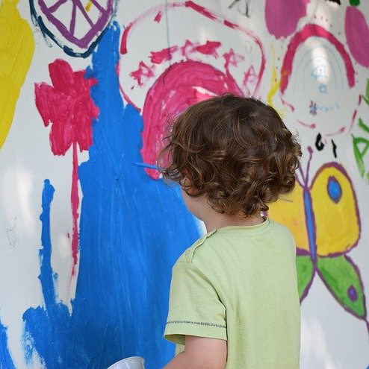
In Kindergarten your child will.....
Explore
Imagine
Create
Share
Learn
Tinker
Discover
Grow
Make
Care
Collaborate
Notes:
Learning involves engaging young minds to take risks, explore, grow and communicate.

Slide 7
Foundations of Learning: Supporting the Whole Child
Social and Emotional
Language and Communication
Cognitive
Physical
Notes:
Children learn in mind, body and spirit (ELF).
* Learning involves supporting the whole child – social/emotional, cognitive, language/communication, physical. It is focussed on building relationships, on connectedness and fostering a sense of community.

Slide 8
Social Emotional Development
Nurturing a sense of
well-being and belonging supports children as they learn about and investigate the world around them
(Early Learning Framework, 2019).
Notes:
We have learned so much over the years. The heart and mind are connected (FPPL) and we must foster a sense of safety, security and well-being in order for children to be able to learn.
Having your child feel a sense of well-being and belonging is integral to success. Research has proven that a focus in SEL during the early years can have long-lasting positive effects on our mental health, in school, in society and the economy. (CASEL). If we have strong SEL foundations in the early years, academic performance increases by 11% and students with good SEL skills have better attendance, improved behaviour, higher graduation rates and better self –awareness.
There are 5 areas we focus on to support SEL
* Self Awareness – understanding self (strengths, challenges, emotions)
* Self Management – managing emotions and behaviours
* Social Awareness – understanding and empathy for others
* Relational Skills – Positive relationships, teamwork, dealing with conflict
* Responsible Decision Making – Making the right choices (constructive/ethical)
Things you can do to support SEL:
Learning is socially constructed. Games and other forms of collaborative playing are crucial for self-regulation. Important concepts, such as sharing, waiting one's turn, following directions, not being too rough, and controlling frustrations are all learned through play. It helps children learn to communicate, cooperate, understand emotions and recognize the emotions of others.
Encourage your child to take risks – climb on the playground, play with a new friend, try something new, visit a place they've never been before – this builds confidence and a sense of safety and security
Allow your child to experience failure, disappointment or setbacks. This provides an opportunity to identify emotions and work through them. It also provides an opportunity to discuss effective problem solving strategies and work through them together. Your child will develop perseverance and resilience and learn how to navigate when things don't go their way. This might involve loosing at a game, not getting the toy they want, or having a disagreement with a friend. These are all opportunities to listen to your child and model, discuss and support their feelings.
When children are able to recognize feelings and emotions in themselves, they are more capable of seeing and recognizing feelings in others and this developing a sense of empathy and understanding-
Acknowledging and taking care of your own feelings will help you find that calm, confident parent inside of yourself that your child is going to need during this transition.

Slide 9
Cognitive Development
Oral Language & Communication
Emergent Literacy
Emergent Numeracy
Critical and Creative Thinking
Notes:
All children learn and acquire oral language, literacy, numeracy and critical and creative thinking skills at different rates and move through stages at different speeds. Allowing children opportunities to PLAY will enhance their cognitive skills and help them make sense of the world.

Slide 10
Communication and Oral Language
Speaking
Listening
Sharing
Communicating
Socializing
Negotiating
Notes:
Oral language development is an important part of emergent literacy. Children learn how language has a purpose and is used in different contexts. They learn how to share their ideas, communicate, and how to socialize with others. They begin to understand how sounds and letters are linked and they begin to make sense of how reading and writing fit in with their social world.
Things you can do to support oral language:
Encourage them to talk, talk, talk
Encourage your child to share their thoughts and feelings (builds confidence)
Actively listen to your child's message
Model good listening and ways to communicate
Model how they might talk about what they are learning
Use positive language
Extend conversations by asking questions
Offer access to games and activities that give may opportunities to chat, listen and discuss
In Indigenous cultures, knowledge was traditionally shared orally and sharing stories orally is still important today.

Slide 11
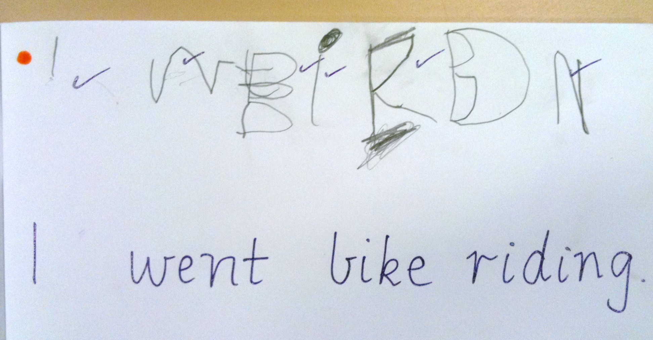
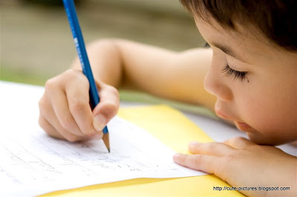
Emergent Writing
Drawing
Scribbling
Forms that resemble letters
Random Letters
One letter to represent a word
Familiar words
Notes:
Never underestimate the power of a good scribble. Each child works through the developmental stages of writing at their own pace. It is important to encourage where they are at. Encouraging your child to begin with drawing their ideas, stories and thoughts is important. You can also begin to talk about letters and sounds and if they are drawing a cat, you can model sounding it out and encourage them to write down any sound they hear. If they hear a "c", that should be celebrated. If they only here a "t" that also should be celebrated.
What is important is to celebrate and encourage all attempts and provide opportunities to practice. We are trying to build confidence and encourage risk taking in these early stages. Modeling writing is another way to share how writing is part of our every day world – grocery lists, letters, notes, etc. are all natural ways to model writing.
Things you can do to support emergent writing:
* Provide tools for literacy - Provide paper, crayons, pencils, markers, paints, booklets
* Provide opportunities to write – play restaurant with a note pad, write pretend mail, make letters with rice or macaroni, etc.
* Create stories together by drawing, using puppets, story boards, retelling familiar stories, dress up (dramatic play), make books together – they draw picture – you write text
* Encourage them to see, copy or write their name whenever possible – ie. On their bedroom door, signing cards

Slide 12
Emergent Reading
Exploring books
Looking at pictures
Retelling stories in their own words
Recognizing rhyme
Recognizing alphabet letters and sounds
Recognizing environmental print
Connecting, visualizing, questioning
This Photo by Unknown author is licensed under CC BY-ND.
Notes:
As children begin to explore books, they start by simply turning the pages and looking at the pictures. They then may begin to retell stories in their own words and wordless books are a wonderful way to encourage them to look at the illustrations for clues as to what the story is about. They may then start to recognize familiar letters or words, or they may memorize familiar books. As you read or explore books, encourage your child to make connections to what they already know or their own experiences, have them make pictures in their minds (visualize) and ask questions as you go along to deepen understanding.
Ways to support emergent reading:
* Surround them with books: wordless, fiction/non-fiction, poetry, chants, humerous books, adventure books- read daily, visit the library,
* Point out familiar words in your environment (STOP signs, billboards, logos) - ask what letter does it begin with, what sounds do you hear
* Play I spy games – I spy..... something in the room that begins with R, something at the park that begins with _, something at the beach that begins with ___.
* Notice letters in the environment that match letters in their name

Slide 13
Emergent Numeracy
Part of everyday life
Problem solving
Logical thinking
Exploring number relationships
Notes:
Numeracy is the ability to reason with and understand math concepts that are relevant to our daily lives. Math offers an enormous repository of games and other play-based opportunities for learning and skill building. Estimation, patterning, observation, and number recognition are part of children's everyday lives. (Burke, 2019)
Research has revealed that "...children have surprisingly powerful everyday (informal) arithmetic knowledge" (Baroody & Dowker, 2003)
Things you can do to support Numeracy Development:
Numeracy Books – patterning, counting, nursery rhymes (1, 2 buckle my shoe), patterns
Board games require counting with dice and one to one correspondence. Hide and Seek – requires counting
Daily activities: Getting dressed – count everything they will put on, count fingers and toes. Meal time – Count the plates, ask how many forks will we need if there are 4 of us? Eating smarties – make a pattern, count stairs as you go up them, count cars as you pass by
Cook together – discuss counting, measuring and nutrition - bigger and smaller
Nature walks- notice patterns in forests, streams, in the community – Count trees, count cars, etc., sort leaves/rocks/etc based on attributes, discuss smaller/bigger, same/different, go over, under, through

Slide 14
Critical and Creative Thinking
Generating new or novel ideas and concepts
Making judgements
Exploring materials
Gathering, assessing and analyzing information
Risk taking
Persevering
This Photo by Unknown author is licensed under CC BY-SA.
Notes:
Having your child participate in critical and creative thinking is integral to preparing them for 21st Century skills. Children will face jobs and challenges later in life that are not even imagined yet. Being involved in critical and creative thinking develops perseverance, curiosity, and innovation. They have to solve problems and collaborate to try to figure out what to do when they don't know what to do. This may involve the notion of try and try again – experiencing failure and persevering. This is where thinking outside of the box comes into play and where our future inventors and creators evolve from.
Example: Building a boat that floats on water – using boxes, tape, sticks, paper, plastic, etc. - Question – how many marbles can it hold, how will the water impact the materials, could you make a mast? Challenge: Who can make a boat that can hold the most marbles? - Perseverance
Things you can do to support Critical and Creative Thinking:
Provide open ended materials (loose parts) for creating (sticks, rocks, shells, cardboard tubes, popsicle sticks, buttons, pipe cleaners, boxes) - Not Just a Box
Plant a garden – use rakes, shovels, seeds – connecting with the environment – how much water, how much sun, how deep
Build and create – structures, forts, a boat that floats – a race track – test it
Make music using pots, pans, buckets, bells, spoons
Create a dance to your favourite music – perform it

Slide 15
Physical Development
Fine and Gross Motor Skills
Movement
Coordination
Outdoor Play
Notes:
It is important for children to participate in pyhsical play as it develops fine and gross motor skills, helps them to develop an awareness of body space and enhances coordination.
There has been a reduction in play and this may be a contributing factor in rising levels of childhood obesity, as well as increasing incidences of anxiety, stress, and depression in young children (Hewes, 2014). When children are outside and enjoying the natural environment, this is another "classroom" for them to extend their learning and to build connections and appreciation of the land on which we live. Indigenous teachings and beliefs hold that the health of a human being is tied to the health of the land they inhabit so having our children play outside, respecting their environment and appreciating all that we can learn from our "outdoor classrooms" supports our well being.
Ways to support physical development:
* Fine Motor Skills: Using playdough, threading beads onto pipe cleaners, making a pasta necklace, using scissors, handling crayons
* Give them plenty of opportunity to play both inside and outside – at least one hour per day
* Engage in the world around you – the forest, the park, the playground. In the snow, the rain, in puddles
* Screen time should be limited to less than 1 hour per day from 2-4 and 2 hours for 5 and older. If you are using screen time, choose age appropriate apps/programs. Turn off all screens during family mealtimes and other family activities
*Little ones need lots of sleep, usually 10-12 hours a night. Start turning back the clock before school starts.

Slide 16
What you will experience when you walk through the door......
Gradual Entry Process
Relationship Building
Welcoming Conversations
Notes:
There will be a gradual entry process where each day your child attends for longer periods of time . This can take different formats but the purpose is to have your child gradually adjust to their new environment in small group sessions. Teachers will introduce children to classroom routines and procedures so they will feel comfortable and more at ease.
The teacher(s) will want to get to know you and your child – building relationships through welcoming conversations –
Your child will form a bond with teachers, other children, the school community
The school is preparing for your child's arrival and you are integral to that process - you are their first and most important teacher
We are a team, and we are eagerly preparing for your little learners arrival

Slide 17
We look forward to seeing you in September!

