Slide 1
SPORTS DAY 2025
JUNE
2025
June 13th, 2025

Slide 2
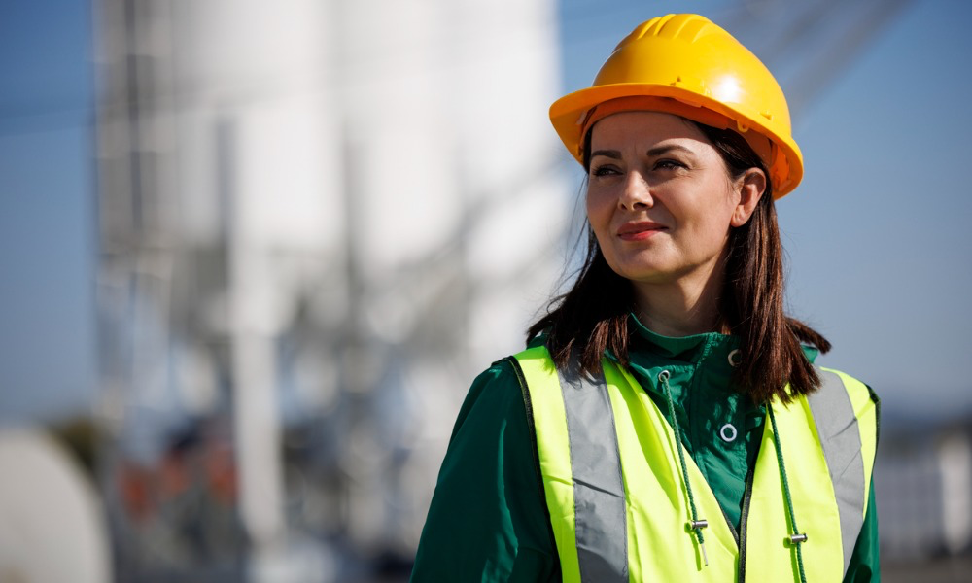
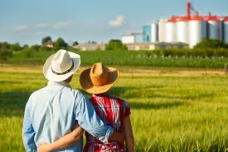
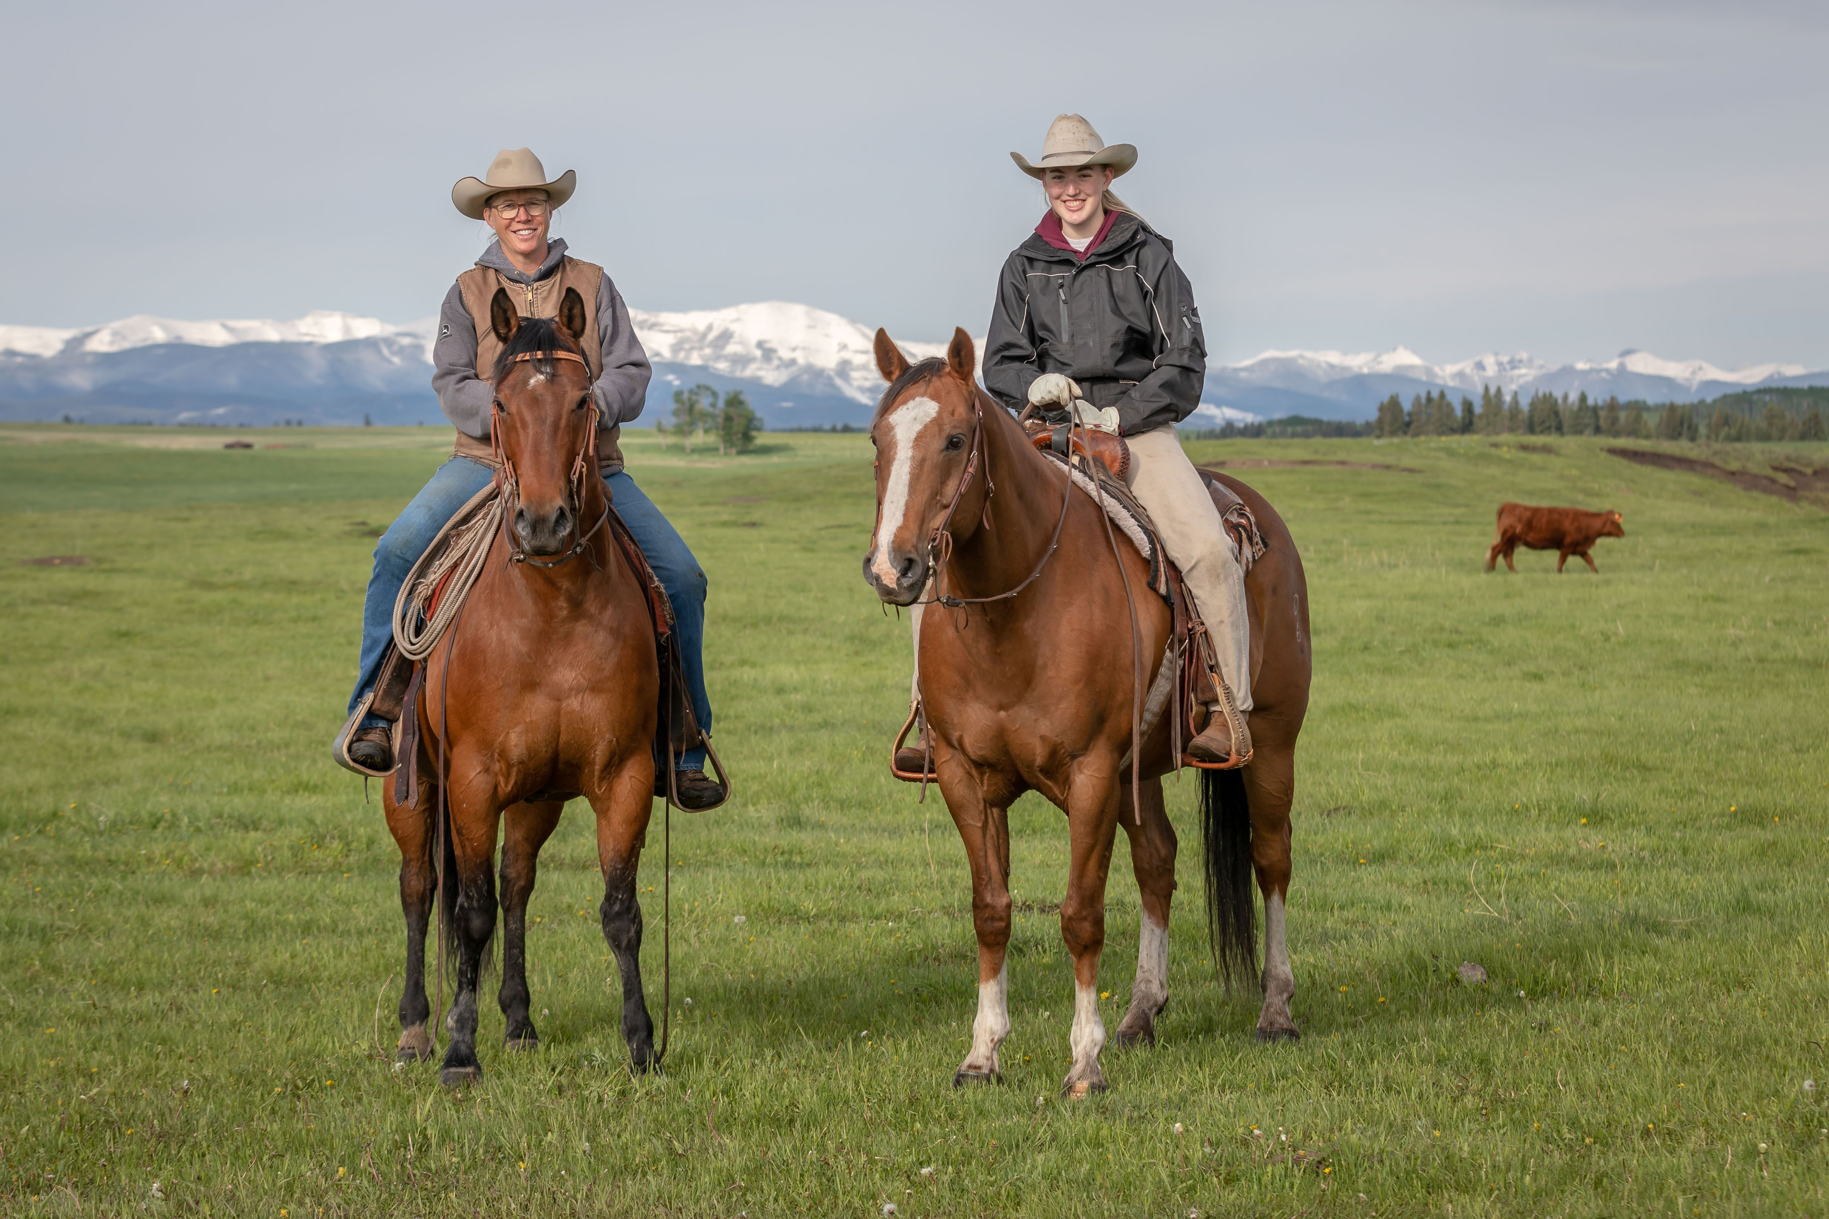
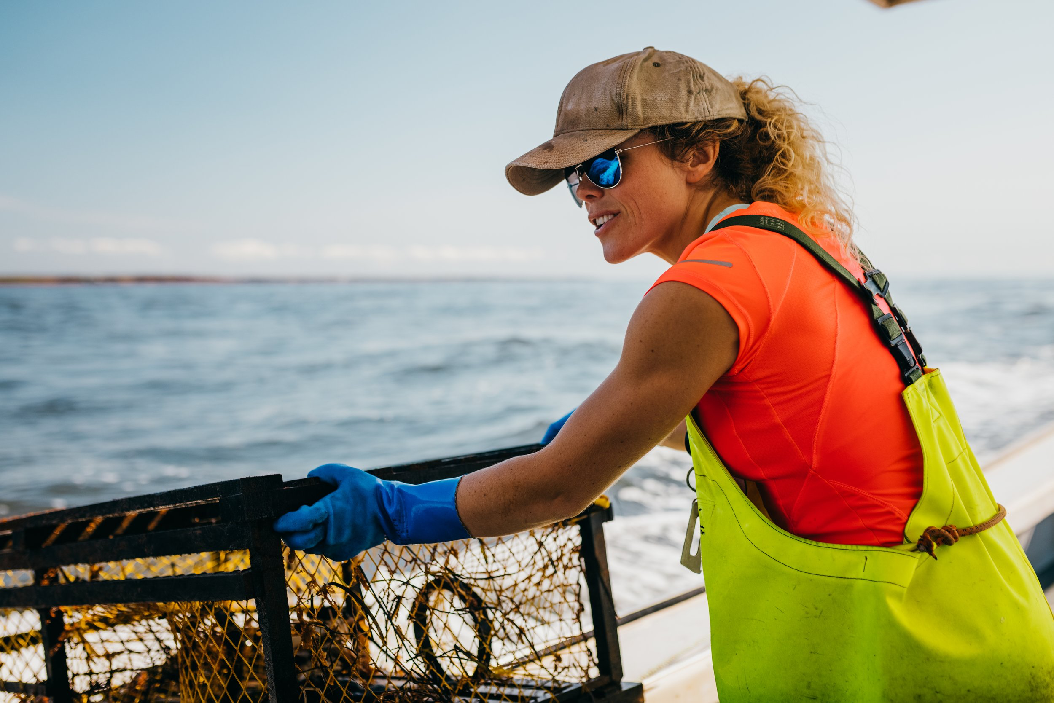
Canadian Resources/Professions

Slide 3
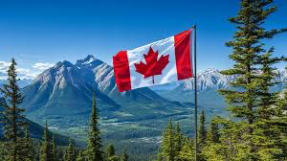
THEME.
"Powered by Nature, United by Pride!"

Slide 4
Team Assignments:
Blue Team — Eastern/Atlantic Provinces: Fisheries ➔ Professions: Fishing, Maple Syrup Farming (Blue = ocean!)
Red Team — Prairies: Agriculture and Petroleum ➔ Professions: Farmers, Oil Workers, Ranchers (Red = rich prairie sunsets and wheat fields)
Yellow Team — North (Yukon, NWT, Nunavut): Mining & Minerals ➔ Professions: Miners, Geologists (Yellow = gold and minerals!)
Green Team — West Coast (BC): Forests/Lumber, Fisheries ➔ Professions: Foresters, Fishing (Green = forests!)

Slide 5
COSTUME PARADE
CRITERIA
We will not have a bike parade instead we will have a costume parade.
Students will dress-up in costumes which depict resources or professions that pertain to each province or territory.
For example: BC/Green Team could dress as a forestry worker, Canuck Hockey Player, or Salmon, or Orca
Prizes will be given to the costumes that best represent their region.

Slide 6
Costume Ideas
Team | Region / Theme | Professions | Key Animals | Costume Ideas | Extra Accessories
🔵 Blue Team | Eastern/Atlantic Provinces Fisheries & Maple Syrup | Fishers Maple Syrup Farmers | Atlantic Cod Lobster Harbour Seal Moose White-tailed Deer Black Bear Beaver | Fishers: yellow rain jackets, rubber boots, fishing hats, toy fish/nets Farmers: plaid shirts, suspenders, syrup buckets, cardboard tree taps | Blue face paint, cardboard boats/oars, ocean creature masks, Leafs or Sens t-shirts
🔴 Red Team | Prairie Provinces Agriculture & Petroleum | Farmers Ranchers Oil Workers | Bison Elk Moose White-tailed Deer Cows Pigs Chickens Horses | Farmers: overalls, plaid shirts, straw/cowboy hats, bandanas, pitchfork props Oil Workers: toy hard hats, safety vests, “oil smudge” face paint | Wheat stalks, cow-print props, tractor themes, prairie hockey shirts (Jets, Flames, Oilers)
🟡 Yellow Team | Northern Canada (Yukon, NWT, Nunavut) Mining & Minerals | Miners Geologists | Polar Bear Grizzly Bear Caribou Muskox Moose | Miners: cardboard pickaxes, hard hats with glow sticks, dirty face makeup Geologists: lab coats, khaki vests, safety goggles, magnifying glasses | Gold nugget props, Arctic hats, snow boots, northern lights face paint or banners
🟢 Green Team | West Coast (BC) Forests & Fisheries | Foresters Fishers | Pacific Salmon Orca (Killer Whale) Sea Otter Dungeness Crab Black Bear Cougar Bald Eagle Raven Great Blue Heron | Foresters: green vests, flannel shirts, wide-brim hats, clipboards Fishers: salmon hats, fishing lures on vests, boot cutouts, cardboard rods | Forest face paint, moss necklaces, bear/eagle/salmon masks, Canucks gear

Slide 7
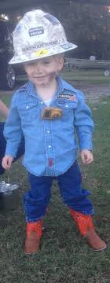
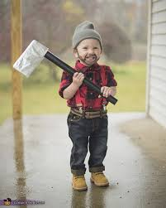
COSTUME IDEAS

Slide 8
POPCORN
POPCORN CREW WILL BE SELLING
$1.00 A BAG

Slide 9
SEE YOU ON JUNE 13TH
DRESS –UP IN YOUR HOUSE TEAM COLOURS AND COSTUME

