Slide 1
Guildford Park PARENT ADVISORY COUNCIL
November 18, 2020

Slide 2
ACKNOWLEDGEMENT
This Photo by Unknown author is licensed under CC BY-NC.

Slide 3
Introductions
Chair – Connie Giffin
Vice Chair – Debbie Hebert
Treasureer – Teresa Johanson
Secretary –________________________________

Slide 4
BUDGET
2020-21 PAC Funding Requests
Total Requests |  |  | Total Allotted
$26,200.00 |  |  | 24,331.54
Item | Cost |  | Allotted Funds
Scholarships (6*$500) | $3,000.00 |  | $3,000
Dry Grad | $3,500.00 |  | $2,500.
Awards | $2,500.00 |  | $2,500
GP Games Club - TV | $540.00 |  | $ 540.
English Dept. | $799.77 |  | $799.77
Tourism | $1,500.00 |  | $1,500.00
BASES | $2,650.00 |  | $2,000
Graphic Novel | $500.00 |  | $500.
Math Dept. | $1,061.77 |  | $1,061.77
Ab. Ed. Elders | $1,200.00 |  | $ 930.00
Science Dept. | $2,500.00 |  | $1,000.00
Music Dept. Tuba | $4,000.00 |  | $2,000.00
Tech. Comm. |  |  | $1,000.00
GP Annual - All Students | $5,000.00 |  | $ 5,000.00

Slide 5
Principal Message
Administration
Dr. Monica Frank (A to F)
Mr. Ken Strain (G to N)
Mr. Mike Moloney (O to Z)
Activities
Enrolment
Quarter Two
Dr. Tinney - Great Interview

Slide 6
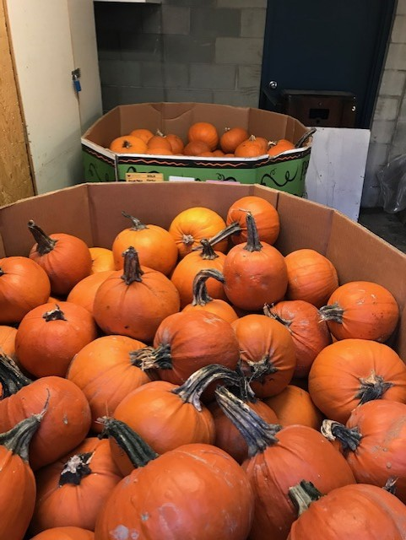

Slide 7
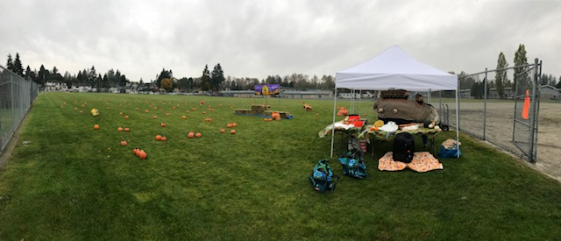

Slide 8
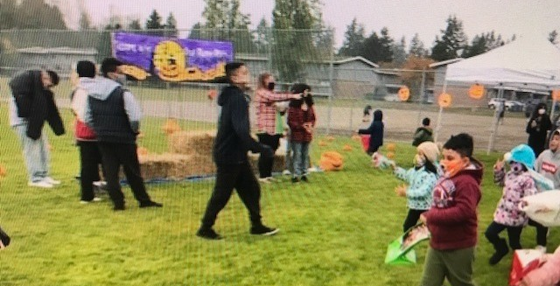

Slide 9
November
Remembrance Day Presentation – Nov. 5
Quarter Change – Nov. 9
Progress Reports – On line
Continue to look for fun and safe activities

Slide 10
Exposure what does this mean?
Receiving this letter does not mean you have been exposed to COVID-19.
The intent of this letter is to provide early notification to our school community that an individual that is confirmed to have COVID-19 was at our school.
Public health is following up on this exposure and has initiated contact tracing to identify any individuals that need to self-isolate or self-monitor for symptoms.
If you do not receive a phone call or letter from public health officials, please continue to attend school and monitor for symptoms compatible with COVID-19 as per our school policy.
For privacy reasons, we cannot give out any further details.
If you have any health questions or concerns, we encourage you to call 811. Our district follows the following process for COVID-19 exposures at our sites.
https://www.fraserhealth.ca/health-topics-a-to-z/coronavirus/school-notifications#.X2RWKJOpG1v

Slide 11
Exposure – Nov. 5th

Slide 12
Questions

Slide 13
THANK YOU!
Next Meeting will be January 13, 2021
HOPE TO SEE YOU THERE!

