Slide 1
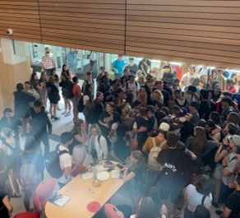
GRAD 2025 Parent Gathering October 24th, 2024
Territorial Acknowledgement
Grad Requirements
Post Secondary Information
Scholarships
Upcoming Events & Dates

Slide 2
We respectfully acknowledge that Surrey schools reside on the traditional, unceded, and shared territories of the Katzie, Kwantlen, and Semiahmoo first nations.

Slide 3
Grad Support Team
Sheila Hammond Principal
Mike Haffner Vice Principal (A - Harr)
Jason Anderson Vice Principal (Harv – Park)
Michelle Larsen Vice Principal (Parker – Z)
ADMIN
Lisa Jouzy (A-E)
Shannon O’Brien (F-Li)
Nicole Bolognese (Lo-Ro)
Chris Black (Ru-Z)
Yogita Rai (LEAP students)
COUNSELLING
CAREERS
Christina Sandhu Career Facilitator
Rain De Guzman Scholarships & CLC12 Teacher
Heather McGowan Career Centre Assistant

Slide 4
Graduation Requirements
Graduation Requirements: 80 Credits (with specific course requirements).
Diploma Verifications are reviewed by counsellors and admin to ensure requirements are met. Parents Contacted if there are concerns.
Online Courses (SAIL) finished by end of June.

Slide 5
Career Centre
Be sure to follow the career centre instagram
@salishcareercentre
Make sure to keep checking the Grad TEAM for Scholarship Information and for Post Secondary Open House & Information session dates

Slide 7
Education Planner BC

Slide 8
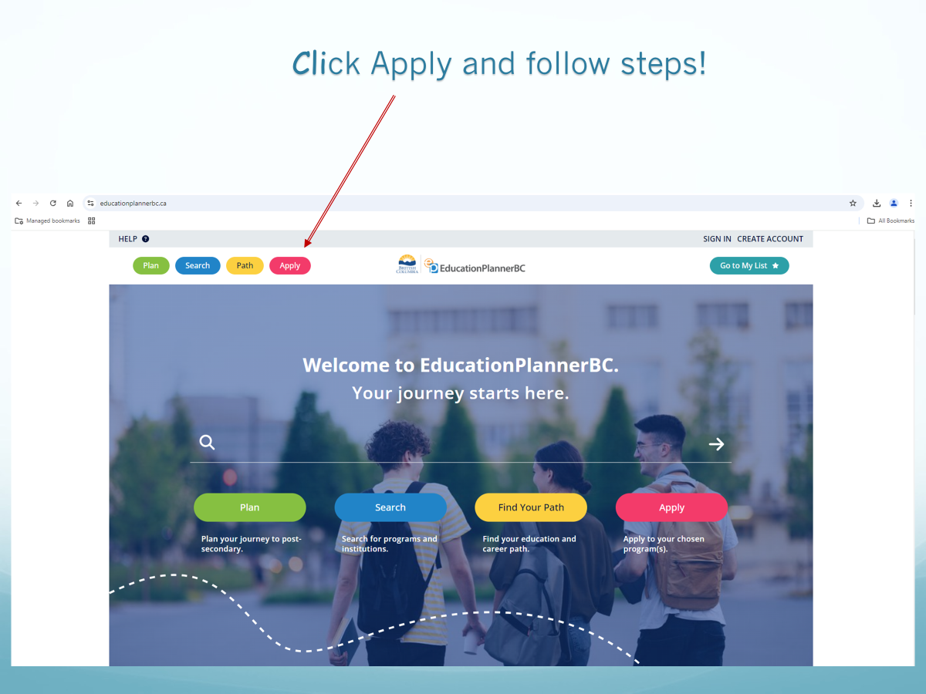
Click Apply and follow steps!

Slide 9
Post Secondary Applications
NOTE:
Applications are now open!
Schools do not all follow the same admissions format—it is important to look up each school’s application steps.
It is also important to check email and/or the university’s Student Services Portal periodically for updates.
UBC
Early Application Deadline December 1st
Final Deadline Jan. 15th 2024
SFU
Application Deadline Jan.31st 2024
KPU
Application Deadline March 1st

Slide 10
Important Reminders
Check application dates and deadlines—most BC school applications are through Education Planner BC.
Check to see if the institution you are applying to requires self-reporting. Confirm dates.
Review deadlines for housing (if applicable)
Think about finances—review StudentAidBC; review dates and deadlines.

Slide 12
Transcripts
Order transcripts through the BC Student Transcripts Service website in order to request high school transcripts to be sent out.

Slide 13
Student Transcript Services

Slide 14
What will you need to create an account?

Slide 15
Create your account

Slide 17
Scholarship Information

Slide 18
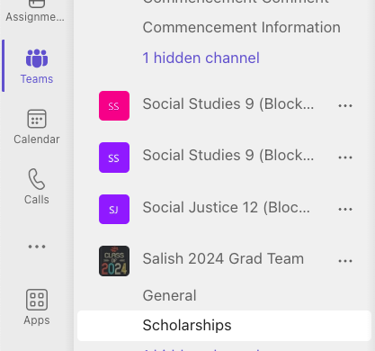
Where can students find scholarship resources discussed tonight?

Slide 20
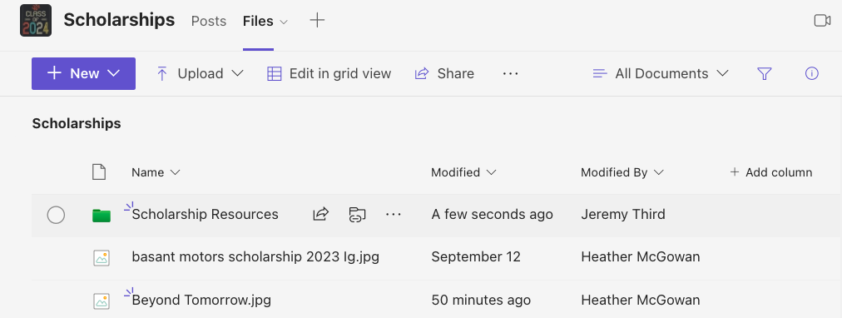

Slide 21
Types of Scholarships
Internal Scholarship: Scholarship recipients are selected by the Salish Scholarship Committee. Students complete one application (Semester 2)
External Scholarship: Scholarships not organized or directly affiliated with our school. These scholarships are ongoing all year. Advertisements for awards are ongoing.
External Nomination Scholarship: Scholarships that the Salish Scholarship Committee nominates students to be considered by external scholarship boards. These scholarships are ongoing. Advertisements for awards are ongoing.

Slide 22
Internal Scholarships
ONE application; eligible for dozens of awards
Includes community scholarships (realtors, local businesses etc.) and District Scholarships (District Authority, Surrey Teachers Association etc.)
Applications open on Monday, January 5th 2024 at 3:00pm. Applications will be completed on the Grad Teams Page 2024 under assignments tab.
Applications close Friday, April 5th 2024 at midnight. No late applications will be considered.
Information Session for students will be on Monday, January 5th 2024 at 2:30pm in Theatre.

Slide 23
Where to find upcoming External and External Nomination scholarships?

Slide 24
Grad 2025 Teams Page
Wolves E-Agenda
Announcements

Slide 25
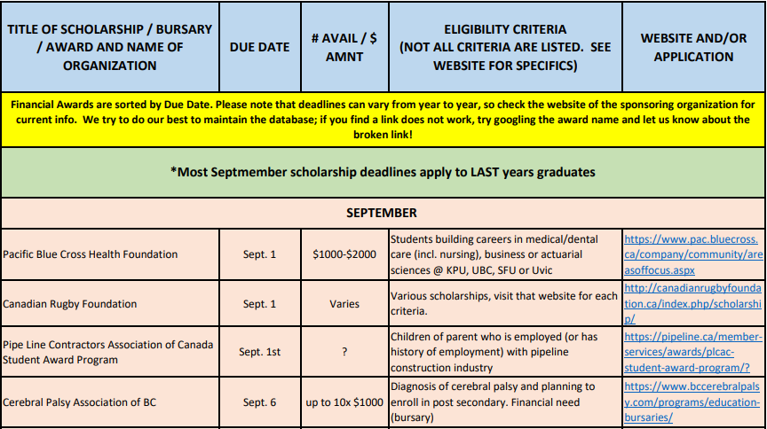
Database for scholarships
25 pages of scholarships! Please note: dates may be incorrect on full PDF. We update monthly and post out on the first of each month.

Slide 27
District Website
https://www.surreyschools.ca/page/11480/post-secondary-scholarships

Slide 28
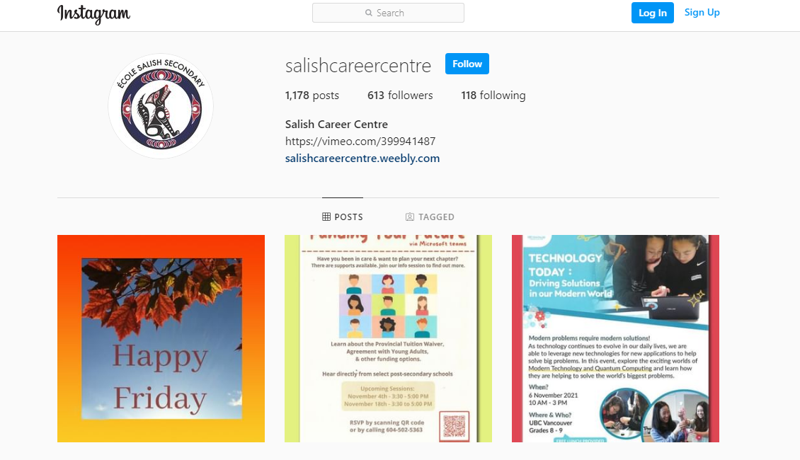
Instagram @Salishcareercentre

Slide 29
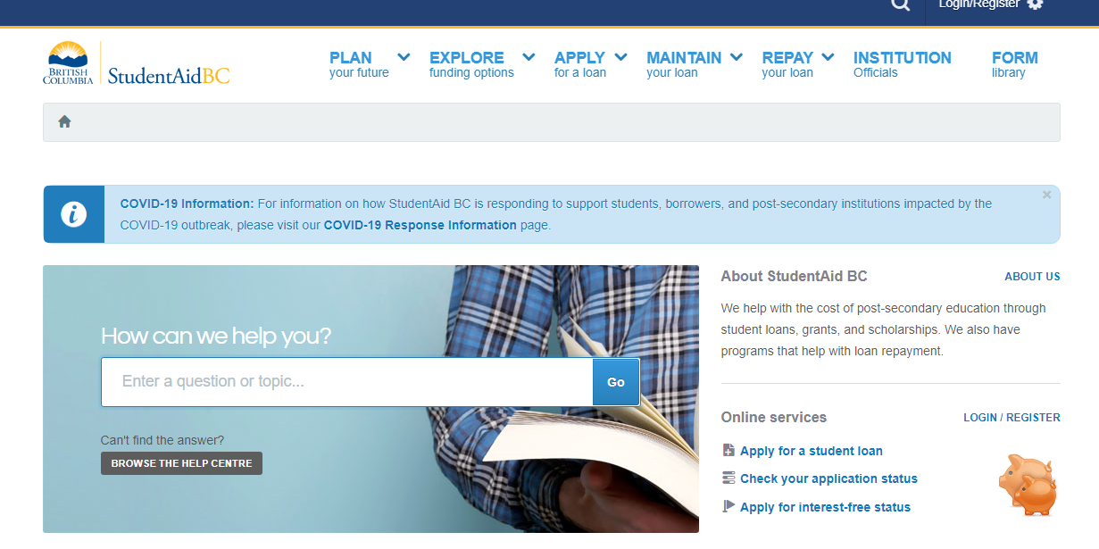
Student Aid BC

Slide 30
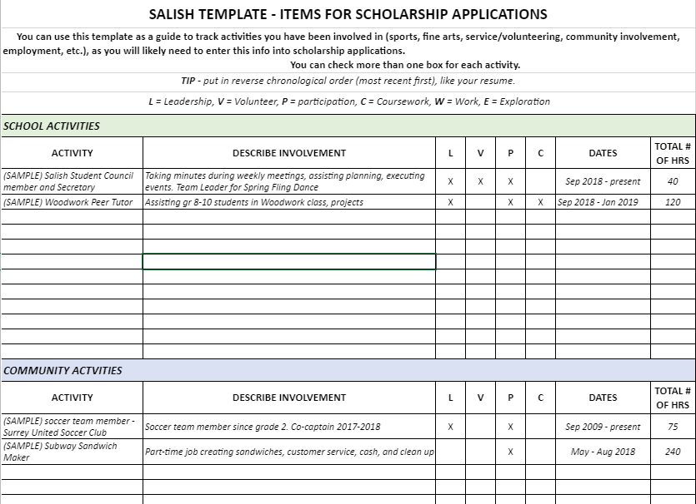
Keep track of accomplishments! Scholarship Spreadsheet
This spreadsheet is in the scholarships folder on Teams

Slide 31
Scholarship Tips
Research – student knows themselves best (interest, PSIs applying to, groups involved with, employers) Links & database is a great place to start
Organize your support network - parents, Career Centre staff, teachers, mentors, etc.
Get your resume in order, including a spreadsheet of accomplishments & activities
Identify your references early. Most scholarships require reference letters - ask early (with scholarship criteria & resume) to give them time to say good things about you
Social Insurance Number: Required for many scholarships

Slide 32
Most importantly:
APPLY!

Slide 34
Literacy 12
January 14th, 2025
Numeracy 10
October 29th, 2024
Literacy 10
April 10, 2025

Slide 35
Grad Photos
October 21st – 27th
Used for: Yearbook & Grad Composite
My child did not sign up or missed their session:
Vancouver Studio
Another Surrey School when the trailer is at their site

Slide 36
$50
Order Deadline
February 1st, 2025
School Cashon-line

Slide 37
Cloverdale Reporter Consent Form
The Cloverdale Reporter is publishing a 2025 Graduation Feature in June
2025

Slide 38
Commencement
Bell Centre
Friday, June 6th
Tickets will be available through School Cash online
All fees must be paid for students to receive commencement tickets.
More info will be shared in GRAD PARENT NEWSLETTER in April.

Slide 39
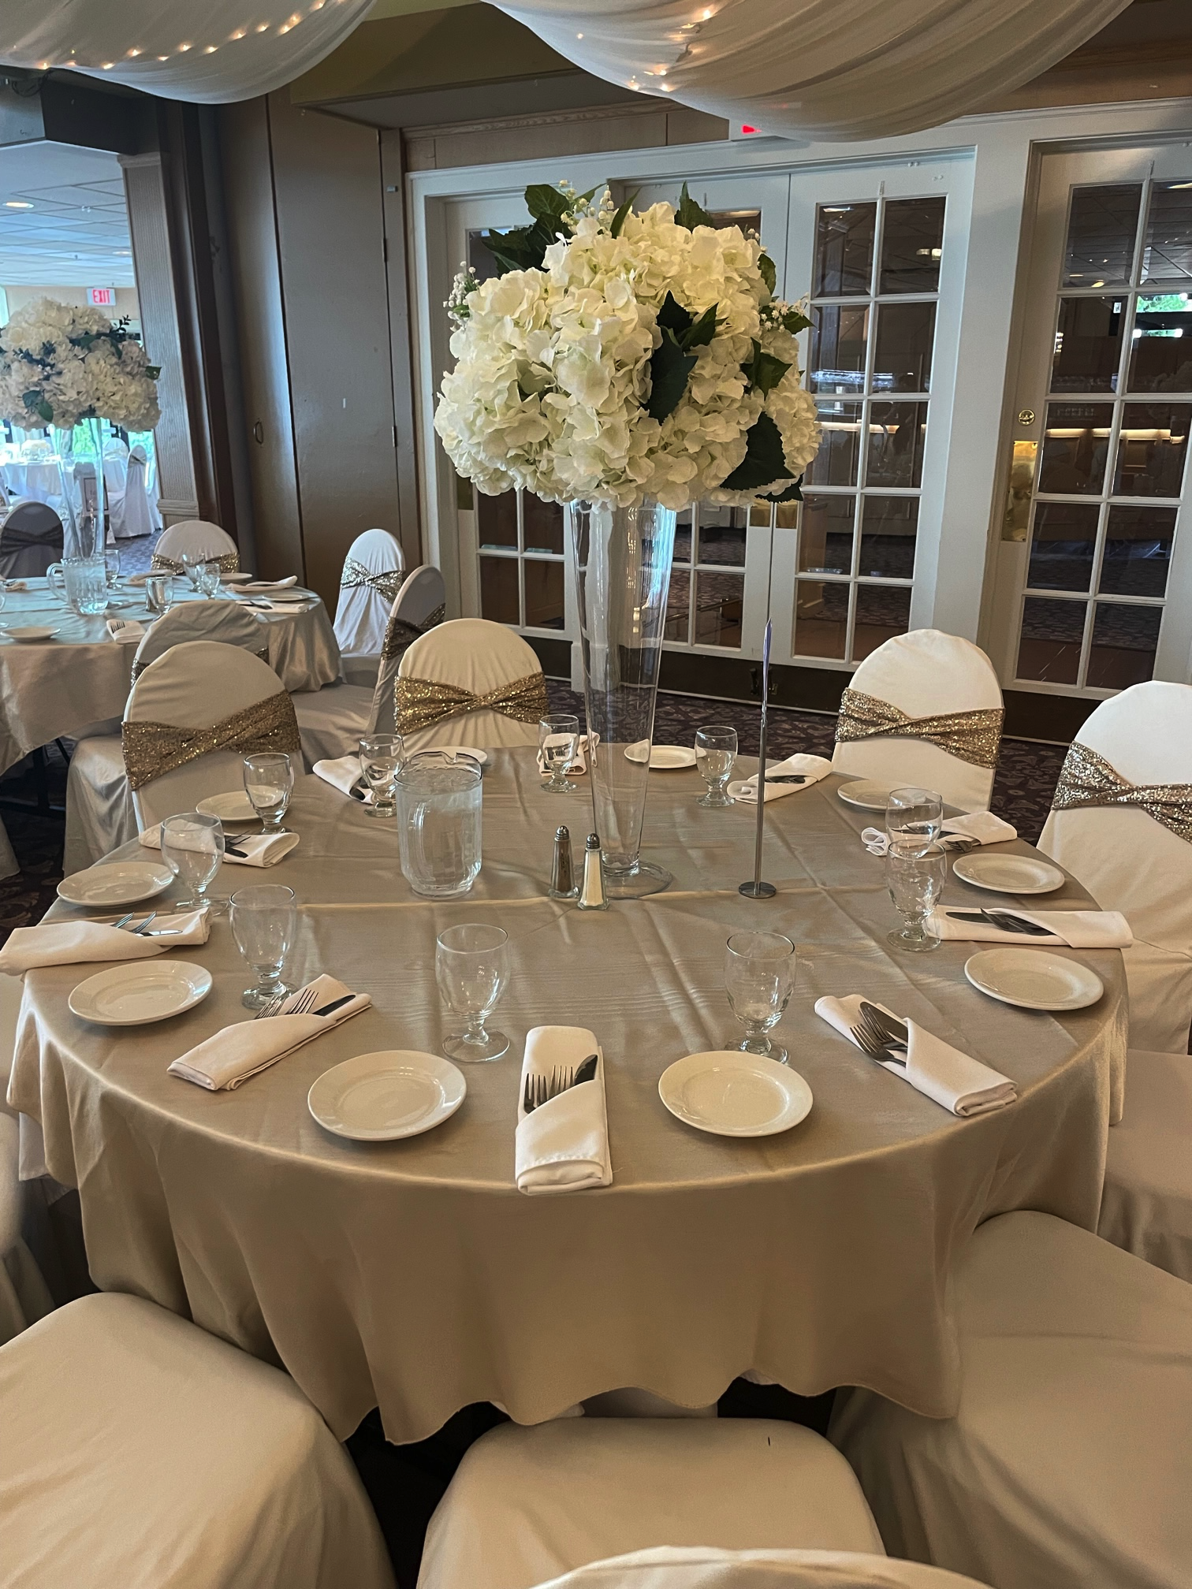
Dinner Dance
Newlands Golf and Country Club Sunday, June 22
Students arrive by 6:30pm for security and remain until transport to the dry-grad event arrives
Guests need approval by admin before tickets are bought and seating is finalized
Students can pick their table / seating
Process will begin in April
DRY GRAD IS RUN BY PARENT COMMITTEE Meeting Announcements will be in the Parent Newsletters.

Slide 40
Non-Sanctioned Events
Sanctioned Events
Are sponsored/supported by the school.
Grad Cruise (Sept)
Grad Dance (Dec)
Commencement
Dinner Dance
Dry Grad
No other events are sponsored by the school.
Examples Include:
House Parties
Ski Trips
Whistler Trip
Grad Camping Trips
River Rafting
Privately organized Dinner Dance Fund Raisers

