Slide 1
Post-Secondary Planning
Grade 11 and 12 Student Assembly 2021 - 2022

Slide 2
Why Should I Apply?
More money
More jobs
Higher employment rate
Increasing demand
Notes:
Tanya
More money: Over the course of their careers, university graduates earn, on average, 1.3 million more than high school graduates
More jobs (even in a tough economy): Remains the best protection against unemployment
Higher employment rate: 3.7% unemployed with a bachelor's degree versus 6.9% unemployed for others in 2011
Increasing demand: Increase in jobs available for university graduates is almost double that of those with no degrees

Slide 3
Common PSI Requirements
BRITISH COLUMBIA
Douglas – English 12 (C requirement)​
KPU – English 12 (C+ requirement)​
UFV – English 12 and 2 grade 12 academics​
UVIC and Capilano – English 12 and 3 grade 12 academics​
SFU – English 12 and 4 grade 12 academics​
UBC – English 12 and 5 grade 12 academics
OUT OF PROVINCE
Alberta: English 12 and 4 Grade 12 academics​
Ontario: English 12 and 4-5 Grade 12 academics​
Notes:
KIRSTEN

Slide 4
Second Language Requirements
UBC
Second Language 11 for admissions
Language 12 or First year second Language course (For BA program only)
SFU
Second Language 11 for admission (Beginners or Intro level accepted)
KPU and UFV
No second language needed for general admission
HOWEVER, BA programs require Language 11 OR First Year University Language
Notes:
Kirsten

Slide 5
BCIT
Can study a wide array of programs which all have individual requirements
Faculties: Business, Computers and IT, Engineering, Health Sciences, Trades etc.
Check the BCIT website (not on Education Planner)
See your counsellor and career center for assistance

Slide 6
Post-Secondary Terminology
Apply to a Faculty: A faculty is an area of study within a school
Each faculty (arts, sciences, business etc.) has different requirements
Applying to an undergraduate program working towards a Bachelor’s Degree
Have a first and second choice
Program | Years
Certificate | 1 year
Associate Degree or Diploma | 2 years
Bachelor’s Degree | 4 years

Slide 7
Example: SFU Demo
How to access requirements on SFU's website
https://www.sfu.ca/students/admission/admission-requirements/canadian-highschool/bc-yukon

Slide 8
Example of Admission Averages
SFU approximate minimum admission averages
Education: 88% (Elementary)
Health Sciences: 88%
Engineering: 86%
Science: 85%
Business: 83%
Arts and Social Sciences: 80%
Environment: 80%
Communication Arts and Technology: 80%
Notes:
Priya

Slide 9
Admissions Data (example from UBC)
FACULTY | Number of Applicants | Number of Seats
Arts | 7,474 | 1,653
Science | 7,718 | 1,400
Business | 1,911 | 450
Engineering | 3,640 | 646
Nursing (Okanagan Campus) | 670 | 130
Kinesiology | 1,925 | 200
Notes:
Priya

Slide 10
Application Process - BC
All applications are online (use personal email)
Apply through Education Planner
http://www.educationplannerbc.ca/
It has direct links to many colleges/universities
NOT: BCIT (access site directly)
Create a BCEID account
Credit card is required for registration fees
Notes:
Banpreet
-

Slide 11
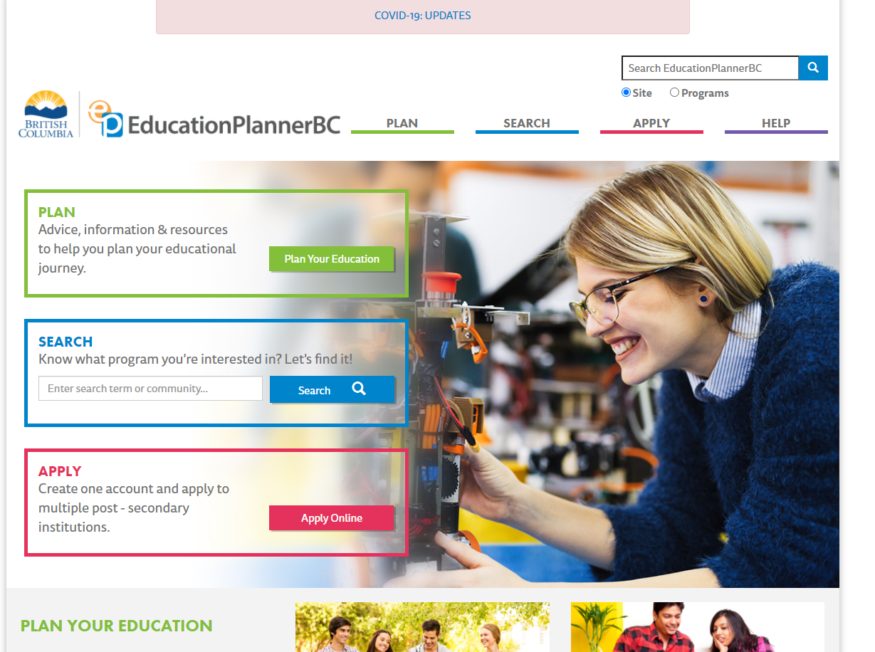

Slide 12
Out of Province Applications
For all Ontario Universities, apply through Ontario Universities’ Application Centre https://www.ouac.on.ca/
For applications to any other provinces, please apply directly to the institution
Some schools require entrance essays
Notes:
Banpreet
-

Slide 13
Application Tips
The counselling department recommends:
Start researching now (grade 11s)
Start applying now (grade 12s)
It is your responsibility to find out when the deadline is
Finish applications by December 31st
If applying to major universities, make sure you have a backup
Everyone should consider applying to KPU
Notes:
Banpreet
Gr. 11 – researching where to apply and the requirements for each program. So you know what courses to pick during course selection

Slide 14
Reporting Marks
Complete the Post-Secondary Information Form online through Student Transcript Service (STS):
Grade 12 students will complete this process in class during December 2021
No need to send in individual transcripts
Some schools ask for self-reporting of grades
Be honest!
April report card is critical!
Notes:
Banpreet
You will create a BCEID in your class, sometime in november
We will provide your teachers with the information that is required for you to sign up

Slide 15
Getting Information Online
https://www.postsecondarybc.ca/ - Sign up for updates!
Get all the information you need on admissions and programs, deadlines, financial aid, housing and more
Notes:
Tanya
https://www.postsecondarybc.ca/institutions/

Slide 16
Upcoming Virtual Open Houses

Slide 17
Getting More Information
Sign up to attend Open Houses and Information sessions virtually
Listen to the Daily Announcements
Watch the TV screens
Book an appointment with a post-secondary advisor
SEE YOUR SULLIVAN COUNSELLOR
Notes:
Kirsten

Slide 18
Upcoming Virtual Open Houses
KPU: Applications to Health Foundations close November 1st
Douglas: October 14th
UBC: Virtual Application Workshop October 18
Capilano: 1pm on October 21st and 26th. November 4th and 9th
Emily Carr: November 20th
SFU: December 7th
University of Alberta: October 16th

Slide 19
Who is Your Counsellor?
Please e-mail your counsellor to book an appointment
Counsellor | Alpha | E-mail
Ms. Watson | A – Dhaliwal | watson_m@surreyschools.ca
Ms. Falk | Dhami – Kissie | falk_k@surreyschools.ca
Mr. Brar | Klair – Reyno | brar_k@surreyschools.ca
Ms. Hundal | Rich – Z | hundal_jenny@surreyschools.ca

Slide 20
Scholarships and Bursaries
See Ms. Rogerson in the Career Centre for any questions
Teams: SHSS Scholarship Info
Teams code can be found at Career Centre
Notes:
Kirsten

Slide 21
Questions?
Please e-mail your counsellor
Notes:
KIRSTEN

Slide 22
Trades
Watch 'Trades Post-Secondary Options Short Video' | Microsoft Stream

