Slide 1
Sullivan Elementary May 2021

Slide 2
​
This slideshow is a brief overview of information to help support early childhood development in preparation for kindergarten.​
For more information about Ready, Set, Learn, please visit the BC Ministry of Education website:​
https://www2.gov.bc.ca/gov/content/education-training/early-learning/support/programs/ready-set-learn

Slide 3
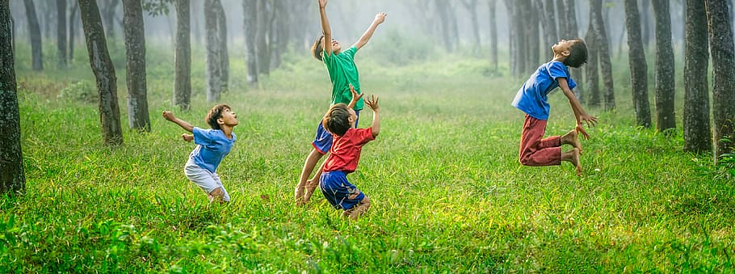
Key Messages (Early Learning Framework 2019)
Families are the most important teacher
Children are strong, capable and full of potential
Play is integral to well-being and learning

Slide 4
RSL Book 2020
"I read, I learn, I draw, I dream. I am free, I am Canada."
By Heather Patterson and 13 Canadian Illustrators
You may phone the school at 604-597-1977 to arrange a time to pick up a copy of this year’s Ready Set Learn book choice.
Please call by June 11th

Slide 5
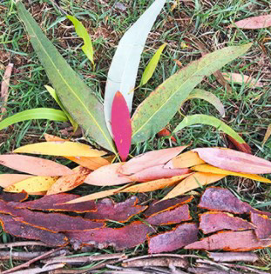
Talk and Read Together
Talk, talk, talk
Ask questions
Read books together
Engage in oral storytelling
Use natural materials to create stories
Explore virtual experiences at Surrey Libraries

Slide 6
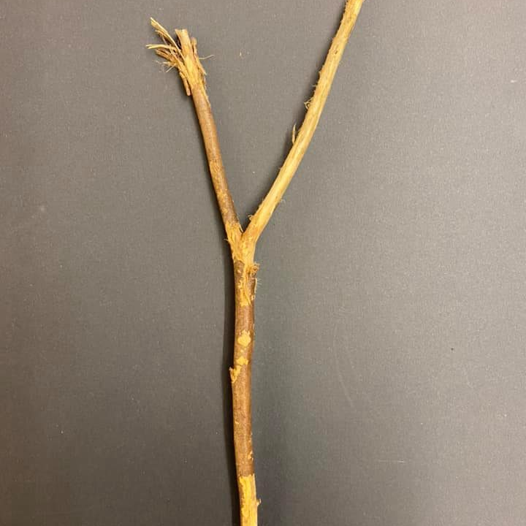
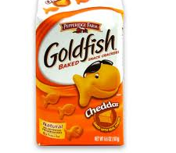
Print in Your Environment
Notice letters in nature
Ask your child to identify the letters of their name within the environment
Have your child build their name with stones or sticks
Help your child to read familiar words in their environment (e.g. STOP signs, logos, product packaging)

Slide 7
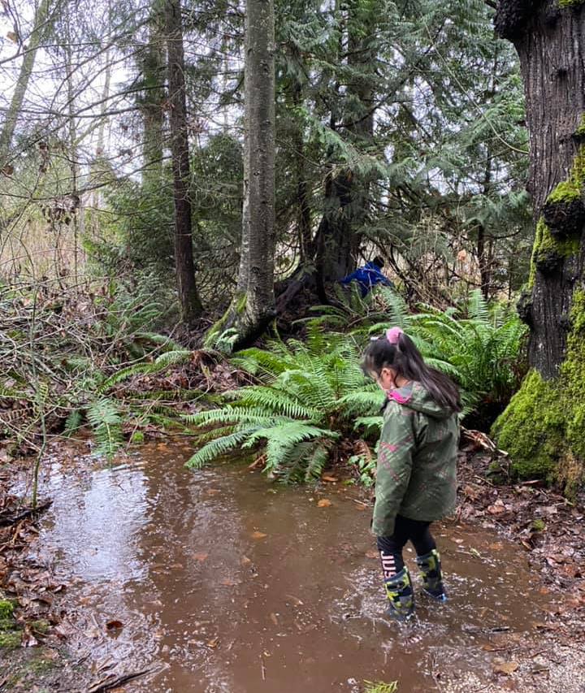
Enjoy Dramatic Play Indoors and Outside
Build castles with sand, sticks, rocks and shells
Create forts with blankets, boxes, tents
Design a garden shop with old crates, boxes and plants
Create a fairy garden
Play in puddles

Slide 8
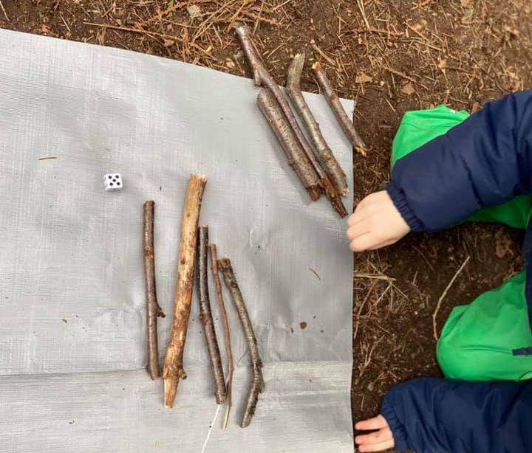
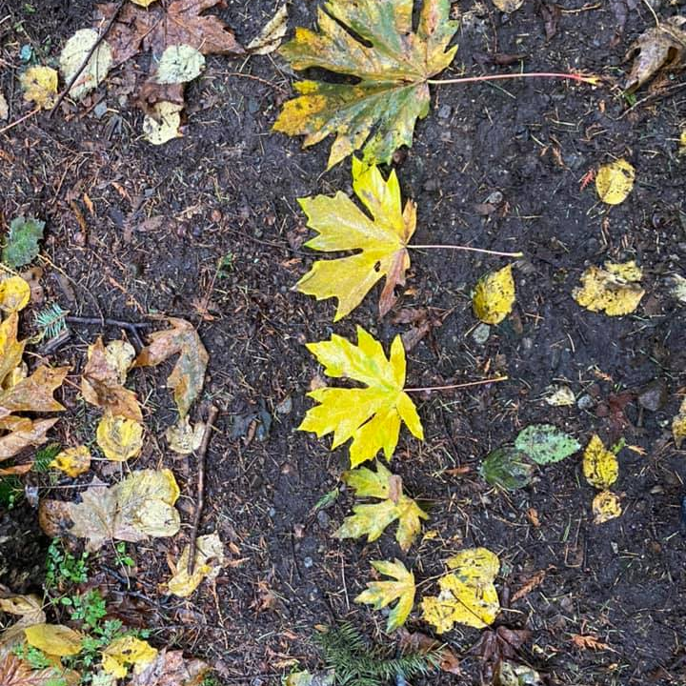
Explore Numeracy Concepts With Nature
Compare and sort items found in nature by colour, size, or shape
Count using dice and sticks
Find collections of objects (shells, rocks) and count how many
Notice shapes on a nature walk
Make patterns with leaves, rocks, or sticks

Slide 9
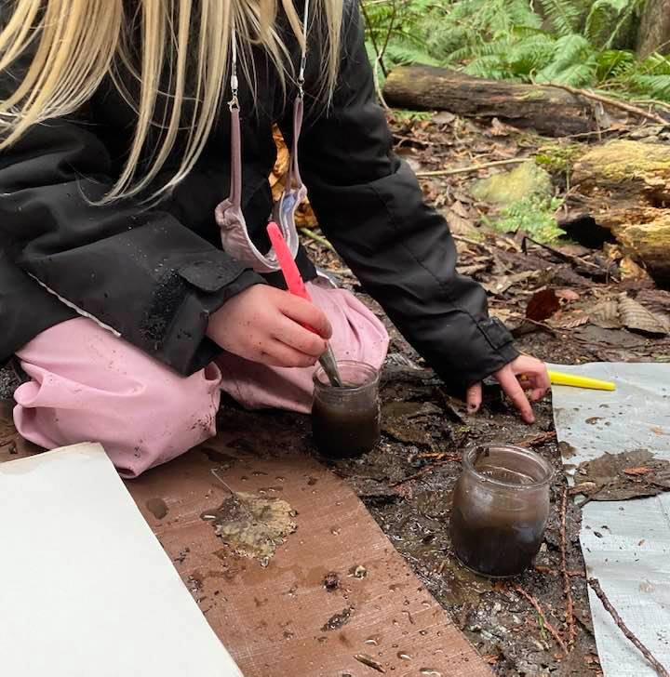
Encourage Imagination and Creativity
Create works of art with mud and water
Provide open ended materials such as sticks, rocks, cardboard tubes, and popsicle sticks to build and create
Make music with pots, pans, buckets, spoons
Explore virtual experiences at Surrey Art Gallery

Slide 10
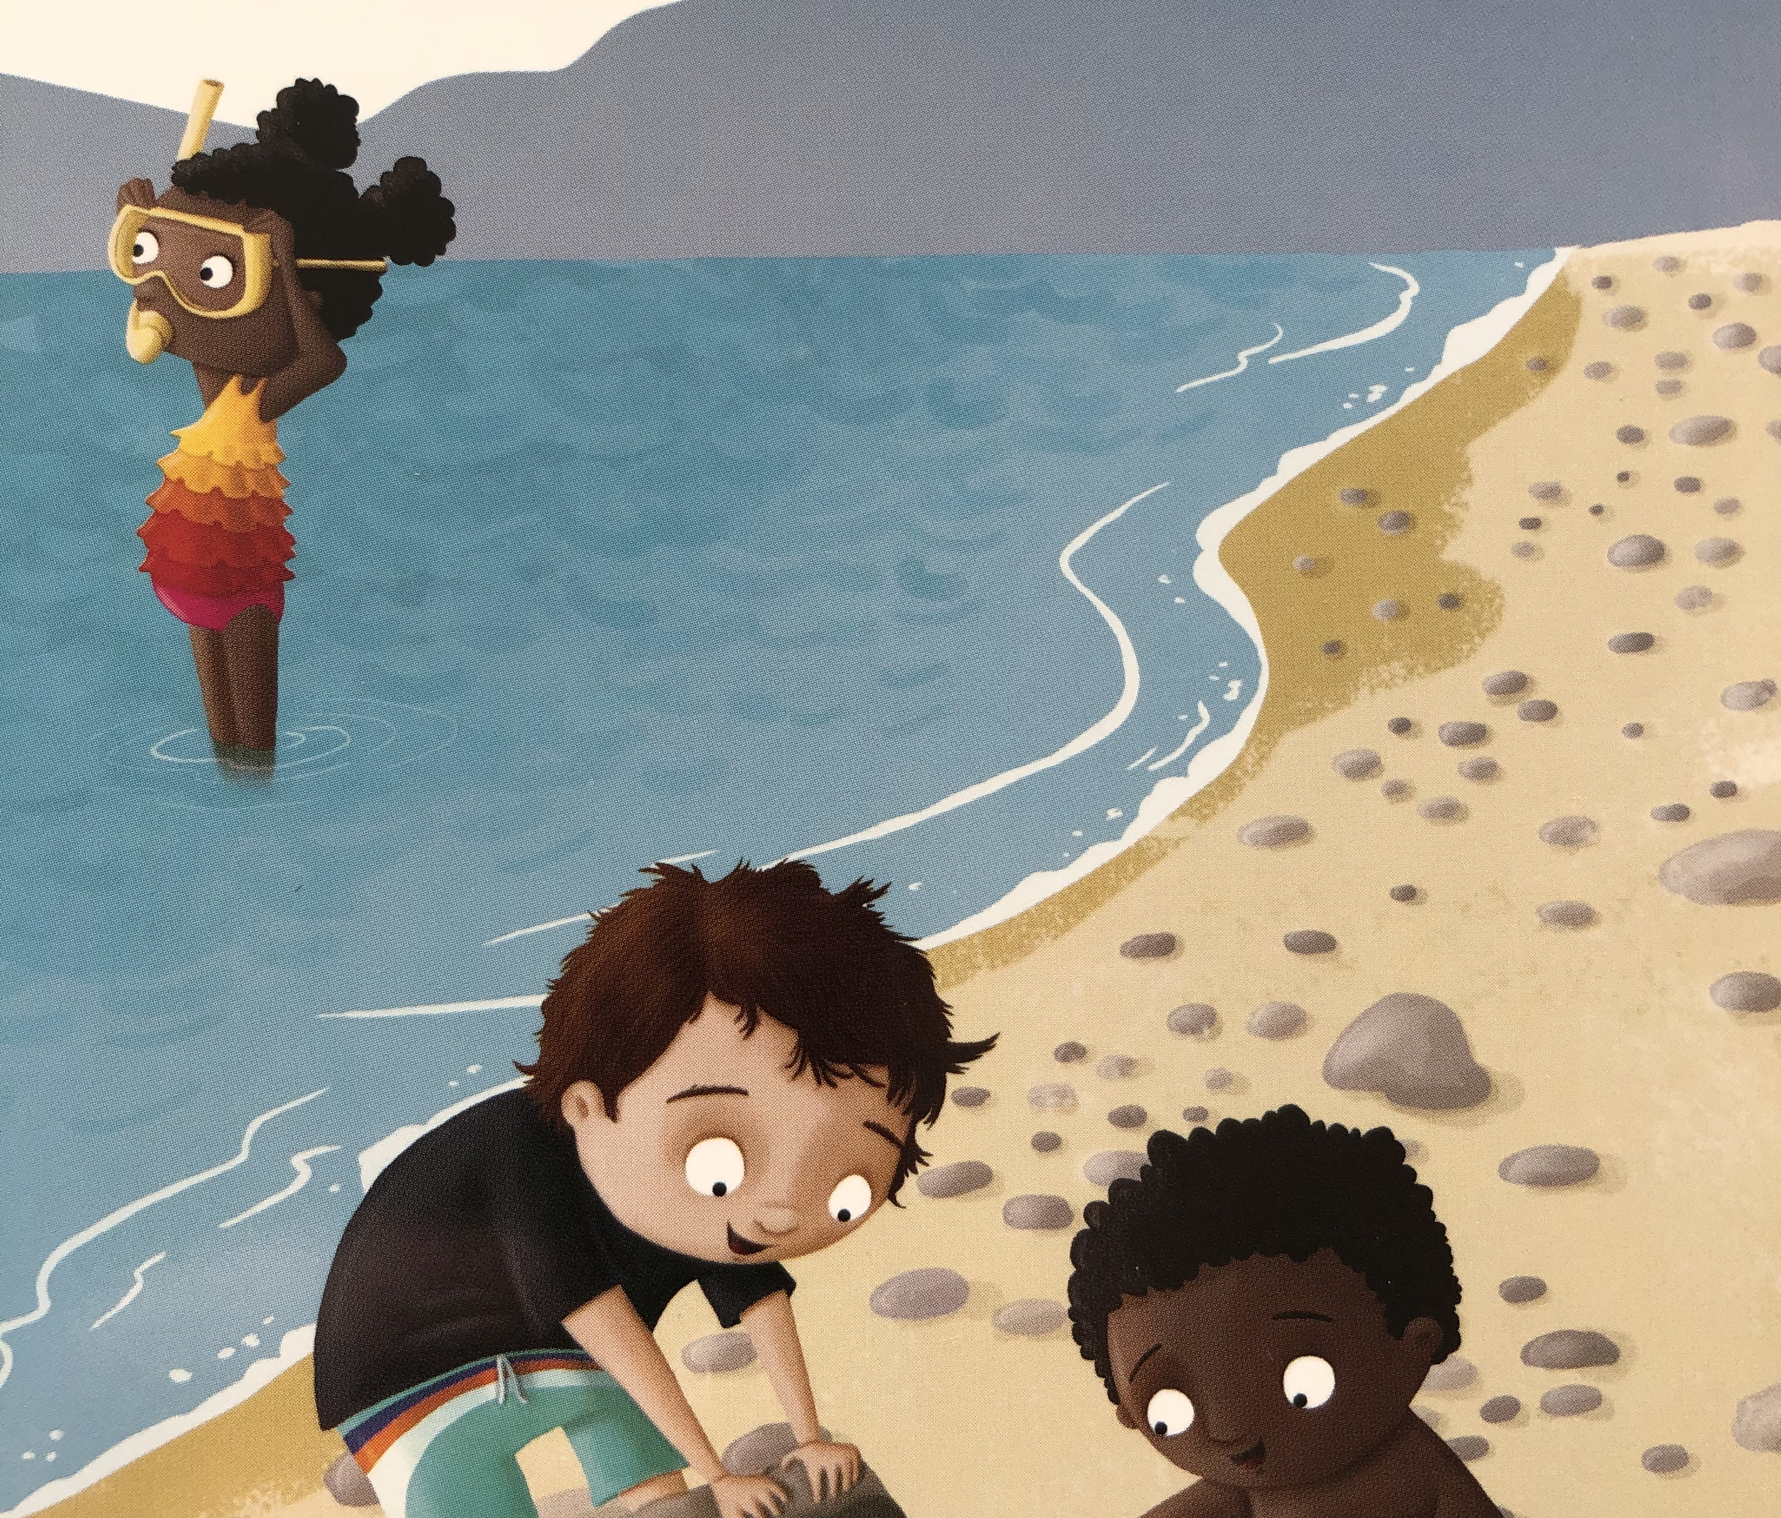
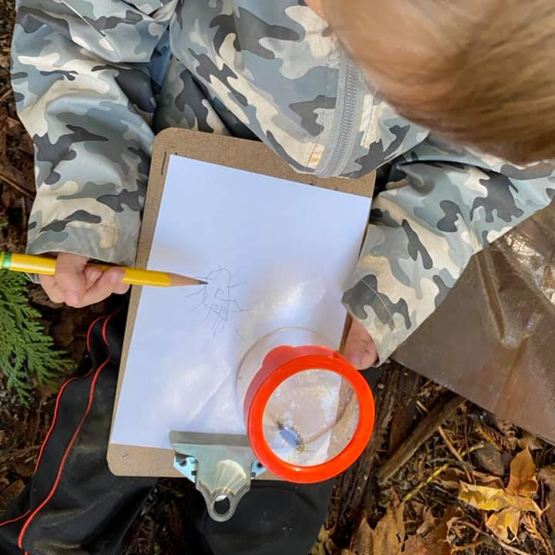
Encourage Wonder with Science
Encourage your child to sit and notice the environment around them
Explore bugs, worms and insects in nature
Discuss weather changes and seasons
Encourage your child to observe, ask questions and wonder
Explore books with scientific concepts
Plant a garden and observe plant growth and changes
Explore virtual learning opportunities at Science World or Surrey Nature Centre

Slide 11
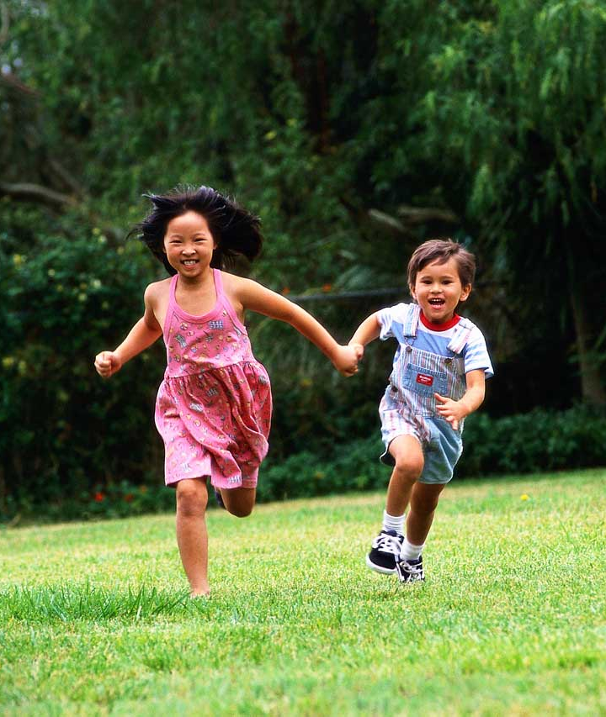
Enjoy Movement and Music
Run and play outdoors in the forest, the park, or the playground
Play in the snow, the rain and the puddles
Play hide and seek or other outdoor games
Create a dance to your favourite music
Enjoy music from around the world
Create instruments out of shoe boxes, buckets, spoons, cardboard tubes & recycled materials

Slide 12
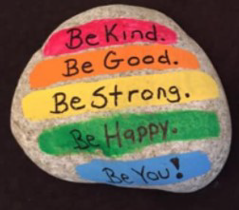
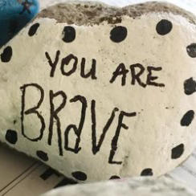
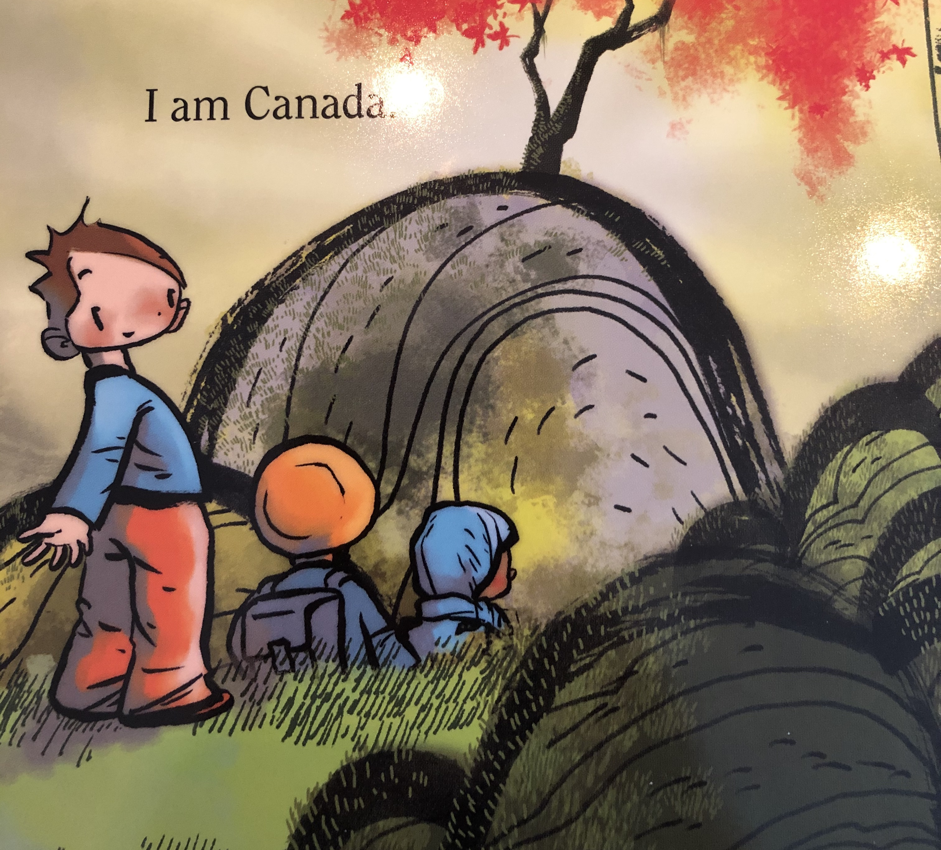
Well-Being and Belonging
Celebrate your culture, traditions and family stories
Embrace opportunities to be outdoors and engage in the world around you
Encourage your child to take risks like climbing on the playground or trying something new to build confidence and a sense of safety/security
Play games that practice turn taking, following directions and sharing
Create "just for you" rocks/messages that can be kept in a special place
Praise your child when they use their words to express their feelings

Slide 13
Fine Motor Skills (Thank you to Ms. Mac for creating this video)
Make and create with playdough (roll & squish)
Use pinecones, shells, and stones for making prints in your playdough
Thread beads onto pipe cleaners
Make a pasta necklace
Encourage experimentation with pencils, scissors, and chalk
Dig for worms
Use tweezers to plant seeds in gardens

Slide 14
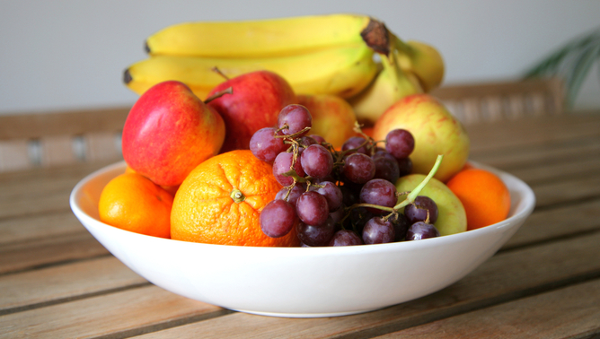
Healthy Living
Eat together, talk together, and make mealtime a family time
Use Canada's Food Guide to make healthy food choices
Little ones need lots of sleep, usually 10-12 hours a night
Limit screen time throughout the day but particularly before bed to ensure a restful sleep
Visit Live5210 for more ideas to support healthy living

Slide 15
Access More Services Through Our Community Partners
Surrey Libraries
Early Years HUB
Fraser Regional Friendship Centre Association (FRAFCA)
First Steps Early Years Refugee Program
Child Care Options Resource and Referral

Slide 16
Additional Information For Families
Early Learning Framework – A Guide for Families
Let’s Play – Activities for Families
First Peoples Principles of Learning
Surreyschoolsone.ca - For ideas to support learning at home (StrongStart)

Slide 17
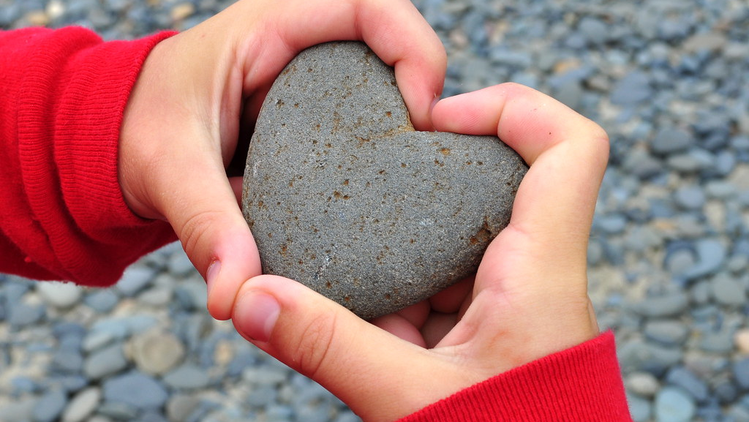
Thank you for viewing our
RSL slideshow!

