Slide 1
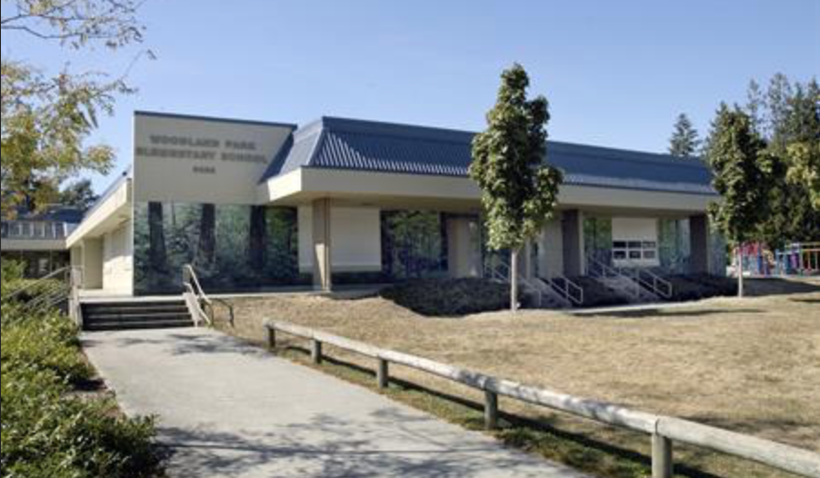
Woodland Park Elementary
Welcome to Ready, Set, Learn

Slide 2
Welcome! Mr. Taylor and Ms. Johal
Address: 9025 158 St, Surrey, BC V4N 2Y6
Phone: (604) 589-5957

Slide 3
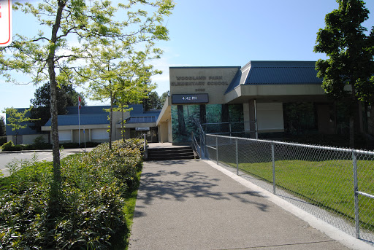
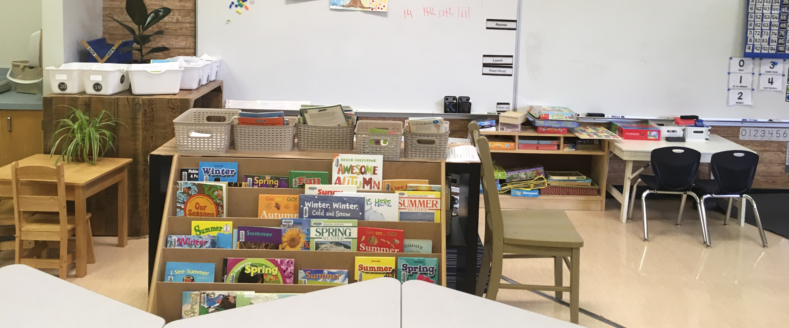
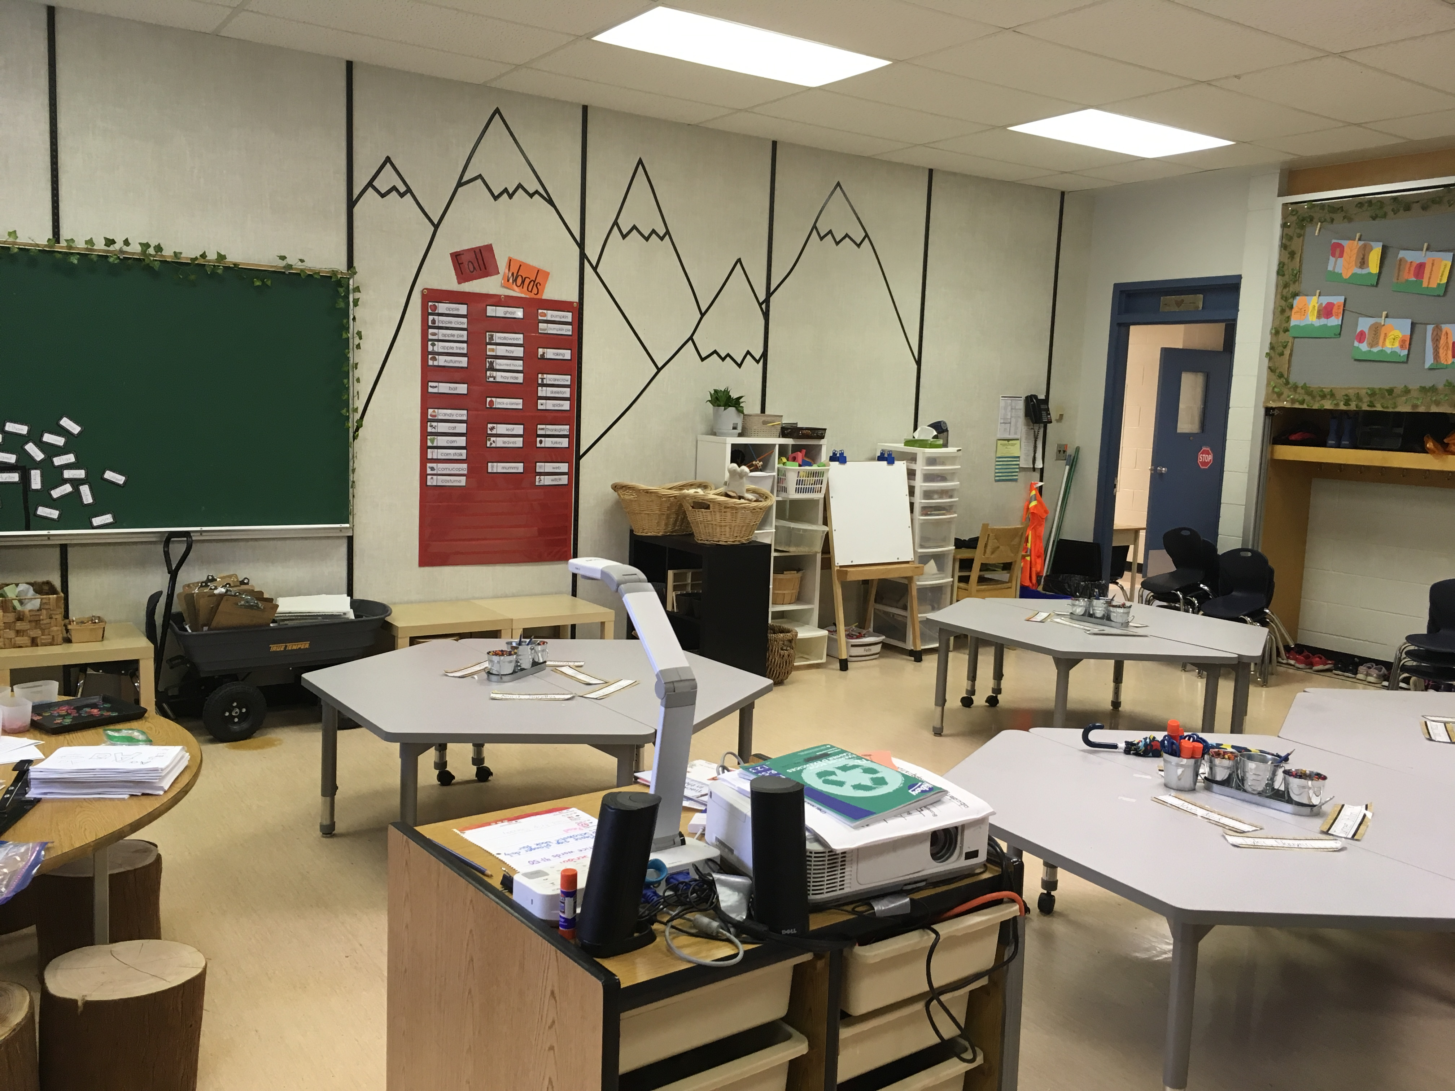
Kindergarten Teachers Mrs. Gallant, Ms. Colwell, Ms. Robert

Slide 4
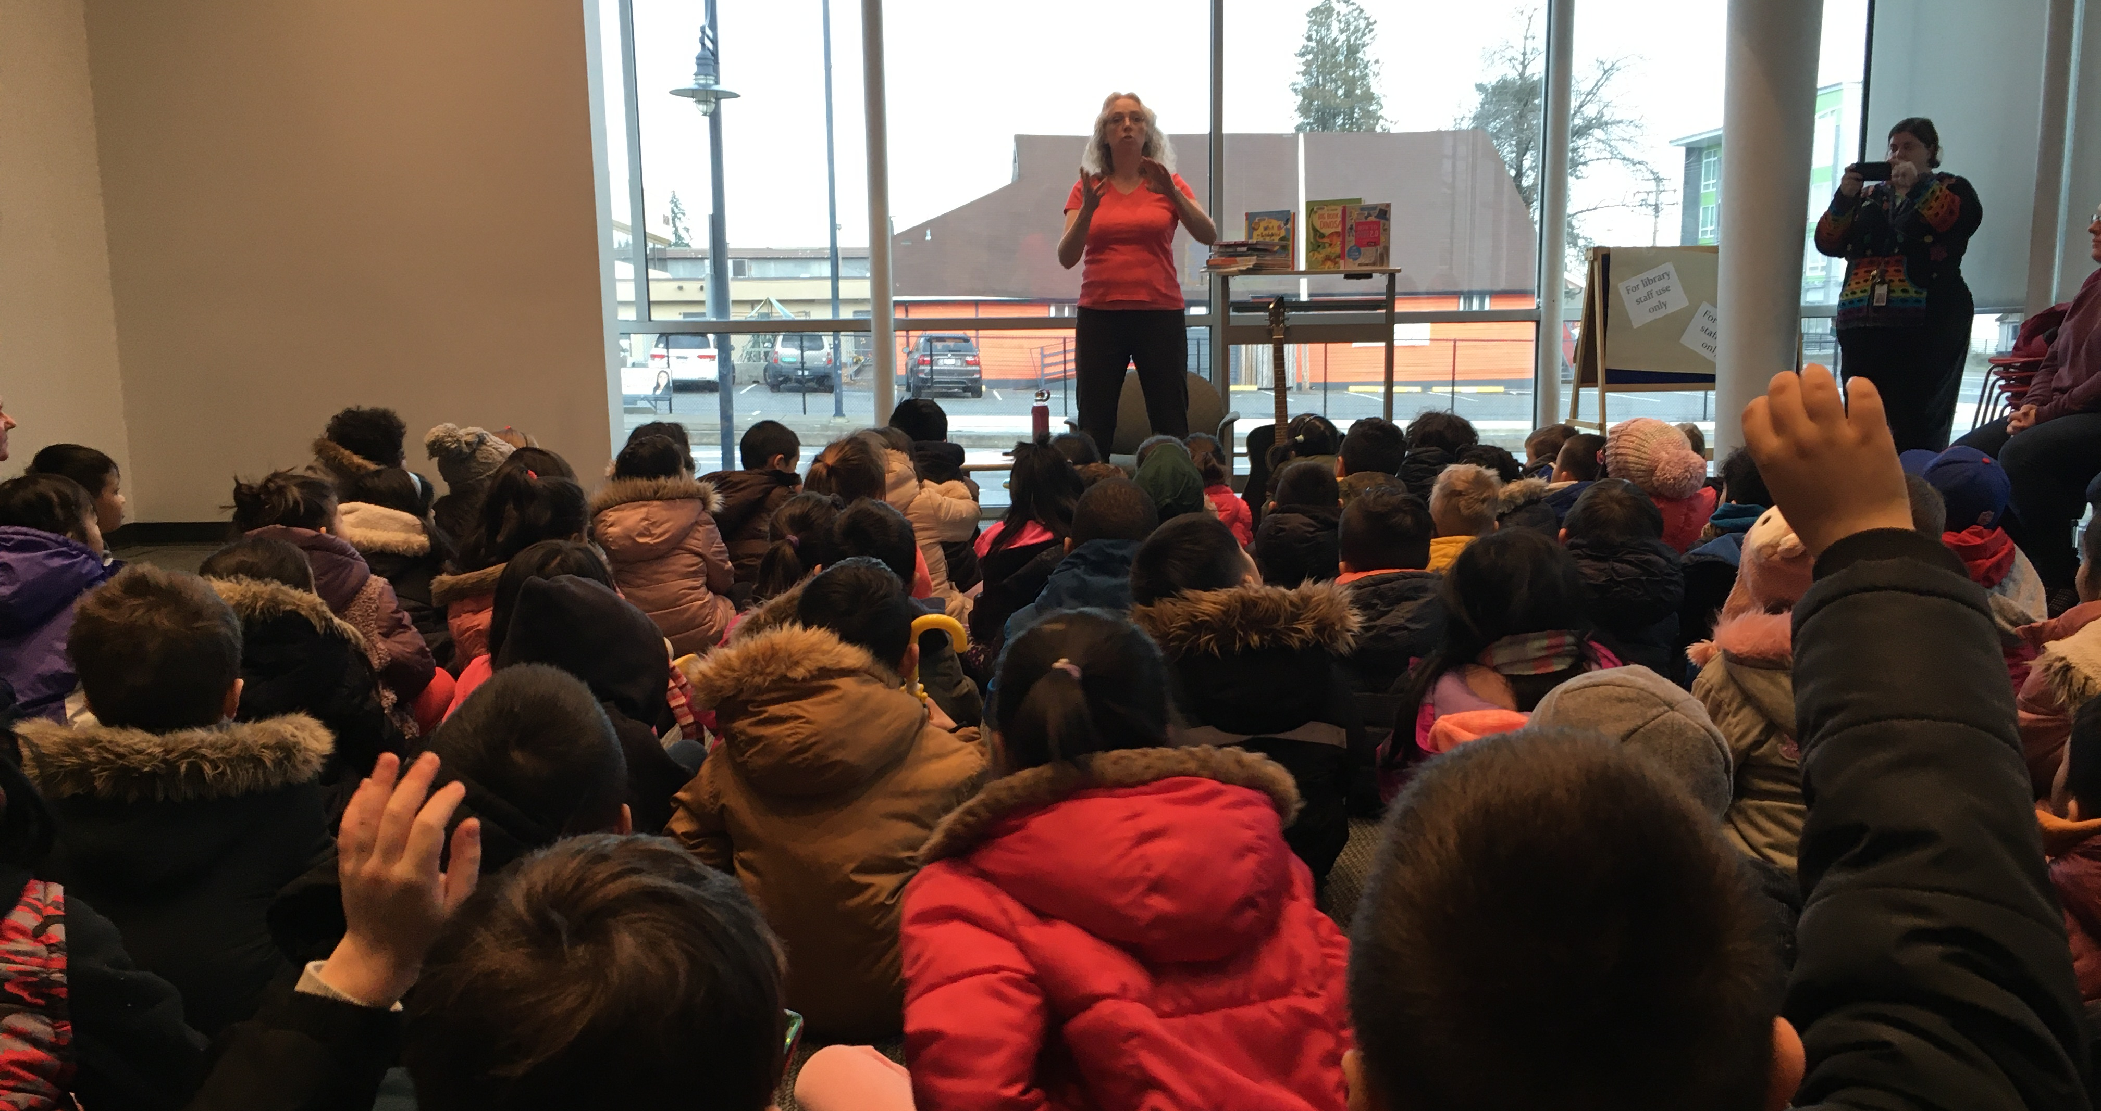
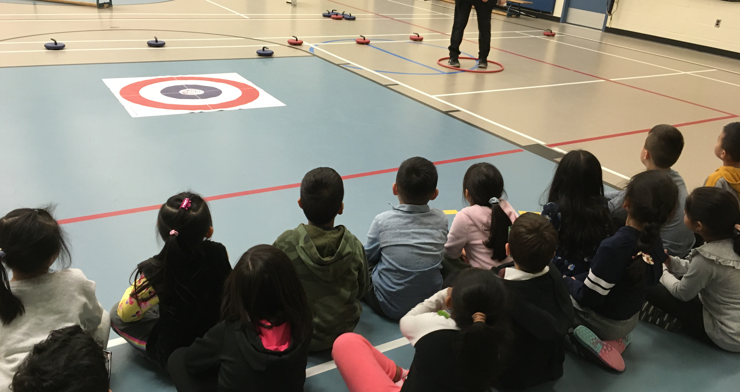
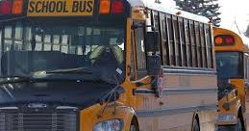
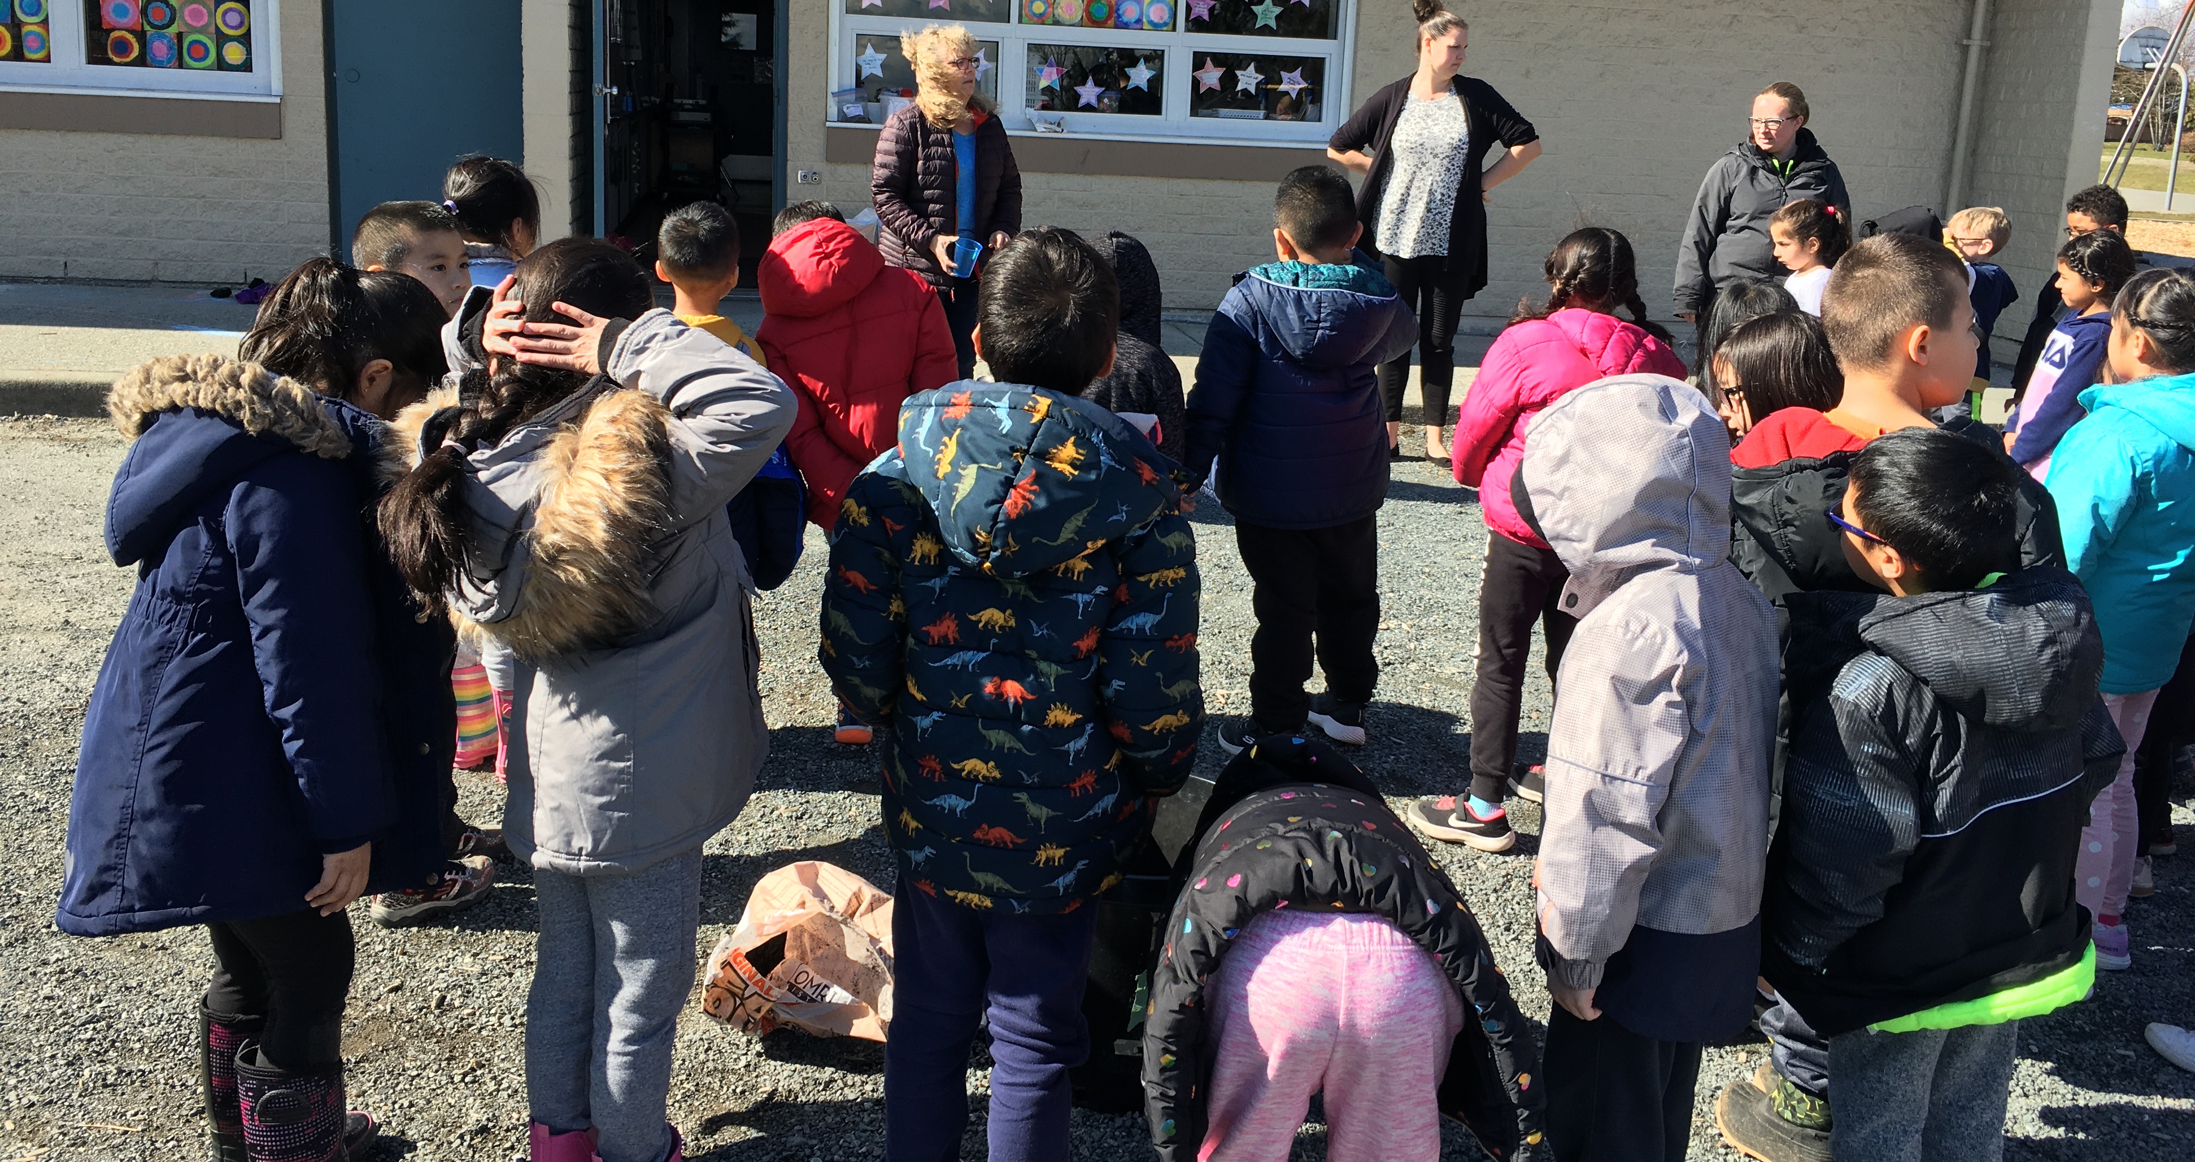
Parent volunteers help to build school community.
PAC
Parent Advisory Council
-Fundraising events to support the school. -Fundraisers: Hot lunch, Sales, Carnivals... -Provide financial assistance for classrooms and field trips. -All parents can participate.

Slide 5
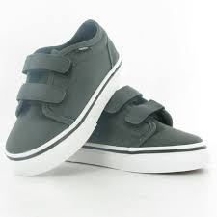
Ready for School: Independence skills
Teach me and give me time to practice:
Jackets:
zippers and inside-out sleeves
Shoes:
on and off (velcro or slip-ons)
Toileting: door closed, wiping, clothing on and off, and washing hands
Entering safe places
independently
play-dates, daycare, activities

Slide 6
Ready for School: Routines
Set up the routine, practice, then expect your child to follow the routine independently
Daily Routine ideas:
Get ready to go – shoes, jacket...
Coming home -- put away shoes, jacket...
Time to eat – wash hands, sit at spot...
Play area and toy clean-up
Bed-Time Routines:
Regular sleep times and routine
Recommended sleep time is 10-12 hours
Morning Routines:
Regular wake up time and routine
Independent dressing

Slide 7
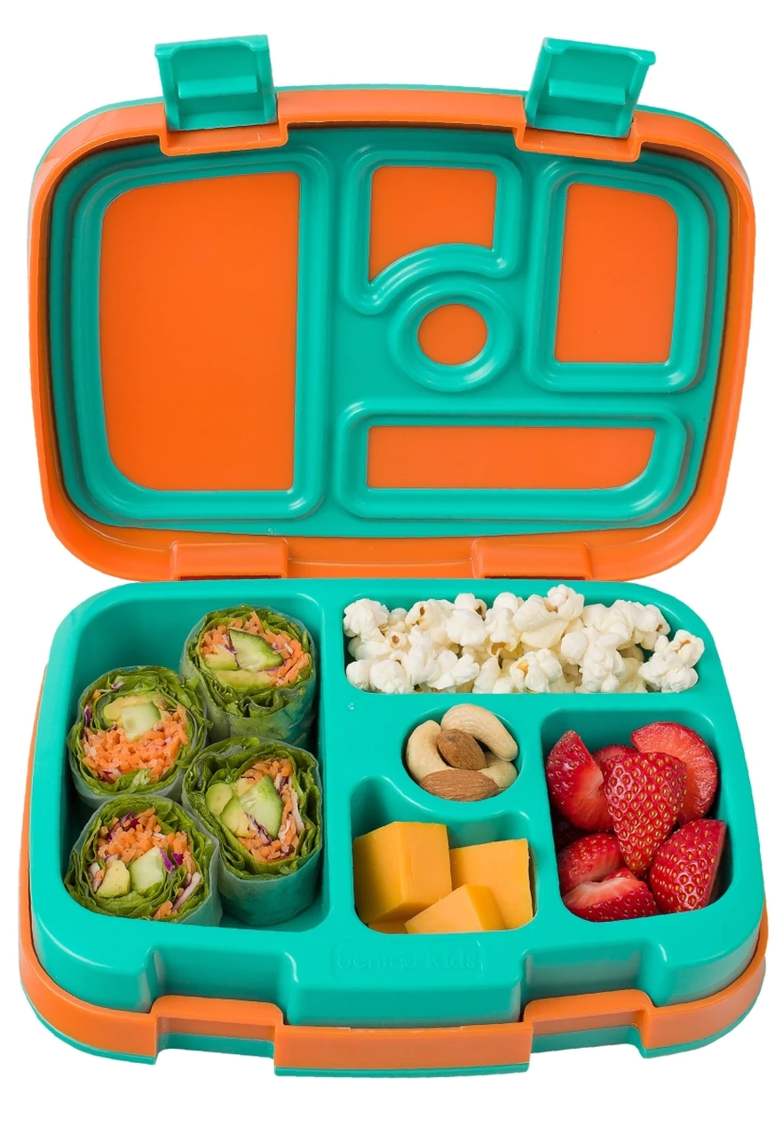
Ready for School: Food
Healthy Choices
Choose from a variety of foods that your child already enjoys eating
Cut food into bite sized pieces
Containers should be easy for your child to open independently
Bring a water bottle to school
Include healthy food choices (Save 'treat' foods for after school)
Send food in backpacks in the morning
Notes:
At school we always encourage healthy eating! Try to provide a variety of foods for your child. Please save 'sometimes foods' like cake, cookies, chocolate bars and candy for special occasions and for after school treats!
Please send your child to school with food they already enjoy eating.
We cannot make your child eat at school but we will encourage them. If your child has not eaten at school (it can be overwhelming for some at first), then have them eat after school.
Keep in mind that recess snack is 15 minutes; lunch is 20 minutes. In the beginning extra time is given to wash up and eat, with the end of the year goal being that your child can manage to eat in the time provided. In no time they will be ready and going to Grade 1!
Make sure your child has had a healthy breakfast at home. There are occasional times, when this unexpectedly doesn't happen – life can get in the way of our best laid plans! Just let us know and we can see that your child has something from their lunch before he or she begins their day.

Slide 8
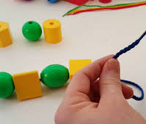
Ready for School Fine Motor Skills
Playdough
Practice with scissors
Colouring with crayons and drawing
Lego: start with Duplo, then move to smaller blocks.
Threading beads

Slide 9
Literacy follow links: Drawing and writing at Home Read the Pictures I Spy Listening and Noticing Walks
Picture reading in action with the book Float:
https://vimeo.com/405561801
Password sd36bc
Share reading of stories and words in your environment every day!

Slide 10
Numeracy 'the ability to understand and work with numbers'
Counting objects, finding patterns, and sorting happen in everyday activities.
follow links:
Set the table
Count the laundry
Heavier or Lighter
Shapes on point

Slide 11
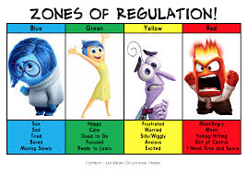
Social Emotional Learning
Students learn how to self-regulate, share and learn with peers and adults.
follow links:
If you're happy and you know it
Bubbles
Engage!
We Like Routines

Slide 12
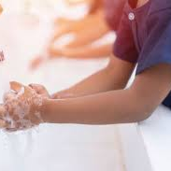
Hygiene Skills
Hand Washing:
Wash often and do a good job!
Charlotte Diamond: Wash Your Hands
Sick kids stay home:
if your child displays any symptoms of a cold or flu stay home.
Please follow Provincial health and Doctor recommendations before returning to school.
Minimum of 48 hours of being symptom free before returning to school.
Coughs and Sneezes:
Practice using tissues and your elbow to cover your face.
Practice blowing your nose independently
Personal Space:
Practice leaving a distance between people

Slide 13
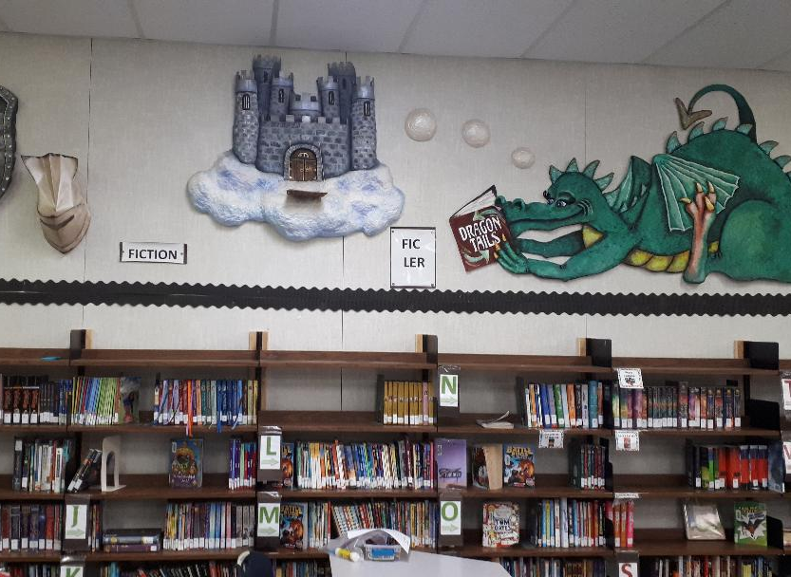
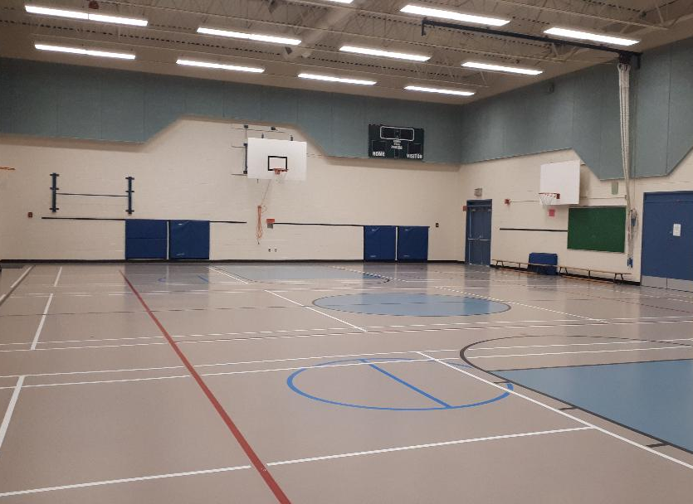
Places we learn and play

Slide 14
Music Ms. McFadden

Slide 15
Home and School
Teachers, Students and Families work as a team
Read newsletters, school website, Freshgrade
Communicate with teachers for holidays and possible concerns
Supporting students with learning at home:
Celebrate effort in work brought home
Ask questions about school activities
Reading together daily.

Slide 16
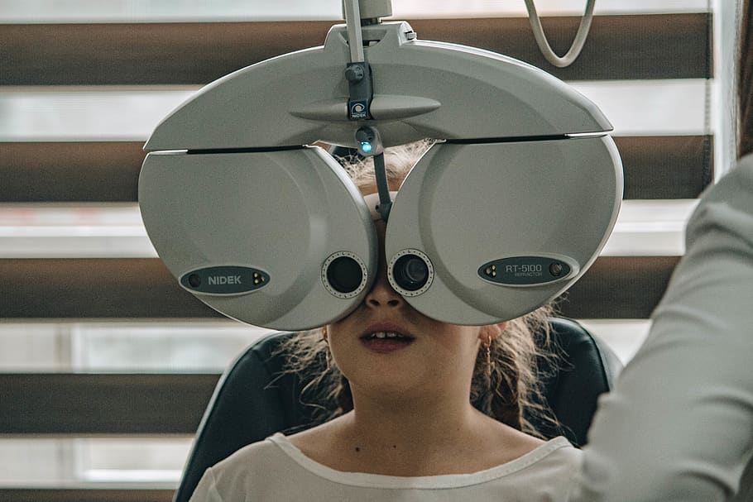
Health Resources
Fraser Health Public Health: www.fraserhealth.ca/service-directory/services/public-health-services/public-health-unit#.XsgIqmhKjRY
Child Development Centre: the-centre.org/
Visit your family doctor for a physical
and developmental check up
Eye doctor – Eye exams are free for children
Options-First Steps: support for refugee families, translation and supports for families.

Slide 17
Educational Resources
School Website:
www.surreyschools.ca/schools/woodlandpark/Pages/default.aspx
Welcome Centre:
https://www.surreyschools.ca/welcomecentre/Pages/default.aspx
Online Surrey District Resources:
https://surreyschoolsone.ca/
BC Curriculum:curriculum.gov.bc.ca/
Learning Videos: YouTube Channels:
Art for Kids Hub, Cosmic Kids Yoga,
Have Fun Teaching
Public Library: www.surreylibraries.ca/

Slide 18
School Days
Schools follow expectations for Health and Safety to create a safe place to learn.
Information about September school start will be sent by email.
Enjoy making learning fun and engaging with your child.

Slide 19
Thank you!

Slide 20
Q & A
Please contact the school if you have any questions:
Woodland Park Elementary
woodlandpark@surreyschools.ca
Telephone: 604-589-5957

